Slide 1
Chapter 1- General Properties of Waves
Reflection Seismology
Geol 4068
Elements of 3D Seismology,
2nd Edition
by Christopher Liner

Slide 2

Outline-I
General Properties of Waves
Physical Assumptions
Wave descriptions
  Body waves
  Surface waves
Particle motion

Slide 3
Outline-II
General Properties of Waves
Wave descriptions
  Graphical
  Mathematical

Slide 4
Outline-III
General Properties of Waves
General theorems and principles
  Reciprocity Theorem
  Fermat’s Principle
  Snell’s Law, Conservation of ray parameter, critical angle
  Huygen’s Principle

Slide 5
Outline-I
General Properties of Waves
Mechanical definition of a wave
Physical Assumptions
Wave descriptions
  Body waves
  Surface waves
Particle motion

Slide 6
Mechanical definition of a wave
Physical Assumptions
t3
Homogeneous, isotropic
medium … cylindrical wavefronts--
rays are at right angles to the wavefronts
t2
t1

Slide 7
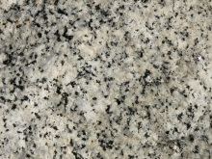
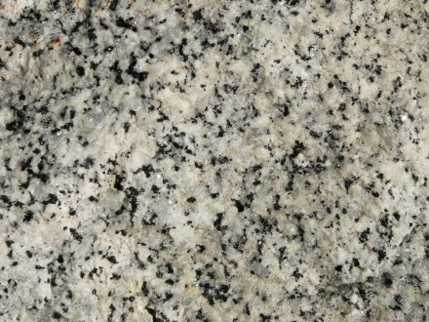
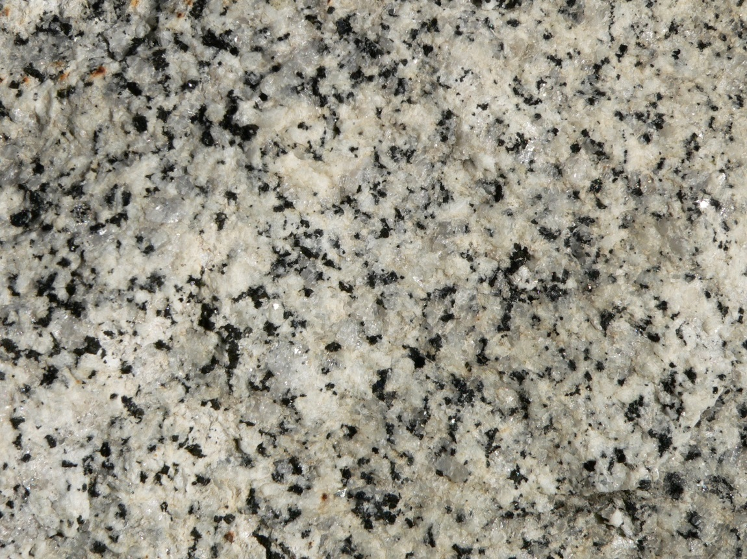
Is granite homogeneous?

Slide 8
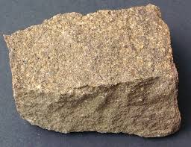
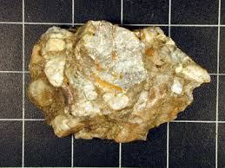
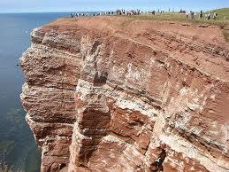
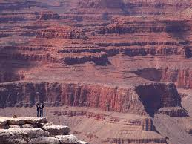
Are sedimentary layers homogeneous?

Slide 9
Mechanical definition of a wave
Physical Assumptions
t3
Anisotropic-- rays are not at
right angles to the wavefronts!
Anisotropy can be as much as 10-20%
t2
t1

Slide 10
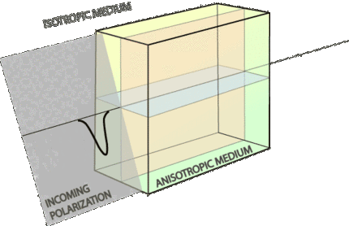
What effect does severe anisotropic cause on seismic waves?
See movie by Ed Garnero: http://en.wikipedia.org/wiki/Shear_wave_splitting

Slide 11
General Properties of Waves
Mechanical definition of a wave
Physical Assumptions
Wave descriptions
  Body waves
  Surface waves
Particle motion

Slide 12
Body Waves
Direction of particle displacement
Direction of propagation of the body wave
Y
Direction of particle displacement
X
Z
Direction of propagation of the body wave
Direction of particle displacement
Direction of propagation of the body wave

Slide 13
Body Waves - do not require a boundary to travel
Direction of particle displacement
SV
Direction of propagation of the body wave
Y
Direction of particle displacement
X
SH
Z
Direction of propagation of the body wave
Direction of particle displacement
P
Direction of propagation of the body wave

Slide 14
General Properties of Waves
Mechanical definition of a wave
Physical Assumptions
Wave descriptions
  Body waves
  Surface waves
Particle motion

Slide 15
Surface Waves
When body waves (P & SV) traveling through rock reach the interface below a fluid (e.g., atmosphere or water) complex particle motions in the rock are generated, such as Rayleigh waves (air/rock) or Stonely waves (solid /rock). These motions are retrograde elliptical at shallow depths to prograde elliptical at increasing depths.
SH waves can be trapped through multiple internal reflections in layers near the surface and these can generate Love waves
X

Slide 16
Surface Waves
X
X
Amplitude of Rayleigh wave
decays with depth
Z
Adapted from Aki and Richards, 2002, p. 156

Slide 17
General Properties of Waves
Mechanical definition of a wave
Physical Assumptions
Wave descriptions
  Body waves
  Surface waves
Particle motion

Slide 18
Particle Motion
--Image 1

Slide 19
Particle Motion
--Image 2

Slide 20
Particle Motion
--Image 3

Slide 21
Particle Motion
--Image 4

Slide 22
Particle Motion
--Image 5

Slide 23
Outline-II
General Properties of Waves
Wave descriptions
  Graphical
  Mathematical

Slide 24
Graphical- periodic waves
Fixed time
particle velocity
V (m/s)
distance
*
*
Displacement/velocity/acceleration
(m;m/s;m/s^2)
time
Fixed position

Slide 25
Graphical
Fixed time
particle velocity
V.s/m
distance
*
*
particle velocity
V.s/m
time
Fixed position

Slide 26
Mathematical
Temporal (f---Hz)
  frequency = 1/period; units of (1/s)
  Angular frequency = 2πf
Spatial (λ---m)
  Wavenumber(k) = 1/wavelength; units of (1/m)
  Angular wavenumber= 2π/λ
Temporal and Spatial mixed
  velocity (m/s) = frequency * wavelength

Slide 27
phase
Spatial domain
Phase angle = distance ahead or behind normalized to circular wavelength
Temporal domain
Phase angle = time earlier or later normalized to circular frequency

Slide 28
phase
Spatial domain
Phase angle = distance ahead or behind normalized to circular wavelength
Temporal domain
Phase angle = time earlier or later normalized to circular frequency

Slide 29
Mathematical Representation
Signal power can be measured in a relative scale known as decibels:
Decibels:
B = log of ratio of powers (energies)
dB = 10 log (P1/P2)
e.g., P1 =100, P2 = 10 then,
P1/P2 = 10
10.log10 = 10
dB = 10
e.g., P1 = 4, P2 = 1 then,
P1/P2 = 4 ; (log4 = 0.6)
10 log4 = 6 (in dB)
octave = f, 2f, 4f, 8f

Slide 30
As humans hear…
Range of octaves = log base2(20000Hz/20Hz)
(= ln (20000/20) / ln(2) = 9.96)
E.g., if human range of hearing were 20 Hz (min.) to 80 Hz (max.)
Octave range, (# octaves) = ln(80/20) / ln(2)
20 * 2 ^a = 80 (max)
a = 2

Slide 31
Mathematical Representation
Geometric Spreading
  seismic amplitude is proportional to the Energy ^ 0.5 of the wave at the moment or place
  energy density or concentration on a spherically expanding wavefront is proportional to 1/(4.π.r^2)
  amplitude is proportional to 1/((4*π)^0.5*r) where r is the distance traveled by a ray along its path

Slide 32
Mathematical
Geometrical Spreading e.g., using cubes
Energy density=
energy/Area
2x
2x
Area2
Area 1
2x
Energy density in Area2/Energy density in Area 1
=
Area1/Area2

Slide 33
Mathematical
Geometrical Spreading
2x
r1=2^0.5*x
2^0.5*x
2x
“Longer side” = 2x(r2/r1)
r2
TOP VIEW=SIDE VIEW

Slide 34
Mathematical
Geometrical Spreading
Area2/Area1 = (r2/r1)^2
Area2
Distance r1 = X.2^0.5
r1
Area 1
r2

Slide 35
Mathematical Representation
Geometric Spreading with a CUBE
By similarity of triangles:
    r2/r1 = length of longer side/2x
    length of longer side = (r2/r1)*2x
    short side =2x
    Area1 = 4 * x^2
    Area 2 = (r2/r1)^2 *4*(x^2)
    Area1/Area2 = (r2/r1)^2

Slide 36
Mathematical Representation
Geometrical Spreading
Energy density ratios = (r1/r2) ^2
Area2
r1
Area 1
r2
Amplitude ratios = r1/r2

Slide 37
General Properties of Waves
General theorems and principles
  Reciprocity Theorem
  Fermat’s Principle
  Snell’s Law, Conservation of ray parameter, critical angle
  Huygen’s Principle

Slide 38
Reciprocity Theorem (e.g.,Aki and Richards, 2002, p. 24)
Corollary: Ground velocities measured by interchanging source and receivers are indistinguishable

Slide 39
Reciprocity Theorem
*
time

Slide 40
Reciprocity Theorem
*
time
=
time

Slide 41
Reciprocity Theorem: Assumption of isotropy
*

Slide 42
General Properties of Waves
General theorems and principles
  Reciprocity Theorem
  Fermat’s Principle
  Snell’s Law, Conservation of ray parameter, critical angle
  Huygen’s Principle

Slide 43
Fermat’s Principle
The path a wave travels will always be that which takes the least amount of time to go from the source to a particular receiver

Slide 44
General Properties of Waves
General theorems and principles
  Reciprocity Theorem
  Fermat’s Principle
  Snell’s Law, Conservation of ray parameter, critical angle
  Huygen’s Principle

Slide 45
Snell’s Law: Consequence of Fermat’s Principle
“Ratio of the sines of the angles of incidence and reflection or refraction are proportional to the ratios of the velocities of the waves in their respective media”

Slide 46
Snell’s Law
Angle of incidence
V1
V1<V2
Angle of refraction
V2
V2

Slide 47
Snell’s Law
Angle of incidence
V1
V1=V2
V2
Angle of refraction

Slide 48
Snell’s Law
Angle of incidence
V1
V1>V2
V2
Angle of refraction

Slide 49
Snell’s Law
Angle of incidence
Angle of reflection
V1
V1<V2
Angle of refraction
V2
transmitted
ray
V2

Slide 50
Snell’s Law
Angle of incidence = critical angle
V1
Angle of refraction = 90 degrees
V1<V2
V2
V2

Slide 51
Snell’s Law
Critical angle = angle whose sine is the ratio of the slow over the fast velocity across the interfaces

Slide 52
Snell’s Law
Conservation of the horizontal ray parameter
p = sin (incident angle)/V1
p (ray parameter) is constant along a ray path in a medium where velocity depends ONLY on depth(Aki and Richards, 2002, p.88)

Slide 53
Snell’s Law
Assumption
Mechanical continuity across the interface i.e., no sliding, i.e., complete coupling of both media across the interface

Slide 54
Snell’s Law
Angle of incidence
V1
V1<V2
Angle of refraction
V2
V2

Slide 55
Snell’s Law
Angle of incidence
delta t
V1
V1<V2
delta t
V2
Angle of refraction
V2

Slide 56
Snell’s Law
Delta t = distance traveled along the interface in the horizontal direction/ V1
= distance traveled along the interface, in the horizontal direction/V2
= sin (angle of incidence) / V1 = p

Slide 57
General Properties of Waves
General theorems and principles
  Reciprocity Theorem
  Fermat’s Principle
  Snell’s Law, Conservation of ray parameter, critical angle
  Huygen’s Principle

Slide 58
Huygens’ Principle
“…every point of a wavefront may be considered to act as a secondary wave in the direction of wave propagation. The sum of these wavelets generates the new wavefront...”
Huygens: 1628-1695; “Traité de la Lumière”, 1678 (Wikipedia)

Slide 59
Huygen’s Principle
Diffractions

Slide 60
Huygen’s Principle
Diffractions

Slide 61
Huygen’s Principle
Diffractions

Slide 62
Huygen’s Principle
Diffractions

Slide 63
Huygen’s Principle
Diffractions

Slide 64
Huygen’s Principle
Diffractions

Slide 65
Huygen’s Principle
Diffractions

Slide 66
Huygen’s Principle
Diffractions

Slide 67
Huygen’s Principle
Diffractions

Slide 68
Huygen’s Principle
Diffractions

Slide 69
Huygen’s Principle
Diffractions

Slide 70
Huygen’s Principle
Diffractions

Slide 71
Huygen’s Principle
Diffractions

Slide 72
Huygen’s Principle
Diffractions

Slide 73
Huygen’s Principle
Diffractions

Slide 74
Movies
Thomas Bohlen, at the University of Kiel, in Germany has many interesting finite difference movies on wave propagation through the earth.
Here is the web link to his web site:
http://tu-freiberg.de/geophysik/research/seismicsseismology/projects/finite-difference-seismic-wave-field-simulation

