Slide 1
Ch. 3 Earth Materials Minerals and Rocks Grotzinger, Jordan Press and Siever, 5th Ed. 2007 Adapted by Juan Lorenzo from Lecture Slides prepared by Peter Copeland • Bill Dupré

Slide 2
Concepts…
Minerals
Ionic and Covalent Bonds
Mineral classes based on negative ions
Mineral classification based on hardness
Cleavage, Fracture, Habit

Slide 3
Concepts continued
Igneous Rocks
Basalt (extrusive)
Granite (intrusive)
Sedimentary Rocks
Erosion=Weathering+transport
Layering/bedding
Compaction
cementation
Metamorphic Rocks
Regional
Rock Cycle
Micas and feldspars ----→ clays
Iron Minerals ------→ rust/oxidation

Slide 4
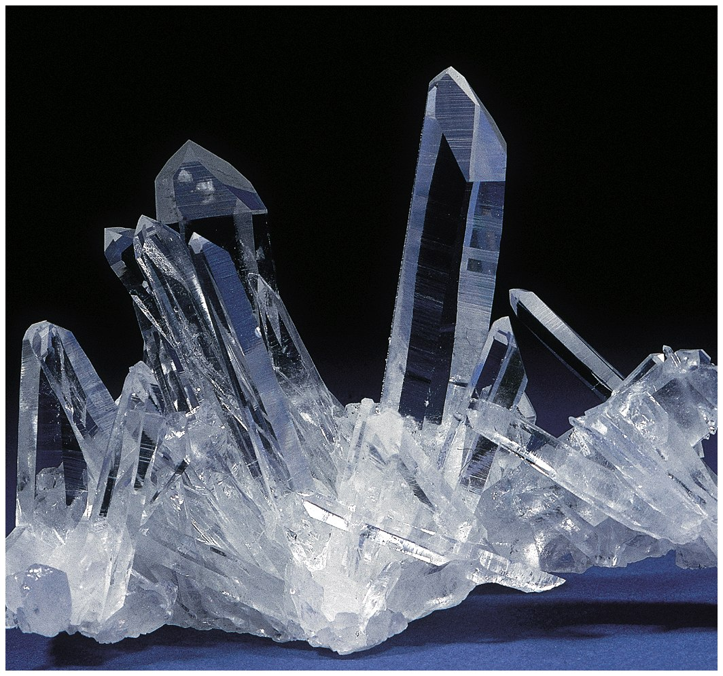
Quartz

Slide 5
Mineral
A naturally occurring, solid, crystalline substance(ordered atomic arrangement), generally inorganic, with a definite chemical composition.

Slide 6
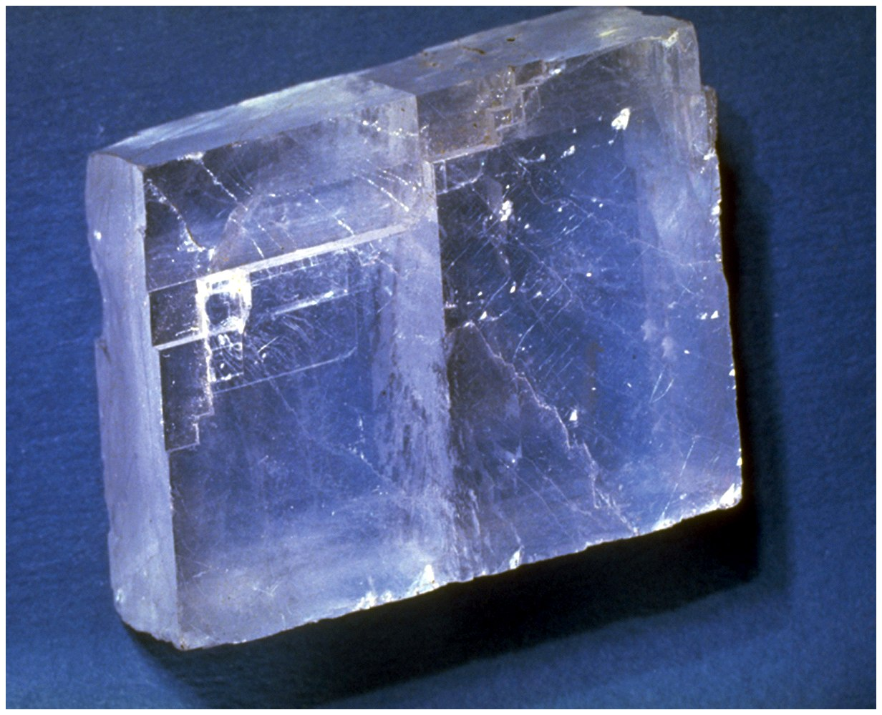
Calcite
Fig. 3.1

Slide 7
Rock
A naturally-occurring consolidated mixture of minerals or mineral-like substances.

Slide 8
Is cane sugar a mineral?
False
True

Slide 9
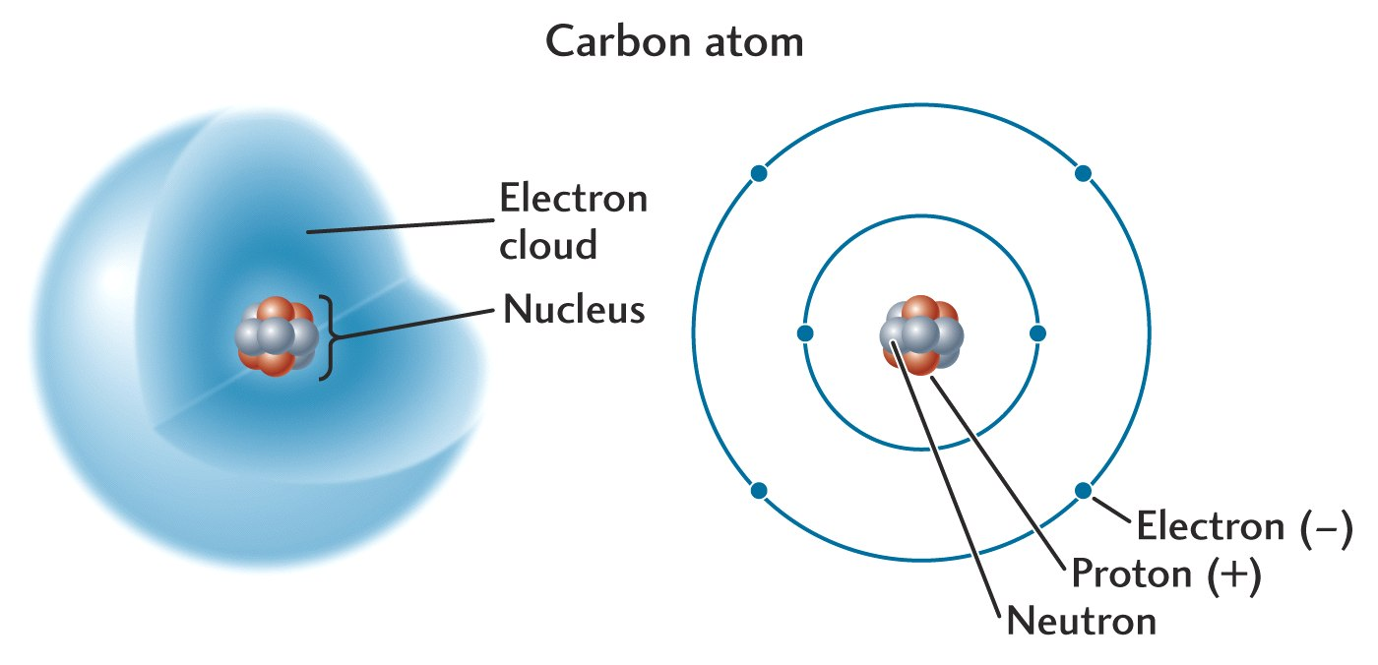

Slide 10
Ions
When an atom loses or gains an electron to or from another atom, what remains is called an ion.
Positively charged ions (loss of electron) are called cations.
Negatively charged ions (gain of electron) are called anions.

Slide 11
Ionic Bonding Rules
ions of opposite charges attract
(total charge must add to zero)
90% of minerals are essentially ionic compounds

Slide 12
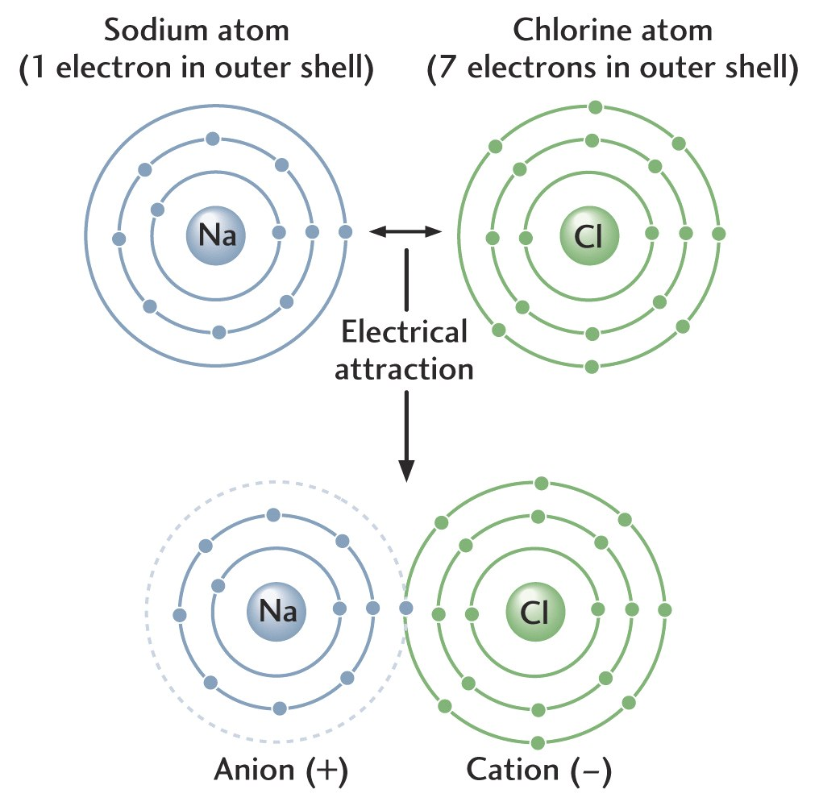

Slide 13
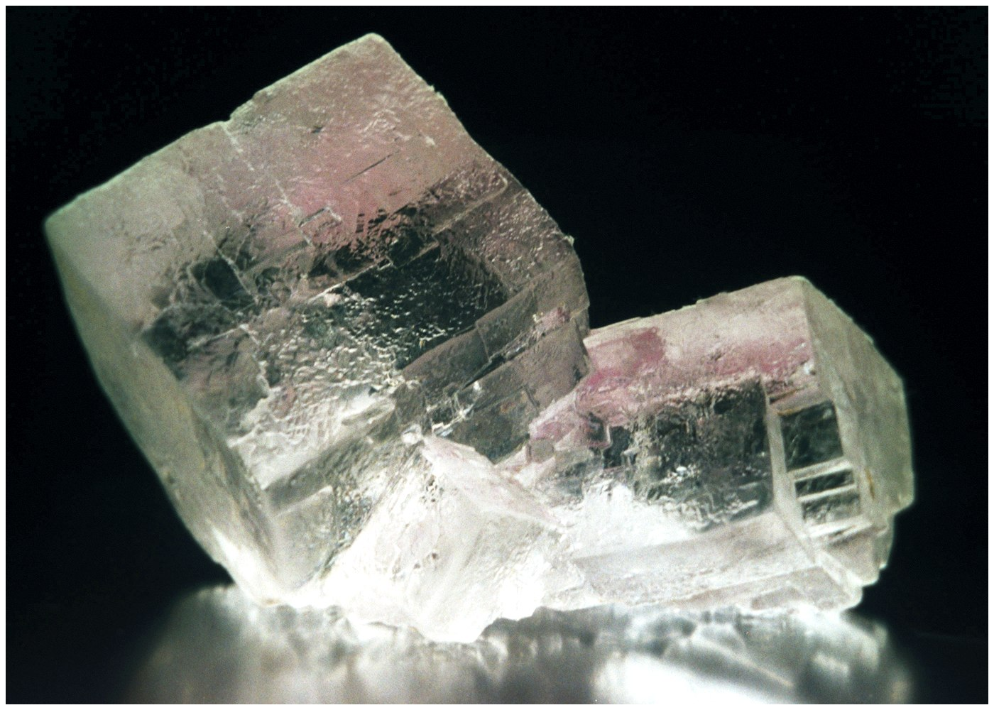
Salt (NaCl)

Slide 14
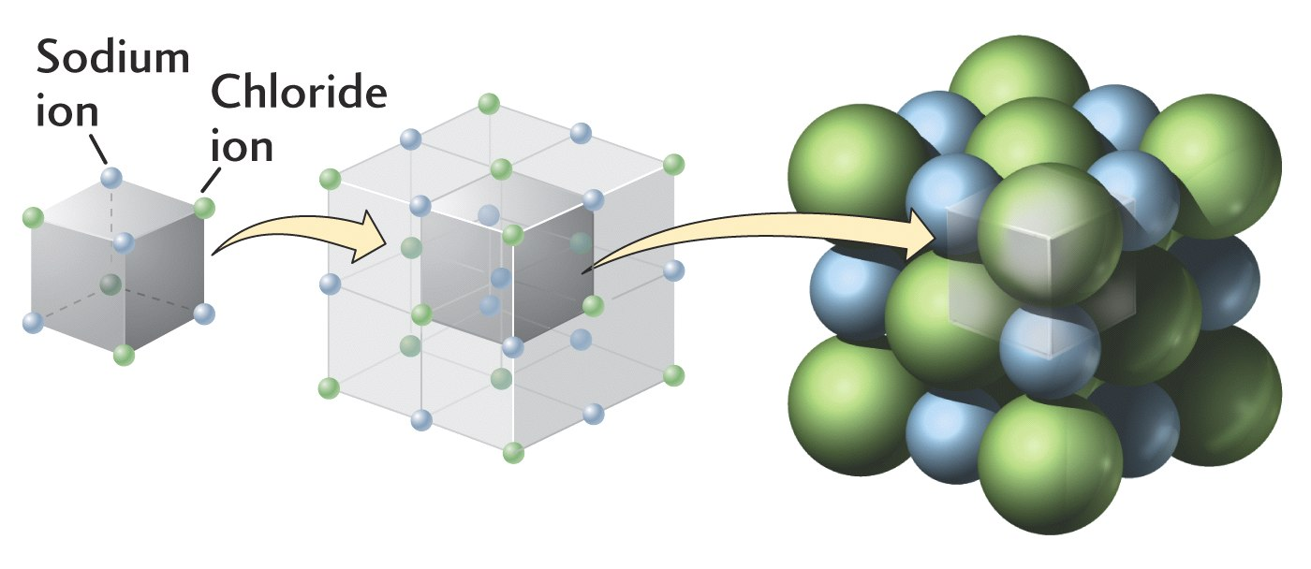

Slide 15
Covalent Bonding
Electrons shared between atoms
Much more stable than ionic bonds

Slide 16
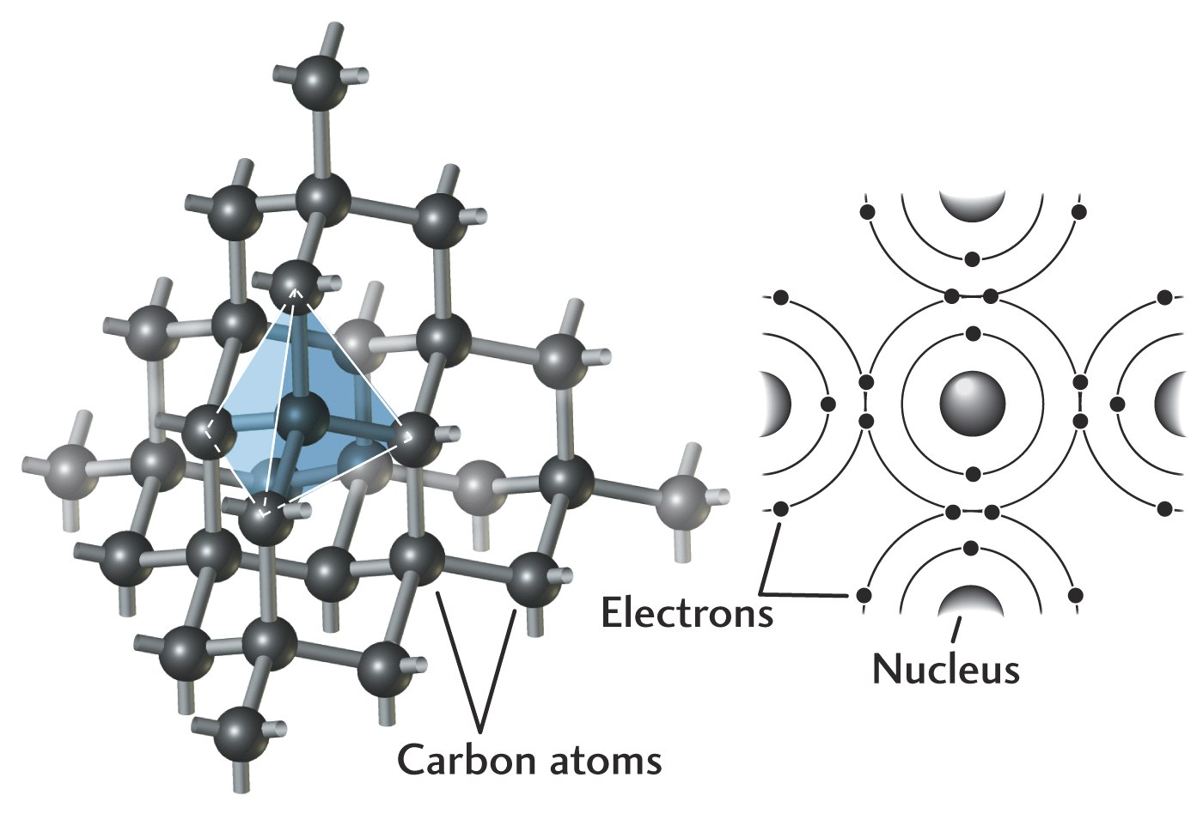
Atomic Structure of Diamond

Slide 17
Mineral Formation
Crystallization from a magma
Crystal growth in the solid state
Precipitation from solution

Slide 18
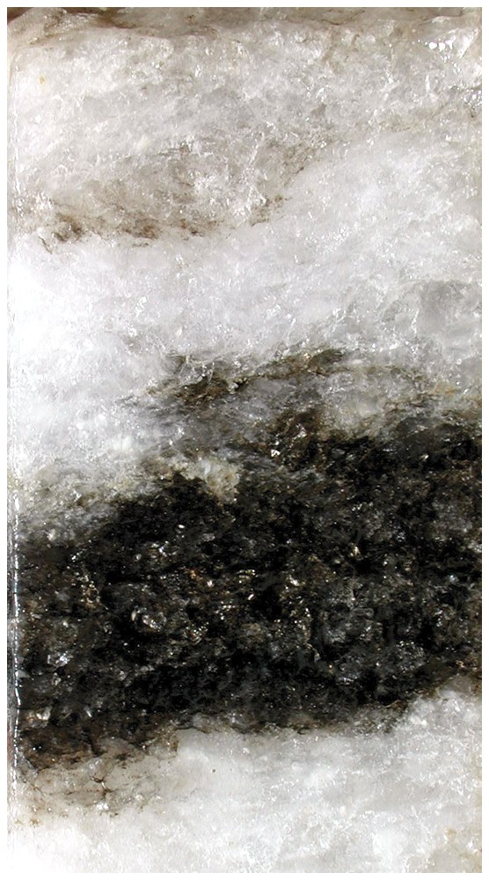
Halite precipitated from solution

Slide 19
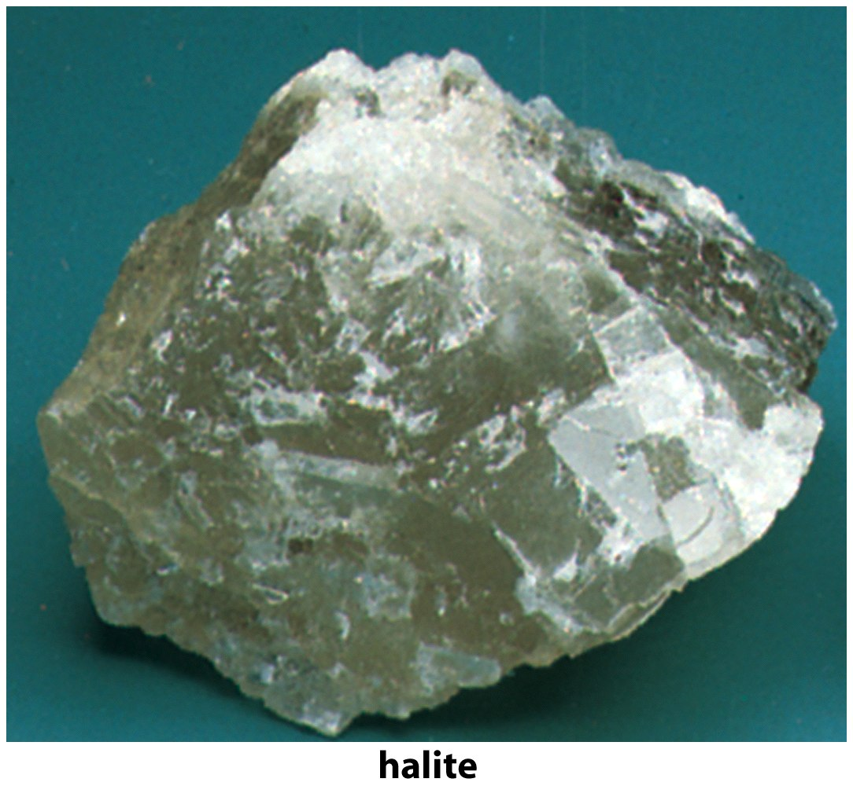

Slide 20
Green Bully
Anion!!!

Slide 21
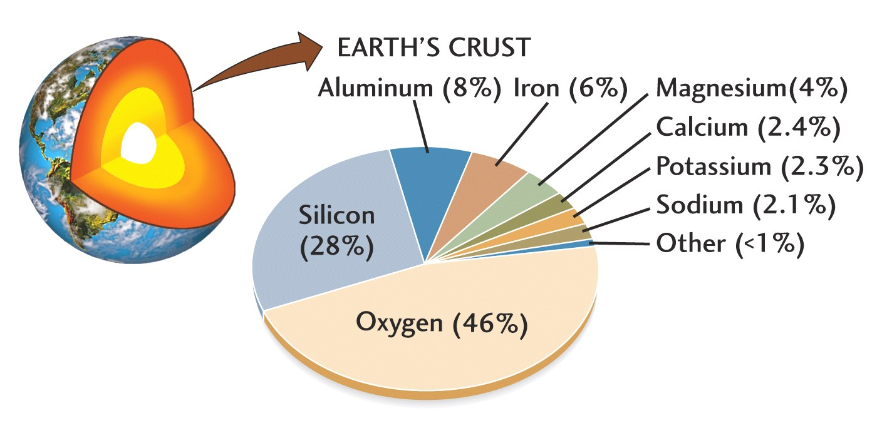
Earth’s Crust

Slide 22
Minerals: May NOT be boring
There are some 3,500 recognized minerals found on Earth.
How many of the following are in your home?
Silicates - (Si, O) combined with other cations
Carbonates - Ca, Mg and
Oxides - O²⁻ and metallic cations
Sulfides - S²⁻ and metallic cations
Sulfates - (SO₄)²⁻ & metallic cations
Phosphates (PO₄)³⁻ & metallic cations

Slide 23
Kidney stones
Calcium phosphate, oxalate (80%)
* http://www.gravmag.com/kstones2.html

Slide 24
Important ions in minerals
anions charge cations charge
O −2
Si +4
K +1
Ca +2
Na +1
Al +3
Mg +2
Fe +2 or +3

Slide 25
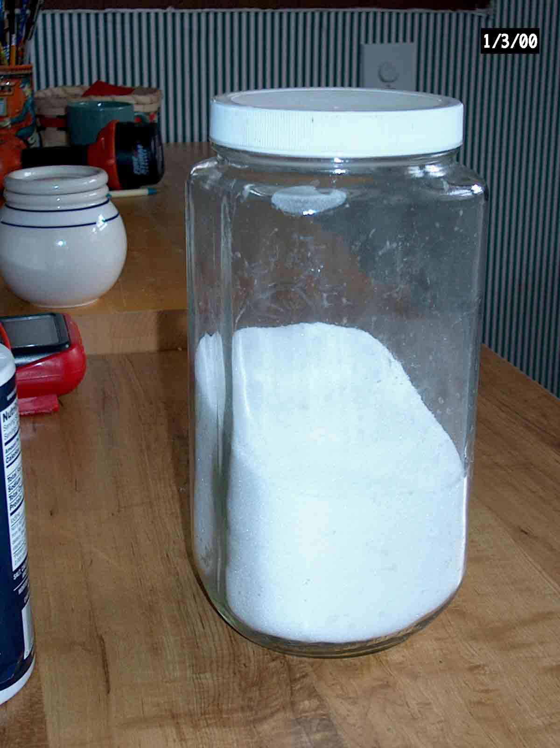
Sugar -Is it a mineral?

Slide 26
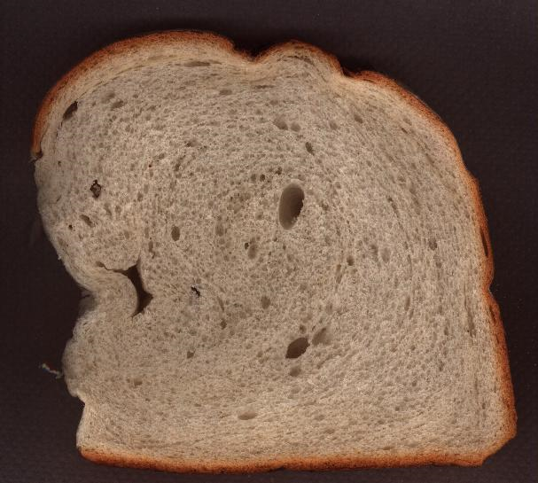
Bread--- is it a mineral?
http://gallery.hd.org/_exhibits/food/bread-white-one-slice-100dpi-DHD.jpg

Slide 27
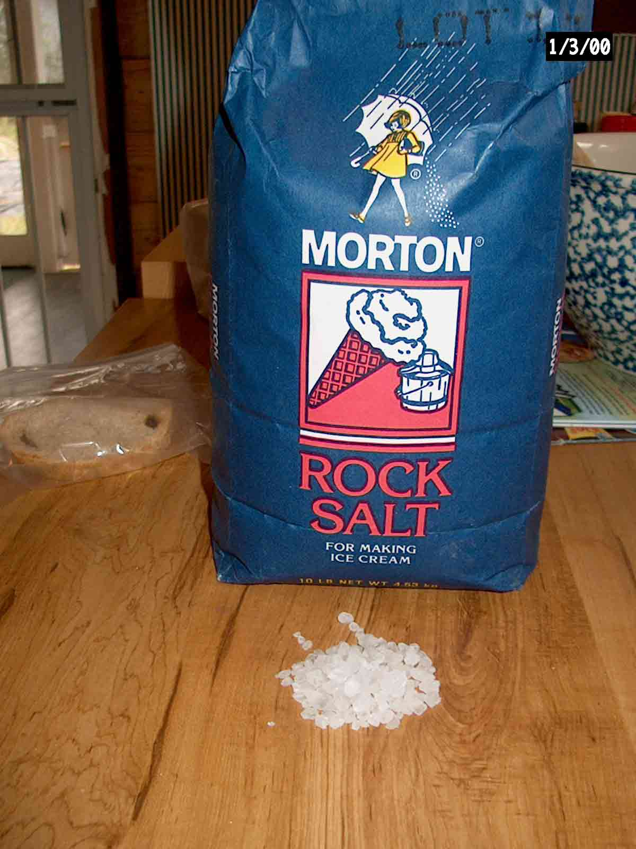
Salt crystals

Slide 28
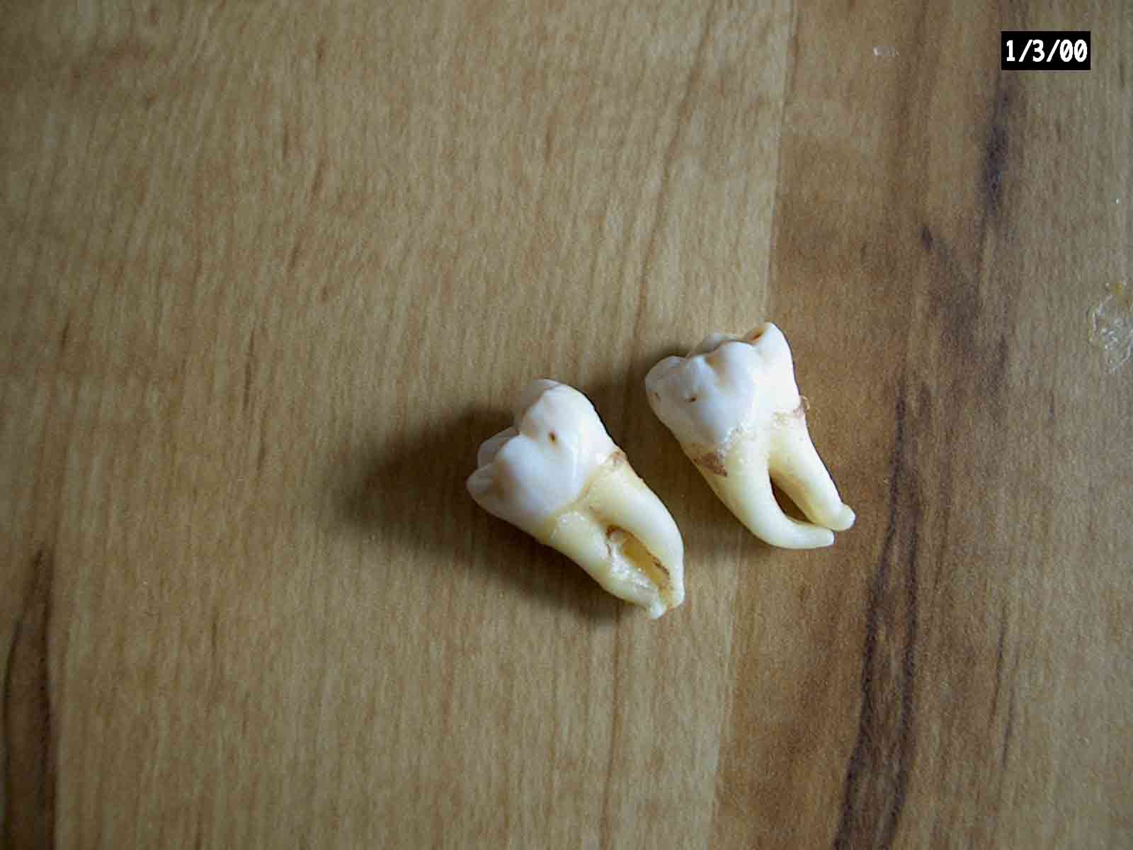
Phosphates-tooth enamel
Tooth enamel is 95% hydroxyapatite (Ca10(P04).2(OH) Dentin is only partly made of hydroxyapatite
Juan Lorenzo’s (ex-)wisdom teeth and more coming soon ….

Slide 29
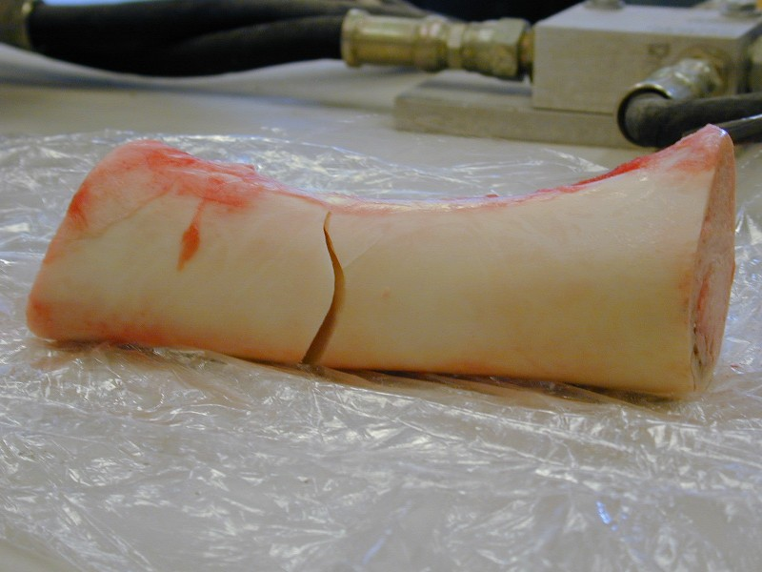
Phosphates-bone
It’s NOT human!
http://users.rowan.edu/~farrell/hohb/Bones/Photos/broken%20bone3.JPG

Slide 30
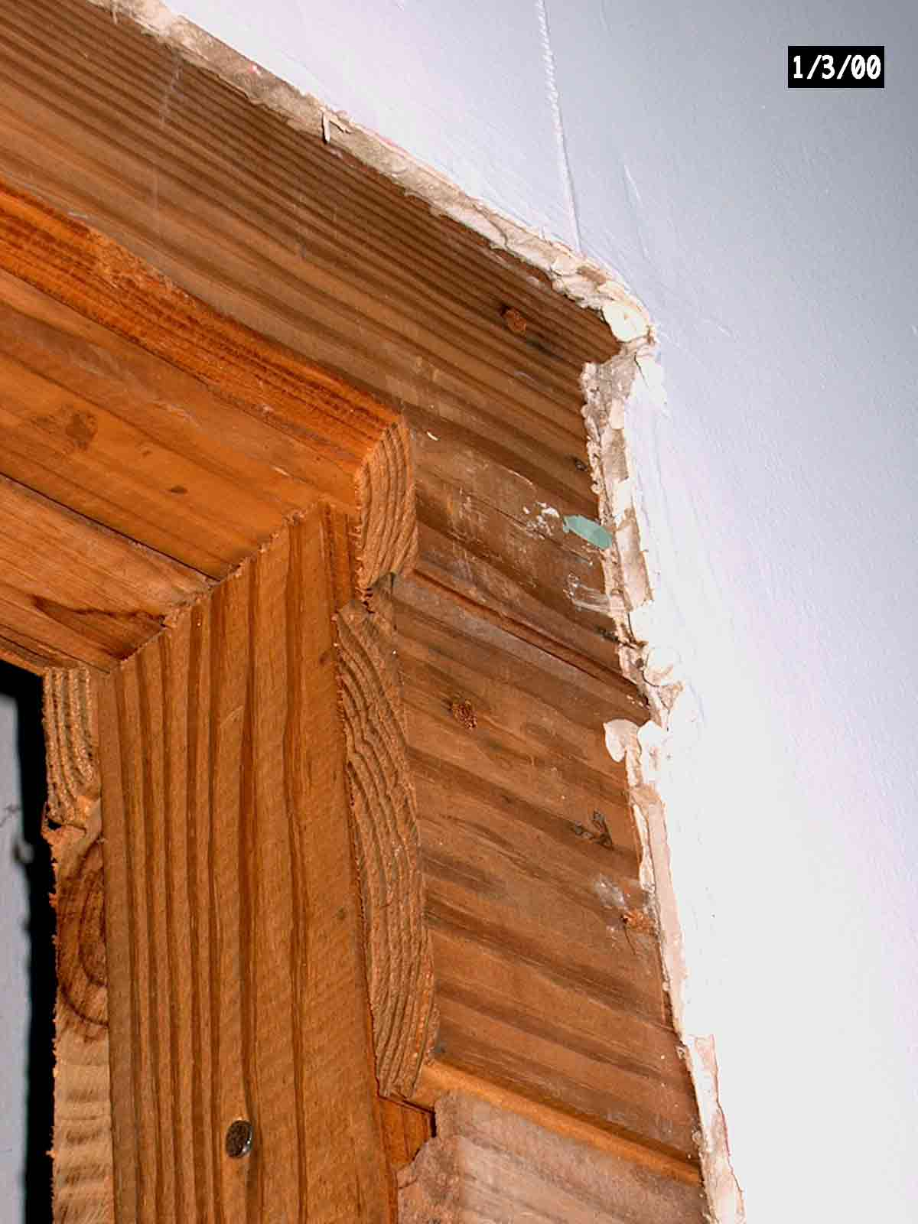
Wallboard - Gypsum (Sulfate)

Slide 31
Sulfates
Gypsum CaSO4 •2H2O
Anhydrite CaSO4

Slide 32
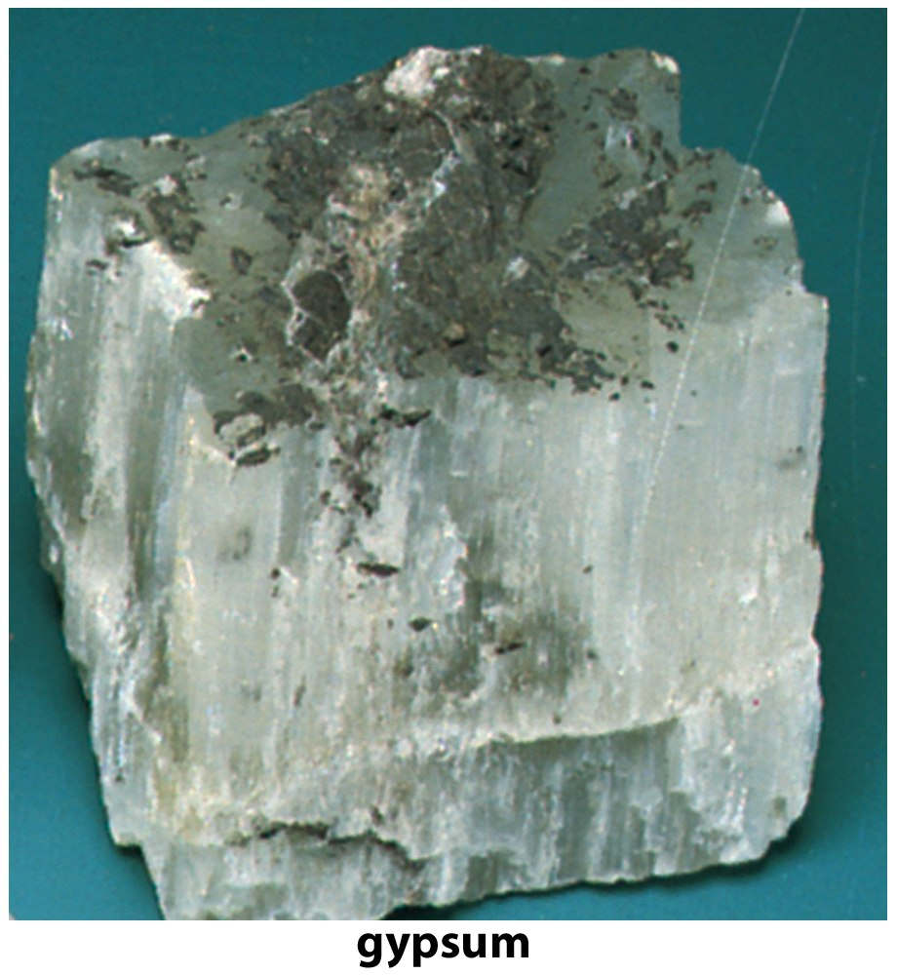

Slide 33
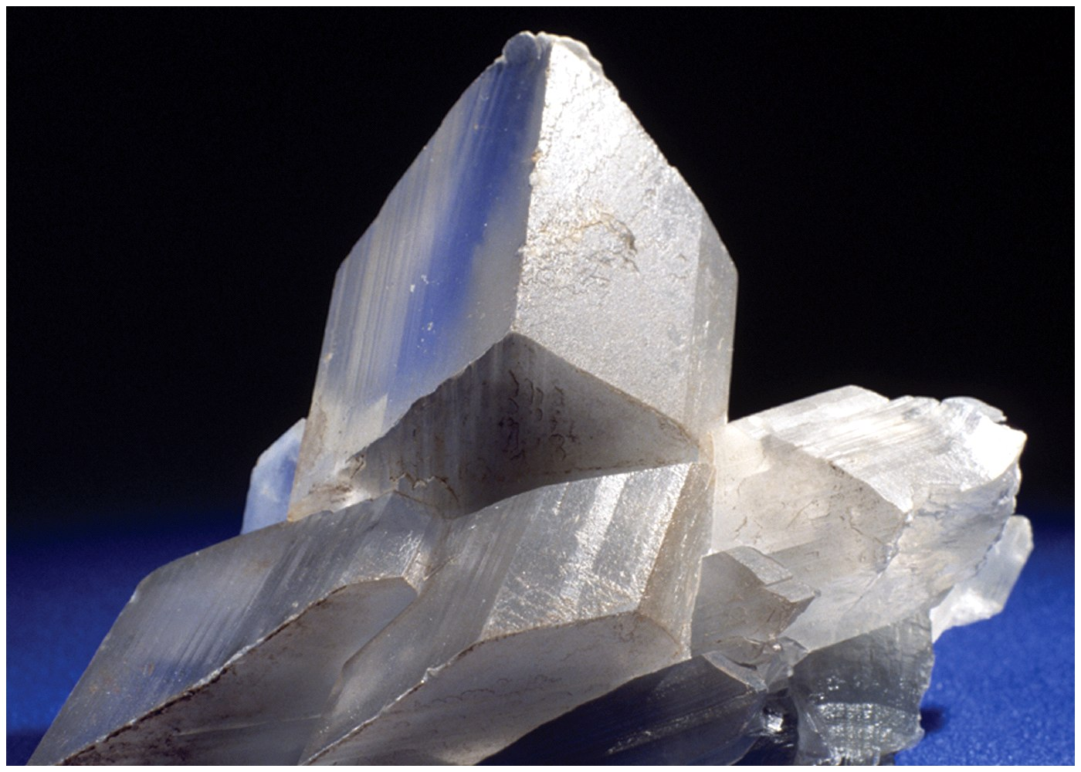
gypsum

Slide 34
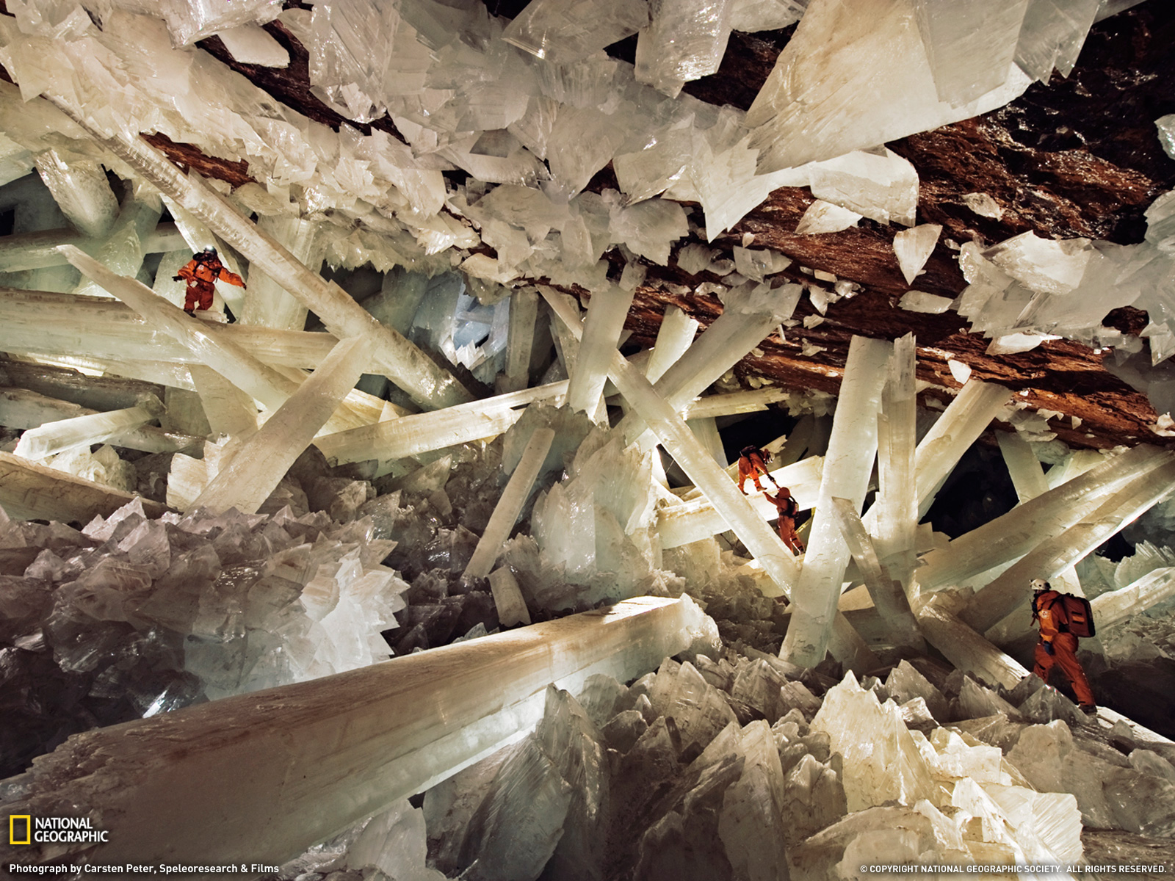
Photograph by Carsten Peter, Speleoresearch & Films *This Month in Photo of the Day: *National Geographic* Magazine Features* Massive beams of selenite dwarf human explorers in Mexico's Cave of Crystals, deep below the Chihuahuan Desert. Formed over millennia, these crystals are among the largest yet discovered on Earth.

Slide 35
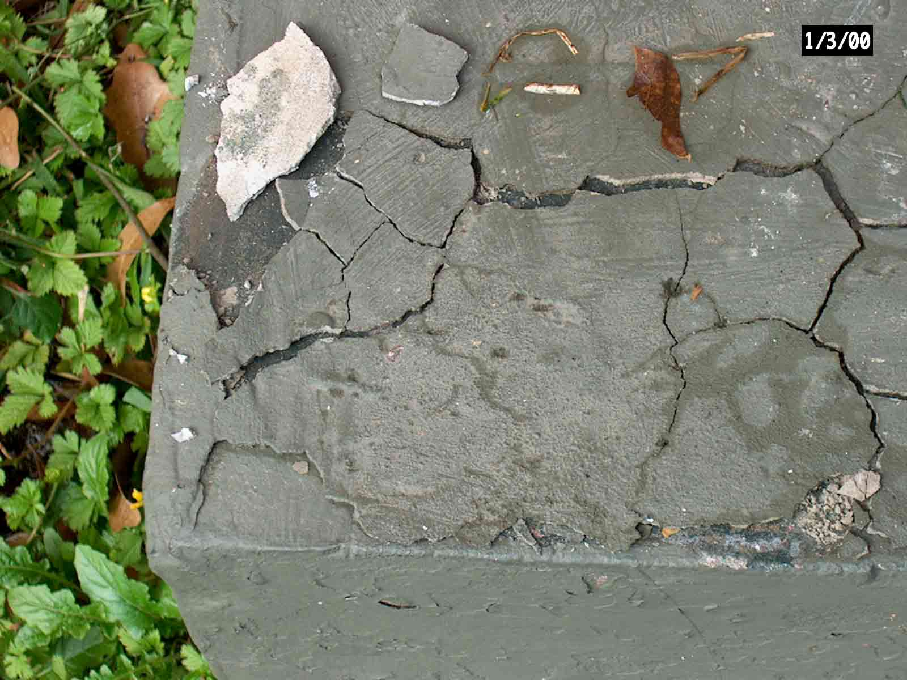
Cement- originally a Carbonate
85% limestone 15% clay - cooked together

Slide 36
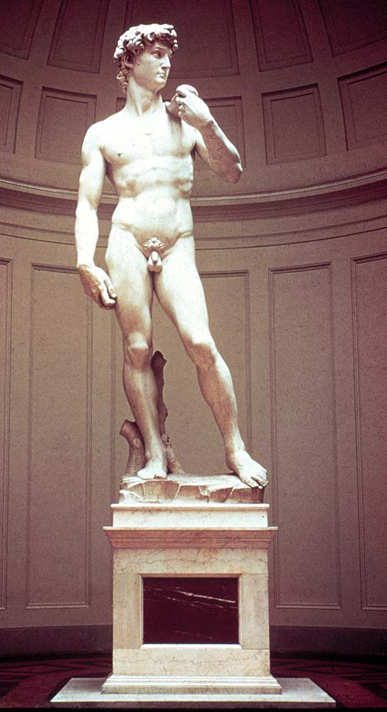
Carbonates - marble
Michelangelo’s David
http://www.pbs.org/wgbh/cultureshock/flashpoints/visualarts/images/david_big.jpg

Slide 37
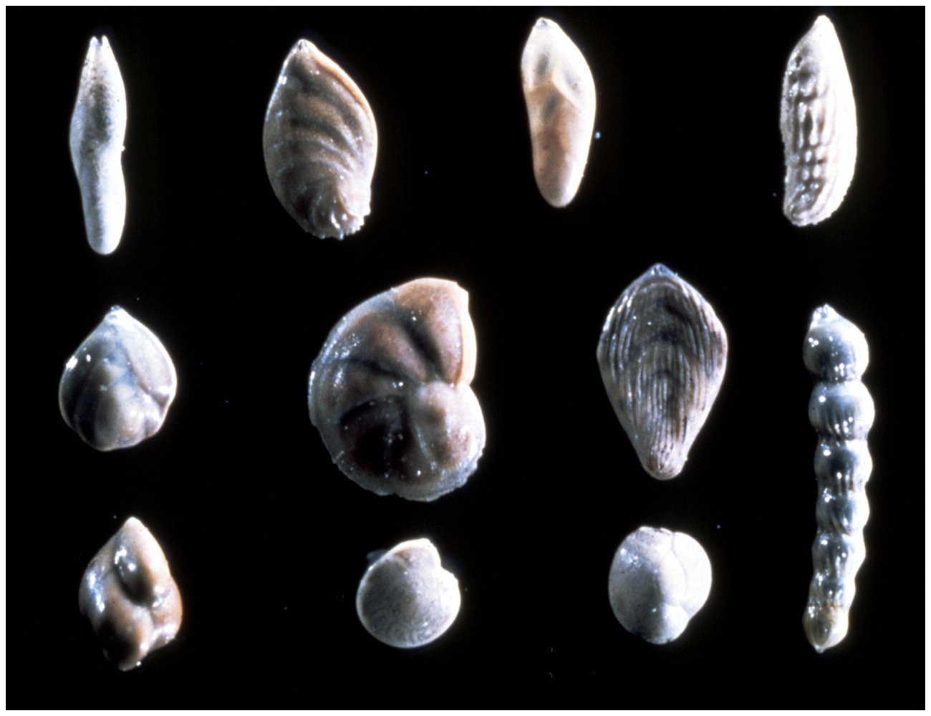

Slide 38
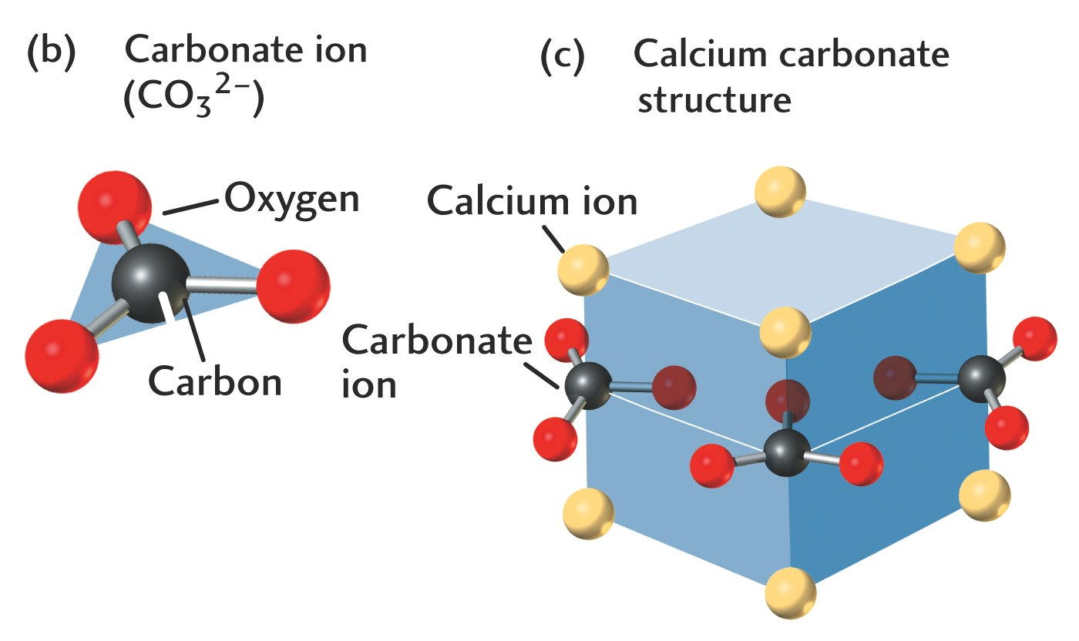

Slide 39
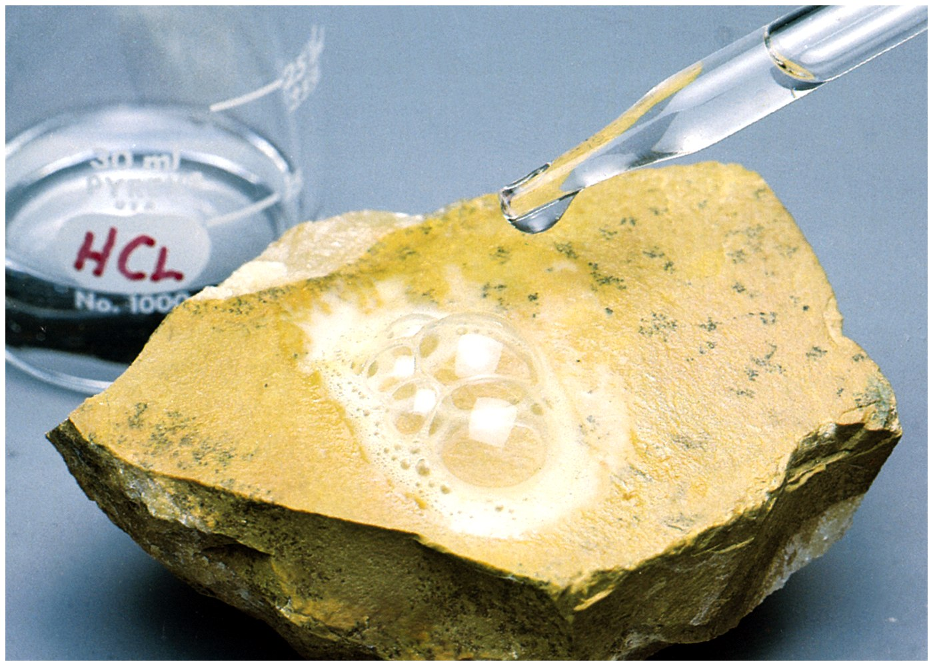
The Acid Test for Calcite

Slide 40
Important Mineral Groups
Name Important constituents
(including Oxygen)
Olivine Si,O Fe,Mg
Pyroxene Si,O Fe, Mg, Ca
Amphibole Si,O Ca, Mg, Fe, Na, K
Micas Si,O Al, K, Fe, Mg
Feldspars Si,O, Al, Ca, Na, K
Carbonates C,O,Ca,Mg
Evaporites K, Cl, Ca, S,O

Slide 41
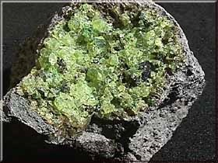
Olivine crystals in basalt

Slide 42
Important Minerals
Quartz SiO₂
Calcite CaCO₃
Olivine (Mg,Fe)₂SiO₄
Plagioclase feldspar
K-feldspar
Micas
Amphiboles
Pyroxenes

Slide 43
Oxides
Hematite Fe₂O₃
_{1.8-1.6 billion years ago}
Magnetite Fe₃O₄

Slide 44
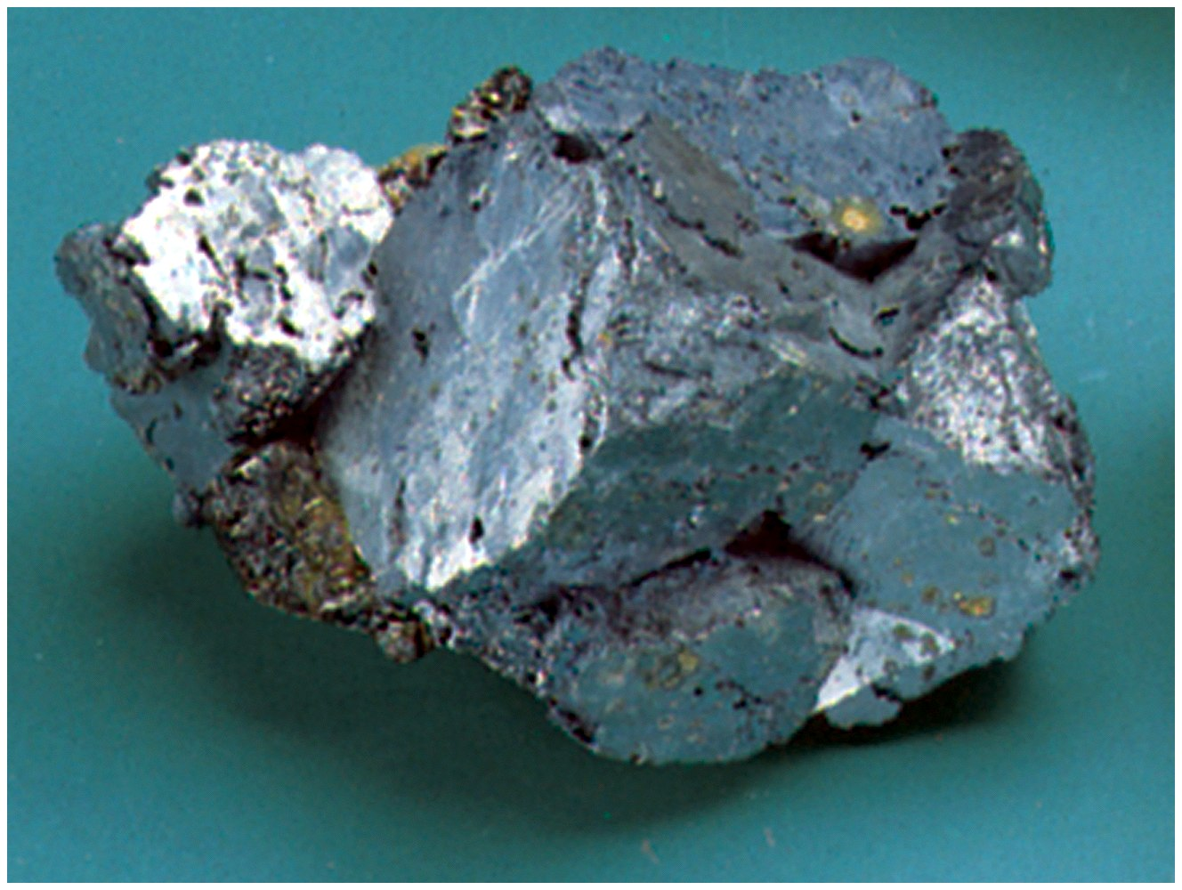
Hematite

Slide 45
Sulfides
Pyrite FeS₂

Slide 46
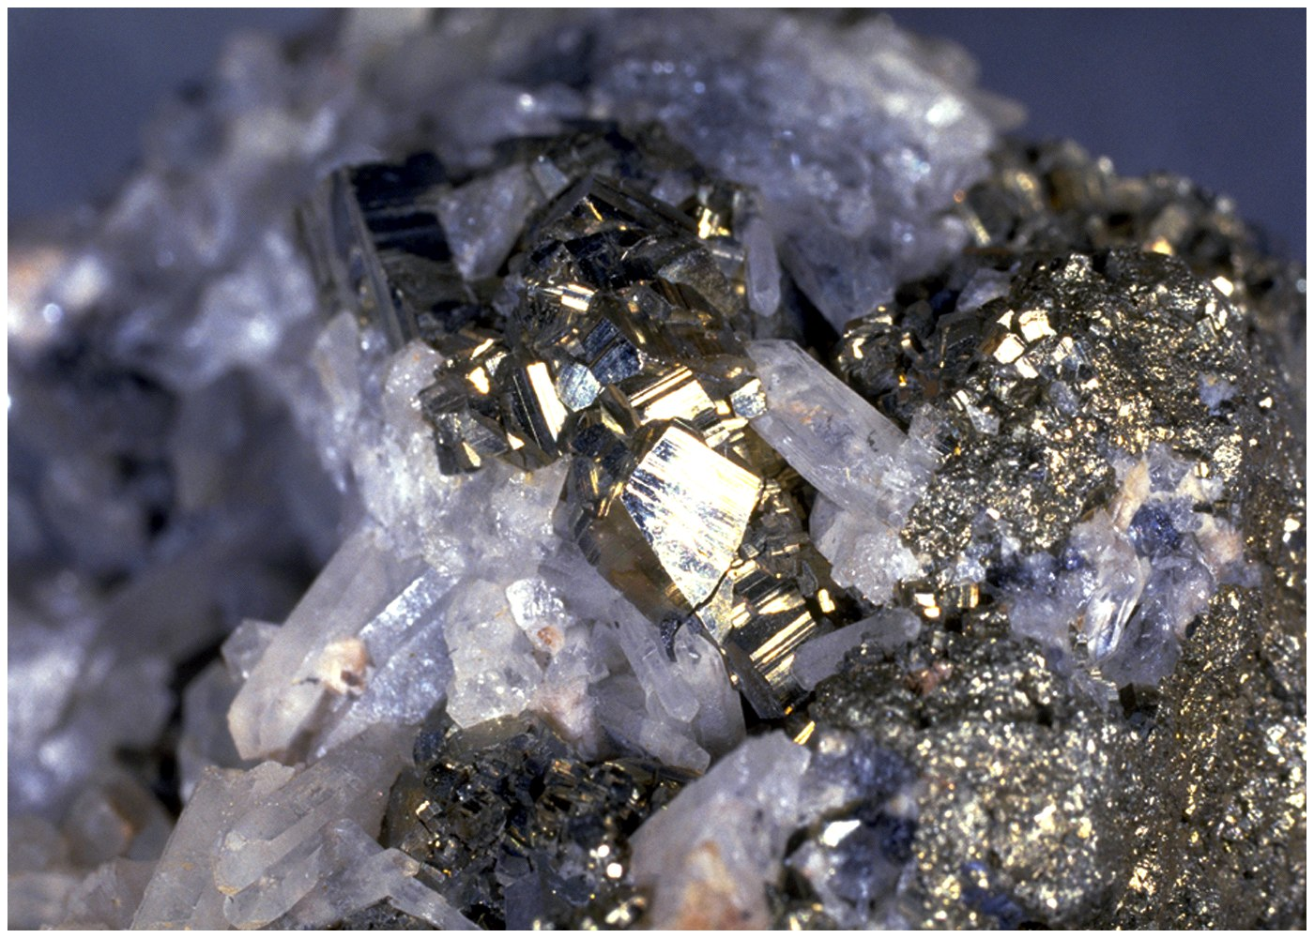
Pyrite

Slide 47
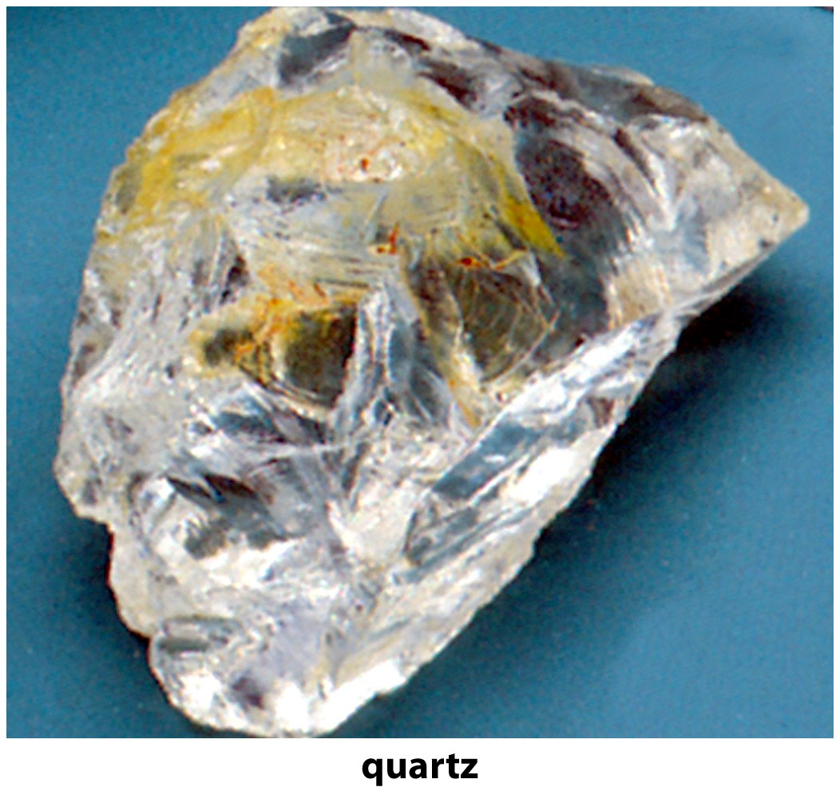

Slide 48
Mineral Identification
Hardness
Cleavage
Fracture
Luster
Color
Density
Crystal habit

Slide 50
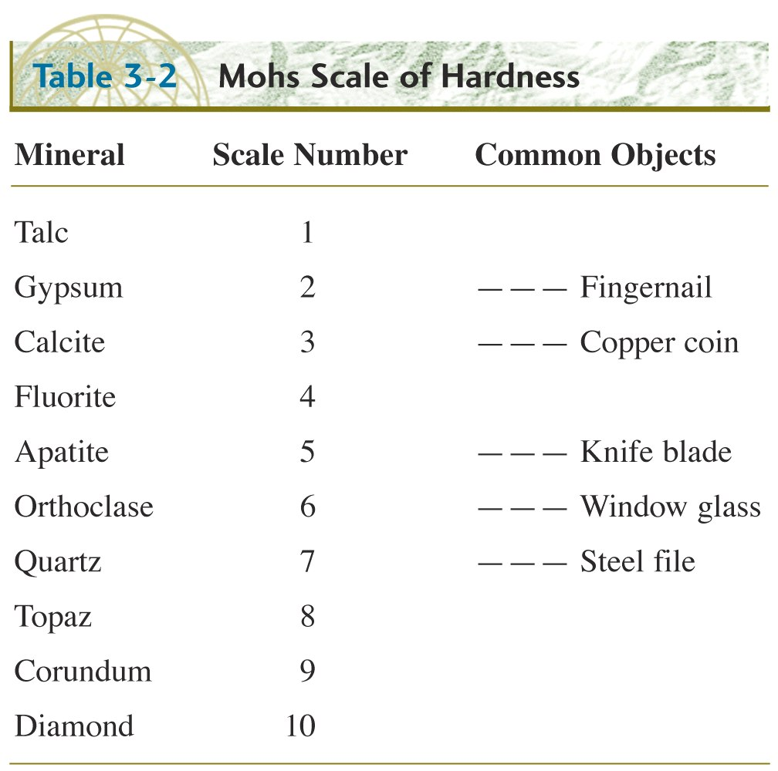
Topaz is a silicate mineral of aluminium and fluorine

Slide 51
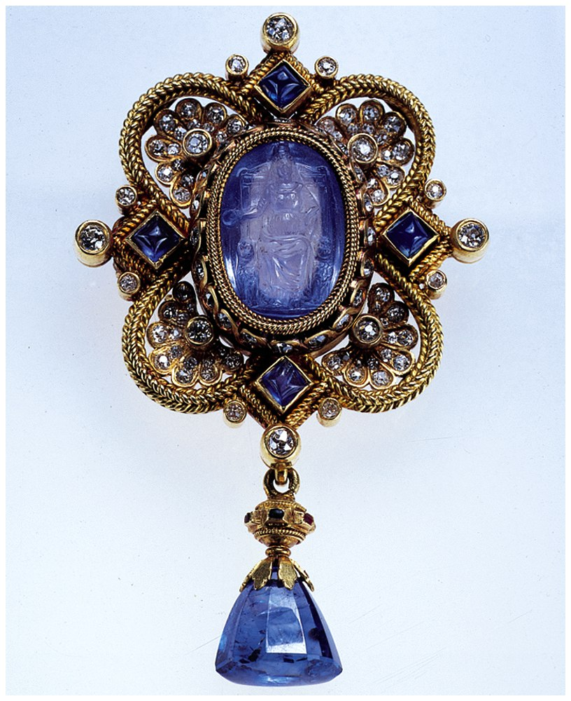
Q. What do rubies (red corundum), sapphires(corundum), emeralds (beryl) diamonds, and sandpaper have in common?
A. Hardness
corundum

Slide 52
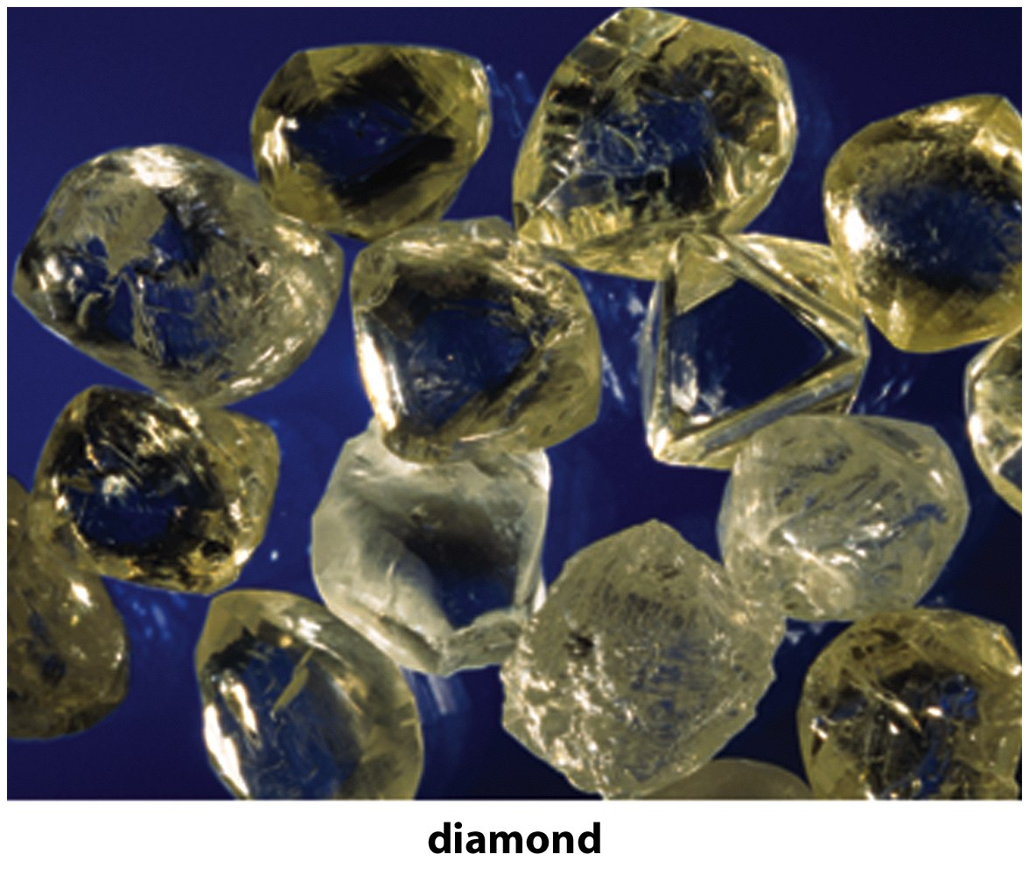

Slide 53
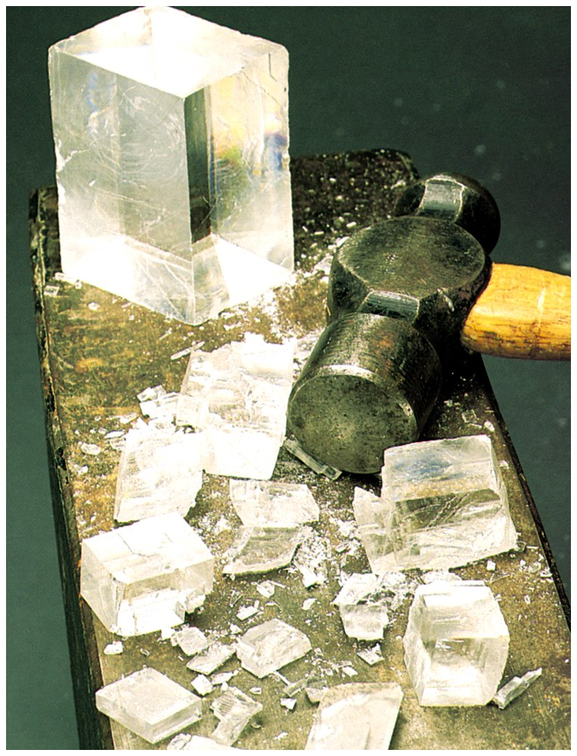

Slide 54
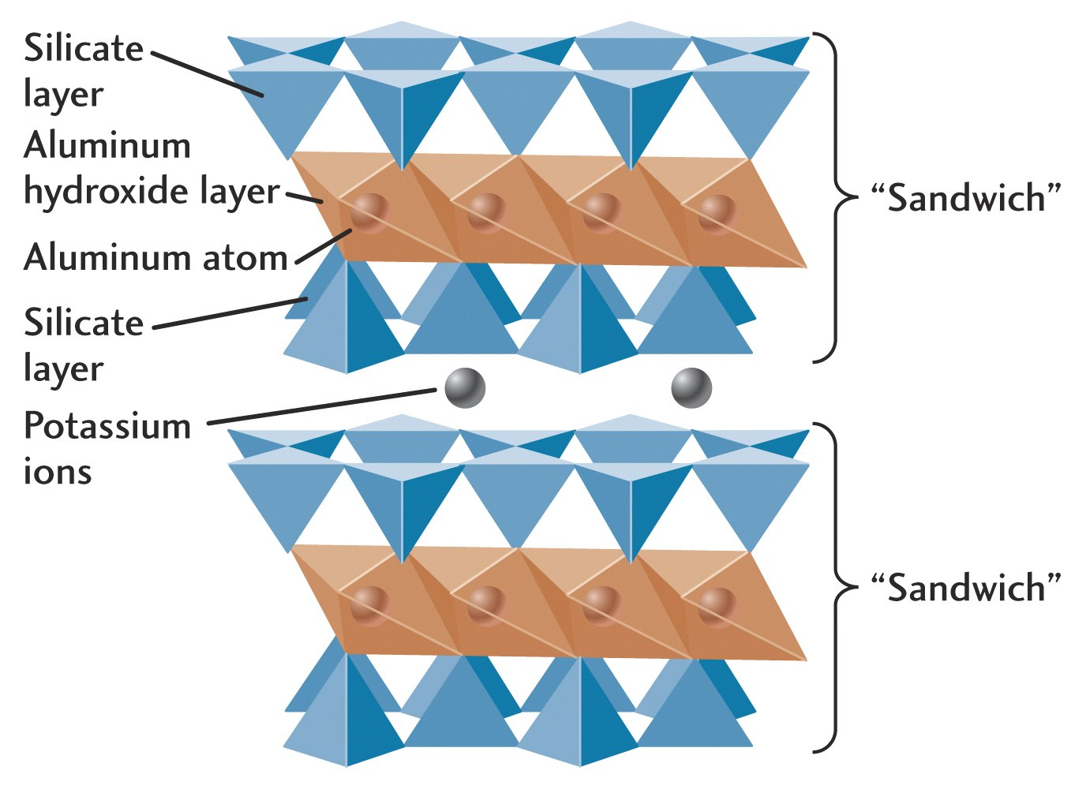
Mica Cleavage

Slide 55
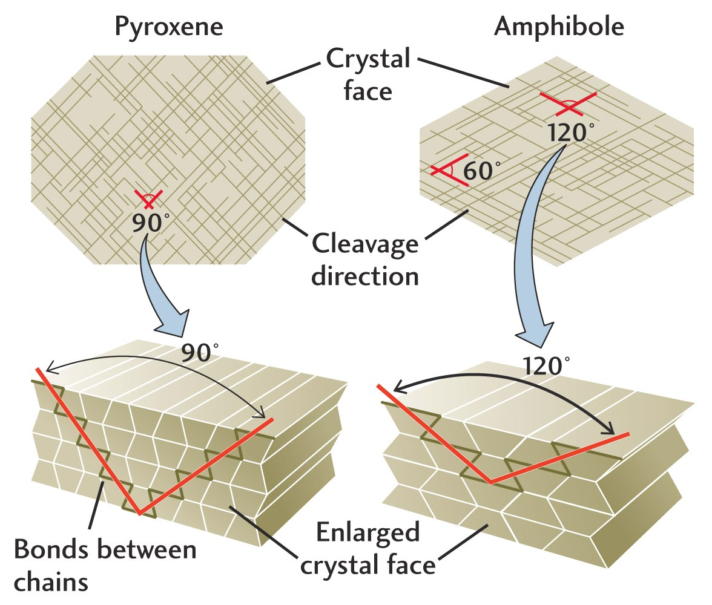

Slide 56
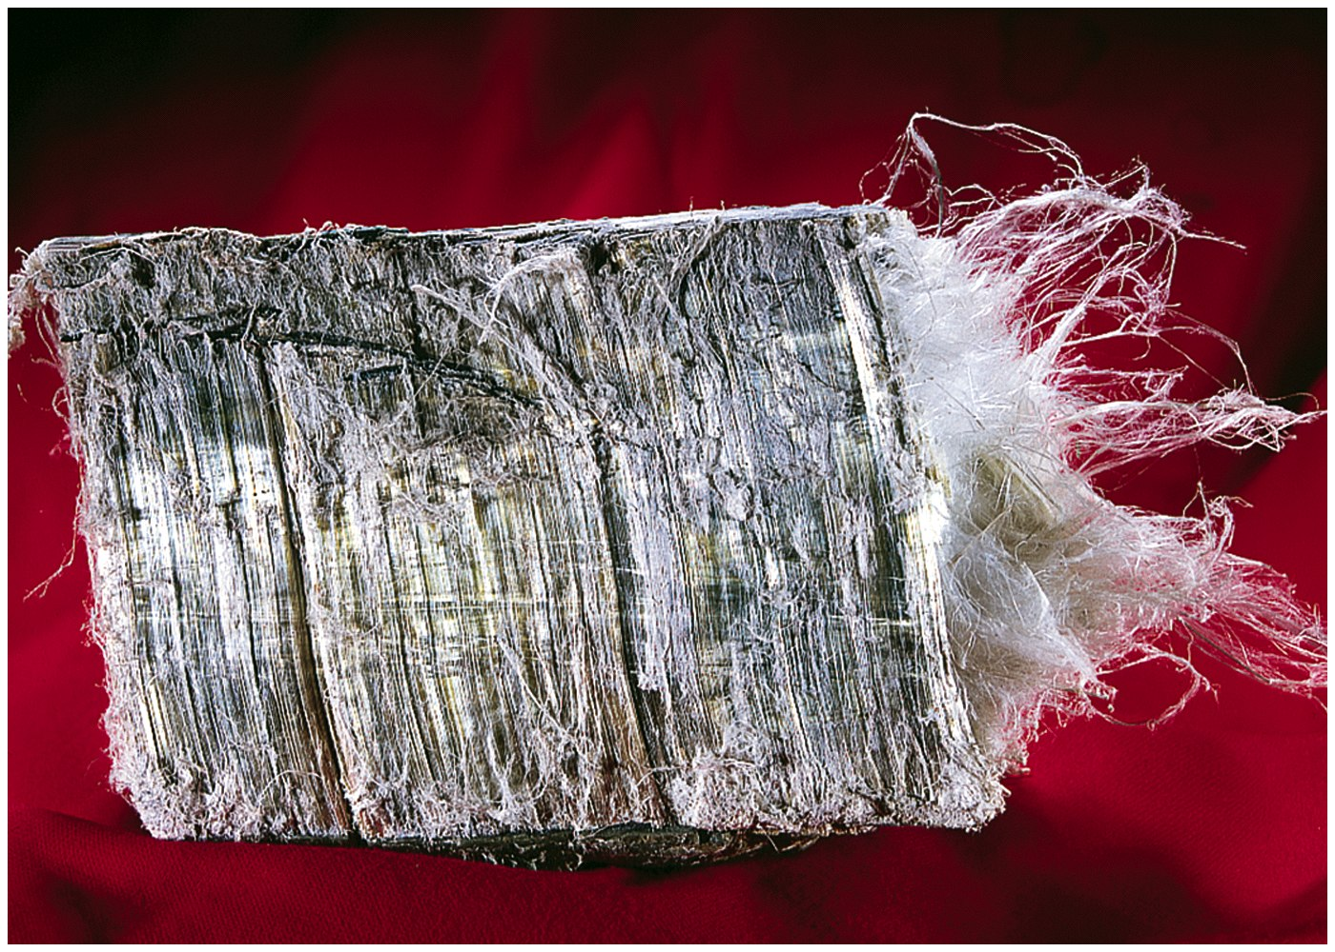

Slide 57
Which minerals commonly precipitate from sea water?
sulfates
silicates
oxides

Slide 58
Rock
A naturally-occurring solid aggregate of minerals.
e.g, marble, granite, sandstone, limestone

Slide 59
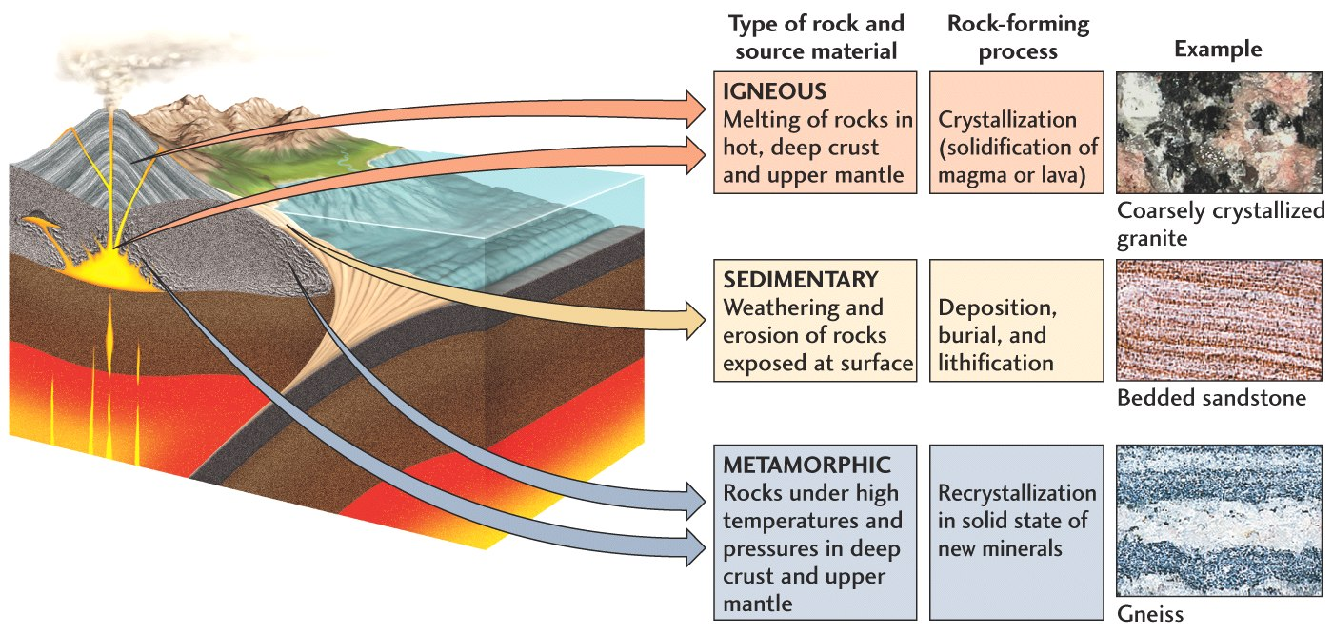

Slide 60
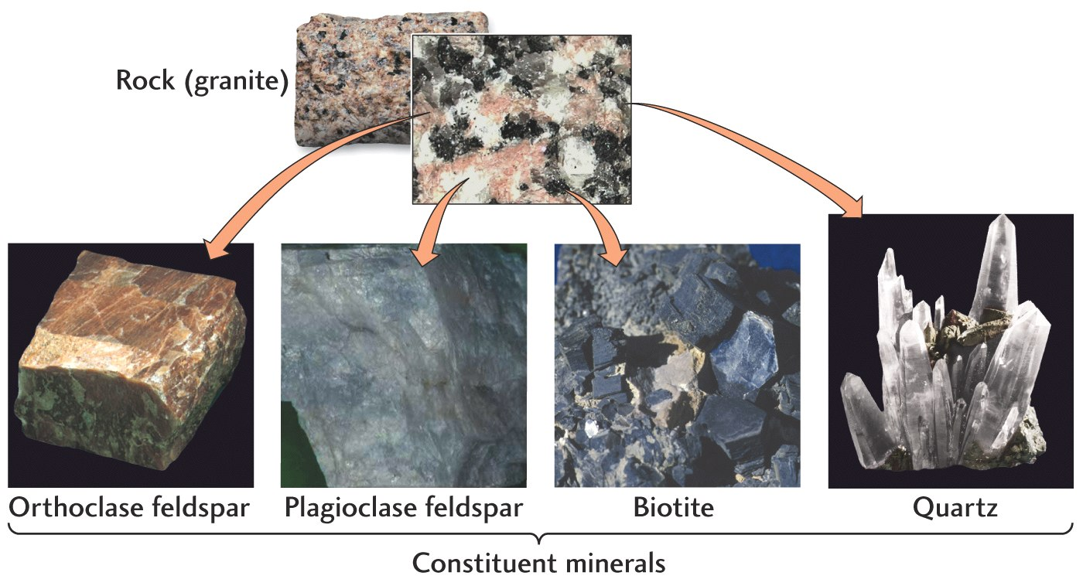

Slide 61
Sedimentary rocks
5 % by volume of the upper crust
75% by area of continents
Often the only record of geologic events:
e.g. Himalaya will some day be broken down and recemented into some type of sandstone

Slide 62
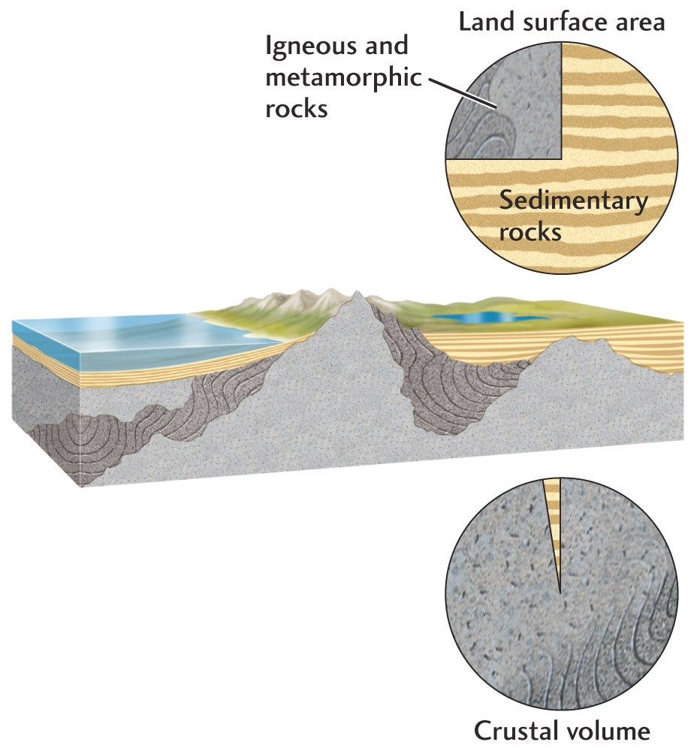
Proportions of the Rock Types

Slide 63
Sedimentary Rocks
Rocks formed by consolidation of pieces of previously-existing rocks
Chemical precipitation from solution

Slide 66
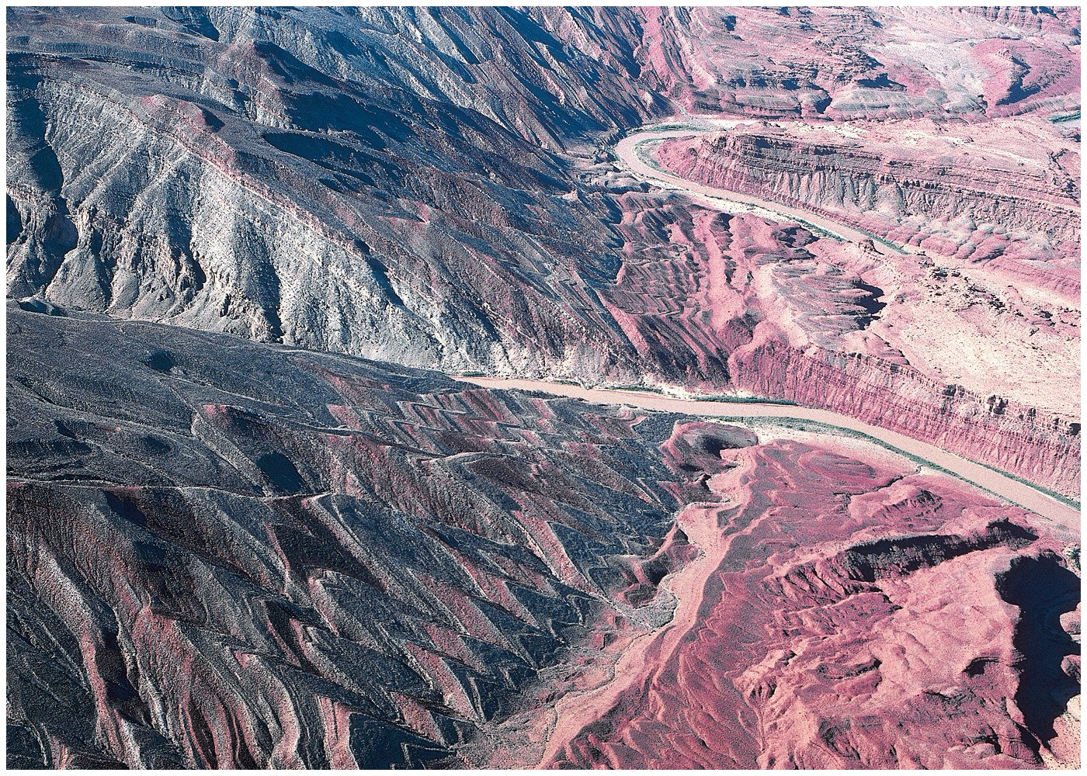

Slide 70
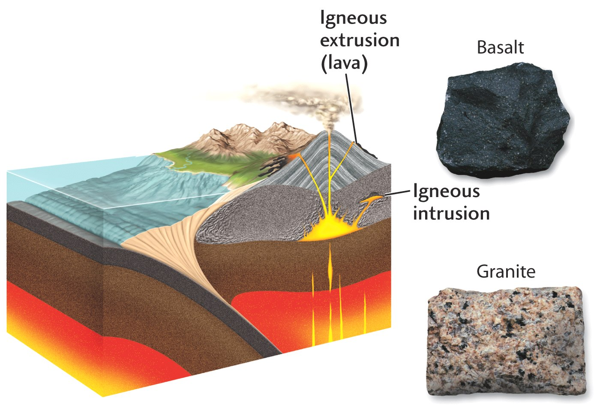

Slide 72
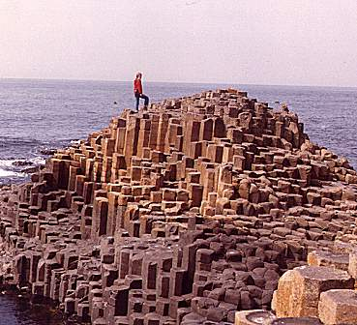
Giant’s Causeway, Ireland

Slide 73
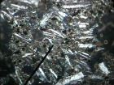
Andesite - granite at the surface
Hand sample-Santiago de Chile
Microscope slide

Slide 74
Metamorphic Rocks
Rocks formed by the transformation of previously-existing rocks in the solid state due to increased temperature and pressure.

Slide 77
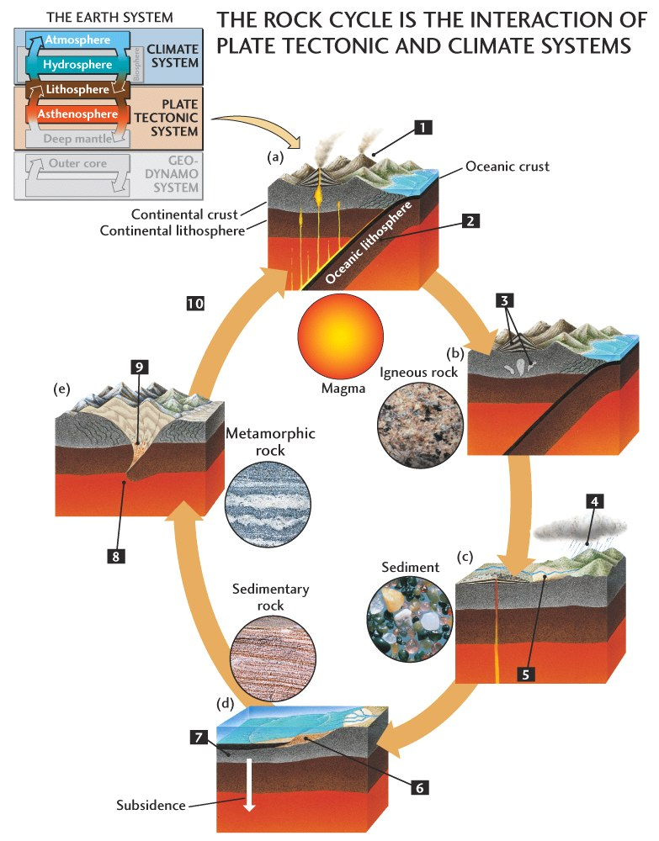

Slide 78
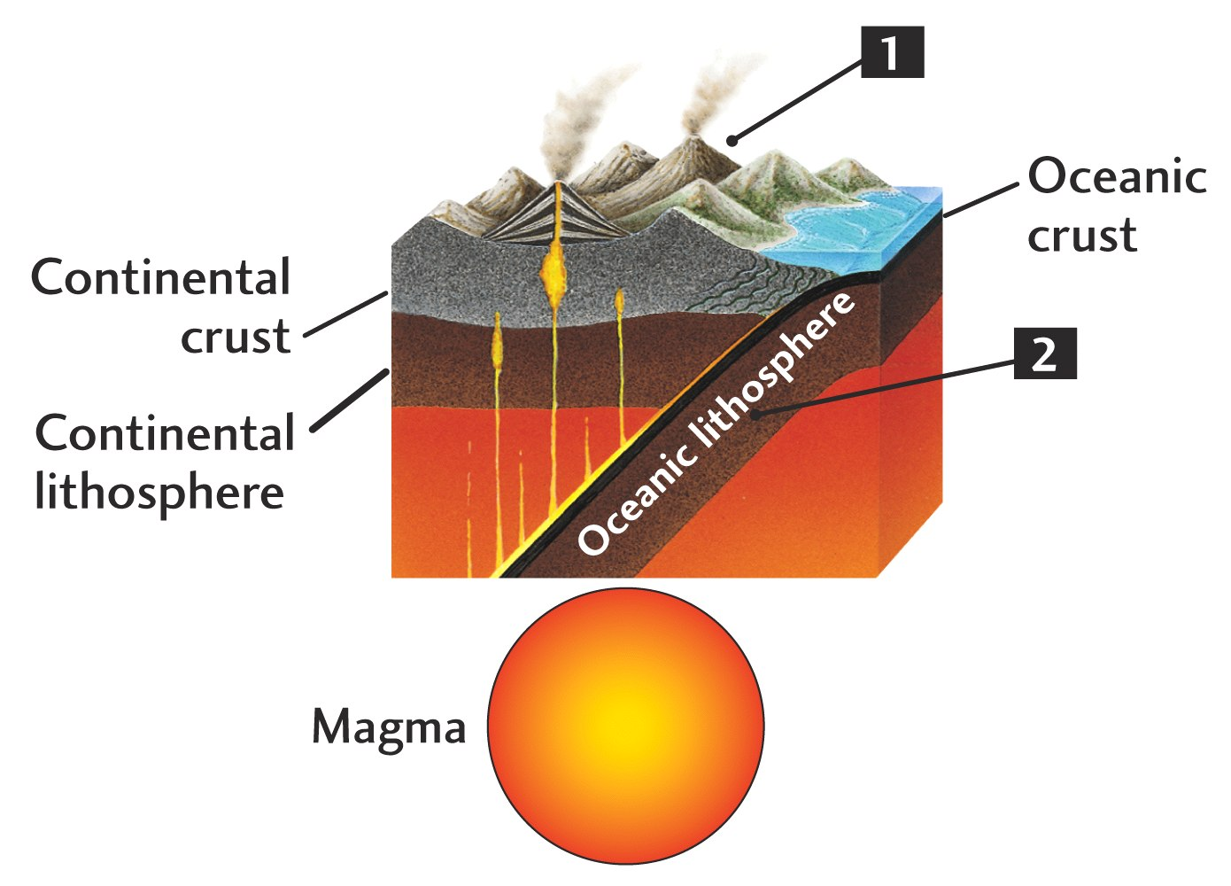

Slide 79
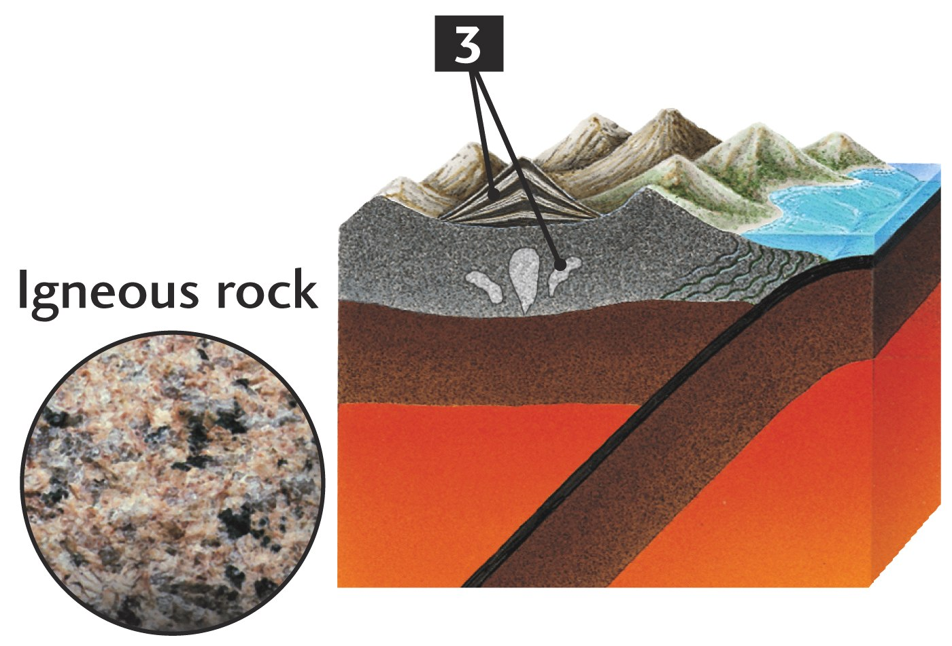

Slide 80
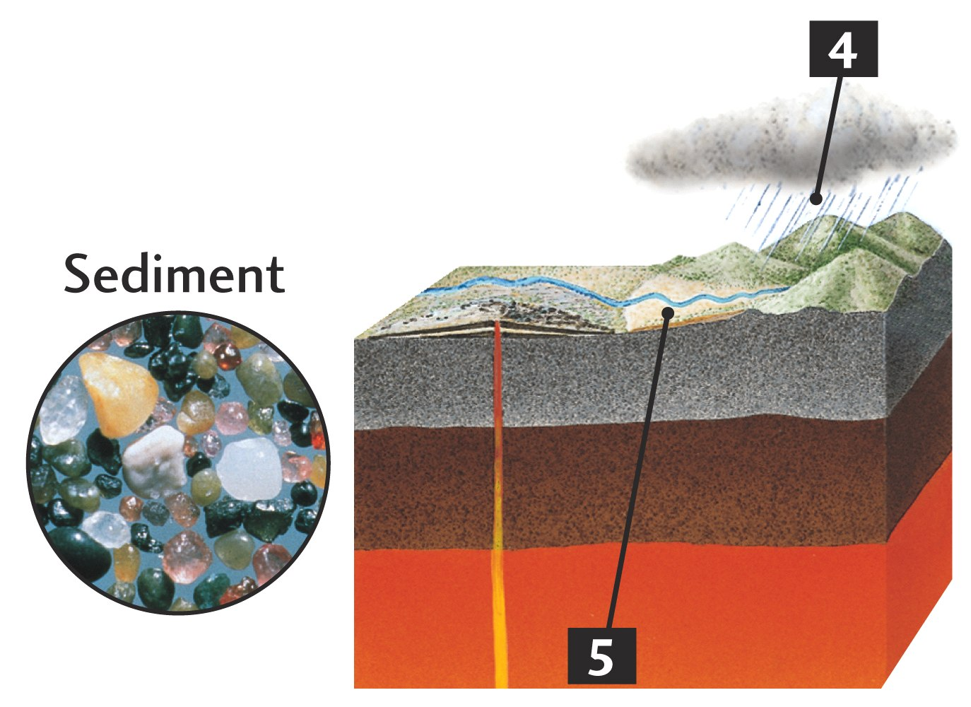

Slide 81
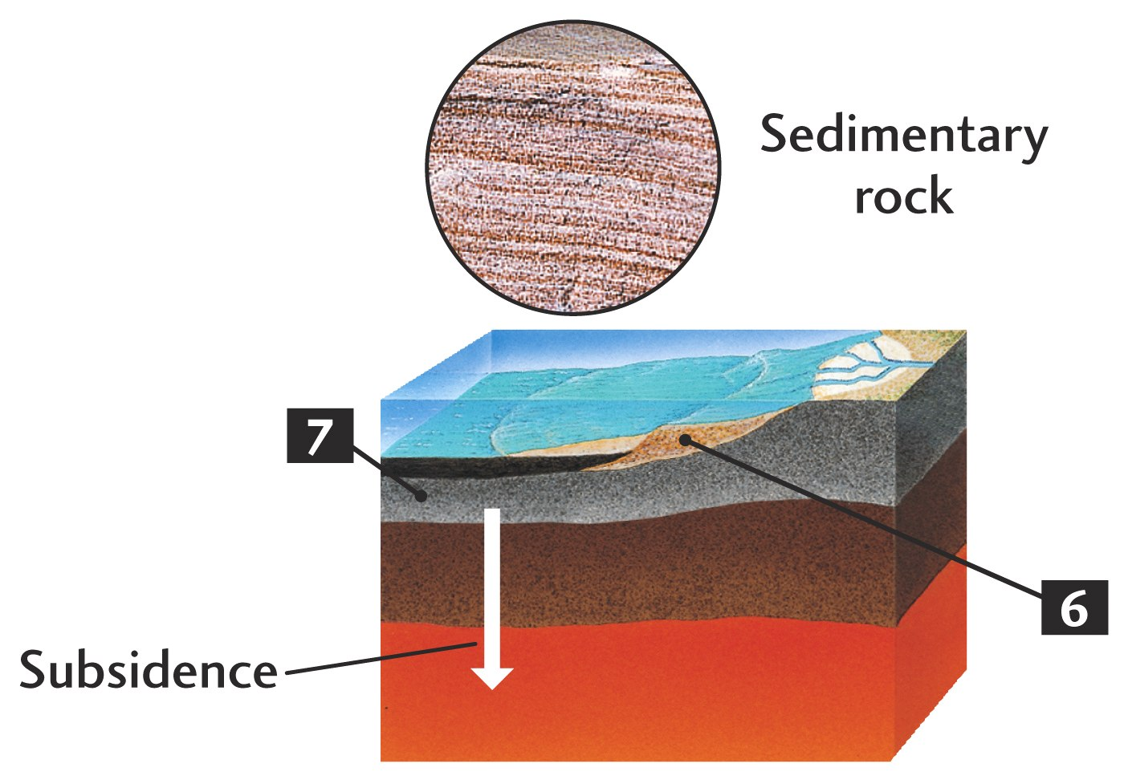

Slide 82
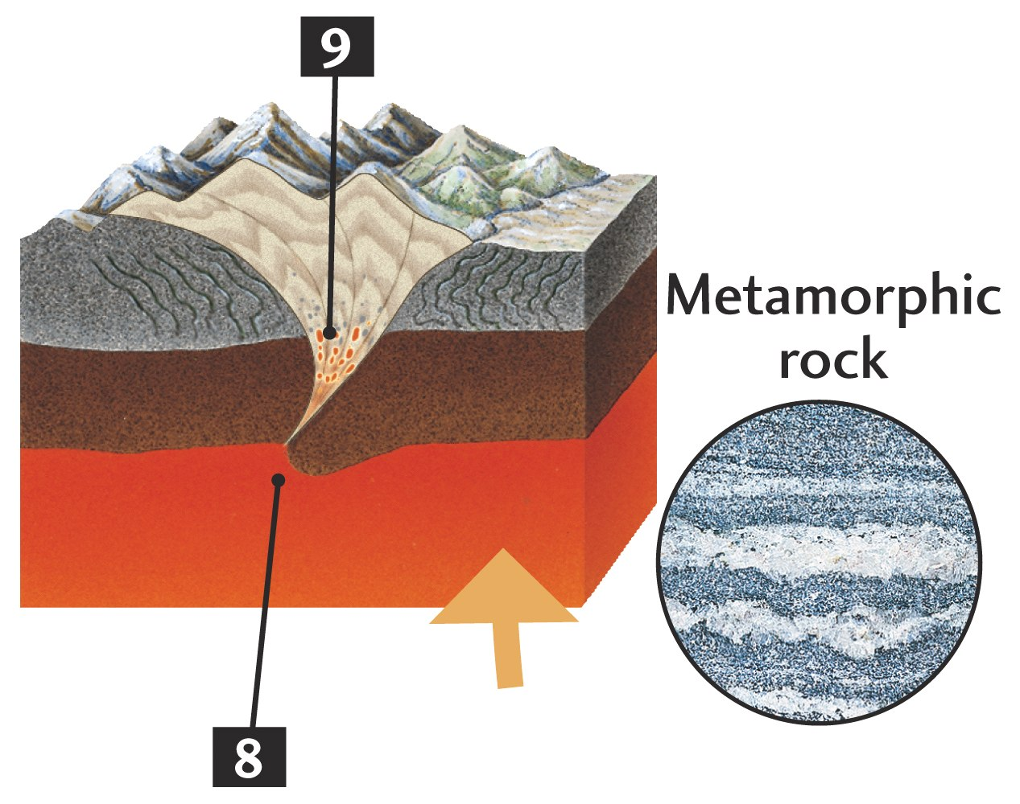

Slide 83
Which sequence of minerals is ranked in the correct order?
Calcite, apatite, fluorite,
Corundum,talc,apatite
Talc,apatite, corundum

