Slide 1
Take Notes
“Studies have shown that students are more satisfied with their final grades if they take and make their own notes during class”

Slide 2
Do you agree?
Yes
No

Slide 3
CHAPTER 1 GROTZINGER,JORDAN PRESS & SIEVER

Slide 4
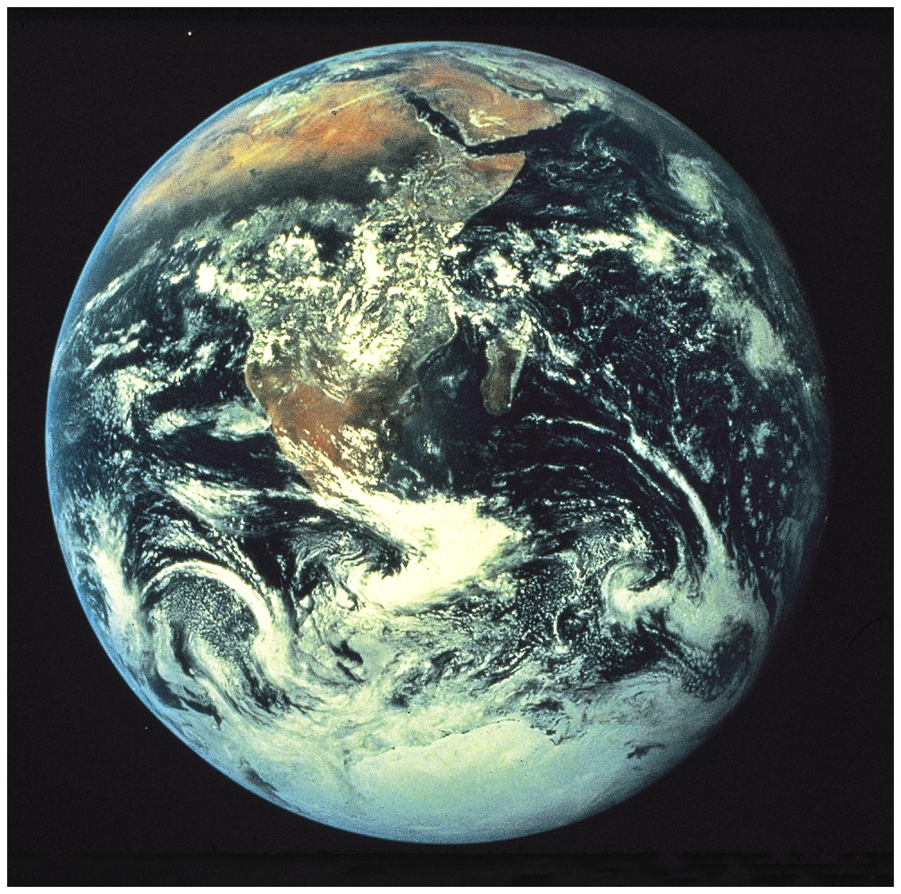

Slide 5
Lecture Outline
1. What is Earth Science?
2. The scientific method
3. The geologic record (Principle of Uniformitarianism) and geological processes
4. Discovery of a layered Earth
5. Earth as a system of interacting components

Slide 6
Lecture Outline
1. What is earth science?
2. The scientific method
3. The geologic record (Principle of Uniformitarianism) and geological processes
4. Discovery of a layered Earth
5. Earth as a system of interacting components

Slide 7
Earth (“Geo”) Scientists study:
rocks (petrology, mineralogy, thermodynamics)
plate tectonics (geodynamics)
the moon (petrology: Byerly)
Mars (physics : Suniti)
the physical evidence for the origin of the solar system (isotope geochemistry): Schaefer
chemistry of the solar system (Geochemistry)
physics of earthquakes (Geophysics)
biology, evolution (Paleoecology: Warny Vertebrate Paleo: Schiebout)
Ancient climate (Geochemists: Bao)

Slide 8
What professional will most likely study images sent back from Mars?
Astronomer
Geologist
Doctor
Engineer

Slide 9
The main difference between Earth Science and the rest of the sciences (except for astrophysics) is the use of “DEEP TIME”. For us a million years passes like a 15-minute break.
Geological processes can take place more slowly than people can notice. But because they run for extremely long periods of time their effects are great.
Water recharge in Baton Rouge takes 1000 years
Climate change has been accelerated by CO2 emissions
over the past 100 years.

Slide 10
Lecture Outline
1. What is Earth Science?
2. The Scientific Method
3. The geologic record (Principle of Uniformitarianism) and geological processes
4. Discovery of a layered Earth
5. Earth as a system of interacting components

Slide 11
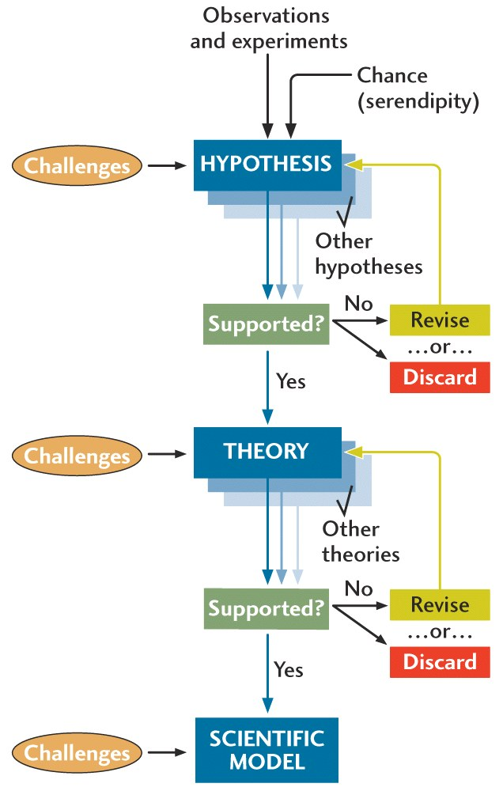
The “Scientific Method”

Slide 12
The “Real” Scientific Method-I
A ‘messy’ approach (Quinn, 2009)
A logical approach
A deductive reasoning approach (Starts with an OLD IDEA) within a body of knowledge
Starts with a need… to explain a trend….
a pattern…
Explains observations in a NEW WAY using one or several reasons. Reasons can be a thought experiment, a computer program, another predictable observation that “makes sense”
Verification that the explanation works by many experts

Slide 13
The “Real” Scientific Method-II
If you know the answer already that is not science
Science is an intellectual process
Barriers to science are human e.g., greed, dishonesty, fear of change, hunger for power, cultural conditioning, politics ...

Slide 14
Lecture Outline
1. What is Earth Science?
2. The scientific method
3. The geologic record . (Principle of Uniformitarianism) and geological processes
4. Discovery of a layered Earth
5. Earth as a system of interacting components
6. Overview of geologic time

Slide 15
Principle of Uniformitariansim
“The present is the key to the past”
— James Hutton

Slide 16
“Extended” Principle of Uniformitariansim
Natural laws do not change but rates, intensity and location within the universe where these processes occur may vary.

Slide 17
Examples of physical processes
Radioactive decay (a Theory)
Gravitational attraction (a Theory)
Electromagnetic behavior (a Theory)

Slide 18
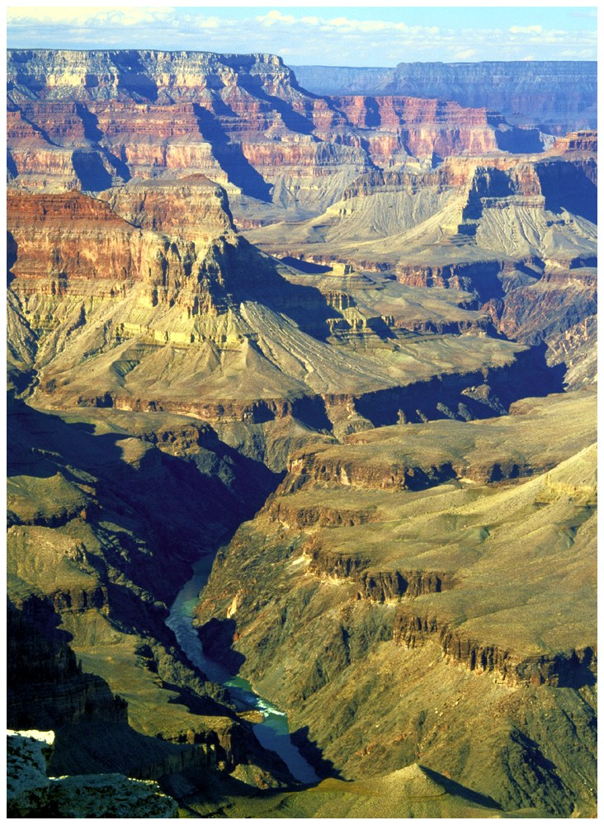
Some Geologic Events are Slow
The Grand Canyon
It took more than 250 million years to deposit this sequence of rocks.
The rocks at the bottom of the canyon are about 2 billion years old.

Slide 19
Some Geologic Events are Rapid
Meteor Crater
This feature (~2 km across) formed in less than one minute about 50,000 years ago

Slide 20
“The chances that a bolide 1-2 km in diameter will hit the earth by 2880 A.D. is 1:300”

Slide 21
Rivers on Titan
NASA

Slide 22
Write down what you think this is? I have one from the Atacama desert of Chile.

Slide 23
Martian ventifact (NASA)

Slide 24
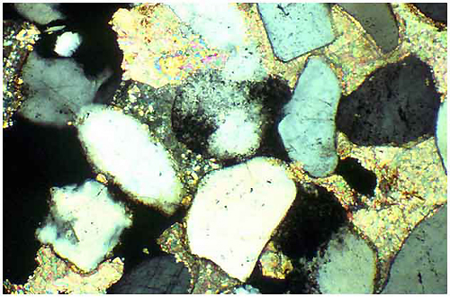
Some Geologic Investigations are Microscopic
1 mm
Features less than 0.1 mm can give important information about the history of many rocks.

Slide 25
Some Geologic Investigations are Microscopic
NASA

Slide 26
Lecture Outline
1. What is Earth Science?
2. The scientific method
3. The geologic record (Principle of Uniformitarianism) and geological processes
4. Discovery of a layered Earth
5. Earth as a system of interacting components
6. Overview of geologic time

Slide 27
Seismic waves – illuminate Earth’s interior
• Compression and shear waves behave differently and are bent or absorbed at layer (chemical) boundaries within the Earth
Earth’s interior is layered according to density
• Surface rock density is less than 3.5 g/cm³
• Whole Earth density is 5.5 g/cm³
• Core density must be about 8 g/cm³

Slide 28
Composition of the Earth (70%)
Key earth elements in the crust: O,Si
Key earth elements in the earth: Fe, O, Si, Mg

Slide 29
Chemical Composition of Earth
Whole Earth:
Fe+O+Si+Mg = 93%
Crust:
O+Si+Al = 82%
Fig. 1.7

Slide 30
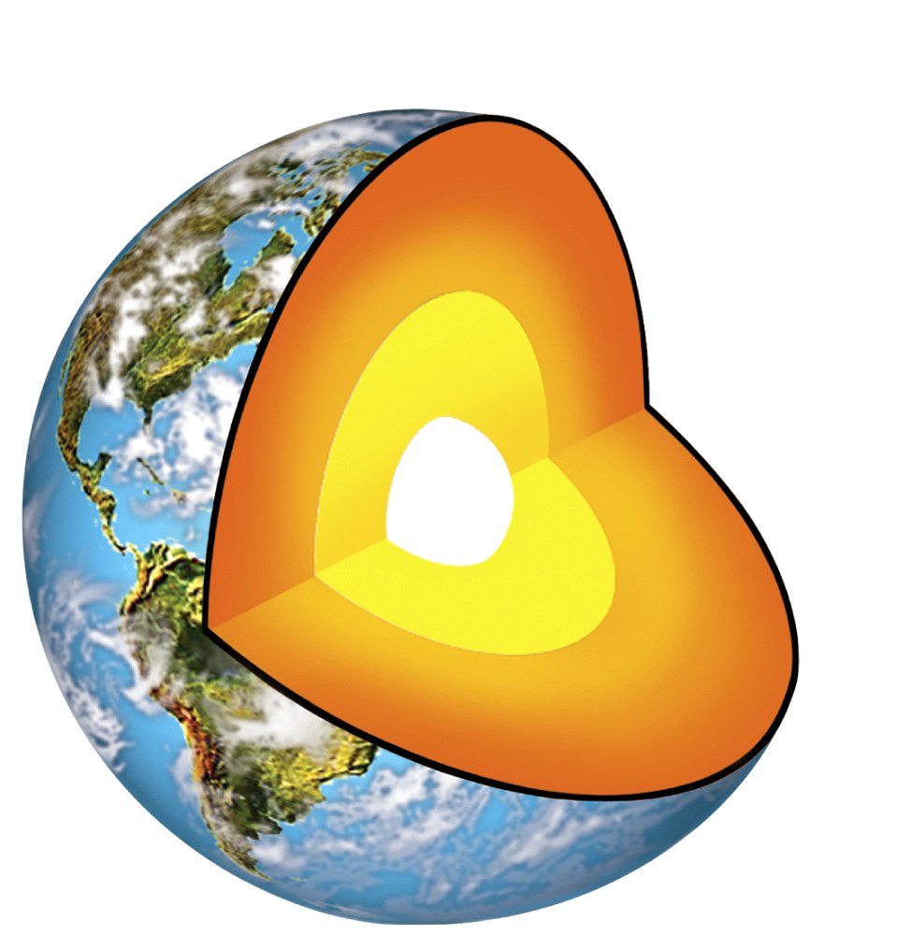

Slide 31
Crust

Slide 32
Mantle
Crust

Slide 33
Mantle
Crust
Liquid iron
outer core

Slide 34
Mantle
Crust
Liquid iron
outer core
Solid iron
inner core

Slide 35
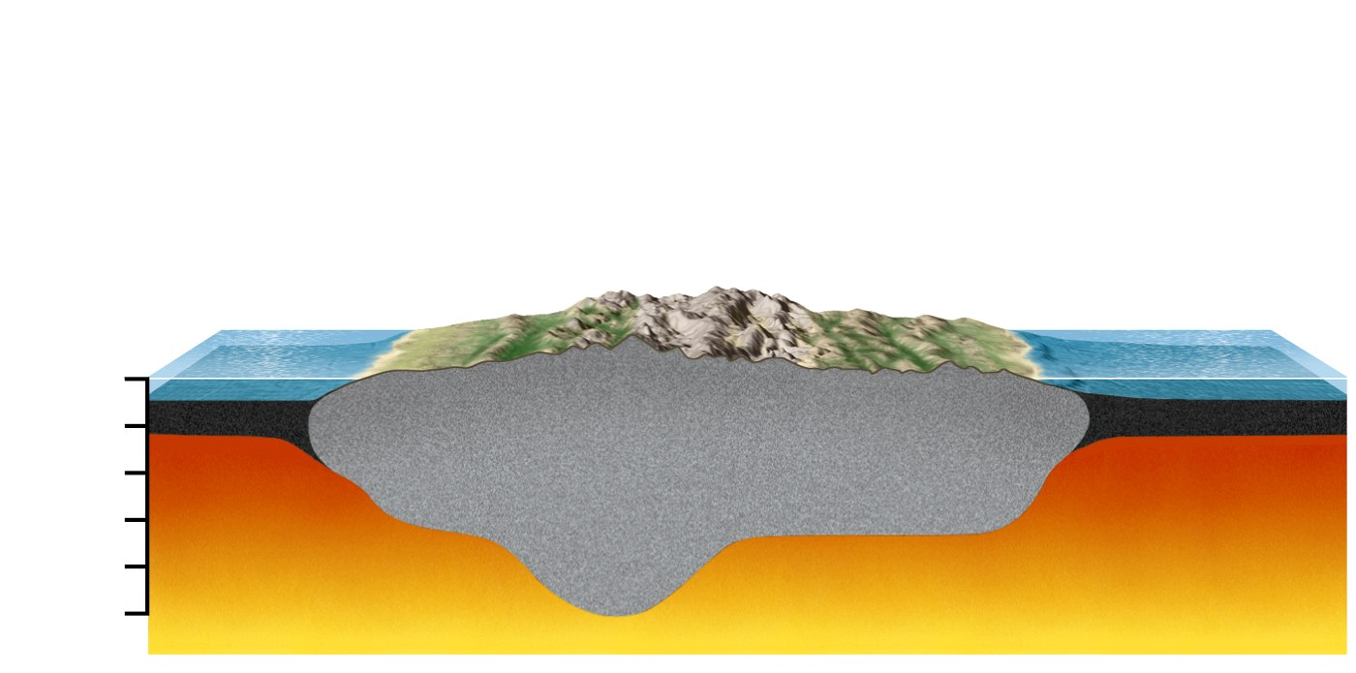
The crust: continents are made of lighter rock and thus literally “float” on material of higher density.
0 (km)
Oceanic crust
(3.0 g/cm³)
10
20
Continental crust
(2.8 g/cm³)
30
Mantle
(3.4 g/cm³)
40
50
Moho
discontinuity
Horizontal distance not to scale

Slide 36
Less dense continental
crust floats on denser
mantle.
10
20
30
40
50

Slide 37
What is your height?
Over 6 feet tall
Over 5 1/2 feet tall
Over 4 ½ feet tall

Slide 38
Composition of the Earth
What is responsible for the distribution of light and dense elements by depth?
How did they get there if the Earth was solid?

Slide 39
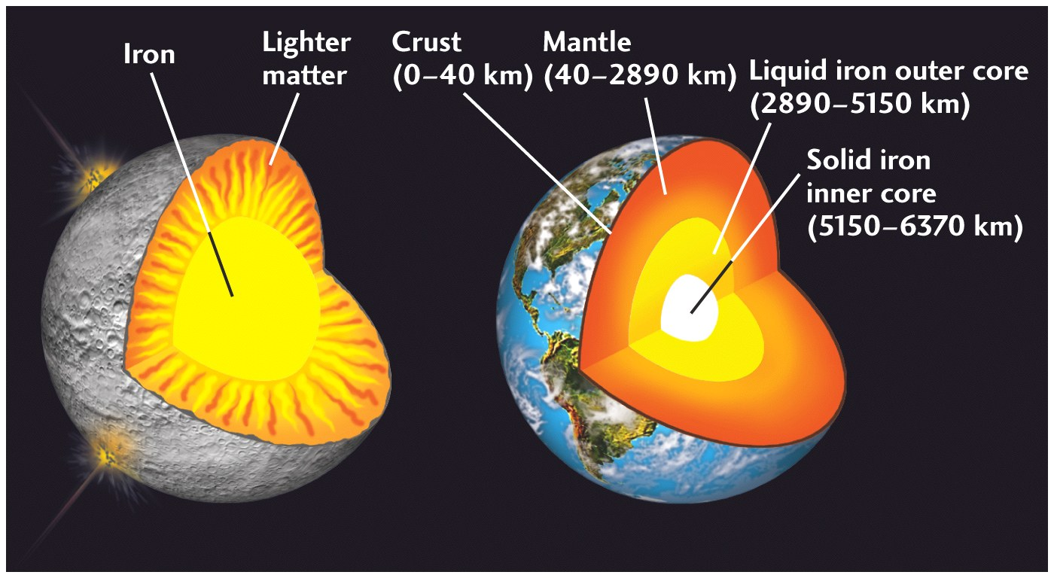
Global Chemical Differentiation

Slide 40
Lecture Outline
1. What is Earth Science?
2. The scientific method
3. The geologic record (Principle of Uniformitarianism) and geological processes
4. Discovery of a layered Earth
5. Earth as a system of interacting components

Slide 41
Earth as a Group of Interacting Systems
Atmosphere, Hydrosphere, Lithosphere, Asthenosphere, Deep Mantle, Inner Core interact
e.g. Volcanic degassing creates warm periods in Earth’s history
The oceans buffer greenhouse gases
The Core’s magnetic field allows migration of fish and birds

Slide 42
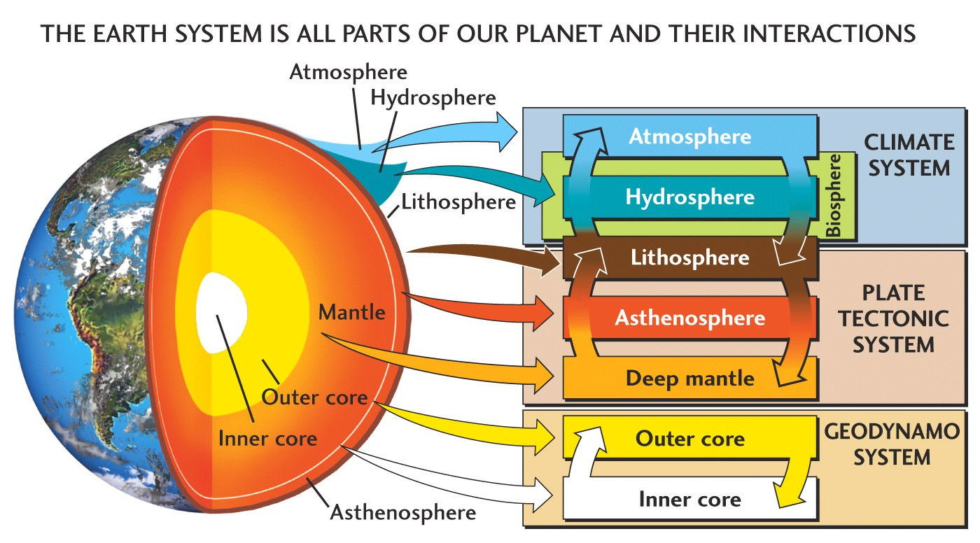
Major Components of the Earth System
Fig. 1.10

Slide 43
END OF CHAPTER 1

