Slide 1
Solar System History Ch 9
Big Bang Theory
Solar Nebula
Planetesimals
Terrestrial Planets
Space missions

Slide 2
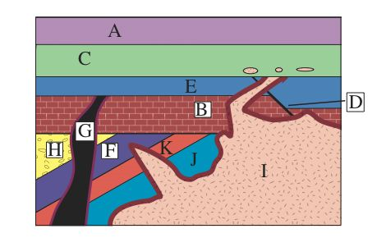
Which is the correct sequence? (Oldest to youngest)
J-K-F-G-H-B
J-K-F-H-B-G-E-D
I-J-K-F-H-B-G
J-K-F-D-I

Slide 3
Big Bang Hypothesis
13-14 billion years ago, all matter and energy was concentrated into a single, inconceivably small (and very dense) point. This hypothesis stems from a mathematical solution to the problem
This hypothesis was tested through the Doppler shift in stellar spectrum, which implied that matter was flying apart in all directions throughout the universe

Slide 4
The Hubble Telescope
Can detect faint light that has travelled for billions of years…from the start of the current universe

Slide 5
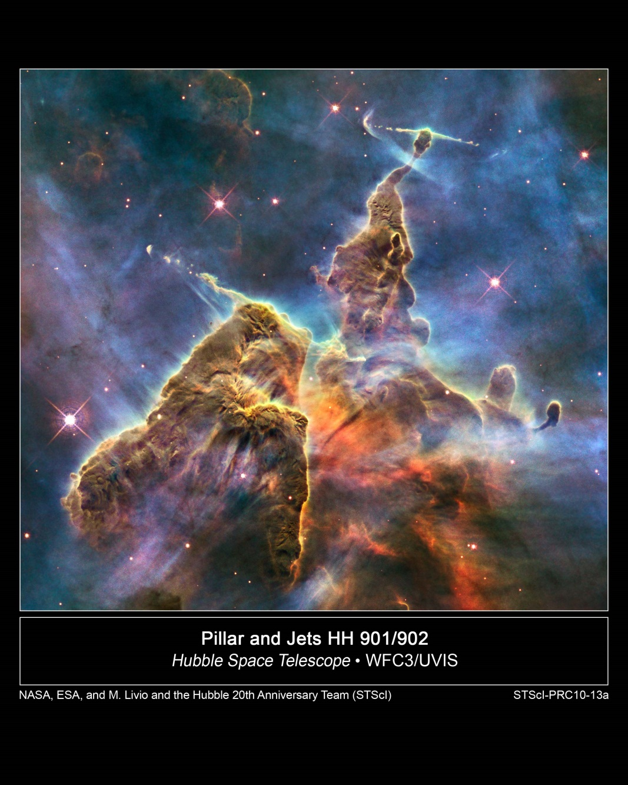
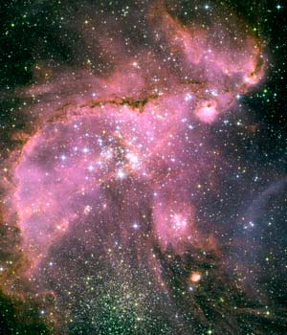
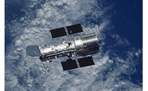
Pretty Pictures
http://hubble.nasa.gov/hubble20th_lg.jpg
http://hubblesite.org/newscenter/archive/releases/2005/2005/35/image/a/format/web/

Slide 6
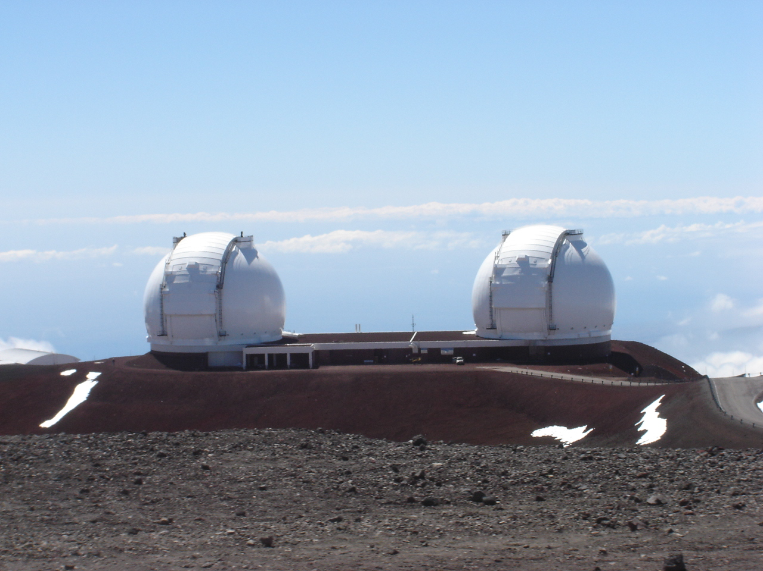
Earth Based Telescopes

Slide 7
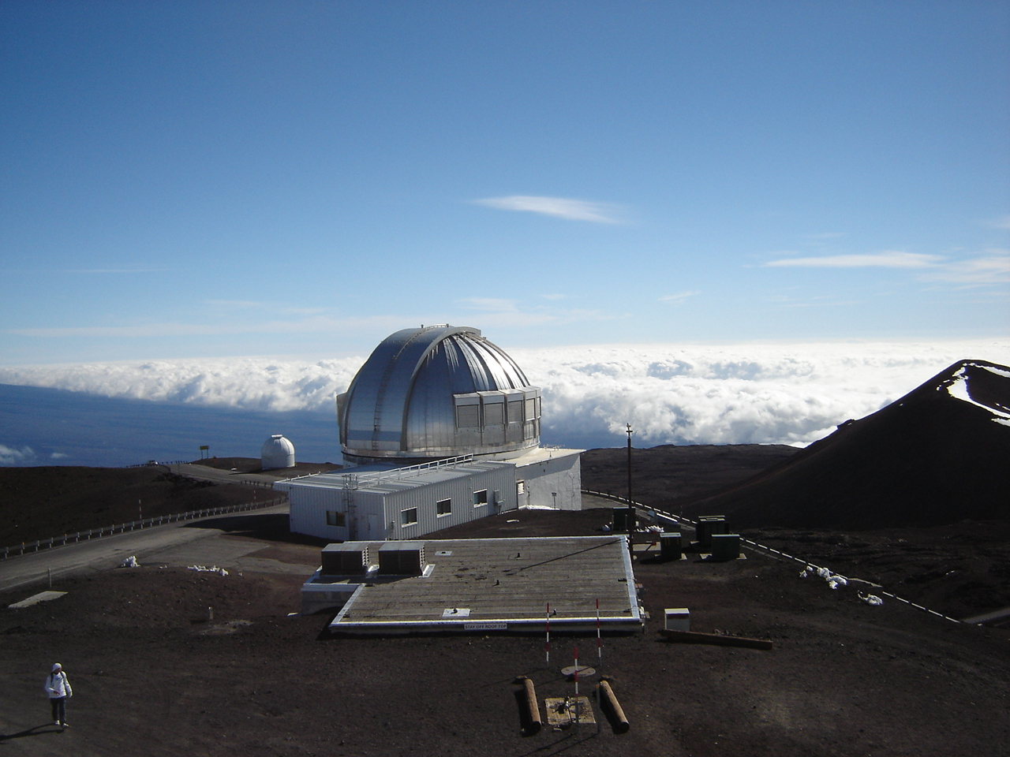
Earth Based Telescopes

Slide 8
Nebular Hypothesis and the origin of our Solar system
Solar system is older than 4.56 billion years
Gravity is the cause of “condensation” of the cloud
Cloud contracted WHILE spinning ever faster
H and He are the most common elements
H and He collected to form fusion reactions

Slide 9
Nebular Hypothesis and the origin of our Solar system
Fusion is more energetic than atomic fission, but requires greater pressures
Hydrogen “fuel” burns to create He

Slide 10
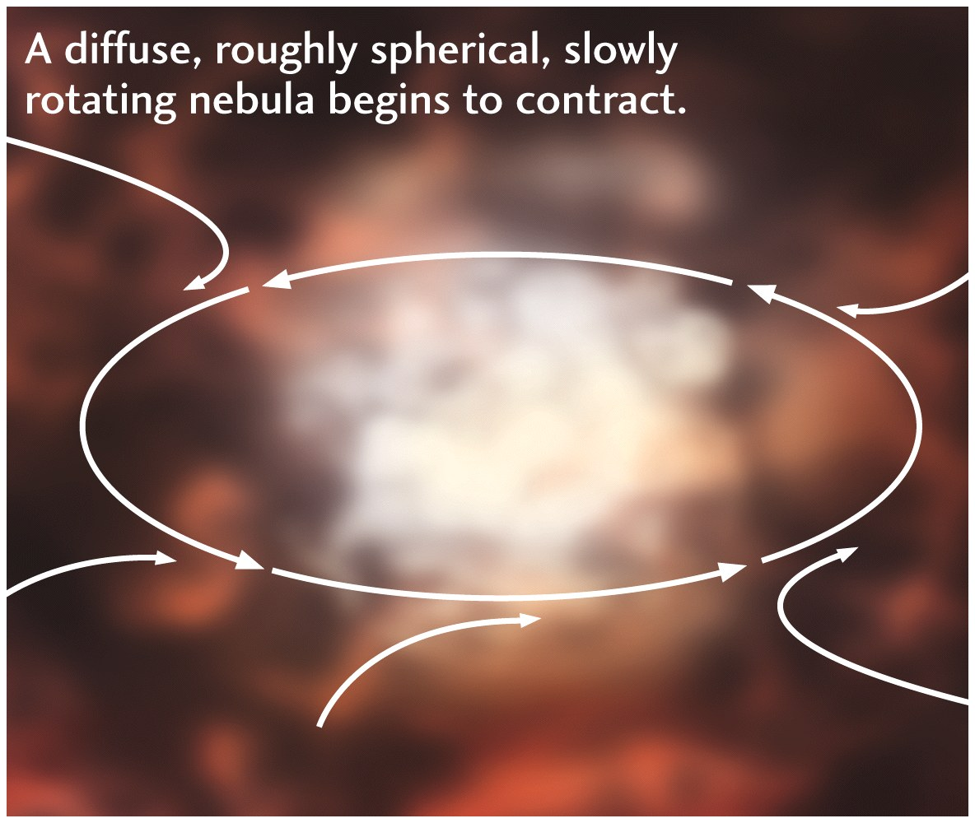

Slide 12
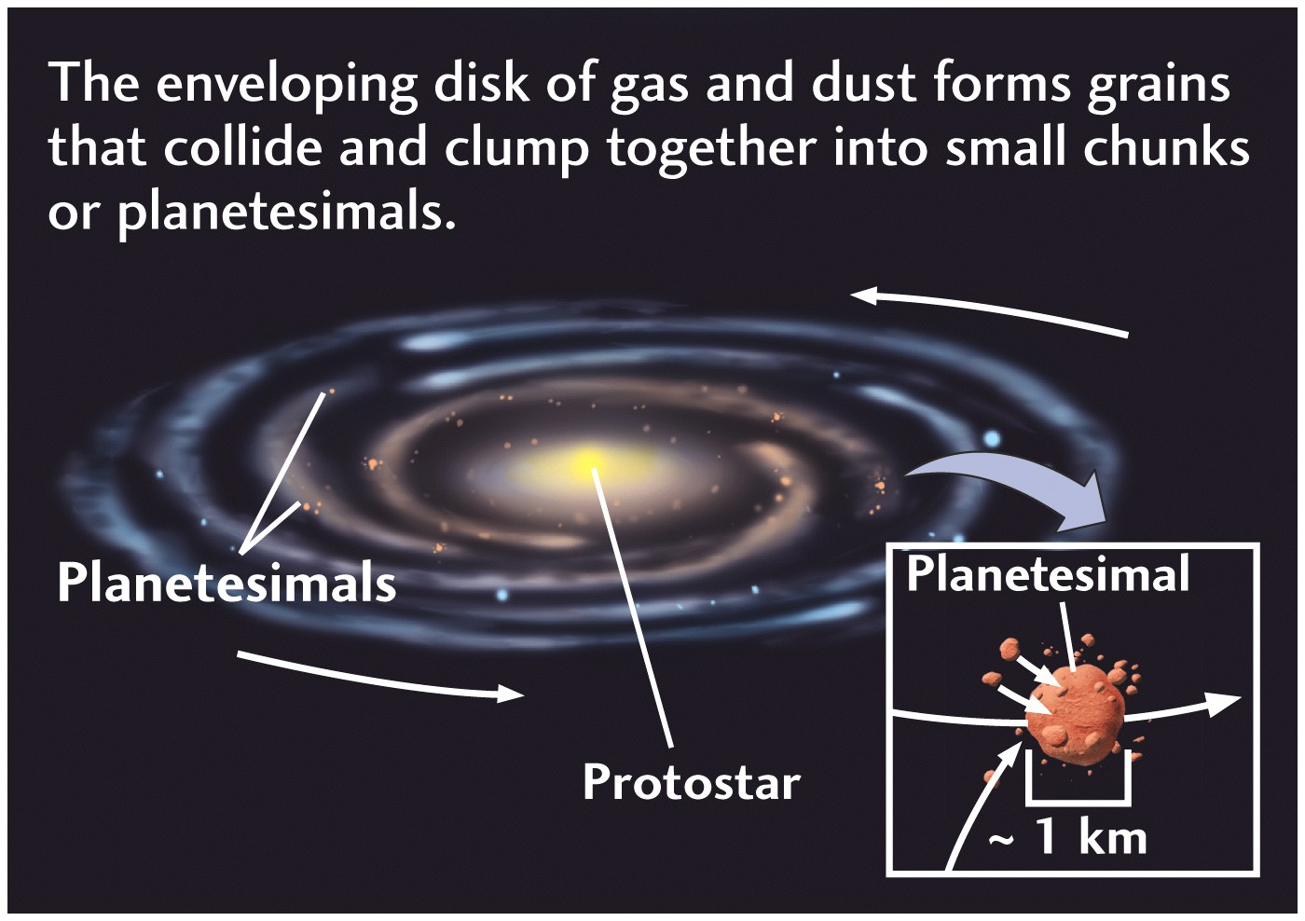

Slide 13
Nebular Hypothesis and the origin of our Solar system
Planetesimals (early-stage, immature, small planets) on the periphery of this contracting, spinning dust cloud began to clump together locally.
Denser materials fell closer to the sun
Less dense materials (gases) could escape to greater distances from the sun e.g. Jupiter

Slide 14
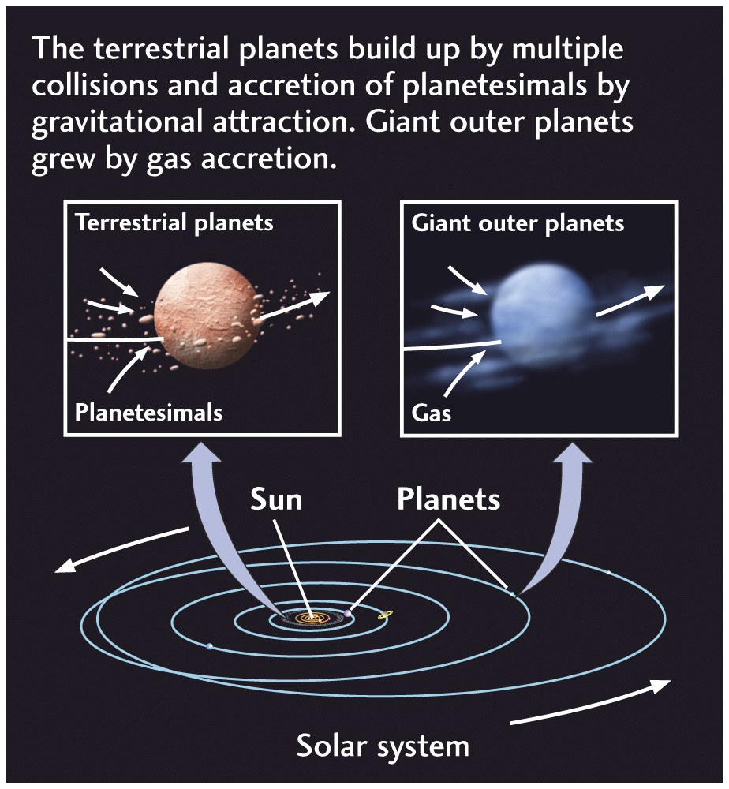
Fig. 1.3

Slide 15
Small Bodies of the Solar System
Asteroids: > 300 in the asteroid belt 100 km in size
Meteorites: objects which strike the Earth
Comets: masses of ice, dust
Notes:
Initially it was thought that asteroids were the remains of a large planet broken apart. However, it is now thought that these are pieces that were never accreted
Comets form in the depths of the solar system and “melt” as they get closer to the sun.
All of these objects have orbital paths that depend on their proximity to the sun, and their mass
Near earth objects…

Slide 16
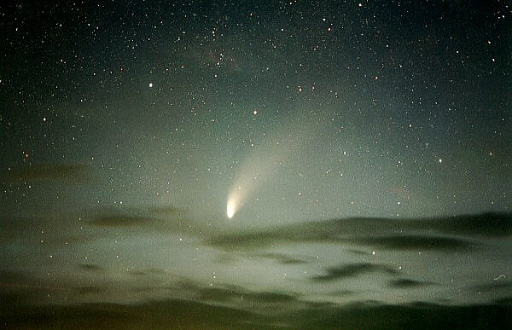
Hale Bopp Comet
http://www2.jpl.nasa.gov/comet/gif/dru61.jpg

Slide 17
Nebular Hypothesis and the origin of our Solar system
Mercury, Venus, Earth, Mars are the terrestrial planets
Rocky, with iron core
Also referred to as the inner planets
Jupiter, Saturn, and Neptune are the gaseous planets
Have a rocky core
Also referred to as the outer planets

Slide 18
Size of the Planets
Fig. 9.3
Notes:
Outside of Pluto is the Kepler belt which is composed of asteroids of similar composition and size to Pluto.

Slide 19
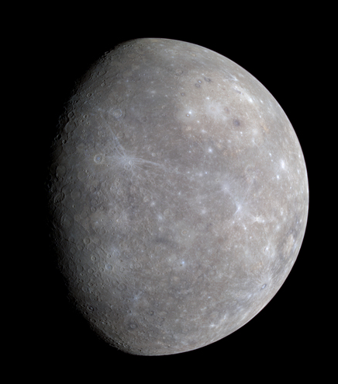
Mercury
Similar topography to the moon
Unlike the moon, Mercury has cliffs
Not tectonically active
No atmosphere
http://solarsystem.nasa.gov/planets/profile.cfm?Object=Mercury
Notes:
When a crater forms, it is there forever

Slide 20
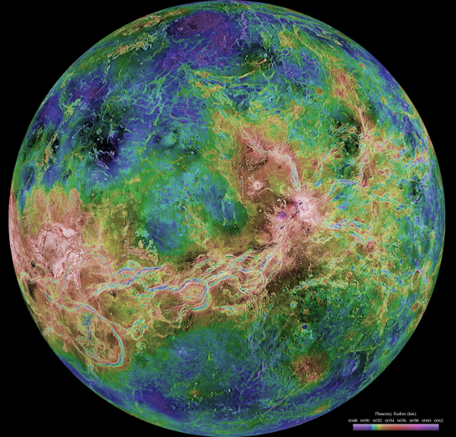
Venus
Thought to have volcanism
Different convection cells different plates
Thick atm. Causes a runaway greenhouse
http://solarsystem.nasa.gov/planets/profile.cfm?Object=Venus
Notes:
Has many small dome interpreted to be volcanoes
Crust is thought to be thin “frozen” segments
Resurfaced by volcanism about 500 million years ago

Slide 21
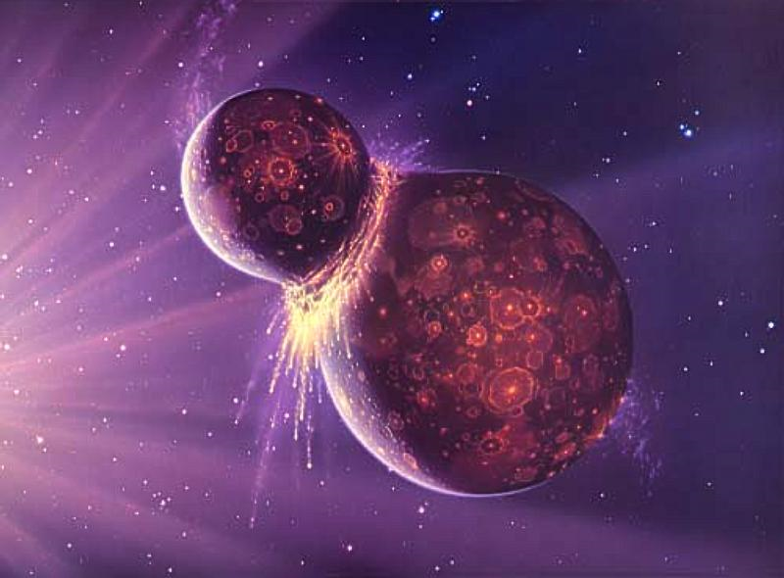
Moon formation
Planetesimal the size of Mars collided with Early Earth
Formed during the “heavy bombardment” period
http://starchild.gsfc.nasa.gov/docs/StarChild/questions/question38.html
Notes:
Image 9.4 from text book
Impact of the planetesimal tilted the Earth’s orbital plan 23 degrees
Debris from the impact aggregated to form the moon

Slide 22
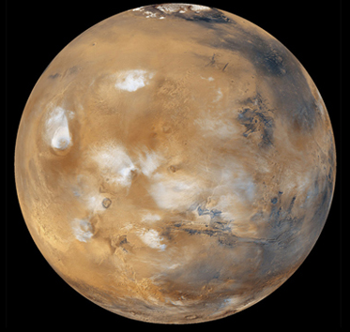
Mars
Red due to iron oxides
Similar surface features and density
Olympus Mons
No global magnetic field
http://solarsystem.nasa.gov/planets/profile.cfm?Object=Mars
Notes:
Olympus Mons: 25 km high (tallest in the solar system)
Has a spotty magnetic field…thought to be the remnants of the previously active global magnetic field
Mars experiences season (like Earth) due to a tilted rotational axis
Volcanism as recent as 1 to 2 billion years ago

Slide 23
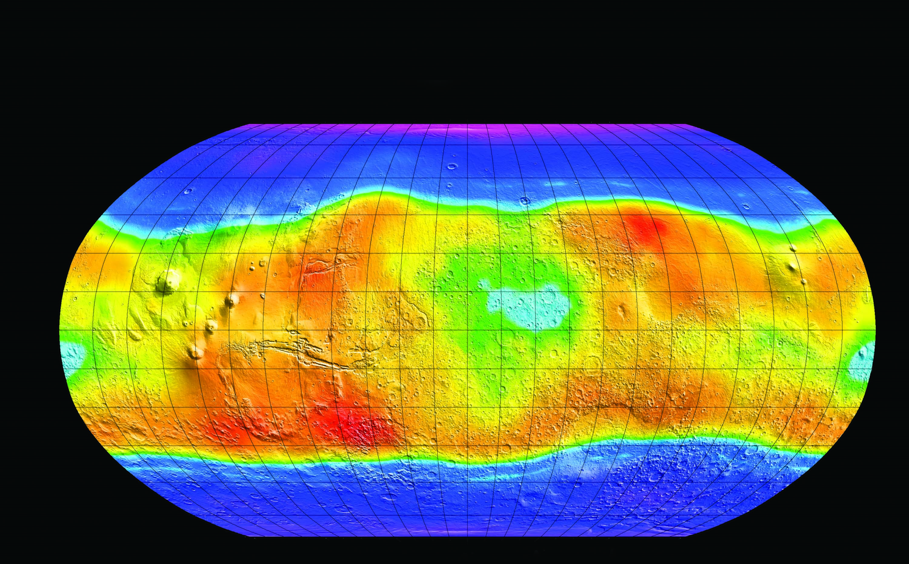
http://solarsystem.nasa.gov/docs/MOLA-Mars%20Water_map_wblack.jpg
Blue areas are frozen water
Notes:
False color image showing frozen water below the surface of Mars

Slide 24
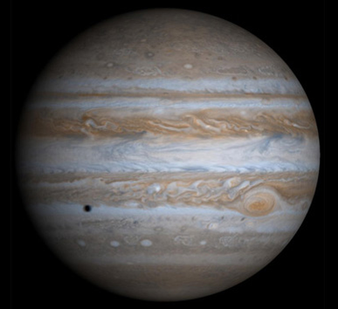
Gas Giants
Jupiter, Saturn, and Neptune
Typically lots of moons
Mostly gas
Hydrogen and helium
Cold
Galileo satellite
http://solarsystem.nasa.gov/planets/profile.cfm?Object=Jupiter
Notes:
Galileo satellite sampled the atm. Of Jupiter
July 13 1995 sampled the atm

Slide 25
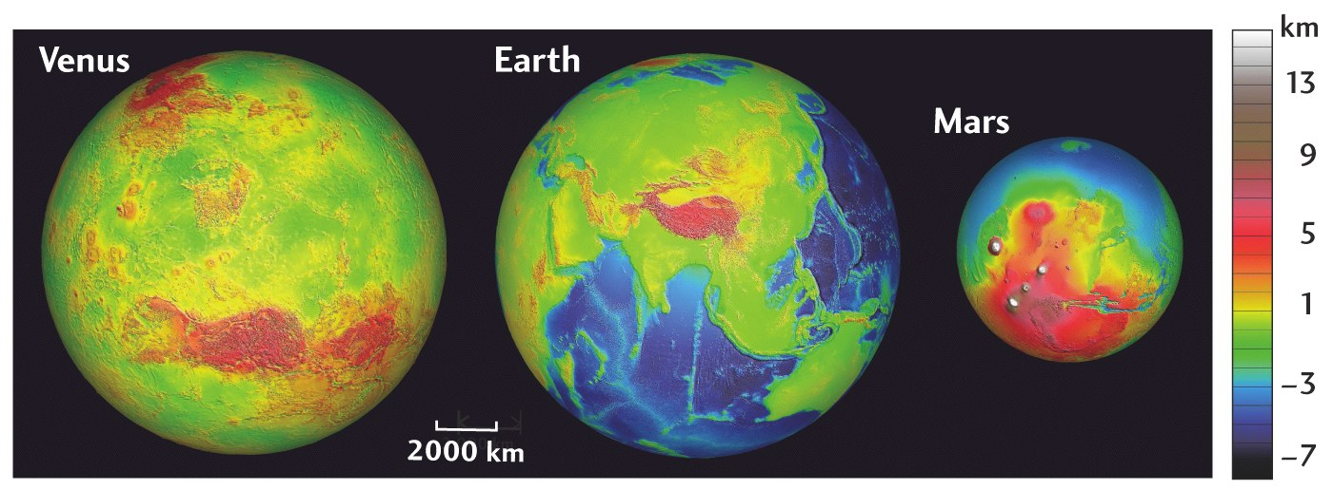
Size and Relief of Venus, Earth, Mars
Fig. 9.7
Notes:
Why do each of these planets have different surface features?

Slide 26
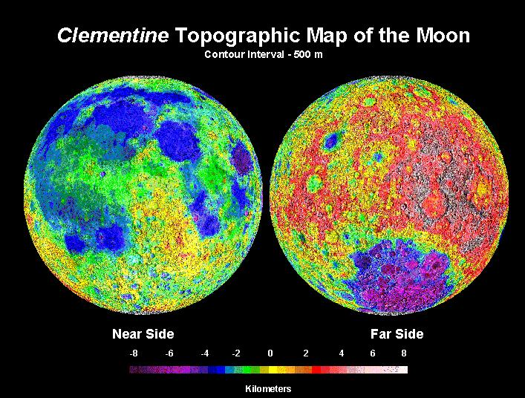
Moon topography (FROM http://www.ep.sci.hokudai.ac.jp/~mosir/work/2002/kamokata/lecture/moon/moon_html/moon_exploer/images/Topography.jpg
Notes:
Why are there so many impact creators on the moon, but not on the Earth?
Plate tectonics have stopped on the moon, while they are still active on the Earth. This has resulted in a much younger surface on the Earth
Erosion has also played a role in this as well.

Slide 27
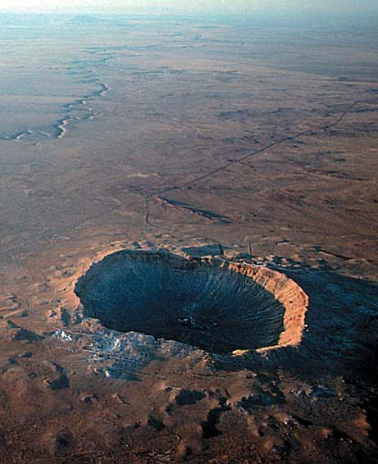
http://www.google.com/imgres?imgurl=http://news.nationalgeographic.com/news/2005/03/images/050310_meteorcrater2.jpg&imgrefurl=http://news.nationalgeographic.com/news/2005/03/0310_050310_meteorcrater.html&h=566&w=461&sz=33&tbnid=M8g4ulBrF9JNyM:&tbnh=249&tbnw=203&prev=/images%3Fq%3Dmeteor%2Bcrater%2Bpictures&zoom=1&q=meteor+crater+pictures&usg=__pVBzhHolZMHgV58SI0li4_uEiqs=&sa=X&ei=h3k7TdrDL5DpgAfco4SqCA&ved=0CBsQ9QEwAg

Slide 28
Differentiation
Transformation of random chunks of primordial matter into a body whose interior is divided into concentric layers
Reason why the Earth has a core, crust and mantle
Notes:
Light objects float to the top and heavy objects sink to the middle
Core: dominated by iron, nickel
Crust: light elements such as oxygen, silicon
Mantle: 2900 km thick, ultramafic silicate rocks with more magnesium and iron than crustal silicates

Slide 29
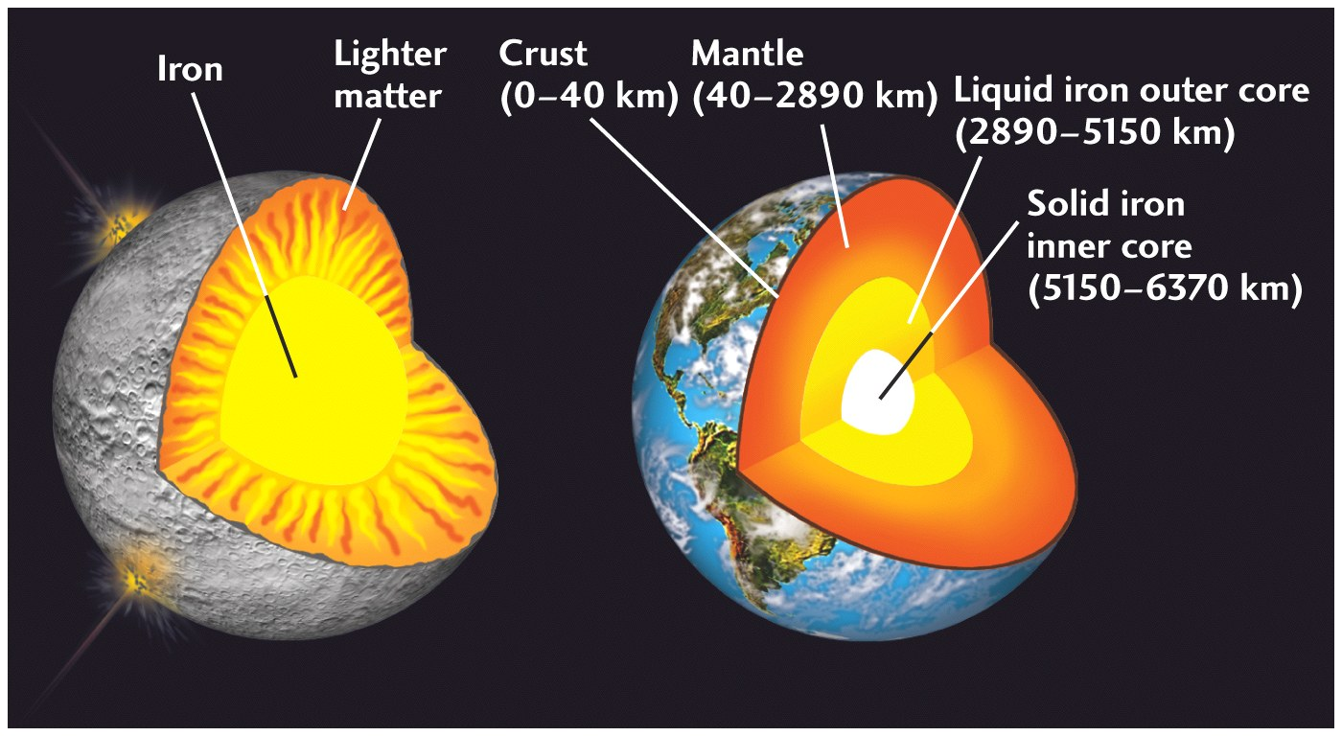
Differentiation

Slide 30
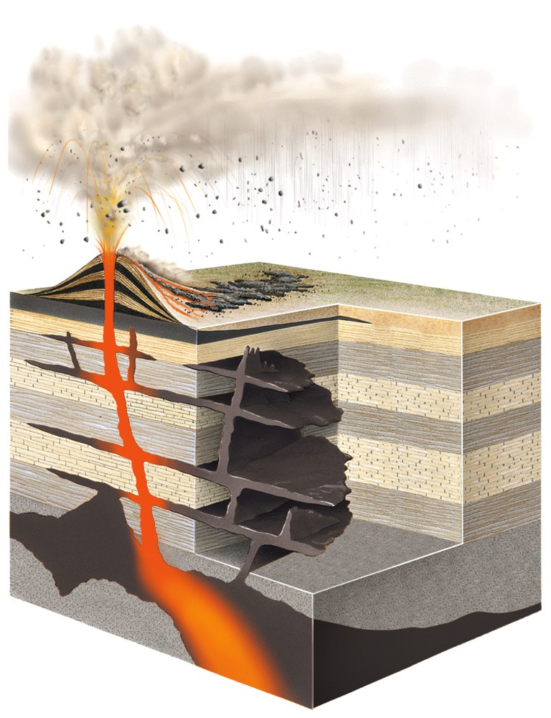
Atmosphere Evolution
Sources of water
Bolides
Water rich minerals
Oxygen evolution
Chapter 11

Slide 31
Evolution of the Atmosphere
6H₂O + 6CO₂ → C₆H₁₂O₆ + 6O₂
Produce oxygen from a carbon dioxide rich environment by photosynthesis
Two notable periods of O₂ rise
Around 2.4 and 0.8 billion years ago
Notes:
O2 increase is thought to be the result of microbes and photosynthetic plants. However this area is still being investigated.
Chapter 11 has more information on microorganisms

Slide 32
How old is the Earth?

Slide 33
How old is the Earth?
Younger than the planetesimals 4.56 by

Slide 34
How old is the Moon?
Oldest moon rocks are 4.47 billion years
…the moon started to form around…4.5 billions years ago
Moon is dominated by:
Lunar highlands
Lots of craters
Lunar maria
Few craters
Notes:
Highlands cover 80%
Maria are the dark areas of the moons and are low lying plains
What does the amount of craters say about the age

Slide 35
What was happening between 4.56 and 4.5 by ?
(1) Accretion to create the first earth… a “magma” earth (100 million-year-period

Slide 36
What happened to the Earth at 4.5 by ?
Earth was hit by a giant bolide (before 4.47 by) that re-melted it and led to the formation of the moon (see earlier slide)

Slide 37
What was happening between 4.5 and 4.4 by ?
Mainly cooling and differentiation
Gravity pulled the denser materials toward the core when the Earth was still molten

Slide 38
Rock/mineral Ages
Australia has 4.4 billion year old zircons
Central continental regions have old rocks
Roughly 4.0 billion years old
Canadian shield, Australia, and Africa

Slide 39
Mars Rovers
Launched 1997, landed 2004
Spirit
Gusev Crater (160 km)
Thought to be a previous lake
Also studied a volcanic plain
Opportunity
Meridiana Planum
Large amount of hematite
Studied first sedimentary rock on another planet
Notes:
Two rovers were designed to last 3 months and drive no more than 300 meters
However they are still going strong(ish) after 7 years
Temperatures as cold as -90 degrees F
One is still moving the other appears to be non-responsive
Meridiana Planum: plains of meridiani
Opportunity making atm measurements

Slide 40
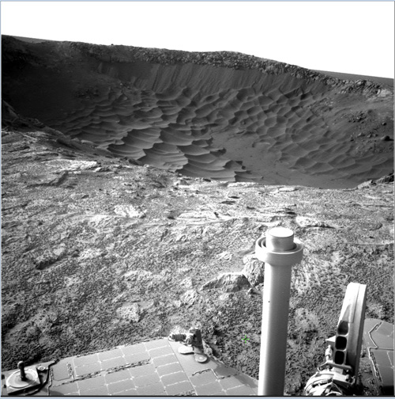
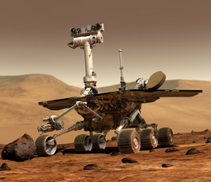
Mars Rovers
http://marsrovers.nasa.gov/home/
http://marsrovers.nasa.gov/gallery/press/opportunity/20110120a/SolsB2453-54_Pancam_L257_atc_br.jpg
Notes:
Spirit is silent
Opportunity still moving
Color image of Santa Maria Crater
Driven 16.6 miles in its seven years
Drove 4.6 miles last year
Was in a “conjunction period” earlier this year but will move onto Endurance crater 14 miles in diameter and 4 miles away

Slide 41
Cassini Mission to Saturn
Cassini-Huygens mission
Launched Oct. 1997
Dec. 2004 Huygens lander released
Jan. 2005 Huygens reached titan
Titan has its own atmosphere
Notes:
Cassini is the orbiter
Huygens was the lander
July 2004 flew through Saturn’s rings
Titan was discovered to have drainage networks, and volcanoes
Liquid methane…not water

Slide 42
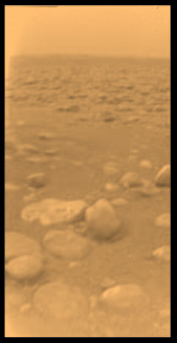
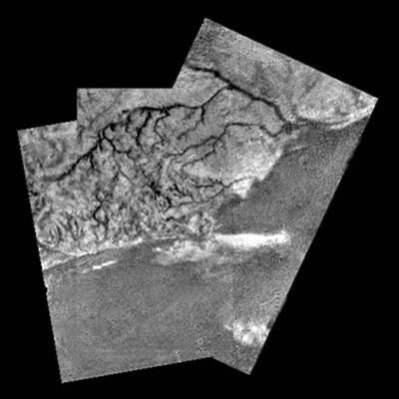
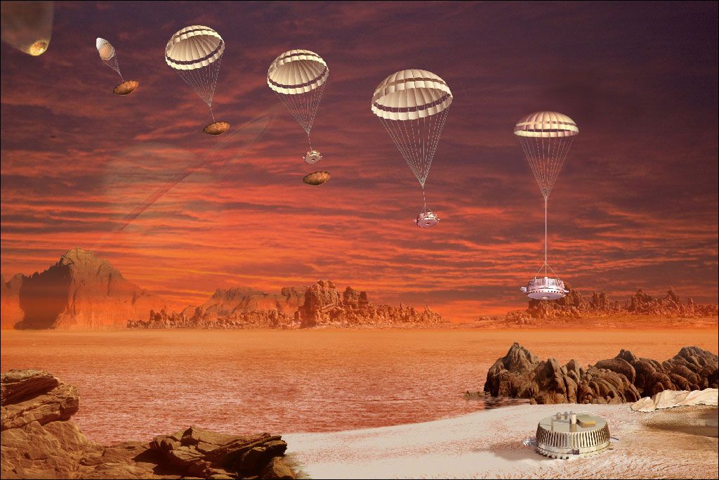
Titan Pictures
http://www.esa.int/esa-mmg/mmg.pl?b=b&type=I&mission=Cassini-Huygens&single=y&start=90&size=b
http://www.esa.int/esa-mmg/mmg.pl?b=b&type=I&mission=Cassini-Huygens&single=y&start=45&size=b
http://esamultimedia.esa.int/images/Science/CONFERENCE/Huygens/Lebreton_Huy_descent_seq_H.jpg

