Slide 1
Chapter 2
Key concepts:
Continental drift
Seafloor spreading
Convergent plate boundary
Divergent plate boundary
Transform-fault plate boundary
Why do plates move?
Magnetic anomalies
Pangaea

Slide 2
Which force(s) create earthquakes and volcanoes?
Gravity
Electromagnetism
Nuclear forces

Slide 3
Plate Tectonics
The unifying theory of the Earth sciences
The outer portion of the Earth is made up of about 20 distinct “plates” (~ 100 km thick), or lithosphere which move relative to each other
This motion is what causes earthquakes and makes mountain ranges

Slide 4
Continental Drift
The concept that large-scale horizontal movements of the outer portions of the Earth are responsible for the major topographical features such as mountains and ocean basins.
Proposed by Alfred Wegner in 1912 based on his observation of drifting sheets of ice.

Slide 5
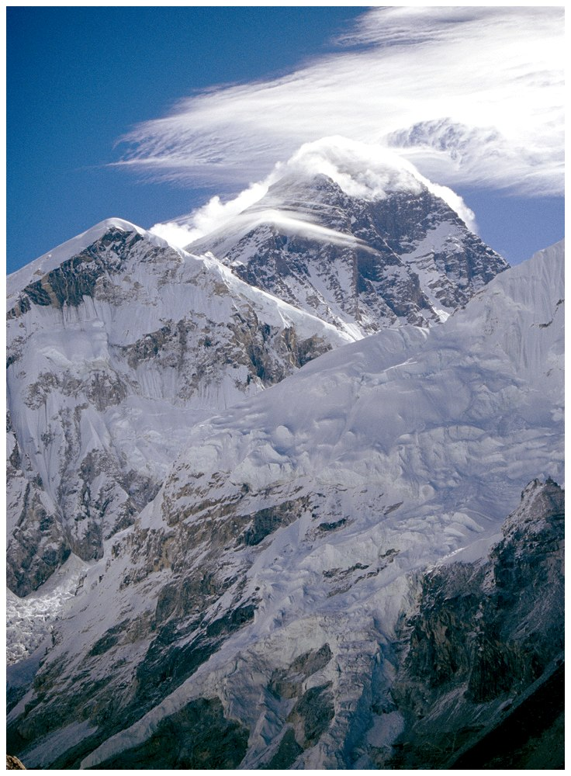

Slide 6
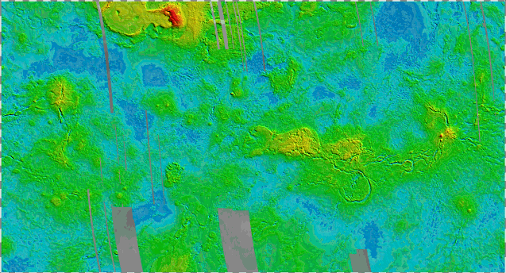
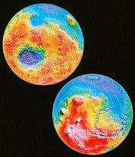
The topography of Mars by NASA and Venus from tes.asu.edu/images/SOL_SYST/VENUS/venus_topography.gif
Venus
Mars

Slide 7
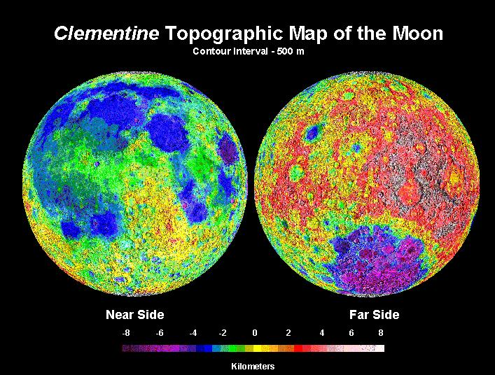
Moon topography (FROM http://www.ep.sci.hokudai.ac.jp/~mosir/work/2002/kamokata/lecture/moon/moon_html/moon_exploer/images/Topography.jpg

Slide 8
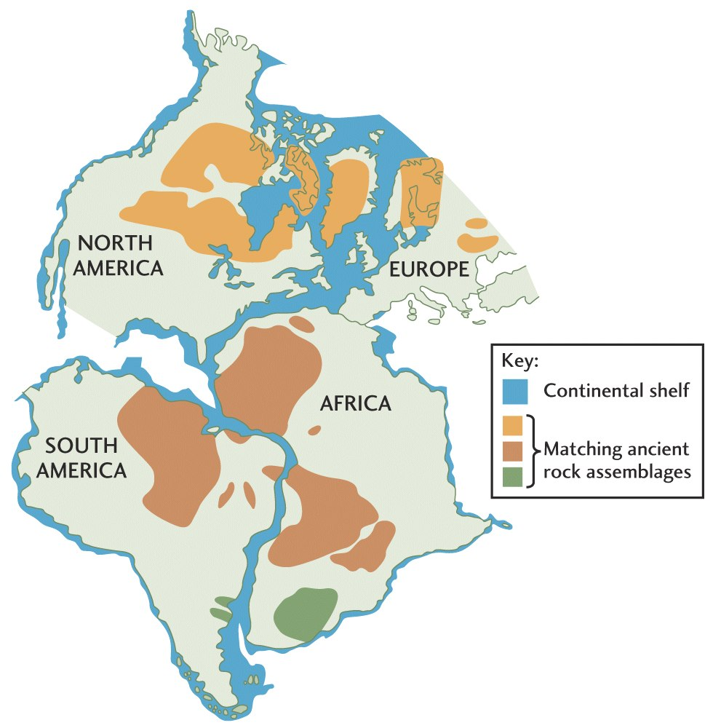
Geographic Fit of
the Continents
One of the first pieces
of evidence used to
argue for
continental
drift
Suggested that all continents were once together in a single supercontinent called Pangea
Fig. 2.1

Slide 9
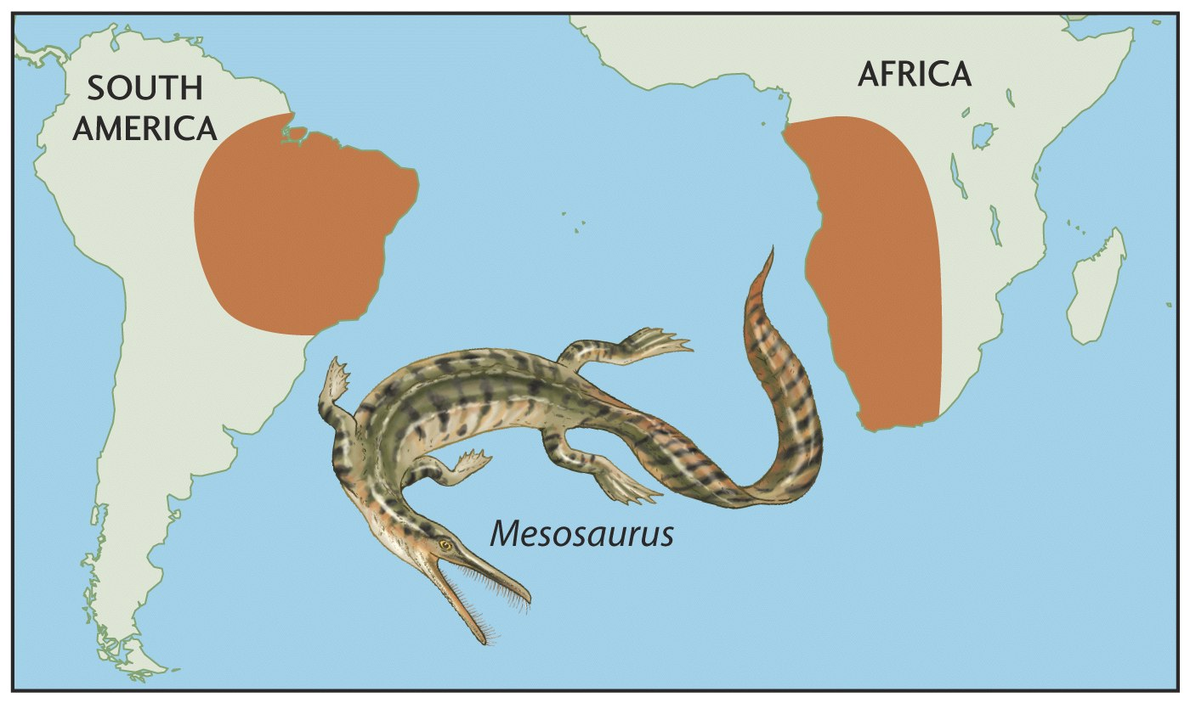
Geology and Paleontology Matches on Opposite Sides of the Atlantic
Fig. 2.2

Slide 10
The Rejection and Acceptance of Continental Drift
Rejected by most geologists.
New data after WWII led to the “plate tectonic revolution” in 1960’s.
Now embraced by essentially everybody.
Today’s geology textbooks radically different than those 40 years ago.

Slide 11
Plate Tectonics
Integrates evidence from many branches of science
First suggested based on evidence from geology and paleontology
Fully embraced after evidence from geophysics

Slide 12
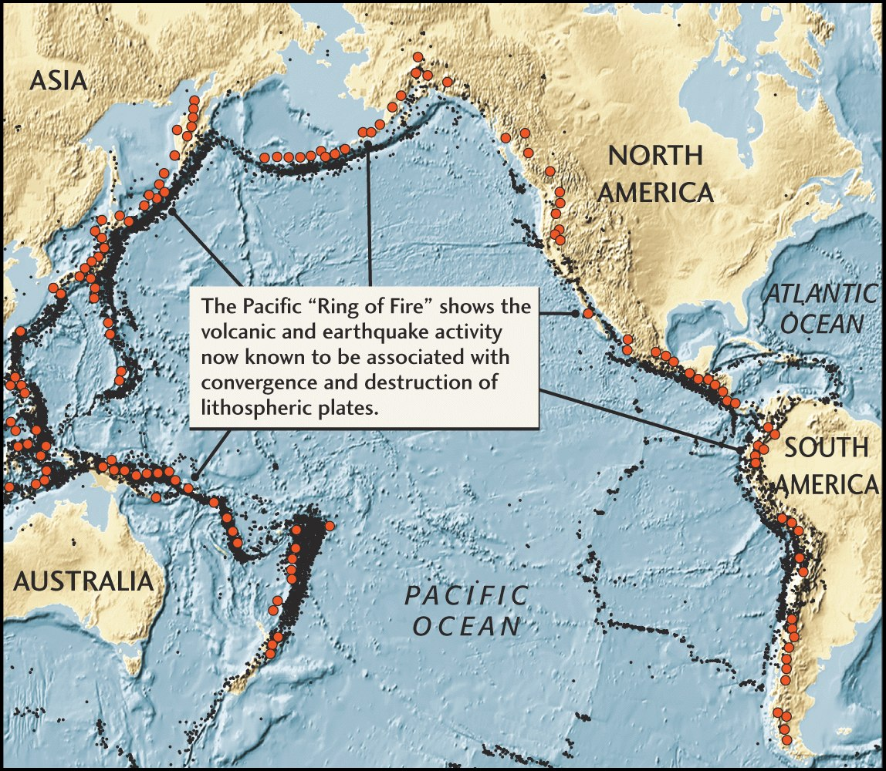
Plate Tectonics Predicts Location of Earthquakes and Volcanoes
Fig. 2.4

Slide 13
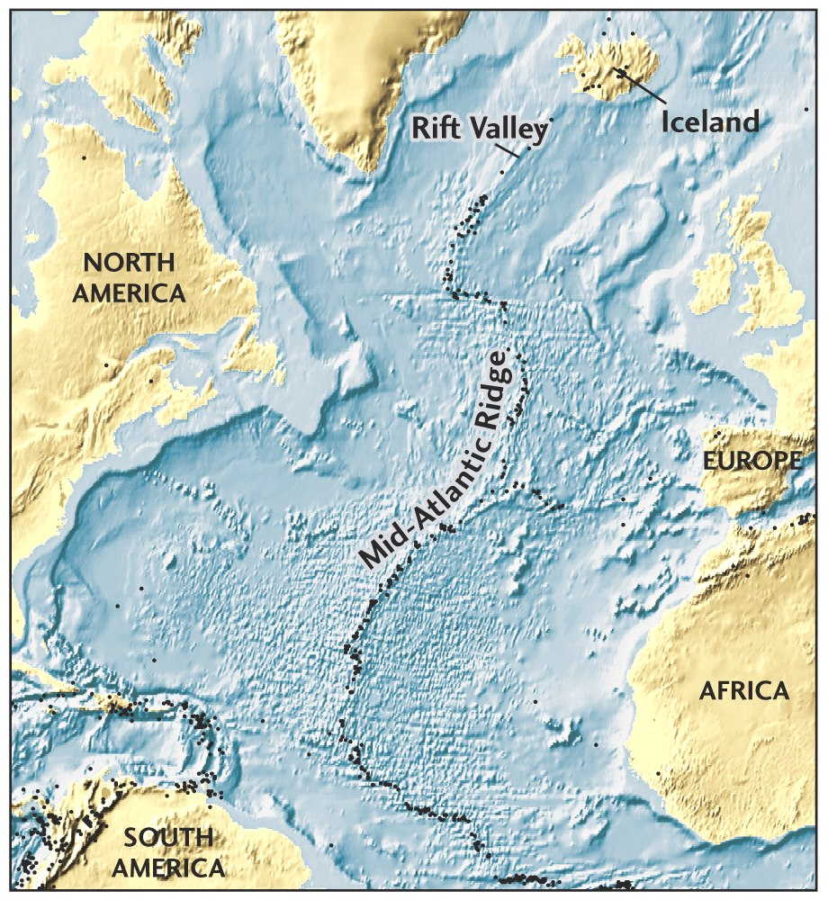
Evidence for Plate Tectonics Came from the Seafloor
bathymetry
age of ocean crust
magnetic data
Fig. 2.3

Slide 14
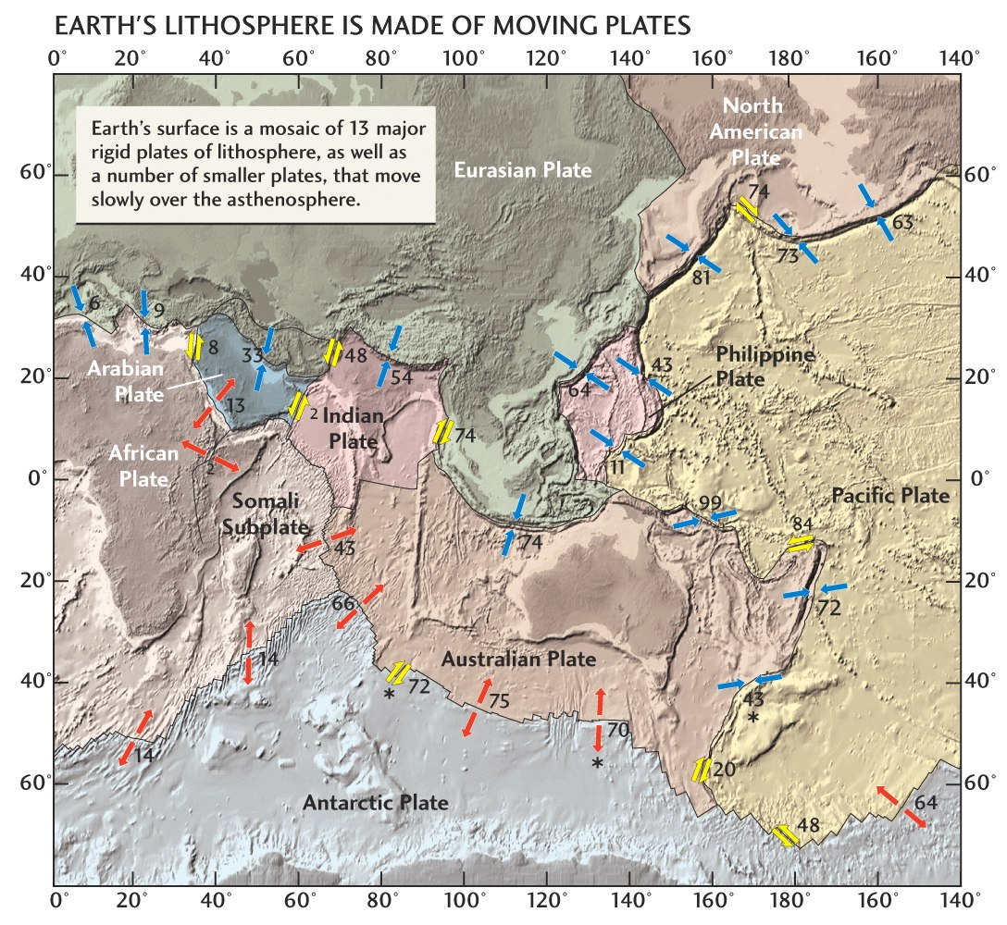
A Mosaic of Plates
Fig. 2.5

Slide 15
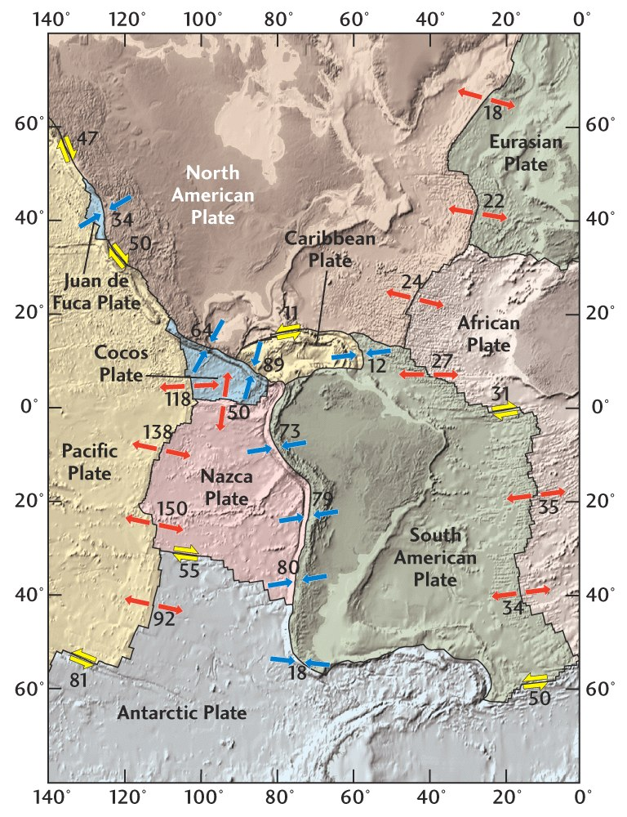
Modern Plate Motions
geology
GPS measurements
magnetic data
mm/year
Fig. 2.5

Slide 16
Driving Mechanism of Plate Tectonics
GRAVITY
Convection may have overturned asthenosphere 4–6 times.

Slide 17
Driving Mechanism of Plate Tectonics
GRAVITY-- cooling lithosphere thickens with age and slides under its own weight down the top of the asthenosphere
Convection may have overturned asthenosphere 4–6 times.

Slide 18
Key parts of Plate Tectonics
Lithosphere or rigid lid that holds both crust and cold mantle together as one solid block (0-100km)
asthenoshphere or plastic,ductile, layer also within the mantle (100km depth to 300 km depth??)

Slide 19
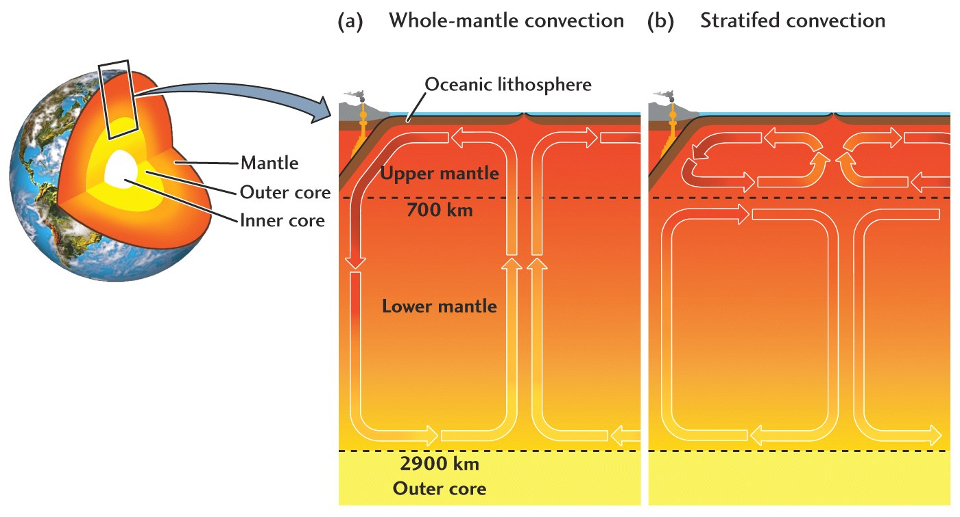
Two Models of Mantle
Convection
Fig. 2.17

Slide 20
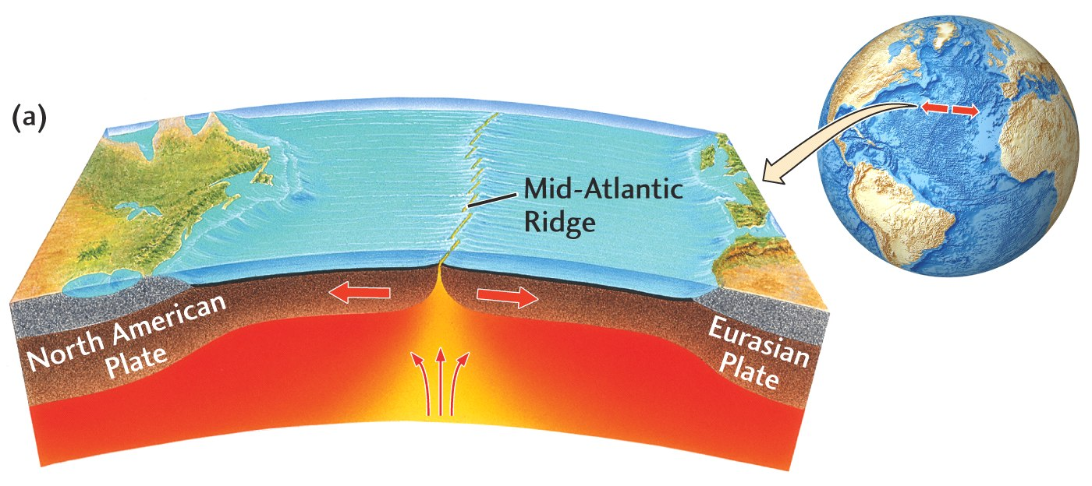
Divergent Plate Boundary
Usually start within continents—
grows to become ocean basin
Fig. 2.6

Slide 21
Compositional subdivisions of the earth
Crust
10-70 km
thick
cont. granite
2.7 g/cc
oceanic- basaltic
>2.8 g/cc
Mantle
peridotite
>3 g/cc
down to 2900 km depth
mantle

Slide 22
Mechanical subdivisions of the upper earth
lithosphere
RIGID
asthenosphere
DUCTILE

Slide 23
Comparison of views earth structure
lithosphere
RIGID
crust
asthenosphere
DUCTILE
mantle
Mantle

Slide 24
Plates
Group of rocks all moving in the same direction
Can have both oceanic and continental crust or just one kind.

Slide 25
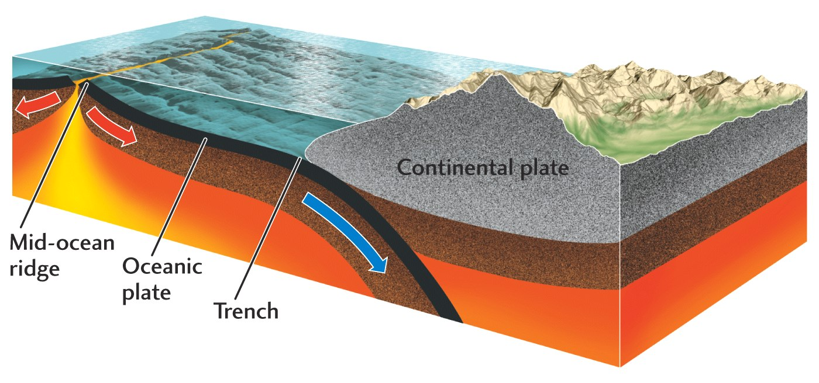
Ridge Push and Trench Pull
Fig. 2.16

Slide 26
The Seafloor as a Magnetic Tape Recorder
During and after WWII, it was noticed that the magnetic field near the ocean floor exhibited significant variation.
Subsequent analysis shows that the changes in the rocks reflect changes in the Earth’s magnetic field over time.

Slide 27
The Seafloor as a Magnetic Tape Recorder
When certain magnetic minerals cool below their Curie temperature of 573 degrees the magnetic domains in these minerals “freeze” in the direction of the current earth’s magnetic field until the sample is weathered away or reheated in the lab or by natural burial.

Slide 28
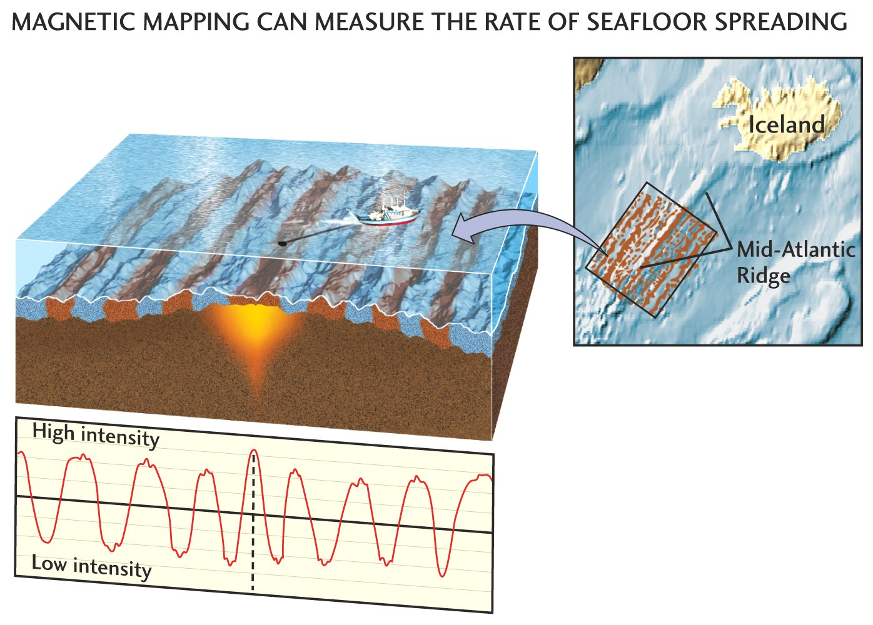
Fig. 2.11

Slide 29
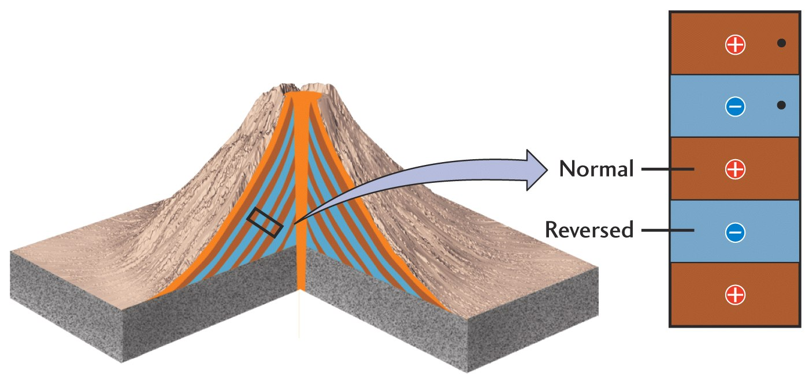
Magnetic Reversals in a
Single Volcano
Fig. 2.11

Slide 30
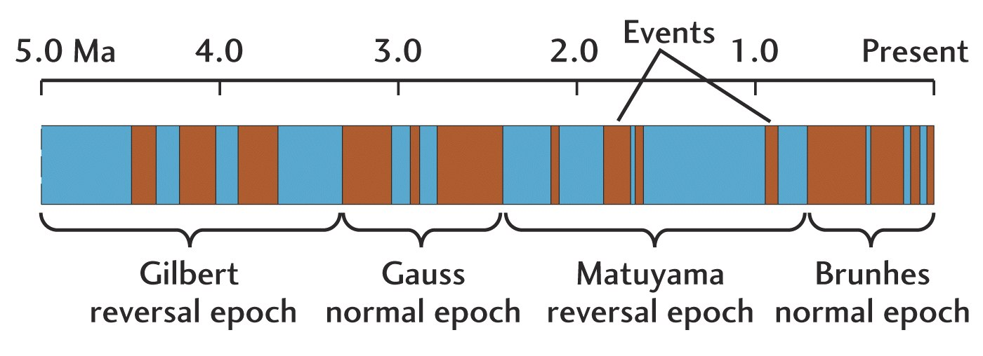
The Magnetic Record
Fig. 2.11

Slide 31
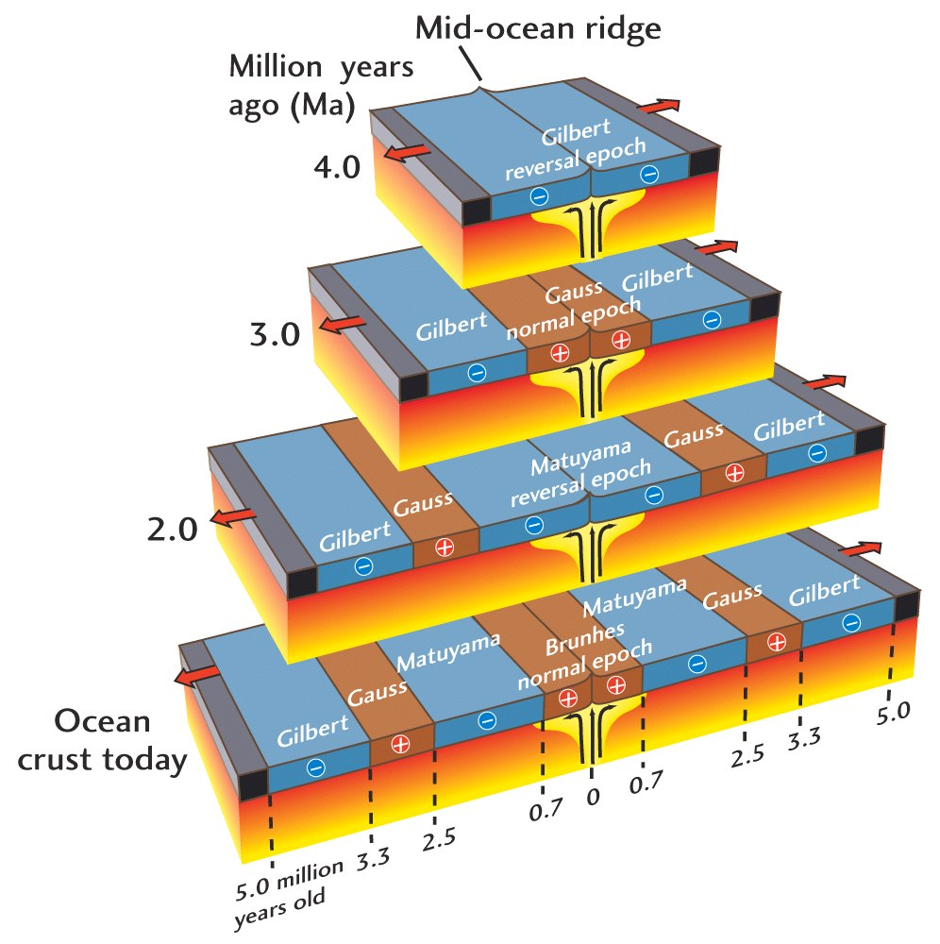
Magnetic Reversals at Mid-ocean Ridges
Fig. 2.11

Slide 32
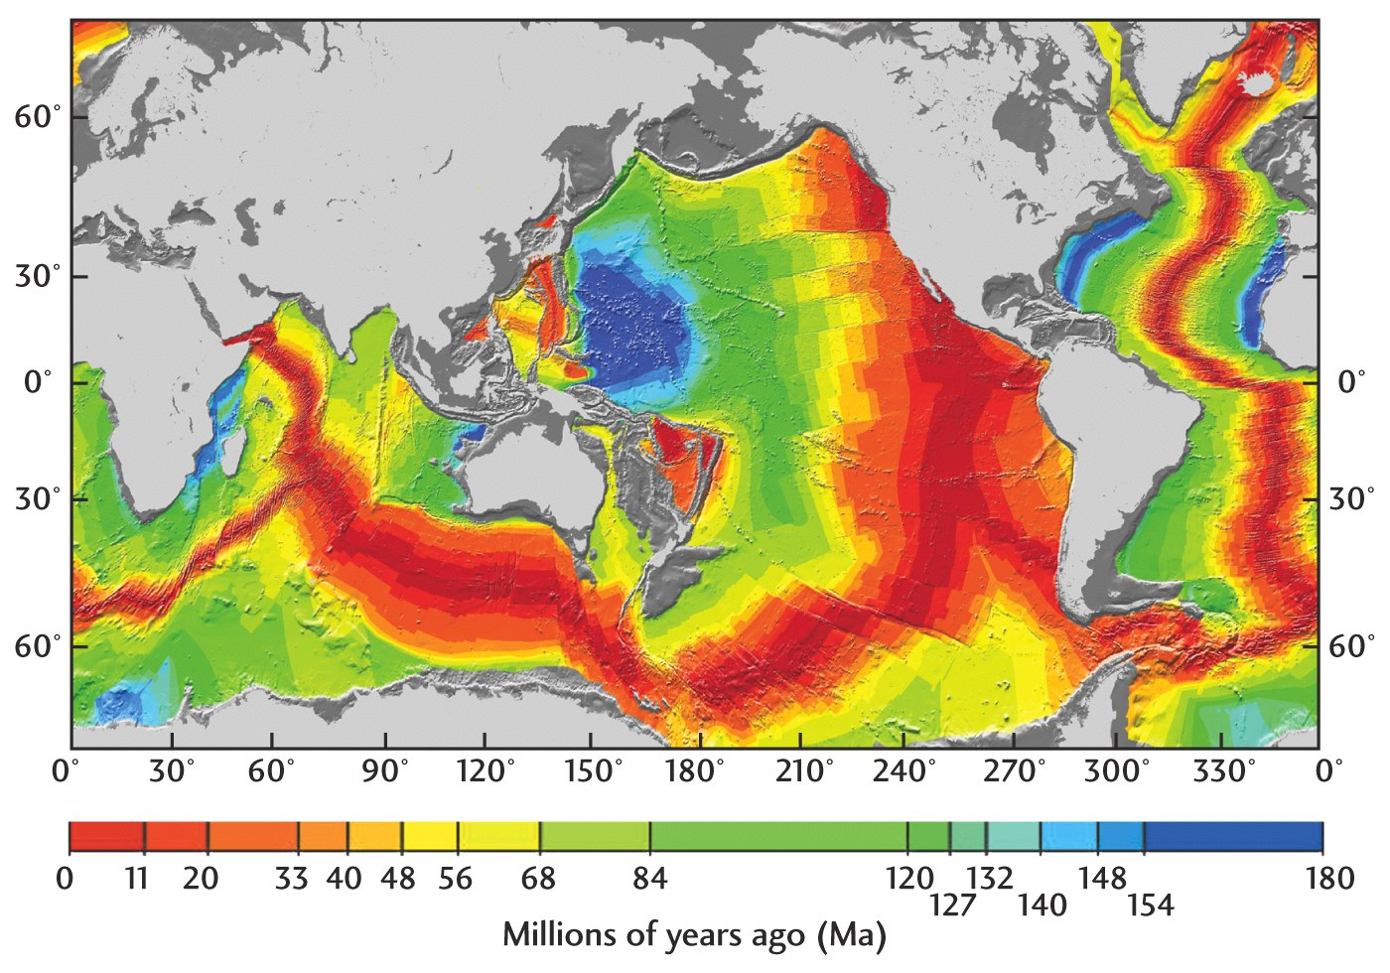
Magnetic Age of the Oceans
Fig. 2.14

Slide 33
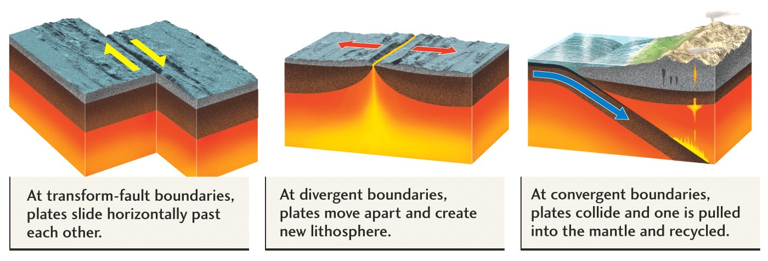
Three Types of Plate Boundaries
Transform
Divergent
Convergent
Fig. 2.5

Slide 34
Divergent Plate Boundary
Usually start within cotinents—
grows to become ocean basin
Fig. 2.6

Slide 35
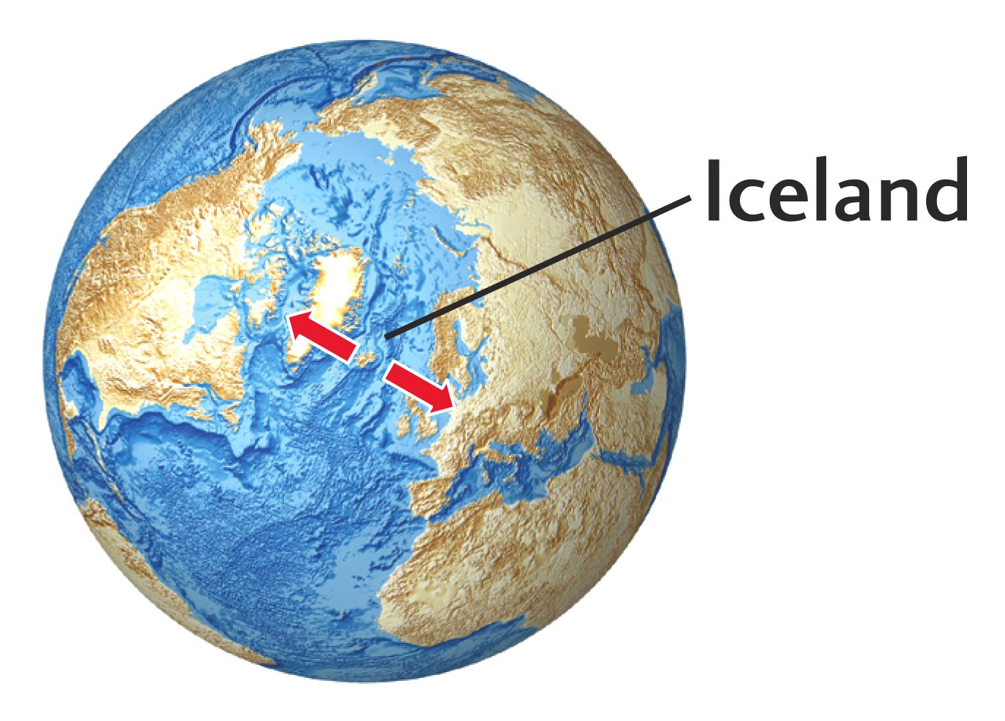
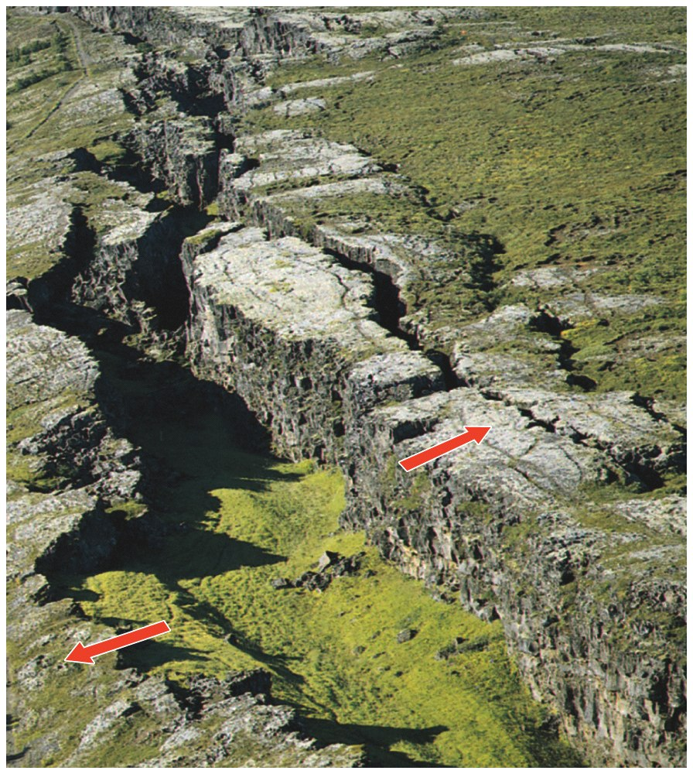
Divergent Plate Boundary
Fig. 2.7

Slide 36
Continental Rifts
• East Africa, Rio Grande rift
• Beginning of ocean formation although it may not get that far
• Rifting often begins at a triple junction (two spreading centers get together to form ocean basin, one left behind).

Slide 37
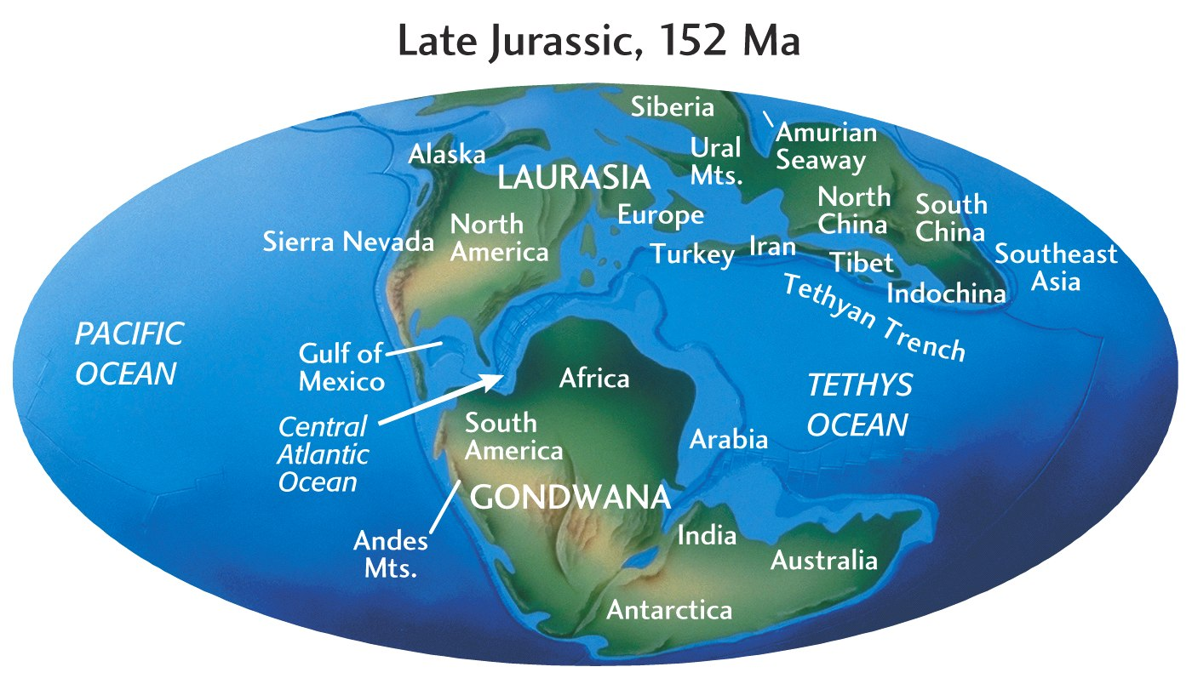
Fig. 2.15

Slide 38
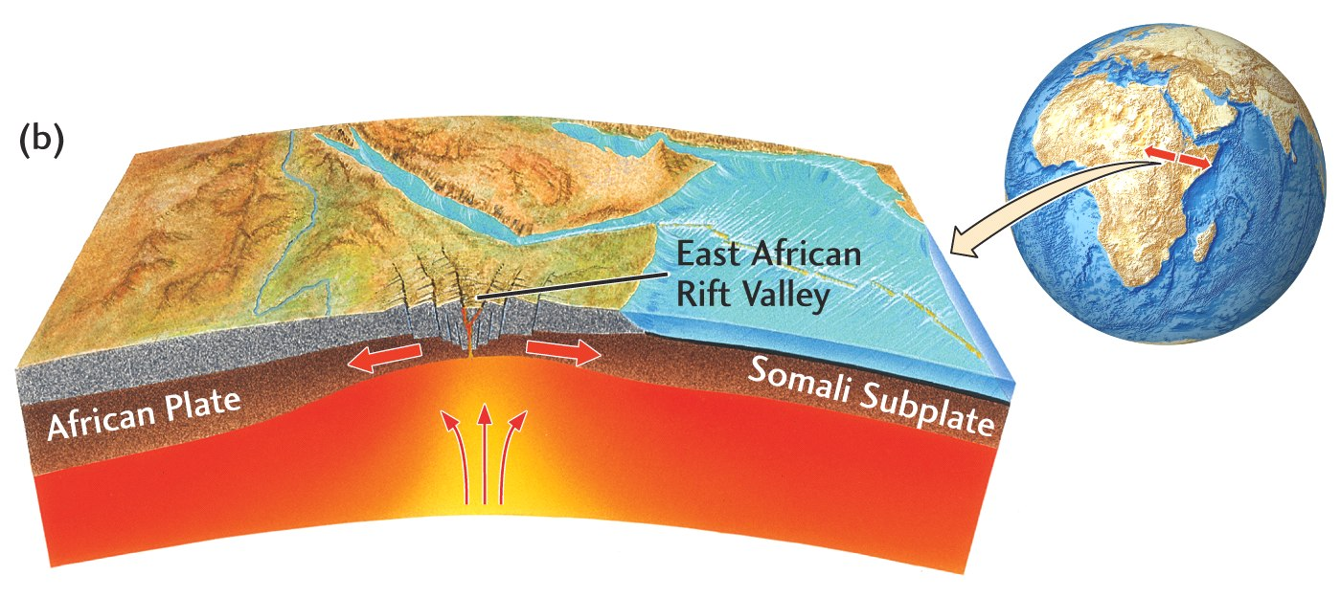
Divergent Plate Boundary
Fig. 2.6

Slide 39
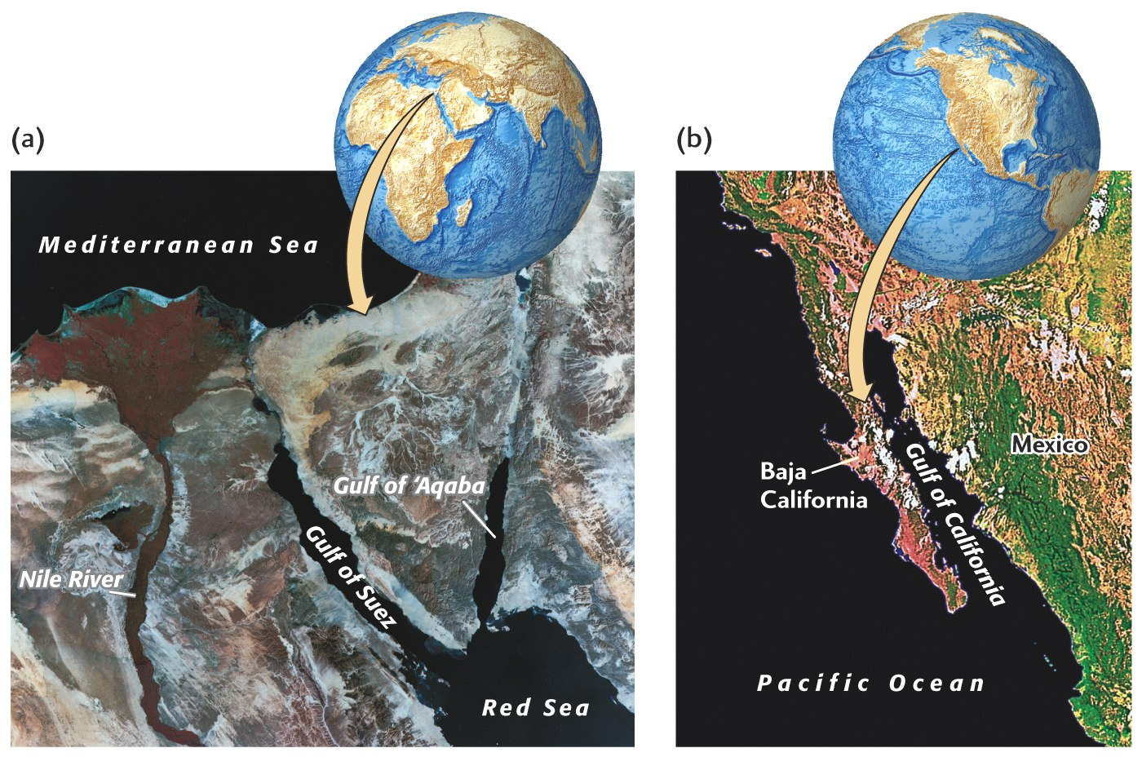
Divergent Plate Boundaries
Fig. 2.8

Slide 40
Convergent Boundaries
Relative densities are important:
continental crust 2.7 g/cm³
oceanic crust 2.8 g/cm³
mantle 3.3 g/cm³

Slide 41
Is the Earth Expanding?
New crust created at Mid-ocean ridge—old crust destroyed (recycled) at subduction zones
The Earth is maintaining a constant diameter.

Slide 42
Convergent Boundaries
Three types:
ocean–ocean Japan
ocean–continent Andes(South America)
continent–continent Himalayas

Slide 43
Ocean–Ocean
Island arcs:
• Tectonic belts of high seismicity
• High heat flow arc of active volcanoes
• Bordered by a submarine trench

Slide 44
Tectonics Predicts Location of Earthquakes and Volcanoes
Fig. 2.4

Slide 45
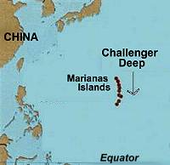
Marianas Islands-Challenger Deep/Marianas Trench (10,924 m or ~ 7miles)
http://www.geocities.com/thesciencefiles/marianas/marianaspic2.JPG

Slide 46
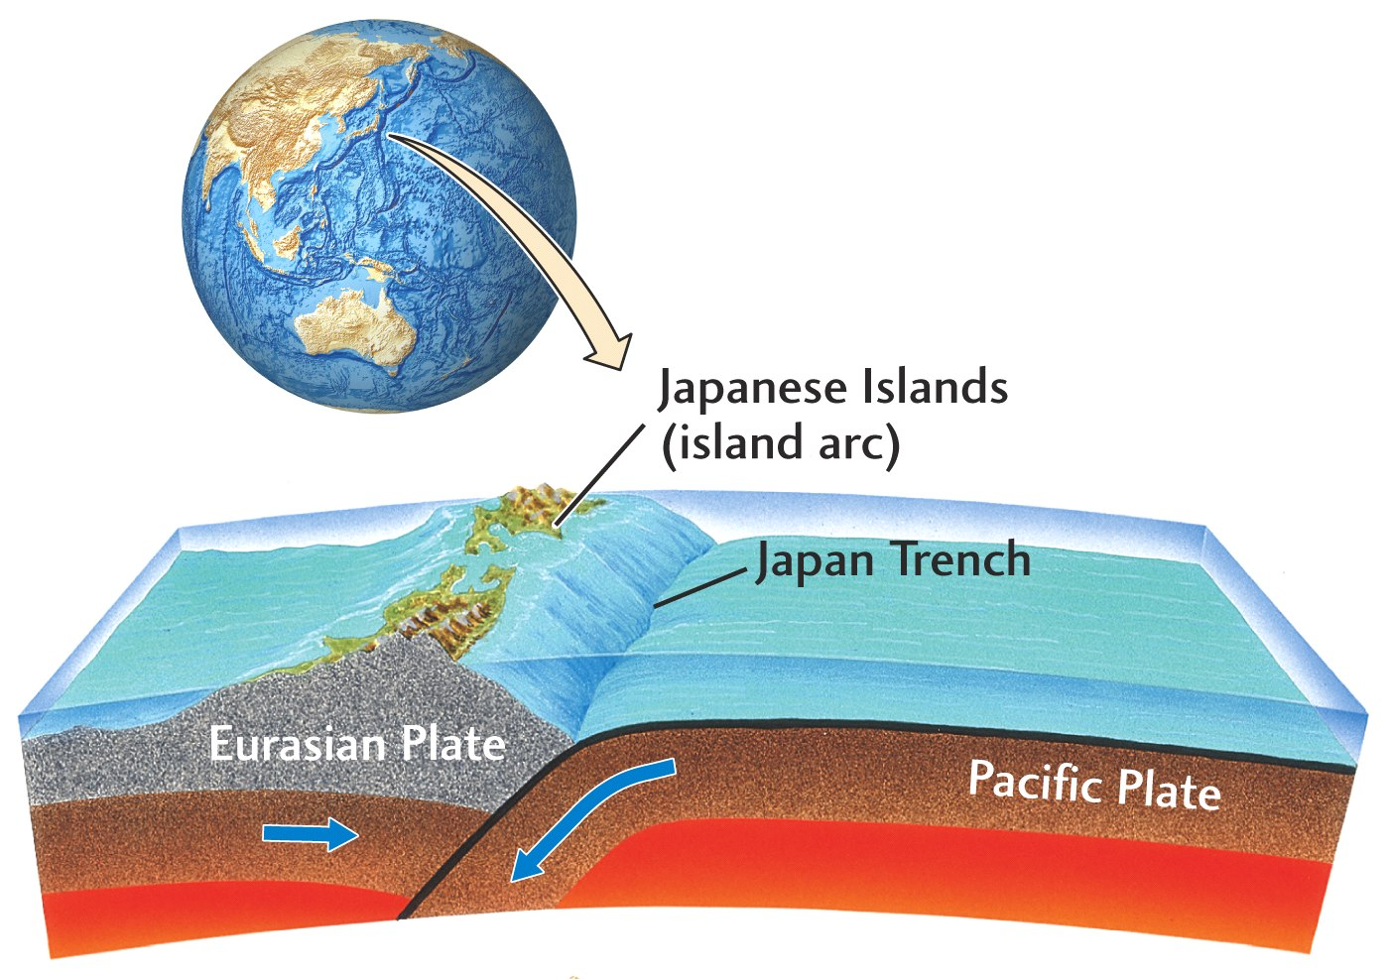
Convergent plate boundary
Fig. 2.9

Slide 47
Ocean–Continent
Continental arcs:
• Active volcanoes
• Often accompanied by compression of upper crust

Slide 48
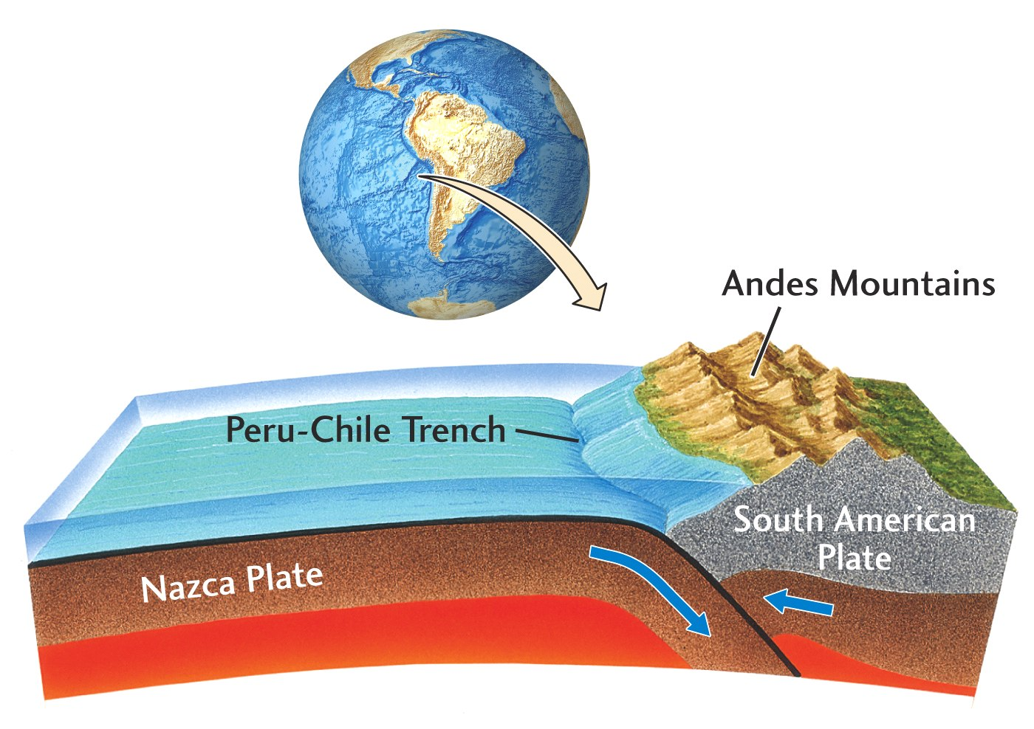
Convergent Plate Boundary
Fig. 2.9

Slide 49
Continent–Continent
In ocean–continent boundaries, collision convergence is taken up by subduction
In continent–continent boundaries, convergence is accommodated by deformation of the crust without subduction (both plates are too buoyant to be subducted)

Slide 50
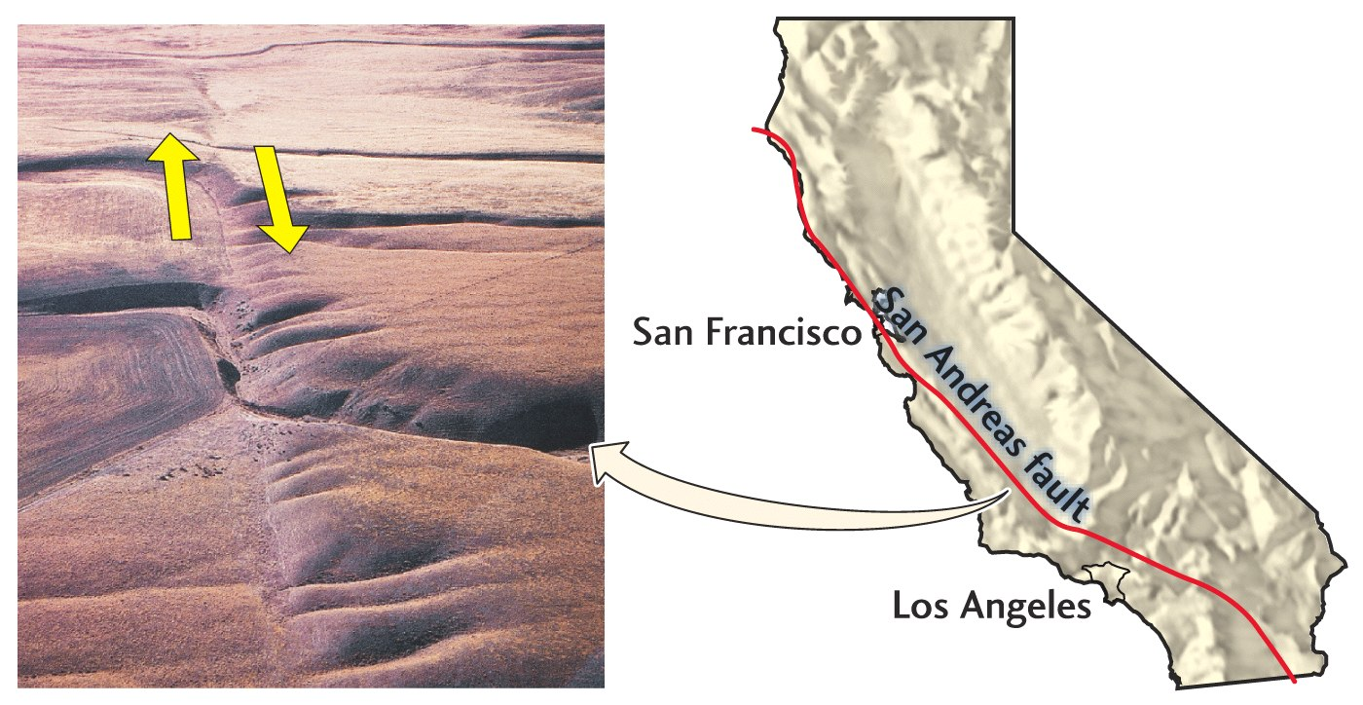
Transform Plate Boundary
Fig. 2.10

Slide 51
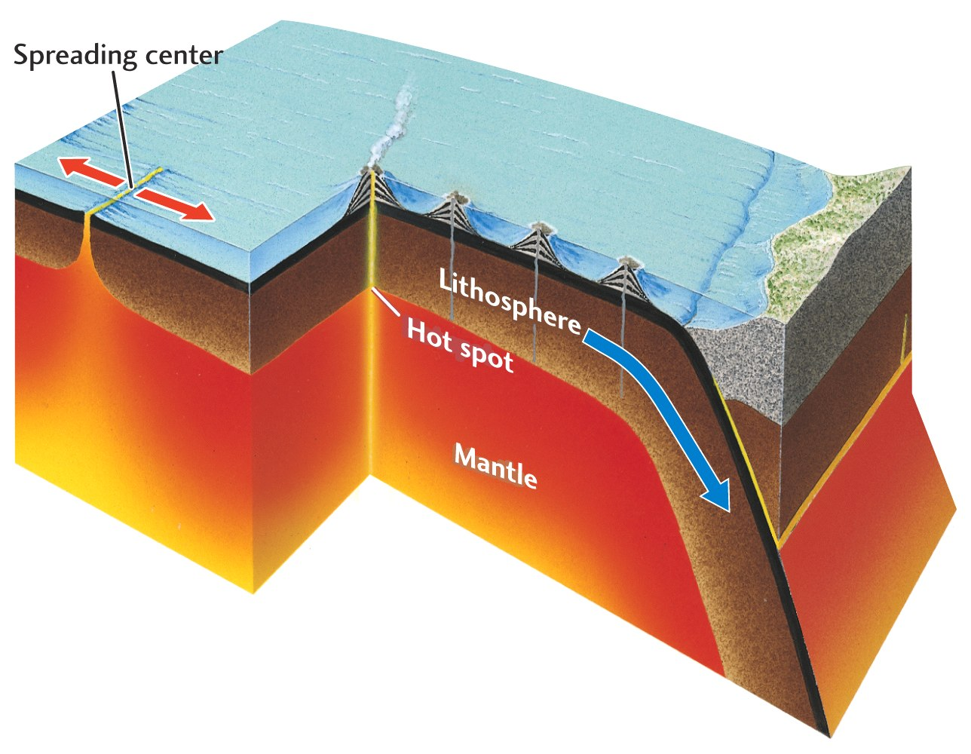
Hot-spot Volcanism
Fig. 2.18

Slide 52
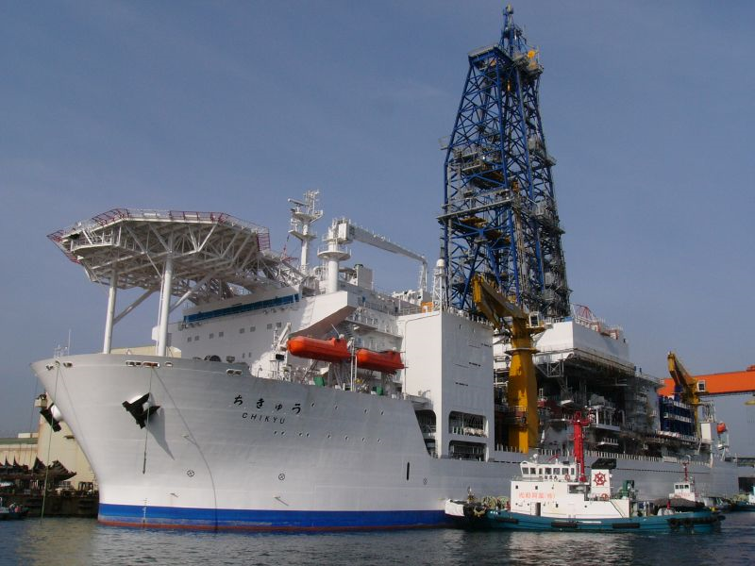
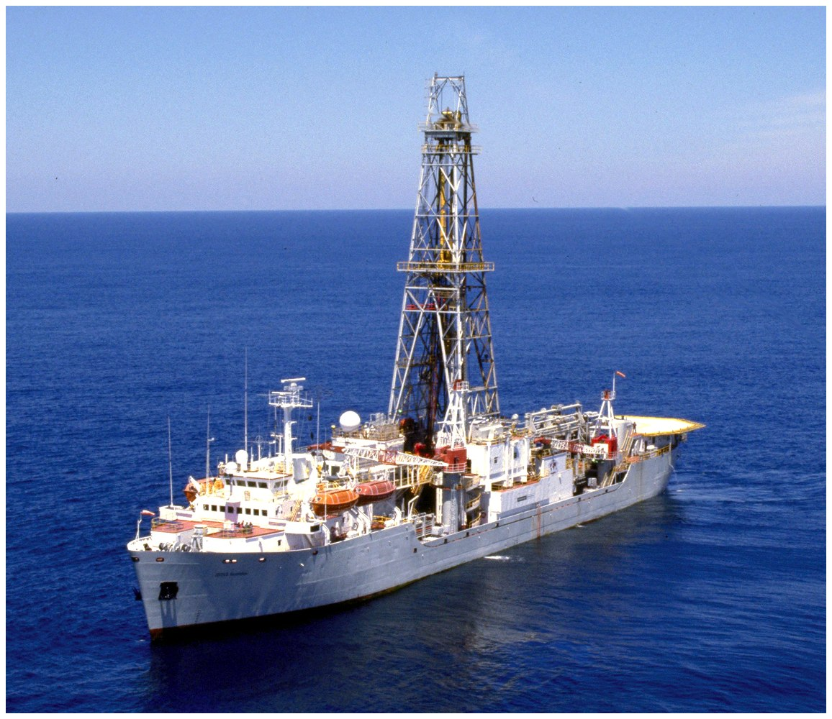
The International Ocean Drilling Project
CHIKYU
JOIDES Resolution
Box 2.1

Slide 53
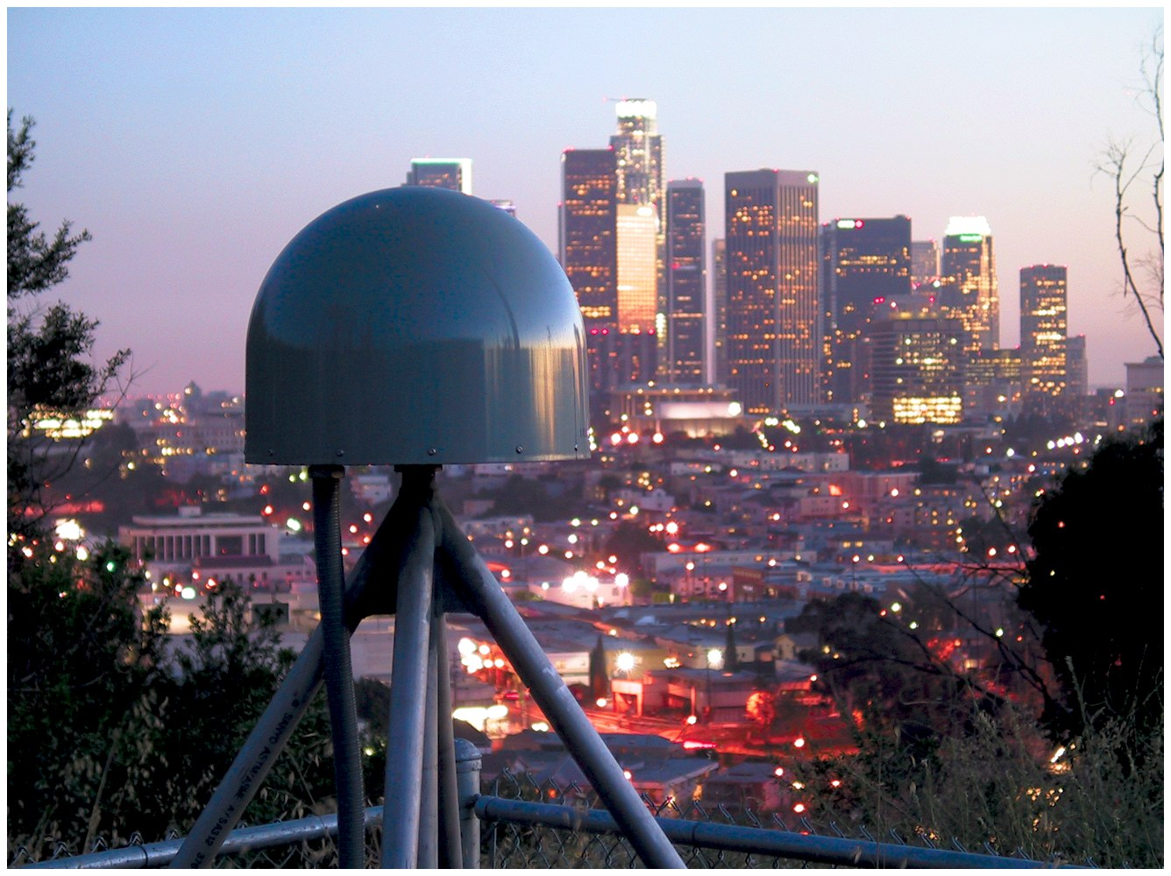
Fig. 2.12

Slide 54
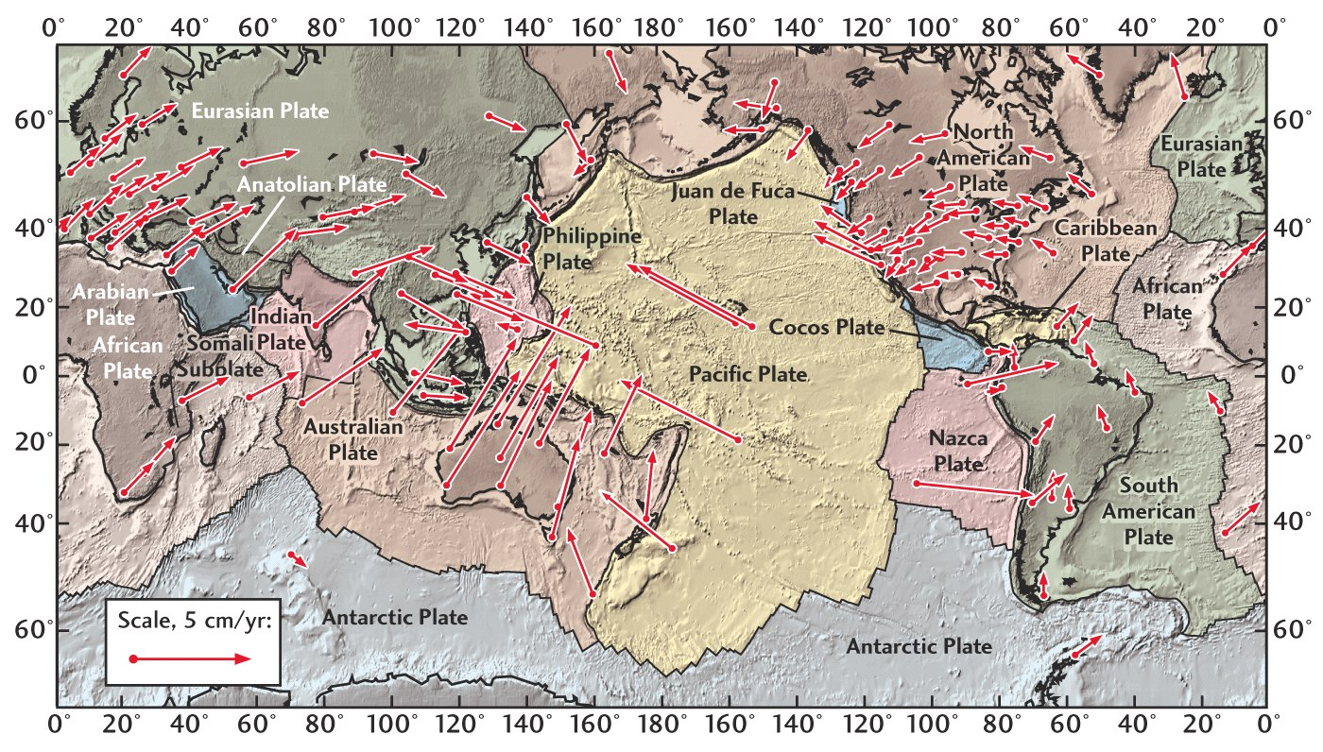
Modern Plate Motions
Fig. 2.13

Slide 55
Rates of Plate Motion
Mostly obtained from magnetic
anomalies on seafloor.
Fast spreading: 10 cm/year
Slow spreading: 3 cm/year

Slide 56
Pangaea (“all lands”)
The latest supercontinent
Started to break apart at the start of the “Age of Reptiles”- the Mesozoic Era of the Earth’s history

Slide 57
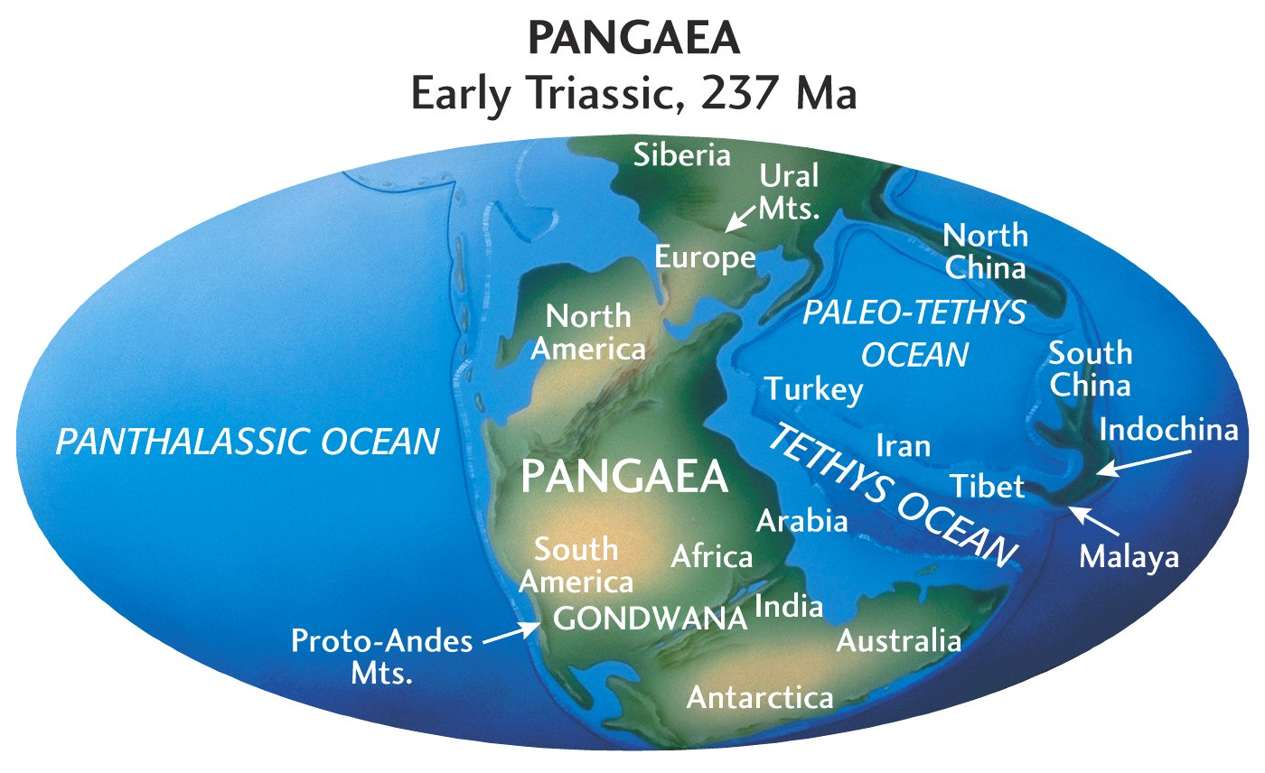
Fig. 2.15

Slide 58
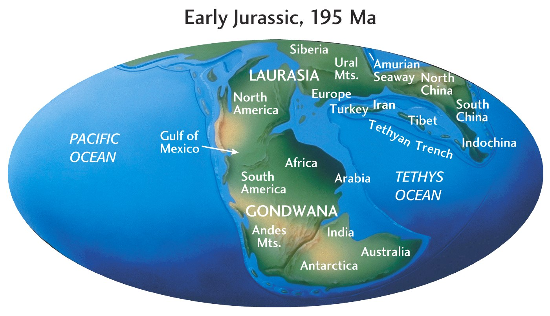
Fig. 2.15

Slide 59
Fig. 2.15

Slide 60
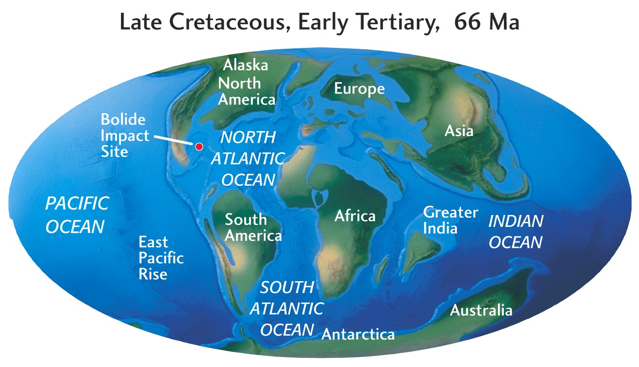
Fig. 2.15

Slide 61
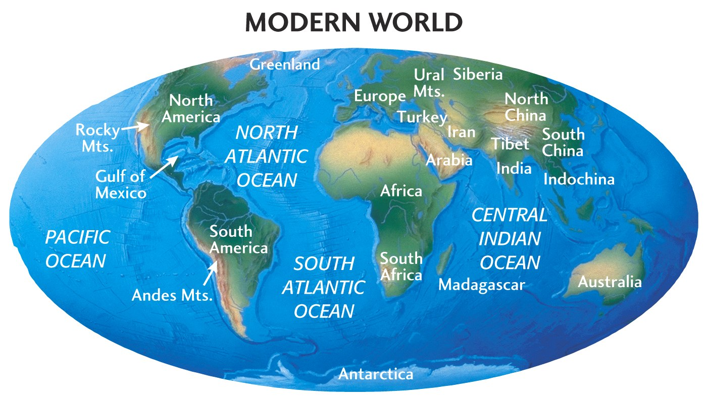
Fig. 2.15

