Slide 1
Chapter 9:
Subsidence and Thermal History
This presentation contains illustrations from Allen and Allen (2005)

Slide 2
Geohistory Analysis
Quantitative analysis that produces subsidence of various geological boundaries and rates of sediment accumulation through time.
Coined by Van Hinte (1973).
Backstripping involves additional incorporation of isostatic (local, flexural, 1-D, 2-Dor 3-D) effects of sediment unloading.

Slide 3
Subsidence History and Thermal History
time
past
present
Layer 3
Layer 2
“Tectonic” subsidence”
Layer 1
depth
basement

Slide 4
Backstripping
(Watts and Ryan, 1976)
Tectonic subsidence is what remains after the effects of sea-level and sediments are removed.
…. It is the background subsidence caused by stretching and thermal cooling of the lithosphere.

Slide 5
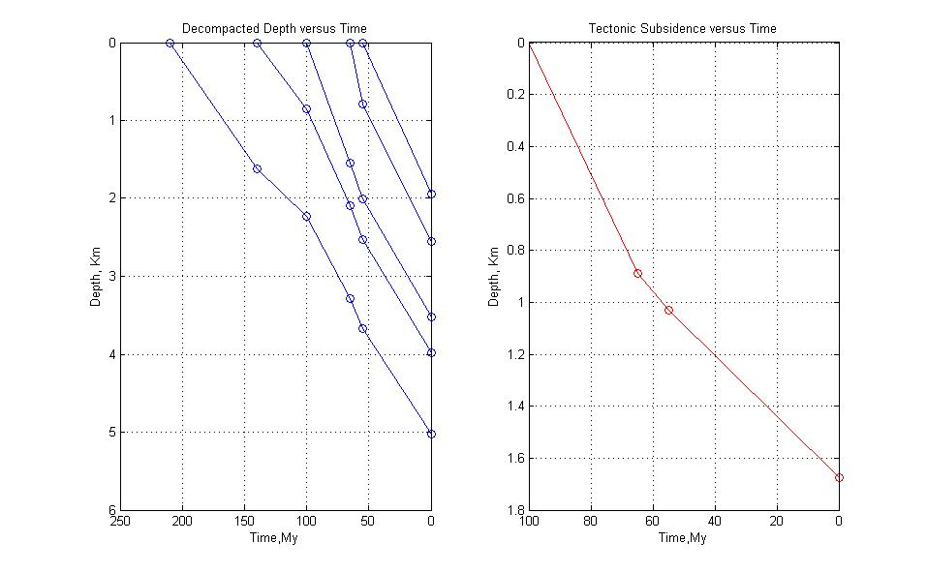
Backstripping

Slide 6
Backstripping
For original matlab program from Allen’s book:
see the following link to a matlab program

Slide 7
Subsidence History and Thermal History
time
past
present
Layer 3
Layer 2
“Tectonic” subsidence”
Layer 1
depth
Thermal window

Slide 8
Subsidence in the forward sense
Sea-level

Slide 9
Subsidence in the forward sense
Sea-level

Slide 10
Subsidence in the forward sense
Sea-level

Slide 11
Subsidence in the forward sense

Slide 12
Subsidence in the forward sense

Slide 13
Subsidence in the forward sense

Slide 14
Subsidence in the forward sense
We need to know:
Sea-level (assumed constant in the example)
Original sediment thickness and hence water-depth (known at all times)
Type of isostatic behavior does the crust exhibit when loaded (flexural, or local/Airy)

Slide 15
Subsidence in the reverse sense
Sea-level (never constant in the past)
Original sediment thickness ( we don’t know??)
We DO know current sediment thickness
Water-depths ( never constant)

Slide 16
Subsidence in the reverse sense

Slide 17
Subsidence in the reverse sense
Porosity: The “new”decompacted thickness must conform to a pre-defined porosity-depth relation. This calculation is achieved by trial and error.

Slide 18
Subsidence in the reverse sense
Paleo-water depth: From biostratigraphic assemblages
Sea-level estimations: Long-term changes are accepted.
Flexural Model: Various Te values can be used.

Slide 19
Flexural backstripping

