Slide 1
Chapter 6:
Strike-slip Basins
This presentation contains illustrations from Allen and Allen (2005)

Slide 2
Strike-slip Basins
Geological and Geophysical Observations
Basin Diversity
Structural Features of the PDZ
Uniform Extension and Pull-apart Basins

Slide 3
Geological and Geophysical Observations Basin Diversity
Where are the maximum, minimum and intermediate principal stress directions?

Slide 4
Geological and Geophysical Observations Basin Diversity

Slide 5
Geological and Geophysical Observations Basin Diversity

Slide 6
Geological and Geophysical Observations Basin Diversity

Slide 7
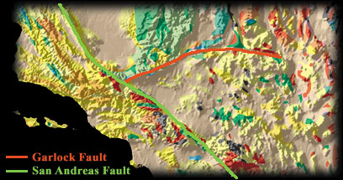
Geological and Geophysical Observations Basin Diversity
Transform --- plate scale
Transcurrent --- crustal scale e.g. Garlock Fault CA
(USGS)

Slide 8
Geological and Geophysical Observations Basin Diversity
Extension or shortening can occur simultaneously along the same fault line, depending on the local relative angle between plate movement direction and fault orientation
Basins are usually narrow and can lose their heat very rapidly

Slide 9
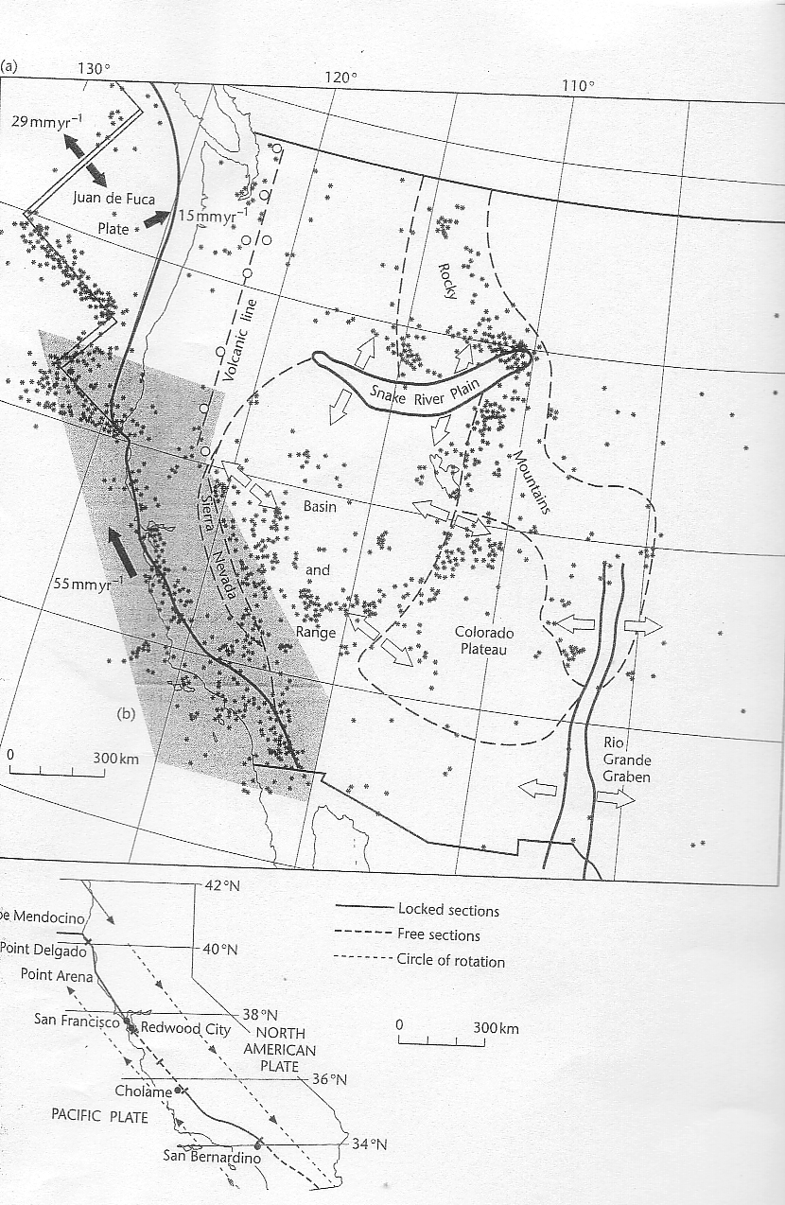

Slide 10
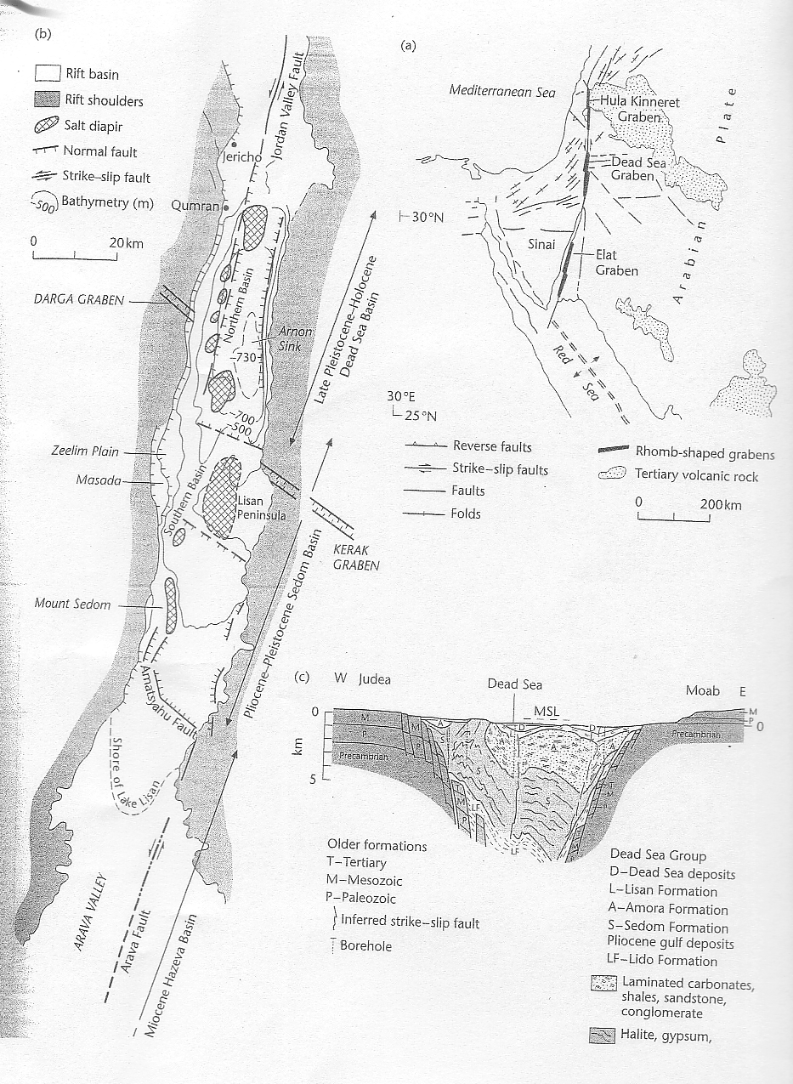

Slide 11
“Transtensional”, pull-apart basins, e.g., Salton Sea, Dead Sea etc.

Slide 17
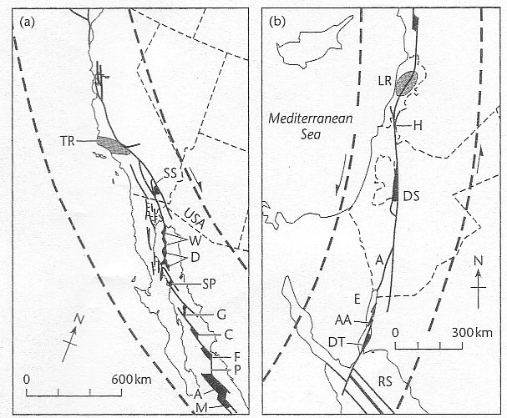
Extension and Contraction along strike-slip boundaries

Slide 18
Transpressional,Push-up block, local convergence

Slide 23
Strike-slip Basins
Geological and Geophysical Observations
Basin Diversity
Structural Features of the PDZ
Uniform Extension and Pull-apart Basins

Slide 24
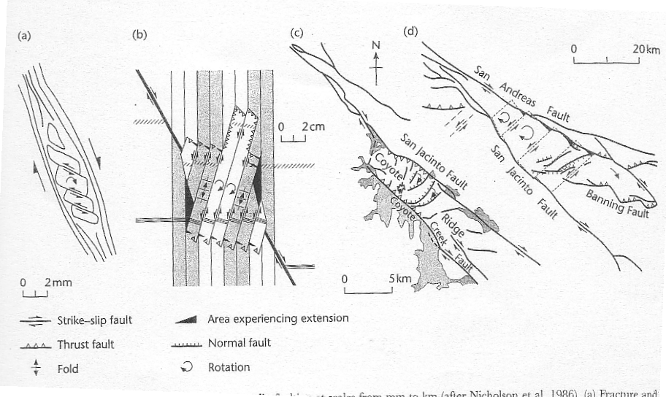
Complex deformation within continental transform zones
Rigid blocks within weak crust

Slide 25
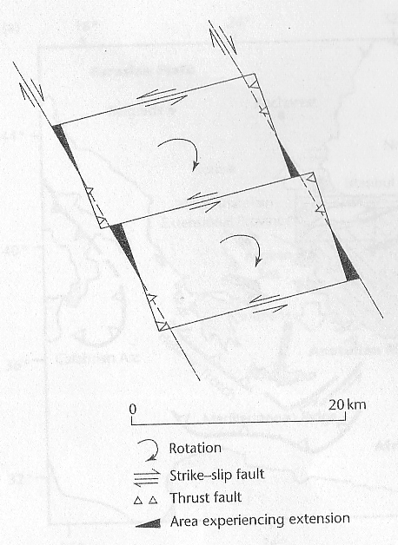
Left-lateral internal fault
Right-lateral confining major fault
extension
CW rotation
shortening

Slide 26
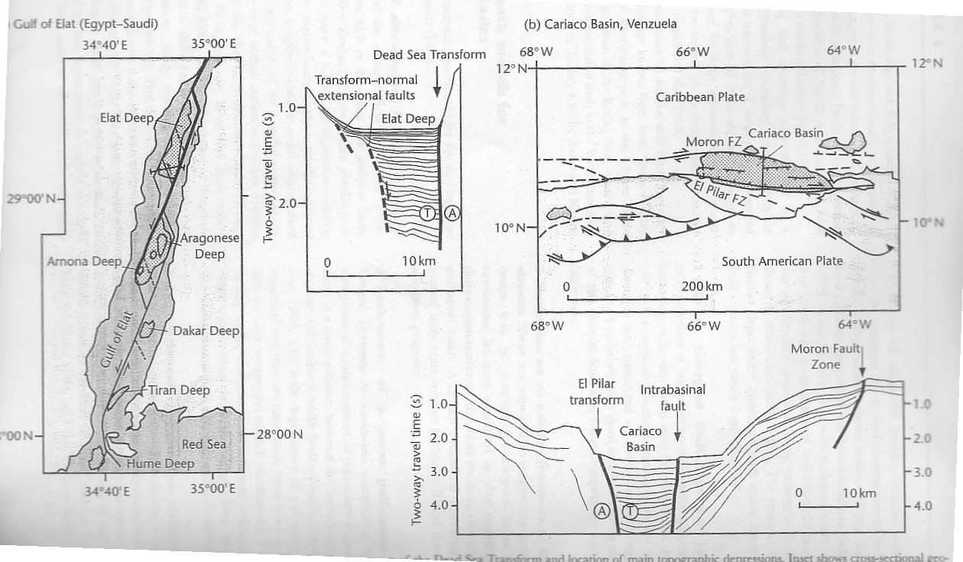

Slide 27
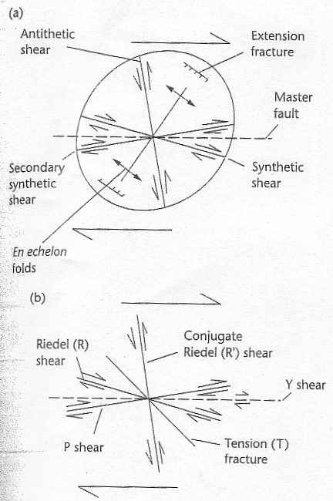
Experimental fault types along a pure strike slip margin
En echelon folds
Principal deformation zone
Riedel shears form at a small angle to the PDZ, & with same offset

Slide 28
Experiments in clay

Slide 29
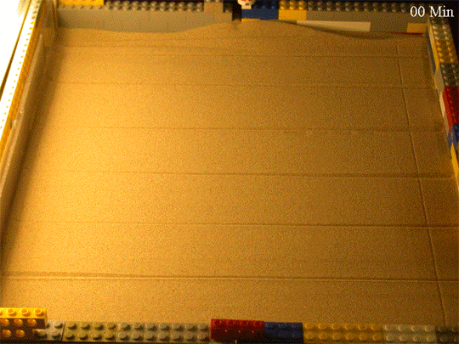
Dr. David Chew; Trinity College Dublin

Slide 30
Dr. David Chew; Trinity College Dublin

Slide 31
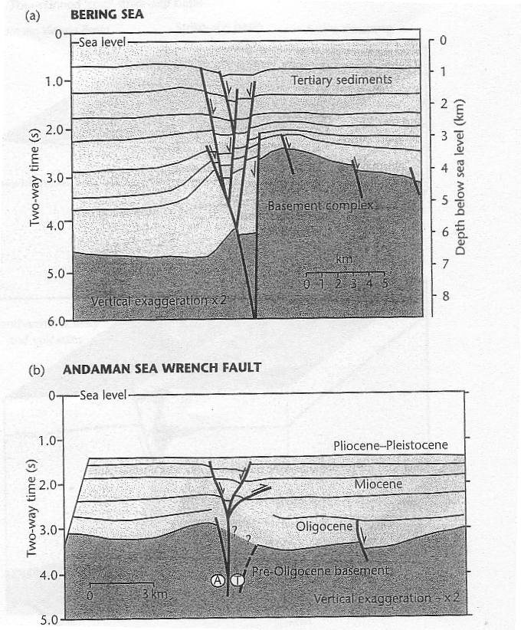
Strike-slip PDZ in Cross-section
Flower-structures
Variable offsets along the same fault because of movement in and out of the plane of observation

Slide 33
Strike-slip Basins
Geological and Geophysical Observations
Basin Diversity
Structural Features of the PDZ
Uniform Extension and Pull-apart Basins

Slide 34
Pitman and Andrews (1985)
Pull-apart basins experience very rapid subsidencein the early part of their history because of high heat loss across the nearby rift walls.

Slide 35
CONTINENT-OCEAN TRANSFORM MARGINS

Slide 36
CONTINENT-OCEAN TRANSFORM MARGINS

