Slide 1
Chapter3:
Basins due to lithospheric stretching
This presentation contains illustrations from Allen and Allen (2005)

Slide 2
Basins due to lithospheric stretching
-Rifts, failed rifts and passive continental margins
Models of continental extension
Active rifting versus passive rifting
Postrift subsidence of continental margins
Dynamical models
McKenzie’s Uniform Stretching Model
Modification of the uniform stretching model
Non-uniform stretching model
Pure shear versus simple shear models
Magmatic activity and finite rifting

Slide 3
Rifts, failed rifts and passive continental margins
A range of extensional basins exist that can be arranged from least to greatest degree of strain, or stretching factor.
A hot lithosphere will lead to uplift and increased differential stresses
If the differential stress is great enough the rocks will break.
A thinned crust leads to subsidence.
A hot lithosphere leads to uplift.
If the thermal supply does not continue then the rift dies.

Slide 4
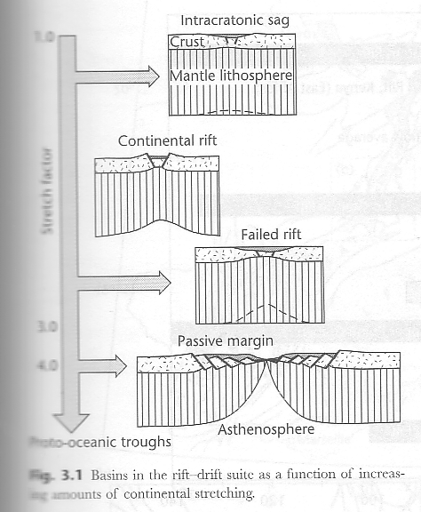
Extensional basins as a function of strain

Slide 5
Stretching factor ( )
Is the ratio of final lithospheric thickness to original lithospheric thickness.
For example, a beta of 2 means that the lithosphere has been thinned by
(a) ¼
(b) ½
(c) none of the above?

Slide 6
Basins due to lithospheric stretching
-Rifts, failed rifts and passive continental margins
-Observations on continental extension
Models of continental extension
Active rifting versus passive rifting
Postrift subsidence of continental margins
Dynamical models
McKenzie’s Uniform Stretching Model
Modification of the uniform stretching model
Non-uniform stretching model
Pure shear versus simple shear models
Magmatic activity and finite rifting

Slide 7
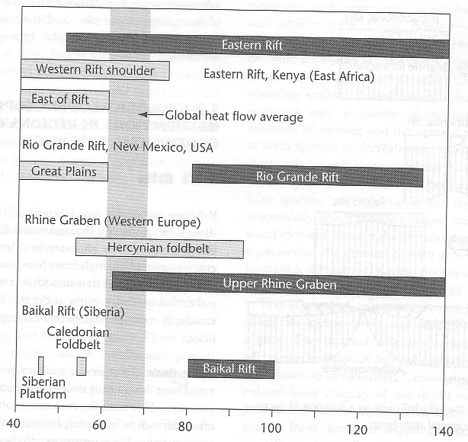
Observations on continental extension
Heat flow:

Slide 8
Observations on continental extension
Seismicity:
Magnitudes <5
hypocenter: < 30 km

Slide 9
Observations on continental extension
Crustal thickness:
beta=1 => no thinning%
beta=2 => thinning by 50 %
beta =
original thickness/ final crustal thickness

Slide 10
Discovered by Pierre Bouguer in the 1700s (Gp. 8 Meyer and Mbamalu)
the difference between what gravity is at a particular location(absolute observed gravity) and what gravity is supposed to be at that location(theoretical gravity value). Bouguer anomaly = theoretical gravity value - absolute observed gravity value.
Reference?
??????

Slide 11
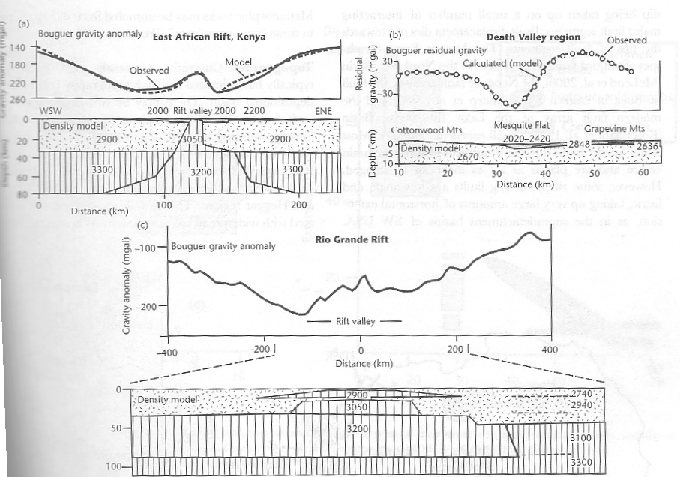
Observations on continental extension
Gravity:

Slide 12
Observations on continental extension
Faults: have special length- frequency distribution
Frequency (log)
Fault length (log)
Major faults take up most of the motion

Slide 13
Observations on continental extension
Faults: have displacement-length relationship

Slide 14
Observations on continental extension
Faults: fault tips curve toward each other

Slide 15
Observations on continental extension
Faults: What do their crosss-sections look like?
B
C
A
B’
A’
C’

Slide 16
Observations on continental extension
Faults: What do their cross-sections look like?
A
A’
C
C’
B
B’

Slide 17
Observations on continental extension
Topography
2 km
50 km

Slide 18
Observations on continental extension
Time scale and extension – PIZZA MODELS
Thin crust
extension
extension
Thick crust
km
km
10 mm/yr
30
60
Rate of extension
Dip of master fault

Slide 19
Basins due to lithospheric stretching
-Rifts, failed rifts
Passive continental margins
Models of continental extension
Active rifting versus passive rifting
Postrift subsidence of continental margins
Dynamical models
McKenzie’s Uniform Stretching Model
Modification of the uniform stretching model
Non-uniform stretching model
Pure shear versus simple shear models
Magmatic activity and finite rifting

Slide 20
Passive vs. Active rifting
Two end-member models ... Two extremes ….A different sequence of events with similar outcomes
East African Rift system is the active end-member and Basin and Range is the passive end-member

Slide 21
Active Rifting
As in plate tectonics, we have two different philosophies in the study of basins caused by extension of the lithosphere. One says that a thermal plume (hot spot model, or active rifting model) uplifts the lithosphere by creating a region of thermal doming.
The uplifted lithosphere now has a tendency to spread away from the center of the uplift toward the sides, moving down the dipping and slippery asthenosphere-lithosphere boundary.

Slide 22
Active (by mantle)
Thermal (plume) doming precedes faulting

Slide 23
Active Rifting
In the Active rifting model, a thermal plume (hot spot model) uplifts the lithosphere by creating a region of thermal doming.
The uplifted lithosphere now has a tendency to spread away from the center of the uplift toward the sides, moving down the dipping and slippery asthenosphere-lithosphere boundary.

Slide 24
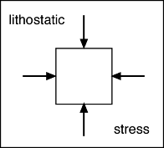
LITHOSTATIC AND DEVIATORIC STRESS
•Lithostatic Stress= Equal pressure from all directions
•Deviatoric Stress= Stress-lithostatic
-
Tension
Boudinage
Compression
Fold
Shear
Fractures
Deviatoric Stress
•Affects textures and structures
http://myweb.cwpost.liu.edu/vdivener/notes/stress-strain.htm
(Gp 3--PP,CH-08)

Slide 25
Passive Rifting
Deviatoric stresses caused by uplift
Uplift of the lithosphere-asthenosphere boundary occurs wholly within the mantle and creates lateral pressures The crust breaks under its own weight.
Observations
East Africa displays signs of an eroded pre-uplift surface possibly caused by doming. Normal faulting then breaks through this eroded pre-rift surface

Slide 26
Passive Rifting
The other philosophy would have tension building in the crust caused by some mechanisms such as trench pull to either side and then the hot asthenosphere would upwell to fill the space.

Slide 27
East African Rift System – active rifting
http://www.geosci.usyd.edu.au/users/prey/Teaching/Geol-1002/HTML.Lect1/AfricanRift.jpg

Slide 28
Basin and Range-passive rifting
Idaho
Nevada
Utah
CO
AZ
NM
thenaturalamerican.com/3_basic_provinces.htm

Slide 29
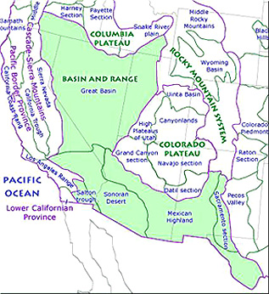
Basin and Range-passive rifting
Idaho
Nevada
Utah
CO
AZ
NM

Slide 30
Basin and Range
Sierra Nevada
www.discoverourearth.org/.../basin_range.html

Slide 31
Active vs. Passive rifting

Slide 32
Active (by mantle)
Thermal (plume) doming precedes faulting

Slide 33
Passive (by lithosphere)
Normal Faults (stresses**) facilitate volcanic activity

Slide 34
Failed rifts and Continental Rifts Active or passive?

Slide 35
Basins due to lithospheric stretching
-Rifts, failed rifts
Passive continental margins
Models of continental extension
Active rifting versus passive rifting
Postrift subsidence of continental margins
Dynamical models
McKenzie’s Uniform Stretching Model
Modification of the uniform stretching model
Non-uniform stretching model
Pure shear versus simple shear models
Magmatic activity and finite rifting

Slide 36
Why and how do basins subside?
Principally: stretching increases heat flow but after the rifting ends the system begins to cool (thermal contraction). Cooling leads to densification of the lithosphere and underlying mantle.
However this is a simple idea. What if there are complications….

Slide 37
Complications during rifting
Abnormal volcanic activity:
stretched
normal
igneous

Slide 38
How does an abnormally hot mantle affect initial crustal subsidence?
Stretching of the whole lithosphere can make the top of crust subside, initially, at normal temperatures (1280 deg).
Abnormally hot mantle brings in more buoyant melts

Slide 39
Cooling lithosphere becomes stronger
Half a “steer’s head”

Slide 40
Basins due to lithospheric stretching
-Rifts, failed rifts
Passive continental margins
Models of continental extension
Active rifting versus passive rifting
Postrift subsidence of continental margins
Dynamical models
McKenzie’s Uniform Stretching Model
Modification of the uniform stretching model
Non-uniform stretching model
Pure shear versus simple shear models
Magmatic activity and finite rifting

Slide 41
Dynamical “= Why?”
The lithosphere is elastic if it is at least 40% of its melting temperature.
Yield stress envelope (YSE) summarizes experimental observations of the mechanical behavior of the lithsophere (see Ch. 2 powerpoint slide and online readings)

Slide 42
Mountains are weaker than thinned crust
High lands push outward toward the coast

Slide 43
Horizontal stress gradient-- with respect to a distant point (A). This shallow zone is susceptible to gravity sliding
SL
A
+
+
sediment
+
Oceanic crust
+
-
mantle
Cont. crust
Flexural stress in elastic lithosphere caused by sediment loading-- compressional(-) under max. load and extensional (+) on edges

Slide 44
Basins due to lithospheric stretching
-Rifts, failed rifts
Passive continental margins
Models of continental extension
Active rifting versus passive rifting
Postrift subsidence of continental margins
Dynamical models
McKenzie’s Uniform Stretching Model
Modification of the uniform stretching model
Non-uniform stretching model
Pure shear versus simple shear models
Magmatic activity and finite rifting

Slide 45
McKenzie’s model
The basic tenets of this model are very simple. Inside the "rift zone" the extension is the same in the crust and in the mantle.
Beta is the linear deformation (extension) factor. For example a beta of 2 means that the original thickness and length underwent a two-fold thinning. At about 3, theoretically, we start to produce decompression melting and the creation of new crust. So we can’t have more than about 300% extension of the whole continental crust and mantle.

Slide 46
McKenzie’s Model
Because it is very simplistic, the initial stretching is instantaneous, so that a basin is produced instantaneously (in most cases but uplift can also be produced). Then, as the asthenosphere cools off the basin subsides a little more in an exponential manner.

Slide 47
McKenzie’s rifting model
passive rifting
Pure shearing (no rotation)
Pre-start
End

Slide 48
McKenzie’s rifting model
Time = 0

Slide 49
McKenzie’s rifting model
Time =0+, beta=1.3

Slide 50
McKenzie’s rifting model
Time = 0+, beta=?

Slide 51
McKenzie’s rifting model
Time = >> 0
heat
Beta =
Extension by %
Volume …
….. Isostasy (…..)

Slide 52
McKenzie’s rifting model
Time = end
Beta = 2
Extension by 200%
Volume conserved
Local Isostasy (Airy)

Slide 53
McKenzie’s rifting model
Crust usually sinks…..
as long as it is > 12% of total original lithospheric thickness
Instantaneous stretching

Slide 54
Rifting thermal conditions
Tm
Initial
Depth (km)
2
1
final

Slide 55
Predictions of McKenzie’s model

Slide 56
Use of McKenzie’s model

Slide 57
Western Approaches (homework seismic line)

Slide 58
Bay of Biscay (120 My old)

Slide 59
Basins due to lithospheric stretching
-Rifts, failed rifts
Passive continental margins
Models of continental extension
Active rifting versus passive rifting
Postrift subsidence of continental margins
Dynamical models
McKenzie’s Uniform Stretching Model
Modification of the uniform stretching model
Non-uniform stretching model
Pure shear versus simple shear models
Magmatic activity and finite rifting

Slide 60
Assumptions of Pure Shear Model
(1) Uniform stretching with depth
(2) Instantaneous stretching
(3) Pure shear stretching
(4) necking depth is at the surface
(5) Airy Isostasy
(6) No radiogenic heat production
(7) Heat flow is only vertical (one-dimensional)

Slide 61
Basins due to lithospheric stretching
-Rifts, failed rifts
Passive continental margins
Models of continental extension
Active rifting versus passive rifting
Postrift subsidence of continental margins
Dynamical models
McKenzie’s Uniform Stretching Model
Modification of the uniform stretching model
Non-uniform stretching model
Pure shear versus simple shear models
Magmatic activity and finite rifting

Slide 62
Non-uniform extension

Slide 63
Non-uniform extension-- laterally discontinuous
(a) Jurassic landward of hinge zone. Uniform stretching but only seaward of hinge zone.
(b) No Jurassic landward of hinge zone. Lithosphere thinned uniformly seaward of hinge zone. Only mantle thinned landward of hinge zone. Rift-flank uplift. (Matches data)

Slide 64
Why use a continuous-stretching-with-depth model
Sometimes the jump in physical properties between crust and mantle can not be observed (Biscay Margin), so a continuous increase of stretching with depth is used.
This simple model can also explain rift-sag or steer’s-head-stratigraphy- type basins.

Slide 65
Basins due to lithospheric stretching
-Rifts, failed rifts
Passive continental margins
Models of continental extension
Active rifting versus passive rifting
Postrift subsidence of continental margins
Dynamical models
McKenzie’s Uniform Stretching Model
Modification of the uniform stretching model
Non-uniform stretching model
Pure shear versus simple shear models
Magmatic activity and finite rifting

Slide 66
Simple Shear vs. Pure Shear

Slide 67
Simple Shear

Slide 68
Simple Shear

Slide 69
Simple Shear vs. Pure Shear

Slide 70
Basins due to lithospheric stretching
-Rifts, failed rifts
Passive continental margins
Models of continental extension
Active rifting versus passive rifting
Postrift subsidence of continental margins
Dynamical models
McKenzie’s Uniform Stretching Model
Modification of the uniform stretching model
Non-uniform stretching model
Pure shear versus simple shear models
Magmatic activity and finite rifting

Slide 71
Heat advected by magma formed at a rifted margin that becomes a divergent plate boundary decreases initial synrift subsidence
Added magma

Slide 72
Basins due to lithospheric stretching
Modification of the uniform stretching model
Induced mantle convection
Flexural compensation
Lithospheric necking
Narrow vs. wide rifts
Rheology of continental lithosphere
Mantle plumes
Melt generation during continental extension
- Stretch factor and strain rate history

Slide 73
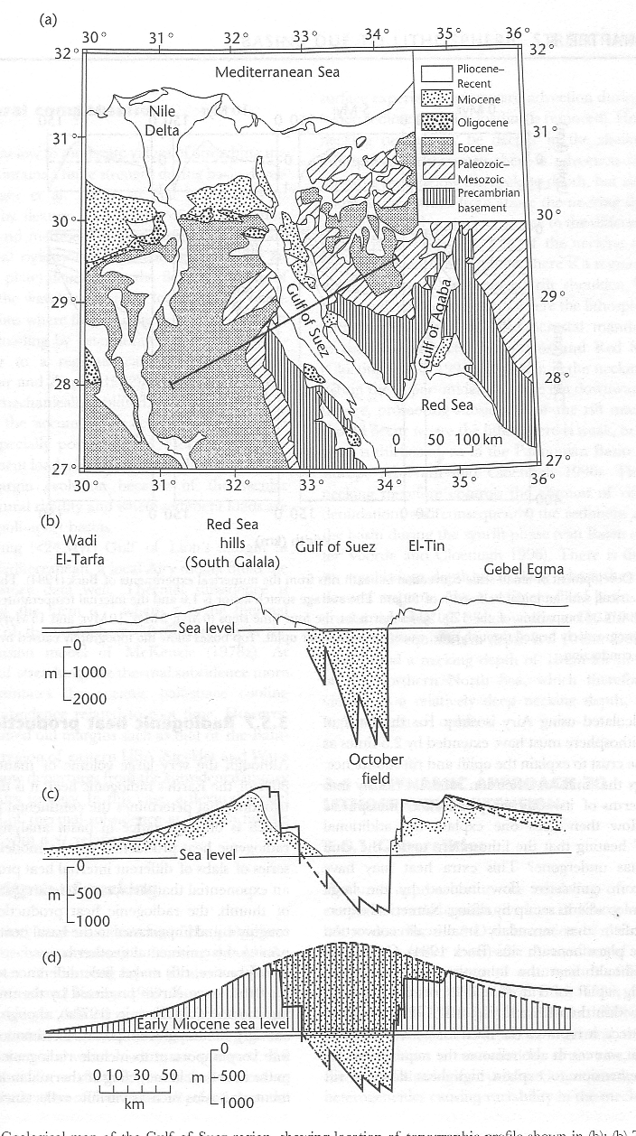
Induced mantle convection (Rift-flank-uplift) (I- “observations”)

Slide 74
Induced mantl convection (Rift-flank-uplift)
Sedimentary infill
Without erosion or sediments (Airy)

Slide 75
Induced mantl convection (Rift-flank-uplift)
Without erosion or sediments (Airy)
thermal uplift
faulting

Slide 76
Induced mantle convection
Steckler’s Red Sea Rift study suggests that rift-flank erosion occurred during the main phase of extension.
Uniform extension cannot explain observed flank uplift and erosion
Secondary convection induced by sharp lateral temperature gradients could have advected additional heat without the need for non-uniform extension

Slide 77
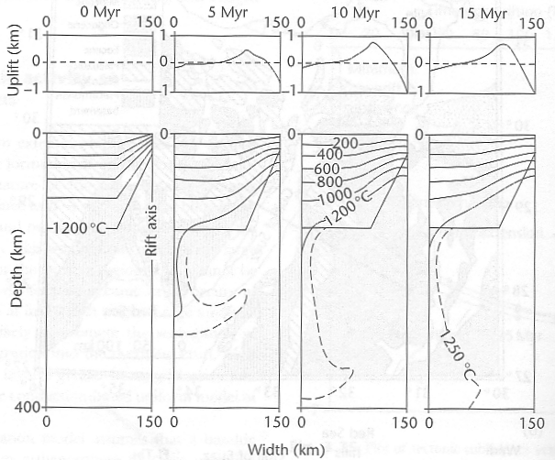
Induced mantle convection
Convection and conduction

Slide 78
Basins due to lithospheric stretching
Modification of the uniform stretching model
Induced mantle convection
Flexural compensation
Lithospheric necking
Narrow vs. wide rifts
Rheology of continental lithosphere
Mantle plumes
Melt generation during continental extension
- Stretch factor and strain rate history

Slide 79
Flexural Compensation
Local (Airy isostasy) when lithosphere is hot, young and weak and lateral strength is minimal. (J.L.)
General case of low-flexure-to-no-flexure

Slide 80
Basins due to lithospheric stretching
Magmatic activity
Induced mantle convection
Flexural compensation
Lithospheric necking
Narrow vs. wide rifts
Rheology of continental lithosphere
Mantle plumes
Melt generation during continental extension
- Stretch factor and strain rate history

Slide 81
Lithospheric Necking
Lithosphere is rheologically layered: intermingled weak and strong layers depending on temperature, strain rate, fluid content etc.

Slide 82
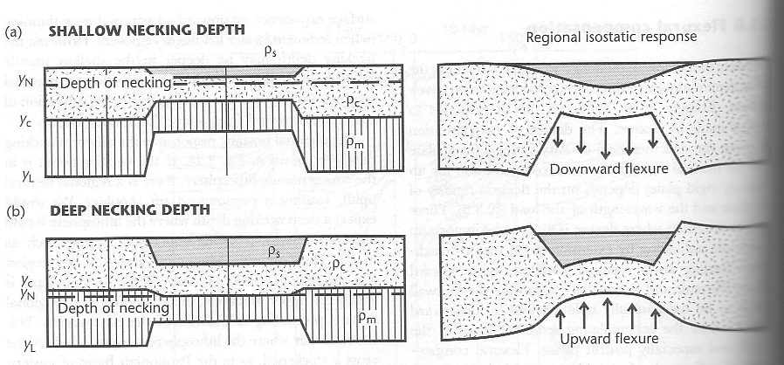
Lithospheric necking

Slide 83
Basins due to lithospheric stretching
Magmatic activity
Induced mantle convection
Flexural compensation
Lithospheric necking
Narrow vs. wide rifts
Rheology of continental lithosphere
Mantle plumes
Melt generation during continental extension
- Stretch factor and strain rate history

Slide 84
Observations on continental extension
Time scale and extension – PIZZA MODELS
Thin crust
wide rifts
Thick crust
km
km
narrow rifts
10 mm/yr
30
60
Rate of extension
Dip of master fault

Slide 85
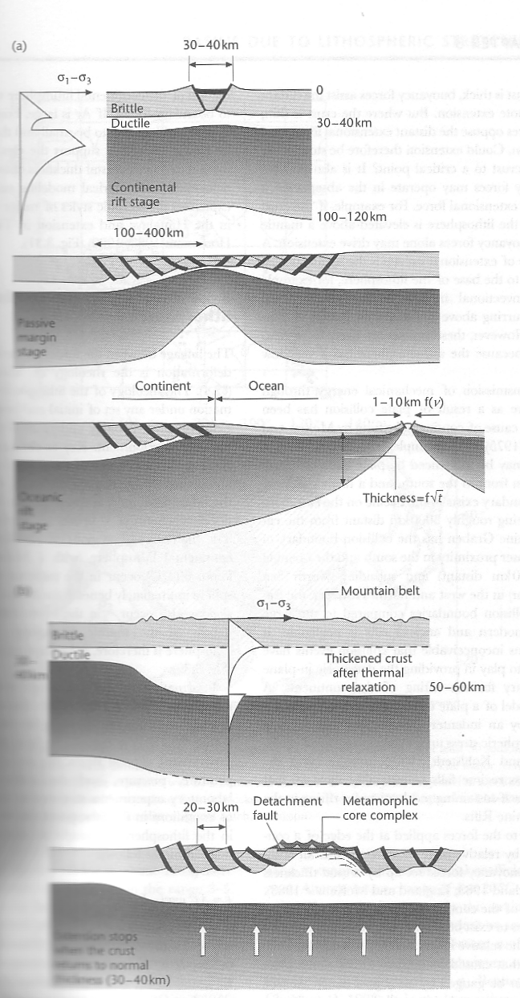
Narrow rifts with low extension

Slide 86
Basin and Range wide rift zone
Extension ends when crust reaches 30-40 km

Slide 87
Basins due to lithospheric stretching
Magmatic activity
Induced mantle convection
Flexural compensation
Narrow vs. wide rifts
Lithospheric necking
Rheology of continental lithosphere
Mantle plumes
Melt generation during continental extension
- Stretch factor and strain rate history

Slide 88
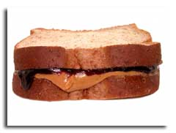
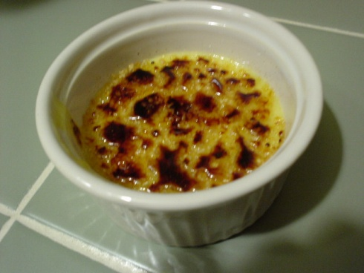
Rheology of the continental lithosphere October 11 - due October 18
Please compare the YSE model (“jelly sandwich”)
with a model where the mantle is also weak (“creme brulee”).

Slide 89
Basins due to lithospheric stretching
Magmatic activity
Induced mantle convection
Flexural compensation
Narrow vs. wide rifts
Lithospheric necking
Rheology of continental crust
Mantle plumes
Melt generation during continental extension
- Stretch factor and strain rate history

Slide 90
Mantle Plumes
In some places mantle plumes are known to exist:
Deccan Traps, Karoo of South Africa… areas of former rifting associated with anomalously hot asthenosphere

Slide 91
Mantle Plumes
“Mushroom” shape:
For example, the Cape Verde swell temperature distribution in the mantle is best modelled as:
1900 m
1500 km
1300 + C
Dynamic uplift
150 km

Slide 92
Basins due to lithospheric stretching
Magmatic activity
Induced mantle convection
Flexural compensation
Narrow vs. wide rifts
Lithospheric necking
Dynamic lithospheric extension
Rheology of continental crust
Mantle plumes
Melt generation during continental extension
- Stretch factor and strain rate history

Slide 93
Underplating
During rifting, igneous melt can pond under continental crust.
Igneous rock generated by adiabatic decompression has a density greater than continental crust and less than mantle.

Slide 94
Underplating
2.8
2.7
3.3
Continental crust
Oceanic crust
3.0
mantle

Slide 95
Underplating
Produces permanent uplift:
Uplift = Underplated thickness (1 – density underplating/density mantle)

Slide 96
Basins due to lithospheric stretching
Magmatic activity
Induced mantle convection
Flexural compensation
Narrow vs. wide rifts
Lithospheric necking
Dynamic lithospheric extension
Rheology of continental crust
Mantle plumes
Melt generation during continental extension
- Stretch factor and strain rate history

Slide 97
Stretch factor and strain rate history
Mapping Moho
Inverting stratigraphic data
Forward modeling stratigraphic data

Slide 98
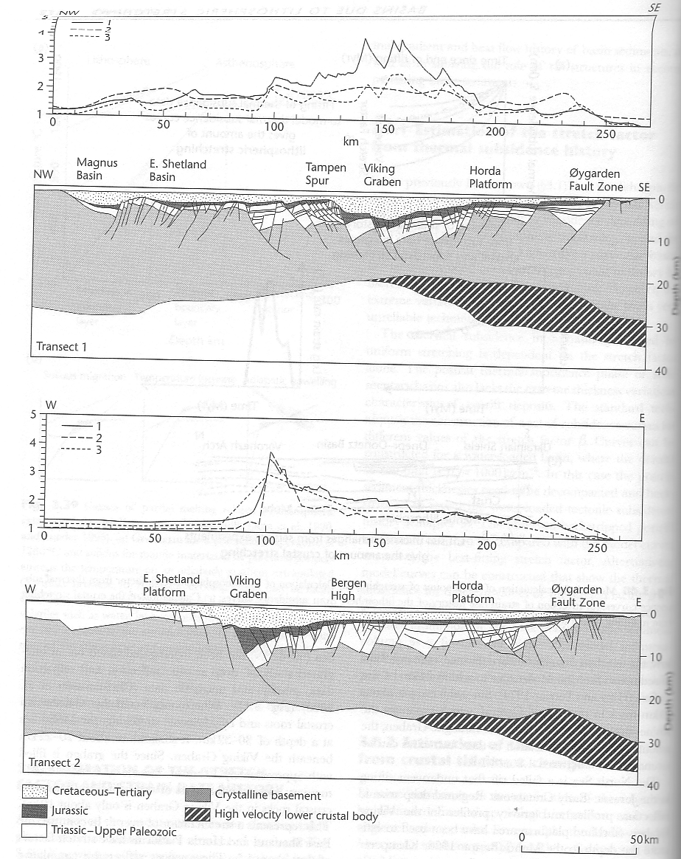
Inverse (2) and forward(3) modeled beta factors

