Slide 1
Geol 4068
Class presentation to accompany reading of
Chapter 2- Waves in Fluids
Elements of 3D Seismology,
2nd Edition
by Christopher Liner
September 6, 2005
Juan M. Lorenzo

Slide 2
Outline
What is a Fluid?
Elastic Moduli
Acoustic Solution to the Wave equation
Density
Velocity

Slide 3
Outline
What is a Fluid?
Elastic Moduli
Acoustic Solution to the Wave equation
Density
Velocity

Slide 4
TYPES OF SEISMIC MATERIALS
Fluid
(no shear strength)
Porous solid (Solid+fluid -BIOT THEORY)
Solid (shear strength and high and finite resistance to compressibility

Slide 5
Outline
What is a Fluid?
Elastic Moduli
Acoustic Solution to the Wave equation
Density
Velocity

Slide 6
Key Physical Parameters of the Acoustic Wave Equation
(Pa)
Bulk Modulus or modulus of incompressibility

Slide 7
Key Physical Parameters of the Acoustic Wave Equation
(Pa)
Bulk Modulus or modulus of incompressibility

Slide 8
Example: Ocean Water
density = 1,035 kg.m^3
Incompressibility modulus is of order 10^9 Pa

Slide 9
Outline
What is a Fluid?
Elastic Moduli
Acoustic Solution to the Wave equation
Density
Velocity

Slide 10
Different Approaches
Hooke’s Law: stress (Pa)= Y (Pa). strain
+ Newton’s Law (F=ma)
Lagrangian Mechanics (Energy Relationships)

Slide 11
Outline
What is a Fluid?
Elastic Moduli
Acoustic Solution to the Wave equation
Density
Velocity

Slide 12
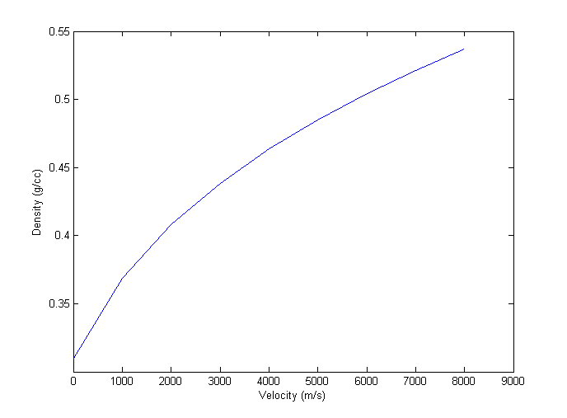
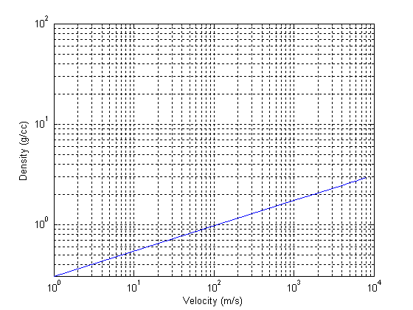
Density is given minor importance with respect to velocity. Usually velocity and density increase together.
Gardner’s Rule (Gardner et al., 1974)
density = a .V^0.25, where a=0.31
Salt: 4500-5000 m/s; 2.0-2.1 g/cc

Slide 13
Outline
What is a Fluid?
Elastic Moduli
Acoustic Solution to the Wave equation
Density
Velocity

Slide 14
(Find typo)

Slide 15
Mean velocity; traditional
Very important for basic seismic processing. Can be obtained directly from seismic field data or GPR field data. Errors ~10%

Slide 16
V=330 m/s, rho =0
z=100000m
i=1
i=2
i=3=j
s = 200m; V=1000 m/s, rho =1.6
V=1500 m/s, z= 500m rho =1.8

Slide 17
Excel macro

