Slide 1
Understanding Seismic Events
Or
“ How to tell the difference between a reflection, a refraction a diffraction from one or more buried layers”
Ch.3 of “Elements of 3D Seismology” by Chris Liner

Slide 2
Outline-1
Full space, half space and quarter space
Traveltime curves of direct ground- and air- waves and rays
Error analysis of direct waves and rays
Constant-velocity-layered half-space
Constant-velocity versus Gradient layers
Reflections
Scattering Coefficients

Slide 3
Outline-2
AVA-- Angular reflection coefficients
Vertical Resolution
Fresnel- horizontal resolution
Headwaves
Diffraction
Ghosts
Land
Marine
Velocity layering
“approximately hyperbolic equations”
multiples

Slide 4
A few NEW and OLD idealizations used by applied seismologists…..

Slide 5
IDEALIZATION #1:
“Acoustic waves can travel in either a constant velocity full space, a half-space, a quarter space or a layered half-space”

Slide 6
A full space is infinite in all directions
-z
-X
X
z

Slide 7
A half-space is semi-infinite
-X
X
z

Slide 8
A quarter-space is quarter-infinite
-X
X
z

Slide 9
Outline
Full space, half space and quarter space
Traveltime curves of direct ground- and air- waves and rays
Error analysis of direct waves and rays
Constant-velocity-layered half-space
Constant-velocity versus Gradient layers
Reflections
Scattering Coefficients

Slide 10
A direct air wave and a direct ground P-wave …..
-X
X
z

Slide 11
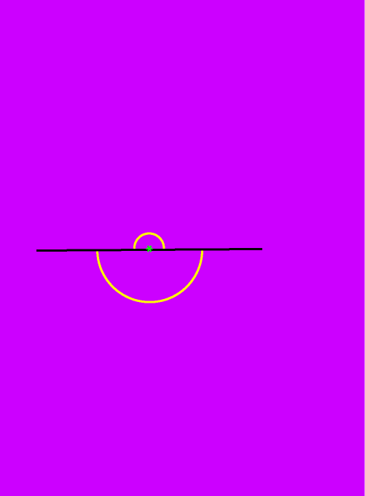
A direct air wave and a direct ground P-wave …..

Slide 12
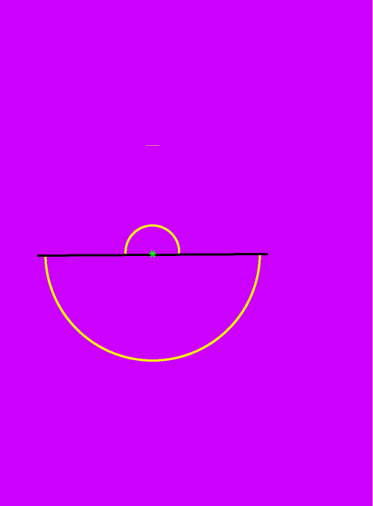
A direct air wave and a direct ground P-wave …..

Slide 13
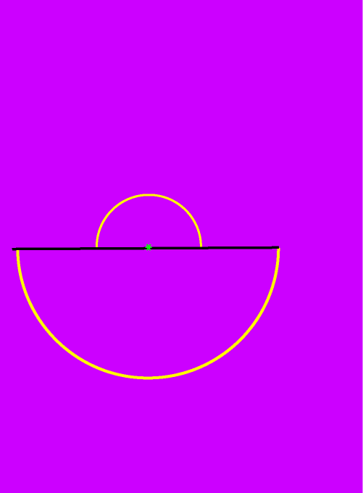
A direct air wave and a direct ground P-wave …..

Slide 14
The data set of a shot and its geophones is called a shot gather or ensemble.
Vp air
ray
wavefront
Vp ground
geophone

Slide 15
Traveltime curves for direct arrivals
Shot-receiver distance X (m)
Time (s)

Slide 16
Traveltime curves for direct arrivals
Shot-receiver distance X (m)
Direct ground P-wave e.g. 1000 m/s
Time (s)
dT
dx
Air-wave or air-blast (330 m/s)
dT
dx

Slide 17
Outline
Full space, half space and quarter space
Traveltime curves of direct ground- and air- waves and rays
Error analysis of direct waves and rays
Constant-velocity-layered half-space
Constant-velocity versus Gradient layers
Reflections
Scattering Coefficients

Slide 18
Error analysis of direct waves and rays
Originally taken from
http://www.rit.edu/cos/uphysics/uncertainties/Uncertaintiespart2.html
by Vern Lindberg
Now available from here

Slide 19
TWO APPROXIMATIONS TO ERROR ANALYSIS
Liner presents the general error analysis method with partial differentials.
Lindberg derives the uncertainty of the product of two uncertain measurements with derivatives.

Slide 20
Error of the products
“The error of a product is approximately the sum of the individual errors in the multiplicands, or multiplied values.”
V = x/t
x = V. t
where, are, respectively errors (“+ OR -”) in the estimation of distance, time and velocity respectively.

Slide 21
Error of the products
“The error of a product is approximately the sum of the individual errors in the multiplicands, or multiplied values.”
(1)
Rearrange terms in (1)
(2)
Multiply both sides of (2) by V
(3)
Expand V in (3)
(4)
Note that (5) is analogous to Liner’s equation 3.7, on page 55
(5)

Slide 22
Error of the products
“In calculating the error, please remember that t, x and V and x are the average times and distances used to calculate the slopes, i.e. dT and dx below
+ error in x
(1
}
} + error in t
}
} - error in t
Time (s)
- error in x
dT
dx
dT
dx
Region of total error

Slide 23
Traveltime curves for direct arrivals
Shot-receiver distance X (m)
Direct ground P-wave e.g. 1000 m/s
Time (s)
dT
dx
Air-wave or air-blast (330 m/s)
dT
dx

Slide 24
Outline
Full space, half space and quarter space
Traveltime curves of direct ground- and air- waves and rays
Error analysis of direct waves and rays
Constant-velocity-layered half-space
Constant-velocity versus Gradient layers
Reflections
Scattering Coefficients

Slide 25
A layered half-space
-X
X
z

Slide 26
A layered half-space
with constant-velocity layers
Eventually, …..

Slide 27
A layered half-space
with constant-velocity layers
Eventually, …..

Slide 28
A layered half-space
with constant-velocity layers
Eventually, …..

Slide 29
A layered half-space
with constant-velocity layers
………...after successive refractions,

Slide 30
A layered half-space
with constant-velocity layers
…………………………………………. the rays are turned back top the surface

Slide 31
Outline
Full space, half space and quarter space
Traveltime curves of direct ground- and air- waves and rays
Error analysis of direct waves and rays
Constant-velocity-layered half-space
Constant-velocity versus gradient layers
Reflections
Scattering Coefficients

Slide 32
Constant-velocity layers vs. gradient-velocity layers
“Each layer bends the ray along part of a circular path”

Slide 33
Outline
Full space, half space and quarter space
Traveltime curves of direct ground- and air- waves and rays
Error analysis of direct waves and rays
Constant-velocity-layered half-space
Constant-velocity versus gradient layers
Reflections
Scattering Coefficients

Slide 34
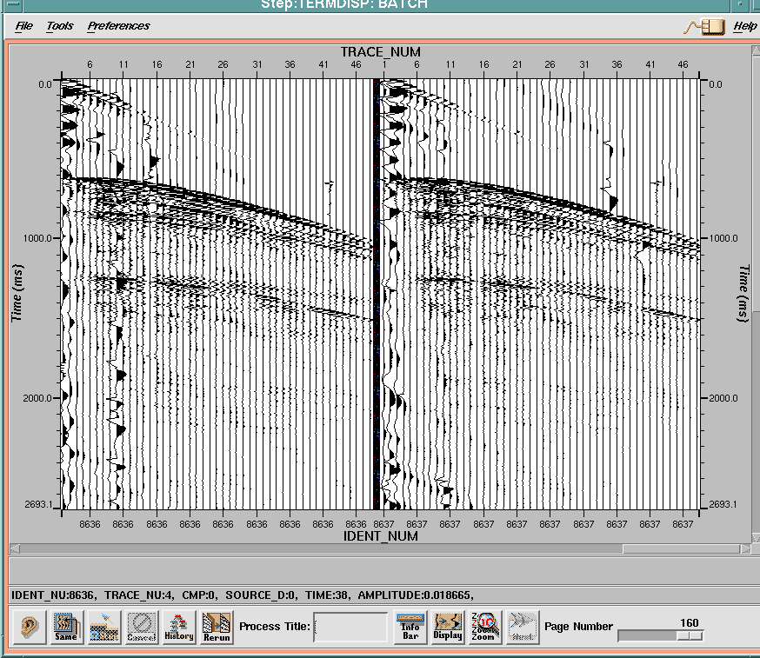

Slide 35
Direct water arrival

Slide 36
Hyperbola
y
asymptote
x
x
As x -> infinity,
Y-> X. a/b, where a/b is the slope of the asymptote

Slide 37
Reflection between a single layer and a half-space below
O
X/2
X/2
V1
h
P
Travel distance = ?
Travel time = ?

Slide 38
Reflection between a single layer and a half-space below
O
X/2
X/2
V1
h
P
Travel distance = ?
Travel time = ?
Consider the reflecting ray……. as follows ….

Slide 39
Reflection between a single layer and a half-space below
O
X/2
X/2
V1
h
P
Travel distance =
Travel time =

Slide 40
Reflection between a single layer and a half-space below
Traveltime =
(6)

Slide 41
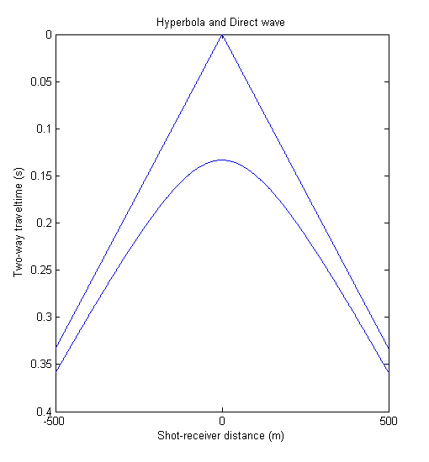
Reflection between a single layer and a half-space below and D-wave traveltime curves
asymptote
Matlab code

Slide 42
Two important places on the traveltime
hyperbola
#1 At X=0, T=2h/V1
T0=2h/V1
*
h
Matlab code

Slide 43
#1As X--> very large values, and X>>h ,
then (6) simplifies into the equation of straight line with slope dx/dT = V1
If we start with
(6)
as the thickness becomes insignificant with respect to the source-receiver distance

Slide 44
By analogy with the parametric equation for a hyperbola, the slope of this line is 1/V1 i.e.
a/b = 1/V1

Slide 45
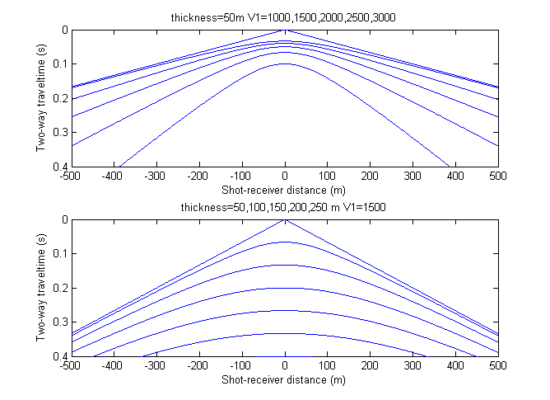
What can we tell from the relative shape of the hyperbola?
3000
Increasing velocity (m/s)
1000
50
Increasing thickness (m)
250

Slide 46
“Greater velocities, and greater thicknesses flatten the shape of the hyperbola, all else remaining constant”

Slide 47
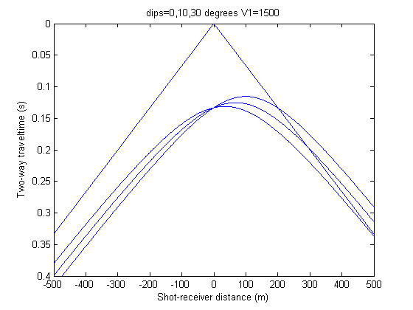
Reflections from a dipping interface
#In 2-D
Direct waves
30
10
Matlab code

Slide 48
Reflections from a 2D dipping interface
#In 2-D:
“The apex of the hyperbola moves in the geological, updip direction to lesser times as the dip increases”

Slide 49
Reflections from a 3D dipping interface
#In 3-D
Azimuth (phi)
strike
Dip(theta)

Slide 50
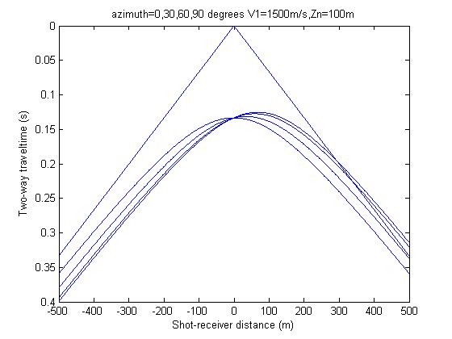
Reflections from a 3D dipping interface
#In 3-D
Direct waves
90
0
Matlab code

Slide 51
Reflections from a 2D dipping interface
#In 3-D:
“The apparent dip of a dipping interface grows from 0 toward the maximum dip as we increase the azimuth with respect to the strike of the dipping interface”

Slide 52
Outline
Full space, half space and quarter space
Traveltime curves of direct ground- and air- waves and rays
Error analysis of direct waves and rays
Constant-velocity-layered half-space
Constant-velocity versus Gradient layers
Reflections
Scattering Coefficients

Slide 53
Amplitude of a traveling wave is affected by….
Scattering Coefficient
Amp = Amp(change in Acoustic Impedance (I))
Geometric spreading
Amp = Amp(r)
Attenuation (inelastic, frictional loss of energy)
Amp = Amp(r,f)

Slide 54
Partitioning of energy at a reflecting interface at Normal Incidence
Incident
Reflected
Transmitted
Incident Amplitude = Reflected Amplitude + Transmitted Amplitude
Reflected Amplitude = Incident Amplitude x Reflection Coefficient
TransmittedAmplitude = Incident Amplitude x Transmission Coefficient

Slide 55
Partitioning of energy at a reflecting interface at Normal Incidence
Incident
Reflected
Transmitted
Scattering Coefficients depend on the Acoustic Impedance changes across a boundary)
Acoustic Impedance of a layer (I) = density * Vp

Slide 56
Nomenclature for labeling reflecting and transmitted rays
P1` P1’
N.B. No refraction, normal incidence
P1`
P1`P2`P2’P1’
P1`P2`
P1`P2`P2’ P2`
P1`P2`P2’

Slide 57
Amplitude calculations depend on transmission and reflection coefficients which depend on whether ray is traveling down or up
R12
N.B. No refraction, normal incidence
Layer 1
1
T12 R23 T21
Layer 2
T12
T12 R23 R21
T12 R23
Layer 3

Slide 58
Reflection Coefficients
R12 = (I2-I1) / (I1+I2)
R21 = (I1-I2) / (I2+I1)
Transmission Coefficients
T12 = 2I1 / (I1+I2)
T21 = 2I2 / (I2+I1)

Slide 59
Example of Air-water reflection
Air: density =0; Vp=330 m/s
water: density =1; Vp=1500m/s
Air
Layer 1
Layer 2
Water

Slide 60
Example of Air-water reflection
Air: density =0; Vp=330 m/s
water: density =1; Vp=1500m/s
R12 = (I2-I1) / (I1+I2)

Slide 61
Example of Air-water reflection
Air: density =0; Vp=330 m/s
water: density =1; Vp=1500m/s
R12 = (I2-I1) / (I1+I2)
RAirWater = (IWater-IAir) / (IAir+IWater)

Slide 62
Example of Air-water reflection
Air: density =0; Vp=330 m/s
water: density =1; Vp=1500m/s
R12 = (I2-I1) / (I2+I1)
RAirWater = (IWater-IAir) / (IAir+IWater)
RAirWater = (IWater-0) / (0+IWater)
RAirWater = 1

Slide 63
Example of Water-air reflection
Air: density =0; Vp=330 m/s
water: density =1; Vp=1500m/s
Air
Layer 1
Layer 2
Water

Slide 64
Example of Water-air reflection
Air: density =0; Vp=330 m/s
water: density =1; Vp=1500m/s
R21 = (I1-I2) / (I1+I2)

Slide 65
Example of Water-air reflection
Air: density =0; Vp=330 m/s
water: density =1; Vp=1500m/s
R22 = (I1-I2) / (I1+I2)
RWaterAir = (IAir-IWater) / (IAir+IWater)

Slide 66
Example of Water-air reflection
Air: density =0; Vp=330 m/s
water: density =1; Vp=1500m/s
R21 = (I1-I2) / (I1+I2)
RWaterAir = (IAir-IWater) / (IAir+IWater)
RWaterAir = (0-IWater) / (0+IWater)
RWaterAir = -1 ( A negative reflection coefficient)

Slide 67
Effect of Negative Reflection Coefficient on a reflected pulse

Slide 68
Positive Reflection Coefficient (~0.5)

Slide 69
“Water-air interface is a near-perfect reflector”

Slide 70
In-class Quiz
Air
1 km
Water
0.1m steel plate
What signal is received back from the steel plate by the hydrophone (triangle) in the water after the explosion?

Slide 71
In-class Quiz
T12 R23 T21 at time t2
R12 at time t1
Layer 1
Water
Layer 2
0.1m steel plate
Layer 3

Slide 72
Steel: density = 8; Vp=6000 m/s
water: density =1; Vp=1500m/s
R12 = (I2-I1) / (I1+I2)
RWaterSteel = (Isteel-Iwater) / (Isteel+Iwater)

Slide 73
Steel: density = 8; Vp=6000 m/s; I=48,000
water: density =1; Vp=1500m/s; 1500
R12 = (I2-I1) / (I1+I2)
RWaterSteel = (Isteel-Iwater) / (Isteel+Iwater)
RWaterSteel = (46,500) / (49,500)
RWaterSteel = 0.94

Slide 74
Steel: density = 8; Vp=6000 m/s; I=48,000
water: density =1; Vp=1500m/s; 1500
R21 = (I1-I2) / (I1+I2)
RSteel water= (Iwater-Isteel) / (Iwater+Isteel)
RSteel water= (-46,500) / (49,500)
Rsteel water = -0.94

Slide 75
Steel: density = 8; Vp=6000 m/s ; I=48,000
water: density =1; Vp=1500m/s; I=1500
T12 = 2I1/ (I1+I2)
T WaterSteel= 2IWater/ (Iwater+Isteel)
T WaterSteel= 3000/ (49,500)
T WaterSteel= 0.06

Slide 76
Steel: density = 8; Vp=6000 m/s ; I=48,000
water: density =1; Vp=1500m/s; I=1500
T21 = 2I2/ (I1+I2)
T SteelWater= 2ISteel/ (Iwater+Isteel)
T SteelWater= 96,000/ (49,500)
T SteelWater= 1.94

Slide 77
For a reference incident amplitude of 1
At t1: Amplitude = R12 = 0.94
At t2: Amplitude = T12R23T21
= 0.06 x -0.94 x 1.94
= -0.11 at t2
t2-t1 = 2*0.1m/6000m/s in steel
=0.00005s
=5/100 ms

Slide 78
Summation of two “realistic” wavelets

Slide 79
Either way, the answer is yes!!!

Slide 80
Outline-2
AVA-- Angular reflection coefficients
Vertical Resolution
Fresnel- horizontal resolution
Headwaves
Diffraction
Ghosts
Land
Marine
Velocity layering
“approximately hyperbolic equations”
multiples

Slide 81
Variation of Amplitude with angle (“AVA”) for the fluid-over-fluid case (NO SHEAR WAVES)
“As the angle of incidence is increased the amplitude of the reflecting wave changes”
(7)
(Liner, 2004; Eq. 3.29, p.68)

Slide 82
For pre-critical reflection angles of incidence (theta < critical angle), energy at an interface is partitioned between returning reflection and transmitted refracted wave
P`P’
P`
reflected
theta
V1,rho1
V2,rho2
Transmitted and refracted
P`P`

Slide 83
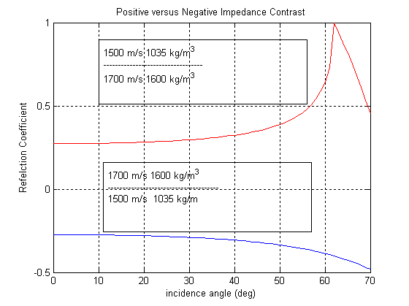
Matlab Code

Slide 84
What happens to the equation 7 as we reach the critical angle?

Slide 85
At critical angle of incidence,angle of refraction = 90 degrees=angle of reflection
P`
critical
angle
V1,rho1
P`P’
V2,rho2

Slide 86
At criticality,
The above equation becomes:

Slide 87
For angle of incidence > critical angle;
angle of reflection = angle of incidence and there are no refracted waves i.e. TOTAL INTERNAL REFLECTION
P`
critical
angle
V1,rho1
P`P’
V2,rho2

Slide 88
The values inside the square root signs can be negative, so that the numerator, denominator and reflection coefficient become complex numbers

Slide 89
A review of the geometric representation of complex numbers
Imaginary (+)
(REAL)
a
B (IMAGINARY)
Real (-)
Real (+)
Complex number = a + ib
i = square root of -1
Imaginary (-)

Slide 90
Think of a complex number as a vector
Imaginary (+)
b
C
a
Real (+)
Real (-)
Imaginary (-)

Slide 91
Imaginary (+)
b
C
a
Real (+)
1. Amplitude (length) of vector
2. Angle or phase of vector

Slide 92
IMPORTANT QUESTIONS
1. Why does phase affect seismic data? (or.. Does it really matter that I understand phase…?)
2. How do phase shifts affect seismic data? ( or ...What does it do to my signal shape?

Slide 93
1. Why does phase affect seismic data? (or.. Does it really matter that I understand phase…?)
Fourier Analysis
Phase
frequency
Power or Energy or Amplitude
frequency

Slide 94
1. Why does phase affect seismic data?
Signal processing through Fourier Decomposition breaks down seismic data into not only its frequency components (Real portion of the seismic data) but into the phase component (imaginary part). So, decomposed seismic data is complex.
If you don’t know the phase you cannot get the data back into the time domain. When we bandpass filter we can choose to change the phase or keep it the same (default)
Data is usually shot so that phase is as close to 0 for all frequencies.

Slide 95
IMPORTANT QUESTIONS
2. How do phase shifts affect seismic data?
Let’s look at just one harmonic component of a complex signal
is known as the phase
A negative phase shift ADVANCES the signal and vice versa
The cosine signal is delayed by 90 degrees with respect to a sine signal

Slide 96
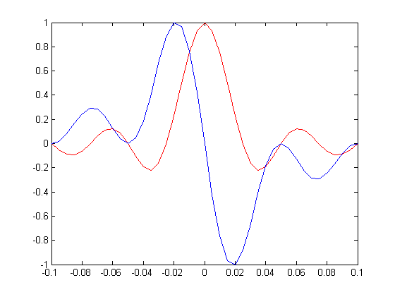
If we add say, many terms from 0.1 Hz to 20 Hz with steps of 0.1 Hz for both cosines and the phase shifted cosines we can see:
Matlab code

Slide 97
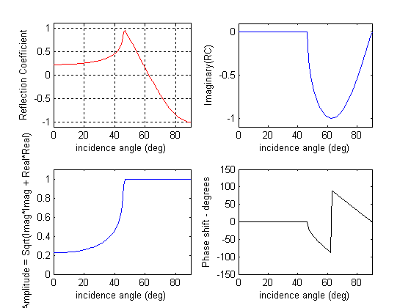
Reflection Coefficients at all angles- pre and post-critical
Matlab Code

Slide 98
NOTES: #1
At the critical angle, the real portion of the RC goes to 1. But, beyond it drops. This does not mean that the energy is dropping. Remember that the RC is complex and has two terms. For an estimation of energy you would need to look at the square of the amplitude. To calculate the amplitude we include both the imaginary and real portions of the RC.

Slide 99
NOTES: #2
For the critical ray, amplitude is maximum (=1) at critical angle.
Post-critical angles also have a maximum amplitude because all the energy is coming back as a reflected wave and no energy is getting into the lower layer

Slide 100
NOTES: #3
Post-critical angle rays will experience a phase shift, that is the shape of the signal will change.

Slide 101
Outline-2
AVA-- Angular reflection coefficients
Vertical Resolution
Fresnel- horizontal resolution (download Sheriff’s paper (1996) in PDF format HERE)
Headwaves
Diffraction
Ghosts
Land
Marine
Velocity layering
“approximately hyperbolic equations”
multiples

Slide 102
Vertical Resolution
How close can two reflectors be before you can not distinguish between them?
Lab Exercise

Slide 103
Vertical Resolution
How close can two reflectors be before you can not distinguish between them?
Look at Liner’s movie VertRes.mov to find out!
What happens when the delay in reflections is approximately the same size as the dominant period in the wavelet?
Can you resolve the top and bottom of the bed when the delay is 1/2 the dominant period? What is the thickness in terms of lambda at this point.

Slide 104
Outline-2
AVA-- Angular reflection coefficients
Vertical Resolution
Fresnel- horizontal resolution (download Sheriff’s paper (1996) in PDF format HERE)
Headwaves
Diffraction
Ghosts
Land
Marine
Velocity layering
“approximately hyperbolic equations”
multiples

Slide 105
If we accept Huygen’s Principle, then every point on a returning wavefront is the result of many smaller wavefronts that have been added together. The first Fesnel zone is that area of the subsurface that has contributed the most visibly to each point on a returning wavefront.

Slide 106
Fresnel Zone reflection contributions arrive coherently and thus reinforce.

Slide 107
Within a Fresnel Zone reflection contributions arrive coherently and thus reinforce.

Slide 108
Within a Fresnel Zone reflection contributions arrive coherently and thus reinforce.

Slide 109
Within a Fresnel Zone reflection contributions arrive coherently and thus reinforce.
First visible seismic arrivals at receiver

Slide 110
Within a Fresnel Zone reflection contributions arrive coherently and thus reinforce.

Slide 111
Within a Fresnel Zone reflection contributions arrive coherently and thus reinforce.
Additional seismic waves keep arriving at the same point

Slide 112
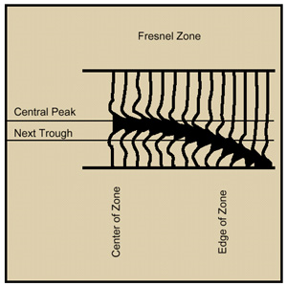
Within a Fresnel Zone reflection contributions arrive coherently and thus reinforce.
Outside peaks and troughs tend to cancel each other and thus make little net contribution. (Sheriff, 1996; AAPG Explorer)
=
Add these seismic arrivals over time

Slide 113
Fresnel Zone reflection contributions arrive coherently and thus reinforce.
O
A
A’
is the first Fresnel zone from where we consider the greatest contribution comes to our seismic arrivals

Slide 114
Lateral Resolution
A-A’ is the first or primary Fresnel zone = 2r
A
r
A’
Assume that the depth to the target >>

Slide 115
Lateral Resolution
A-A’ is the first or primary Fresnel zone = 2r
V1
(8)
A
r
A’
The first Fresnel zone (=2r) is proportional to
V1, square root of t and
square root of the frequency
Assume that the depth to the target >>

Slide 116
Fresnel zone using Kirchoff Theory using a Ricker wavelet
Amplitude = A (time, Reflection Coefficient)
Reflection from a disk is equivalent to:
Sum of the reflection from the center of the disk and reflection from the edge of the disk
+

Slide 117
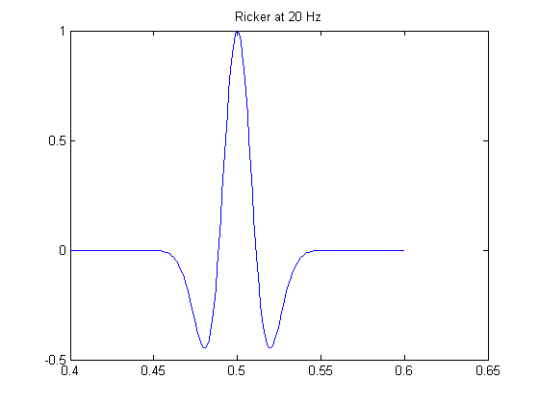
A Ricker wavelet
Matlab code

Slide 118
Fresnel zone using Kirchoff Theory using a Ricker wavelet
A(t,R) = Ricker(tcenter) -
Ricker(tedge)
+

Slide 119
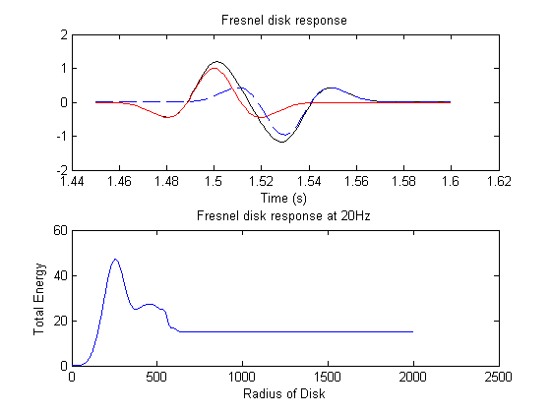
Fresnel zone using Kirchoff Theory using a Ricker wavelet
A(t,R) = Ricker(tcenter) -
Ricker(tedge)
+
Matlab Code

Slide 120
Fresnel zone using Kirchoff Theory using a Ricker wavelet
The second Fresnel zone provides additional high-energy amplitude

Slide 121
Outline-2
AVA-- Angular reflection coefficients
Vertical Resolution
Fresnel- horizontal resolution
Headwaves
Diffraction
Ghosts
Land
Marine
Velocity layering
“approximately hyperbolic equations”
multiples

Slide 122
At critical angle of incidence,
angle of refraction = 90 degrees=angle of reflection
P`
critical
angle
V1,rho1
P`P’
V2,rho2

Slide 123
Pre- and Post-critical Rays
x
z
V1
Critical distance
V2> V1
V2
Direct wave
Pre-critical reflections
Head wave
Post-critical reflections

Slide 124
One-layer Refracted Head Wave
Xc =? Tc=?
x
Critical distance=Xc
z
r1
r1
r3
V1
r2
V2> V1
V2

Slide 125
One-layer Refracted Head Wave
Xc =? Tc=?
x
Critical distance=Xc
z
z0
r1
r1
r3
V1
r2
V2> V1
V2
(9)

Slide 126
One-layer Refracted Head Wave
Xc =? Tc=?
Xc +
x
Critical distance=Xc
z
z0
r1
r1
r3
V1
r2
V2> V1
V2
(10)

Slide 127
Outline-2
AVA-- Angular reflection coefficients
Vertical Resolution
Fresnel- horizontal resolution
Headwaves
Diffraction
Ghosts
Land
Marine
Velocity layering
“approximately hyperbolic equations”
multiples

Slide 128
Diffraction
When an object is substantially smaller than the dominant wavelength in your data it can act as a point scatterer sending rays in all directions. We call this a diffractor.
A point scatter may correspond geologically to a reflector termination, as caused by a fault or by an erosional surface, or it may be the top of a hill (e.g., volcano) or narrow bottom of a valley (e.g., scour surface)

Slide 129
Diffraction

Slide 130
Diffraction

Slide 131
Diffraction

Slide 132
Diffraction

Slide 133
Diffraction
Xsource, zsource
Xreceiver, Zreceiver
x
z
r1
r2
Xdiffractor, Zdiffractor

Slide 134
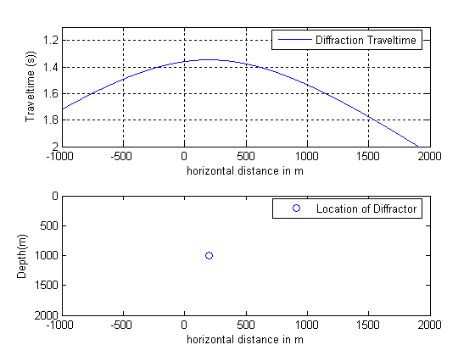
Diffraction
Matlab Code

Slide 135
Diffraction
A diffraction produces a hyperbola in our plots.
A diffraction can be confused with a hyperbola from a dipping bed in our plots.
However, in a seismic processed section (“0-offset,traveltime space) the dipping bed can be distinguished from a the point diffractor. The hyperbola from the dipping bed will change into a flat surface and the diffraction remains as a hyperbola.

Slide 136
Diffraction in 0-offset-traveltime space, i.e. a “seismic section”
x
time

Slide 137
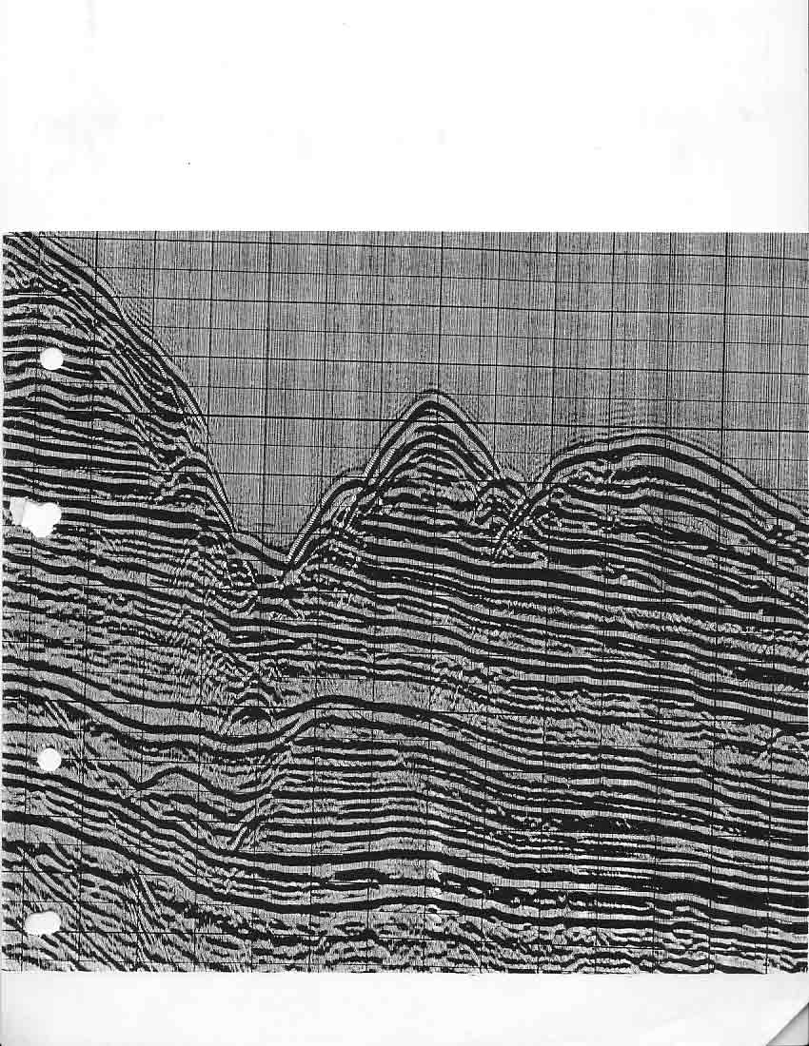
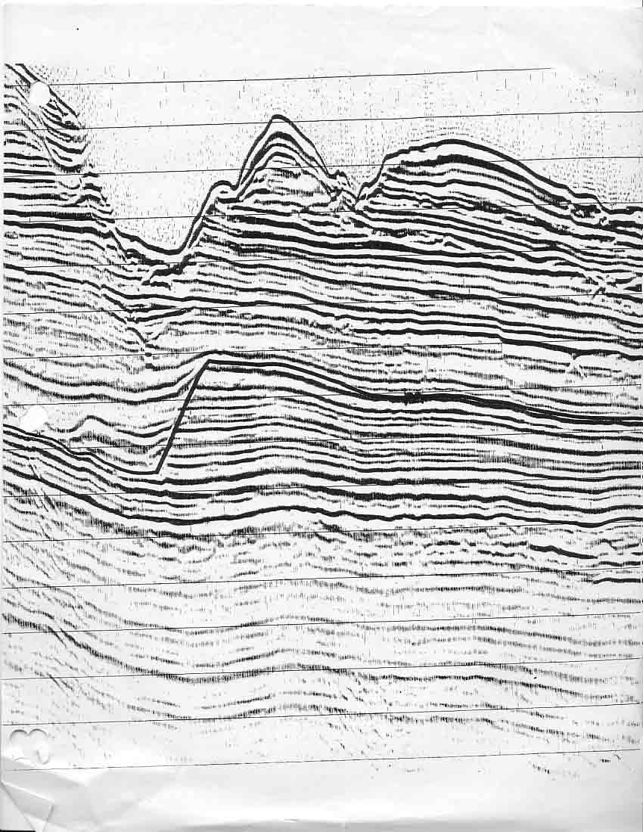
R/V Ewing Line ODP 150
With constant-velocity migration
Unmigrated

Slide 138
Outline-2
AVA-- Angular reflection coefficients
Vertical Resolution
Fresnel- horizontal resolution
Headwaves
Diffraction
Ghosts
Land
Marine
Velocity layering
“approximately hyperbolic equations”
multiples

Slide 140
1
1
2B
2A
3
3
2B

Slide 141
1
1
1
TWTT(s)

Slide 142
2A
2A
TWTT(s)

Slide 143
2B
2B
TWTT(s)

Slide 144
3
3
3
TWTT(s)

Slide 145
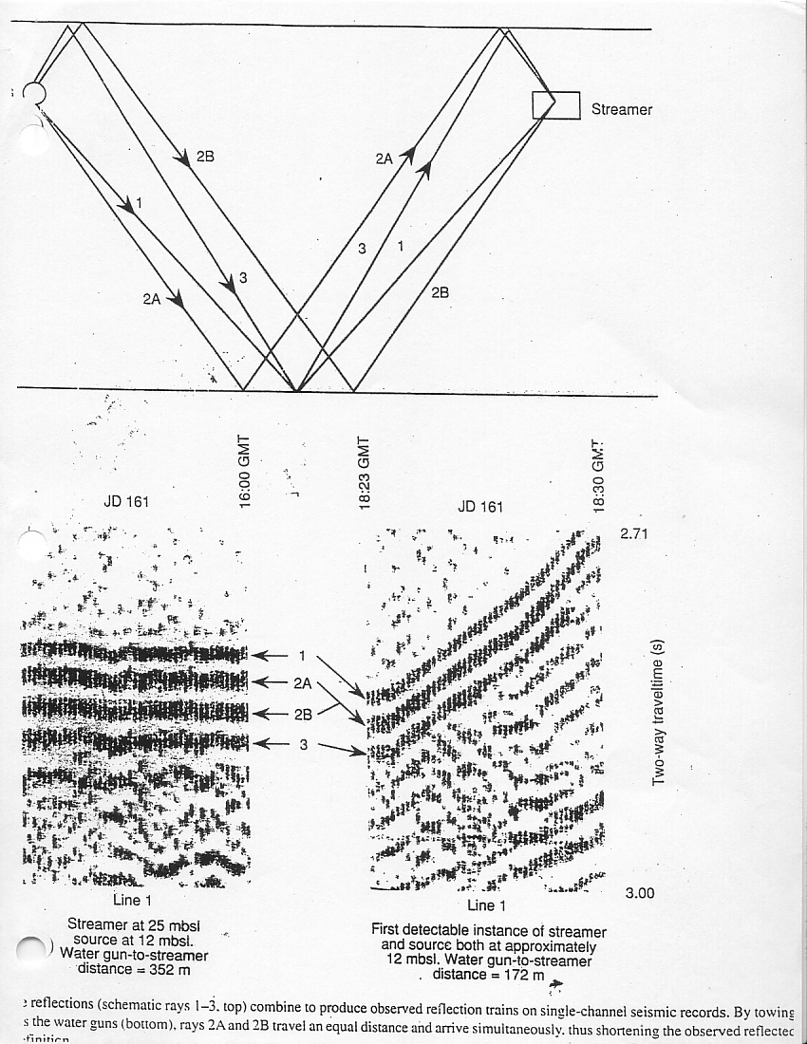
Ghosts
Ocean Drilling Program Leg 150

Slide 146
Ghosting
3
3
3
TWTT(s)

Slide 147
z

Slide 148
Ghosting
All reflected signals are ghosted.
Ghosting depends on the (1) ray angle, (2) depth of the receivers and (3) sources.
Ghosting affects the shape and size of the signal independently of the geology.

Slide 149
Outline-2
AVA-- Angular reflection coefficients
Vertical Resolution
Fresnel- horizontal resolution
Headwaves
Diffraction
Ghosts
Land
Marine
Velocity layering
“approximately hyperbolic equations”
multiples

Slide 150
Approximating reflection events with hyperbolic shapes
We have seen that for a single-layer case:
(rearranging equation 6)
V1
h1

Slide 151
Approximating reflection events with hyperbolic shapes
From Liner (2004; p. 92), for an n-layer case we have:
h1
h2
h3
h4
For example, where n=3, after 6 refractions and 1 reflection per ray we have the above scenario

Slide 152
Approximating reflection events with hyperbolic shapes
Coefficients c1,c2,c3 are given in terms of a second function set of coefficients, the a series, where am is defined as follows:
For example, in the case of a single layer we have:
One-layer case (n=1)

Slide 153
Two-layer case(n=2)

Slide 154
The “c” coefficients are defined in terms of combinations of the “a” function, so that:

Slide 155
One-layer case (n=1)

Slide 156
Two-layer case (n=2)
C2=1/Vrms (See slide 14 of “Wave in Fluids”)

Slide 157
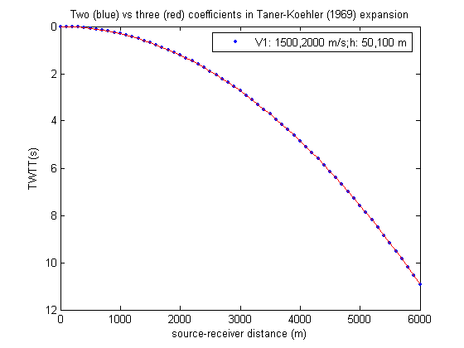
Two-layer case (n=2)
What about the c3 coefficient for this case?
Matlab Code

Slide 158
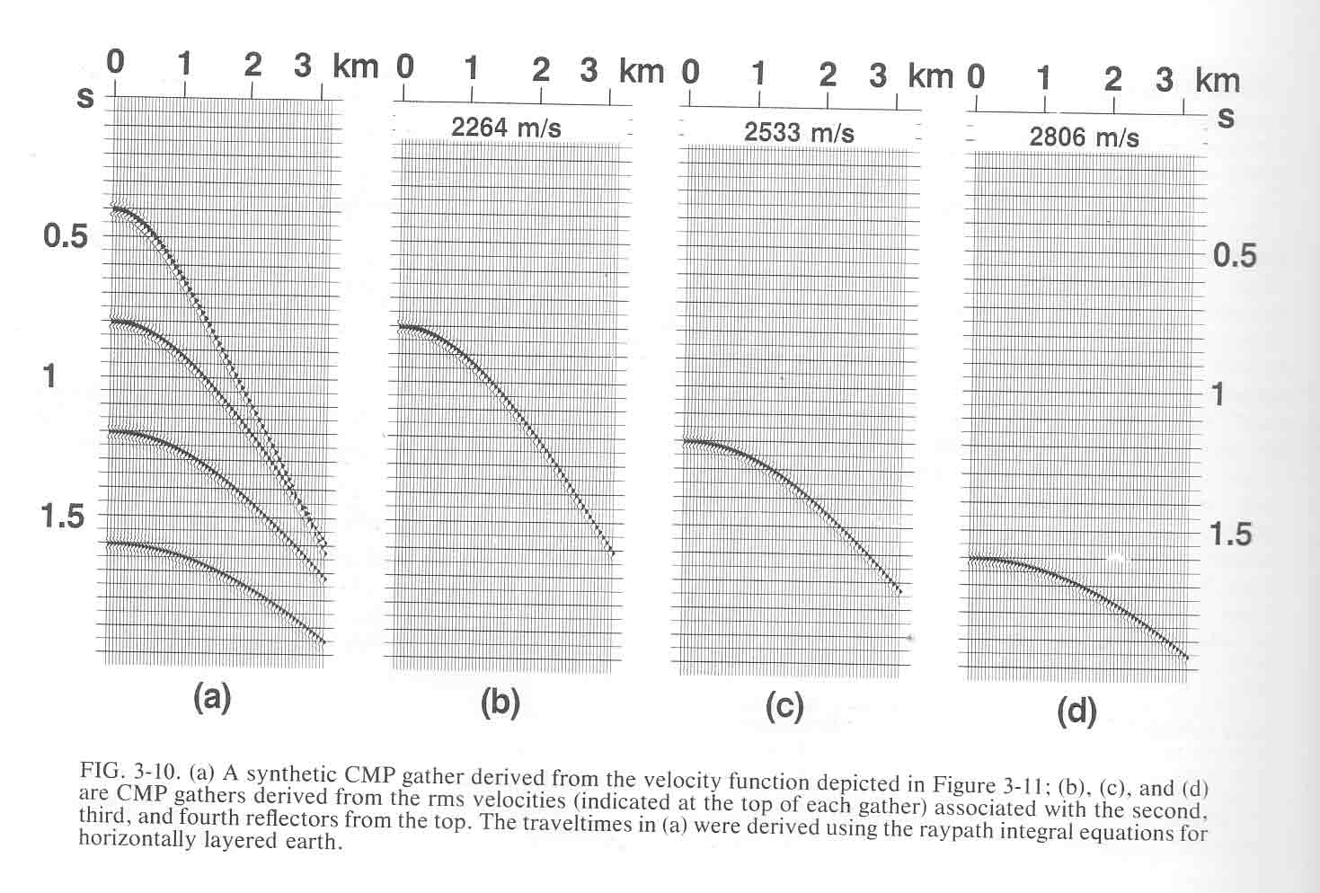
Four-layer case (n=4) (Yilmaz, 1987 ;Fig. 3-10;p.160;
Matlab code
For a horizontally-layered earth and a small-spread hyperbola

Slide 159
Outline-2
AVA-- Angular reflection coefficients
Vertical Resolution
Fresnel- horizontal resolution
Headwaves
Diffraction
Ghosts
Land
Marine
Velocity layering
“approximately hyperbolic equations”
multiples

Slide 160
Multiples
Any reflection event that has experienced more than one reflection in the subsurface (Liner, 2004; p.93)
Short path e.g., ghosts
Long-path e.g., sea-bottom multiples

Slide 161
Sea-bottom Multiples in Stacked Seismic Sections (0-offset sections)
for a Horizontal Seafloor
X (m)
Primary
M1
TWTT(s)
M2

Slide 162
Sea-bottom Multiples in Stacked Seismic Sections (0-offset sections)
for a Dipping Seafloor
X (m)
Primary
M1
TWTT(s)
M2

Slide 163
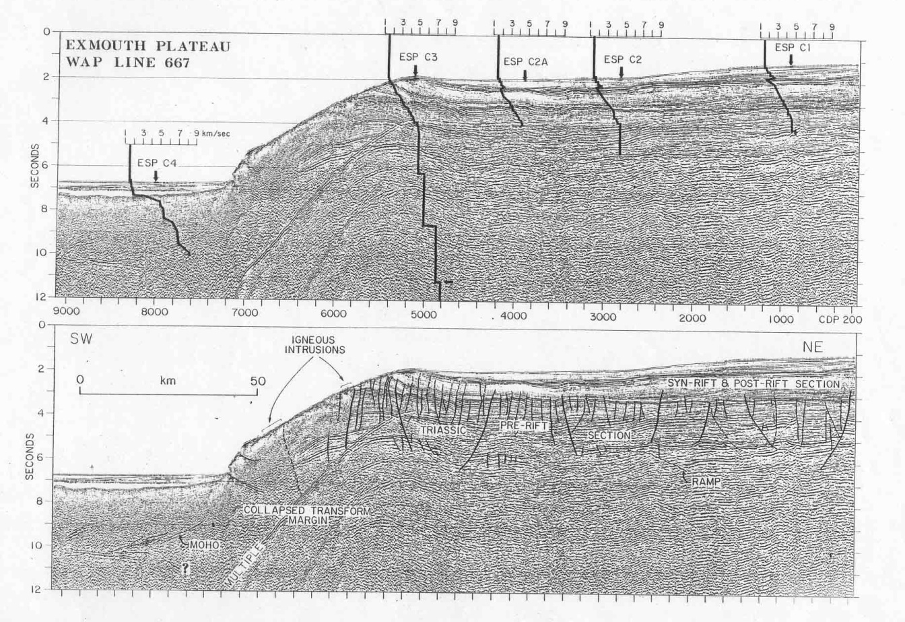
Sea-bottom Multiples in Stacked Seismic Sections (0-offset sections)
for a Dipping Seafloor in Northern West Australia

Slide 164
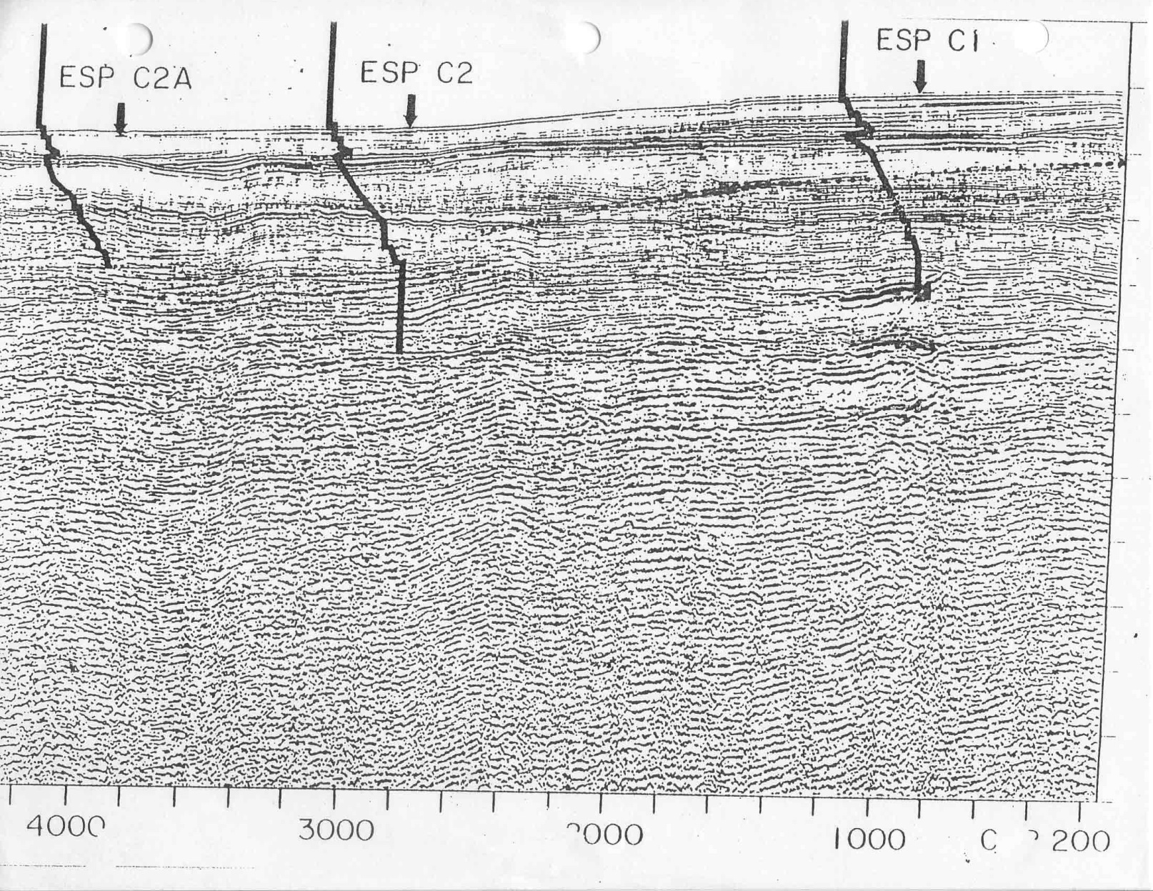
Sea-bottom Multiples in Stacked Seismic Sections (0-offset sections)
for a Dipping Seafloor in North West Australia

Slide 165
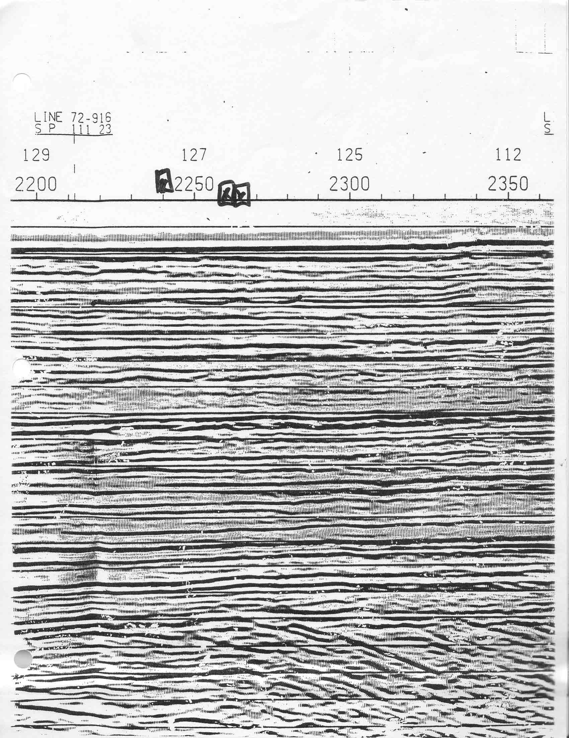
Sea-bottom Multiples in Stacked Seismic Sections
(0-offset sections)
for a Dipping Seafloor in Northern
Australia- Timor Sea

Slide 166
Sea-bottom Multiples in a CMP gather
Source-receiver distance (m)
m/s
T0
Two-way traveltime (s)
2T0
M1

Slide 167
Sea-bottom Multiples in a CMP gather
for a Flat Seafloor
Time to the apex of the hyperbola is a multiple
of the primary reflection
The hyperbola of the multiple has the same
asymptote as the primary

Slide 168
Why is the multiple asymptotic to the same slope as the primary arrival?
Why does the apex of the multiple hyperbola have twice the time as that of the primary hyperbola?
M1
depth
z
2z
M1

Slide 169
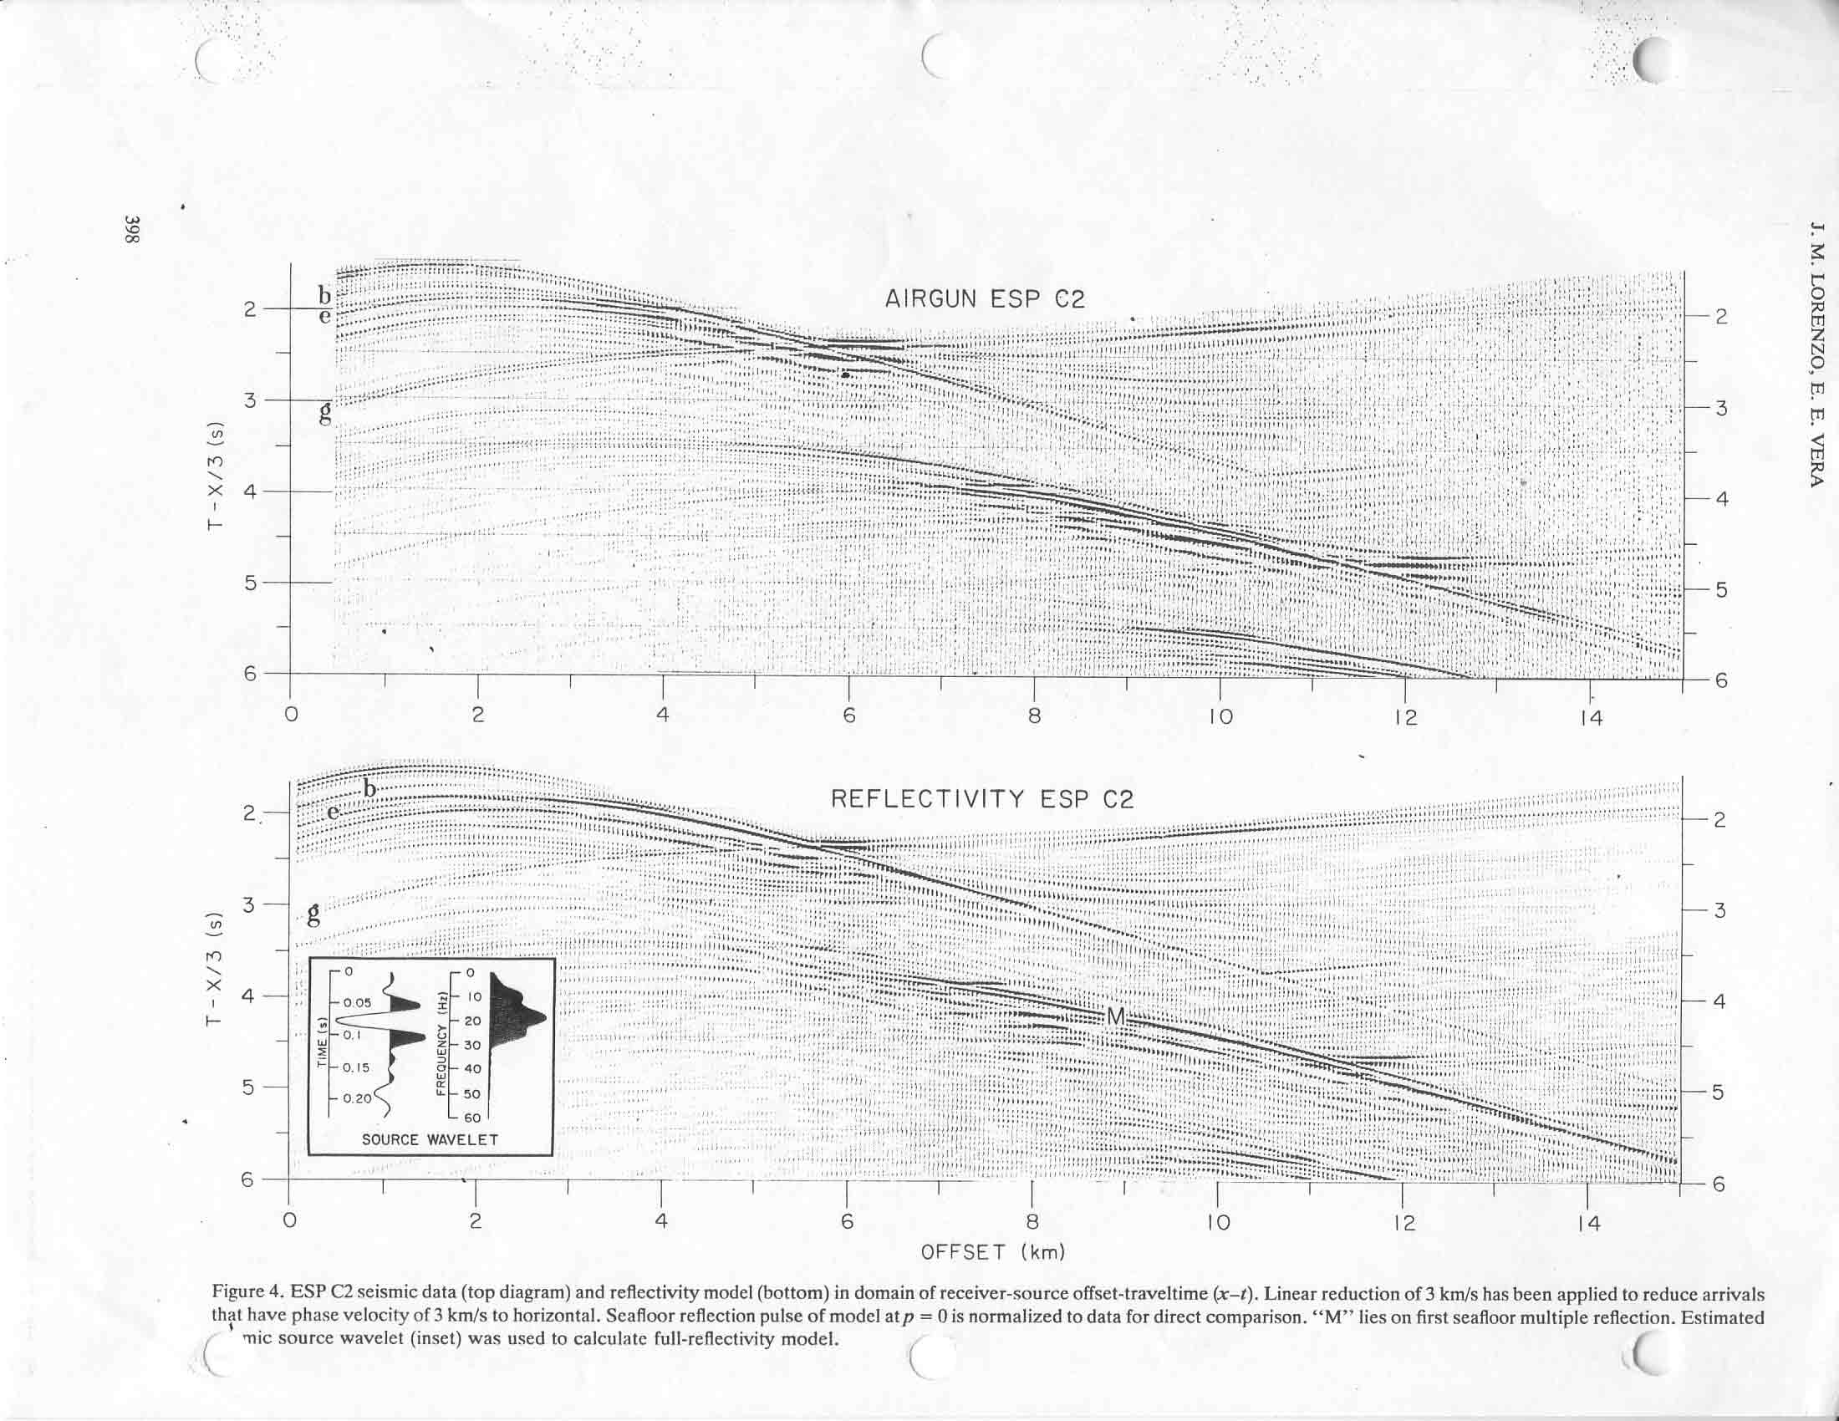
Sea-bottom Multiples in CMP in
Northern Western Australia

Slide 170
FIN

