Slide 1
Surface Wave Dispersion
James Crane
Bolu Owolana

Slide 2
Outline
Introduction
History
Concept
Examples
Conclusions

Slide 3
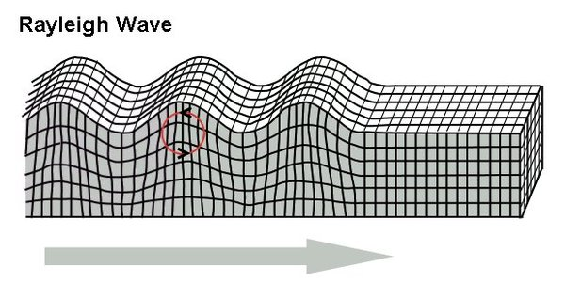
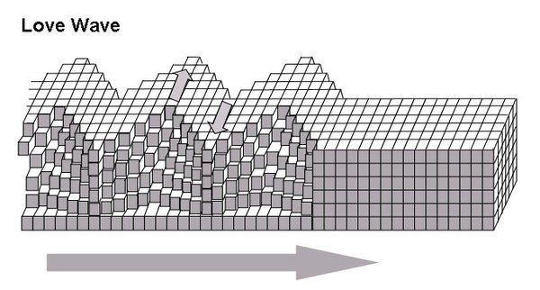
Intro
What is a surface wave
Types
Rayleigh waves are used for inversion

Slide 4
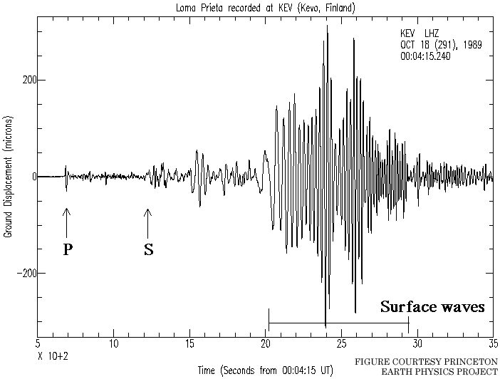
History
Earliest theoretic study of dispersion was made by Love.
Many years later Lord Rayleigh worked out the theory of wave propagation along free surface with retrograde elliptical motion
http://slam.asu.edu/images/seismogram.gif

Slide 5
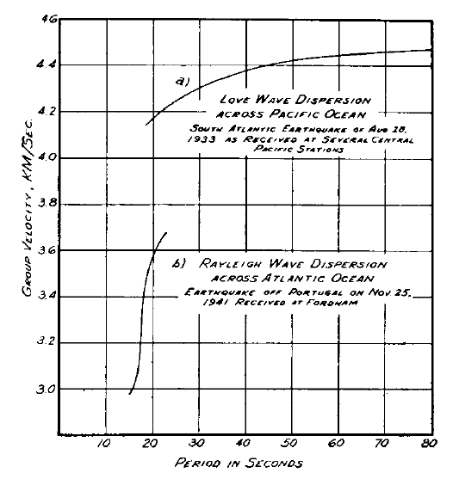
Concept
Dispersion: waves spreading out at different velocities.
Group vs. Phase velocity

Slide 6
Group vs Phase velocity

Slide 7
Dispersion
Phase/group velocities vary with wavelength
Can be used to evaluate subsurface characteristics because the depth of investigation is wavelength dependent
longer wavelengths reflect the depths to which they travel
Shorter wavelengths provide crucial information about the shallow subsurface

Slide 8
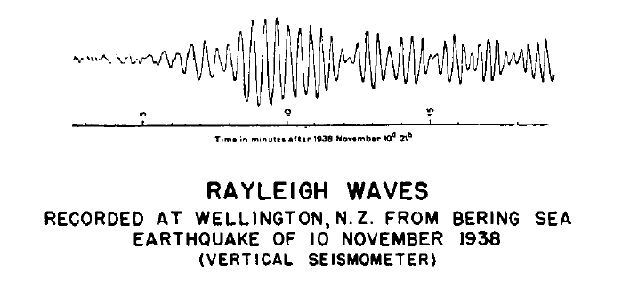
Examples
Earthquakes

Slide 9
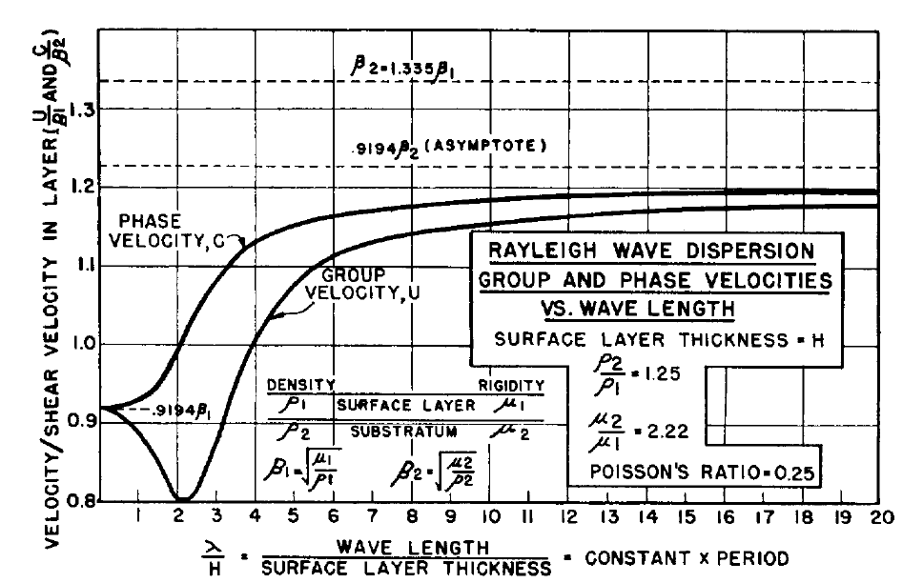

Slide 10
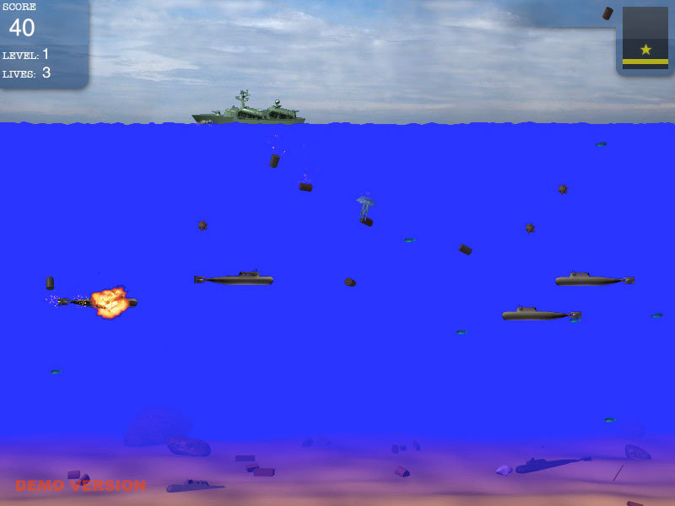
Underwater explosions
Depth charges set off
Noticed dispersion on the pressure wave
High frequency (short wavelength) arrived first indicating a high velocity

Slide 11
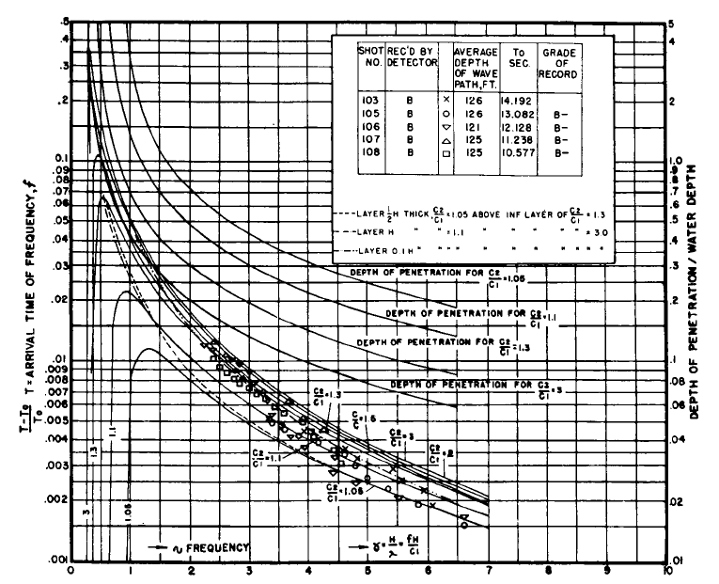
Submarine Geology – Bikini Atoll

Slide 12
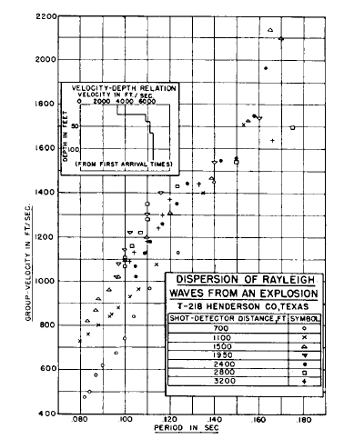
Ground roll

Slide 14
Conclusion
Surface waves are useful in determining velocity, density, elastic properties.
Surface waves can be a useful by-product of seismic exploration rather than a waste product.

