Slide 1
Automatic Picking of First Arrivals
He Dian and Ting Sun

Slide 2
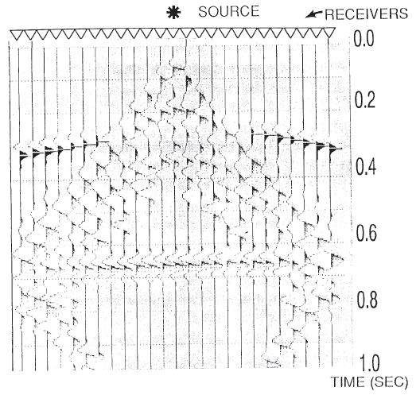
Definition
The first-break picking is that of identifying or picking the first arrivals of refracted signals from all the signals received by the receiver arrays for a particular source signal generation.

Slide 3
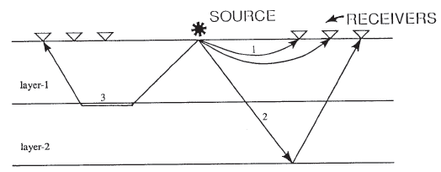
Direct arrivals
Reflected arrivals
Refracted arrivals

Slide 4
Why?
One of the methods for studying the near-surface low-velocity zone and for subsequent determination of static corrections is the technique of employing first arrivals.
A common static correction is the weathering correction, which compensates for a layer of low seismic velocity material near the surface of the Earth.

Slide 5
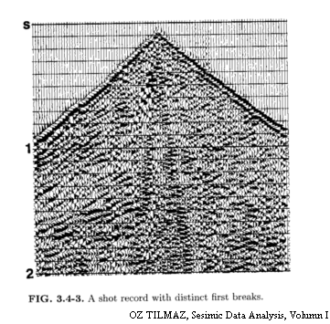

Slide 6
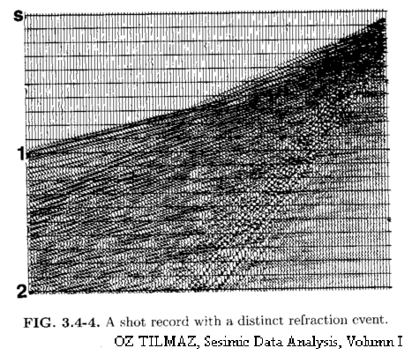

Slide 7
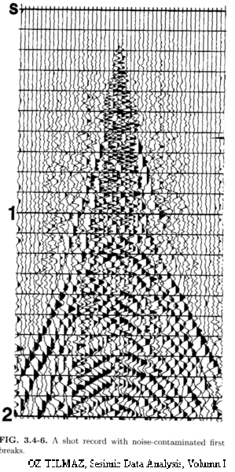

Slide 8
Application
Static corrections for seismic data processing, an important step in producing high-quality seismic sections.
The weathering layer lead to near-surface low-velocity zone and produces travel-time anomalies , and the anomalies result in false subsurface structures in later seismic processing. However, the anomalies can be corrected by using the first break arrival times on refraction signals.

Slide 9
Application
Detailed knowledge of the structure of the low-velocity zone.

Slide 10
Application
Used as observation data in reservoir history matching
History matching is the act of adjusting a model of a reservoir until it closely reproduces the past behavior of a reservoir. The past behavior can be production data and pressure data, well log and seismic data.
The accuracy of the history matching depends on the quality of the reservoir model and the quality and quantity of observation data.
Once a model has been history matched, it can be used to simulate future reservoir behavior with a higher degree of confidence.

Slide 11
Difficulties
The main difficulties are connected with the properties of noise on seismograms:
There is always a non-zero level of noise before first arrive.
2. The analysis of field data shows that first arrival and noise can be spatially correlated over short distances.
3. Other anomalies in the topography of the survey region.

Slide 12
Methods
Coherence method.
Cross correlation method.
Combination of the correlation method an linear least squares prediction technique.
Neural Networks.
Fractal-based algorithm.

Slide 13
Automatic picking of first arrivals
Assume that the data of first arrivals are presented by a seismogram uj,n with N traces recorded at points xn=nΔx, n=1, …, N, at time moments tj=jΔt, j=1, …, J.

Slide 14
Automatic picking of first arrivals
First step of the algorithm…
Destruction of a possible spatial correlation of noise.
This is achieved by suppression of noise with an amplitude below a certain level.
This level is defined by estimation of the average maximum noise level in a given time-space window before the first arrivals.

Slide 15
Automatic picking of first arrivals
First step of the algorithm…
Let such a window be on the traces m1 to m2
For each trace m, the maximum noise level is defined,
Average maximum level of noise,
Define a unit step function,
The process of noise suppression is expressed as,
where α is a minimum threshold value of the ratio of the signal to the average maximum noise level.

Slide 16
Automatic picking of first arrivals
Second step of the algorithm…
is first-arrival detection.
This is based on statistical estimates obtained by summation of traces along straight lines in given directions.
In order to define the directions of summation, we introduce the dimensionless slowness:
where Δx is the distance between traces, Δt is the time sampling interval and vk is the apparent velocity in the direction of summation.

Slide 17
Automatic picking of first arrivals
Second step of the algorithm…
Define a range of summation over L traces, with L=2LH+1 around the central trace n.
Then by summation in direction Pk, get the average,
And the standard deviation
Now introduce the function,

Slide 18
Automatic picking of first arrivals
Second step of the algorithm…
The function can serve as a good estimate for signal-to-noise ratio, as can be clearly seen from two extreme cases.
(1) absence of signal gives a very small value for W
(2) ideal signal on all traces gives infinite value for W

Slide 19
Automatic picking of first arrivals
Second step of the algorithm…
However, in practice we do not know the real distribution of U and furthermore, we must deal with very small ranges of summation.
Thus, propose the following criterion for signal detection
where assuming that on M traces (M<L) there are random deviations of noise with the same amplitude a in a direction Pk. The noise is negligible on the remaining L-M traces.

Slide 20
Automatic picking of first arrivals
Second step of the algorithm…
can serve as a measure of reliability of signal detection.
The inequality
is a criterion for making a decision regarding the presence of a signal. This means that we eliminate the possibility of false detection due to random correlation of noise on M traces.

Slide 21
Automatic picking of first arrivals
Third step of the algorithm…
Find the time of first arrivals on trace n.
Average in a given time window IΔt,
Next, for every value of k we find a minimum value of j, let it equal , for which the inequality
is satisfied.

Slide 22
Automatic picking of first arrivals
Third step of the algorithm…
In order to increase the reliability of detection, we demand that this inequality is satisfied for several consecutive values of in j.
Then, we find the minimum of all the values , let it equal .
The value
thus is the estimate of the time of first arrivals on trace n.

Slide 23
Thanks
Questions?

