Slide 1
Snell’s Law

Slide 2
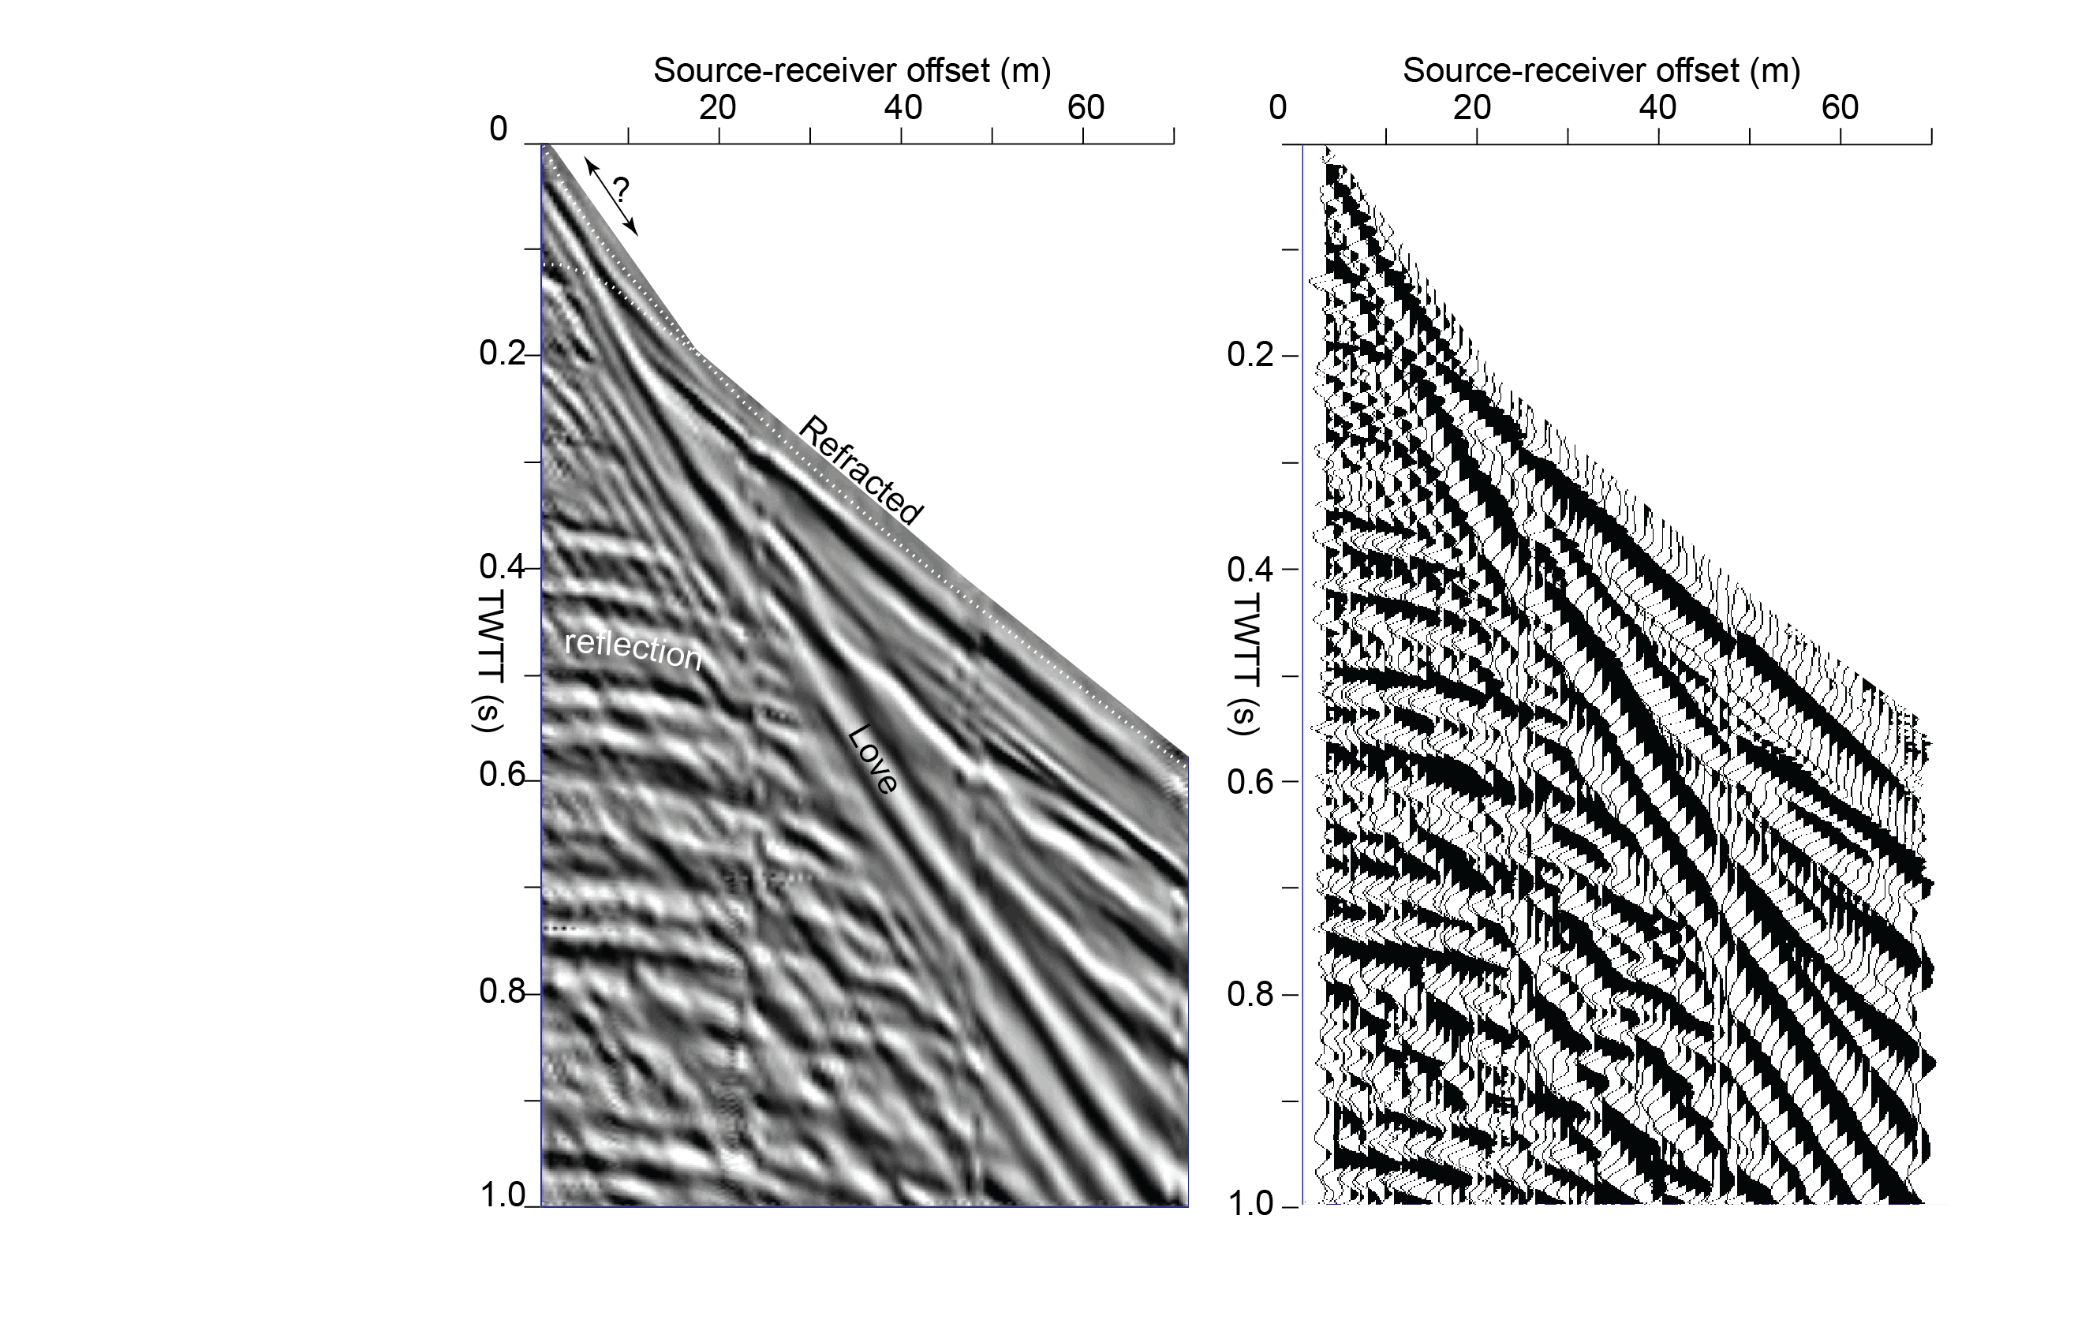
Northern Sh Shot-gather
Seismic Data

Slide 3
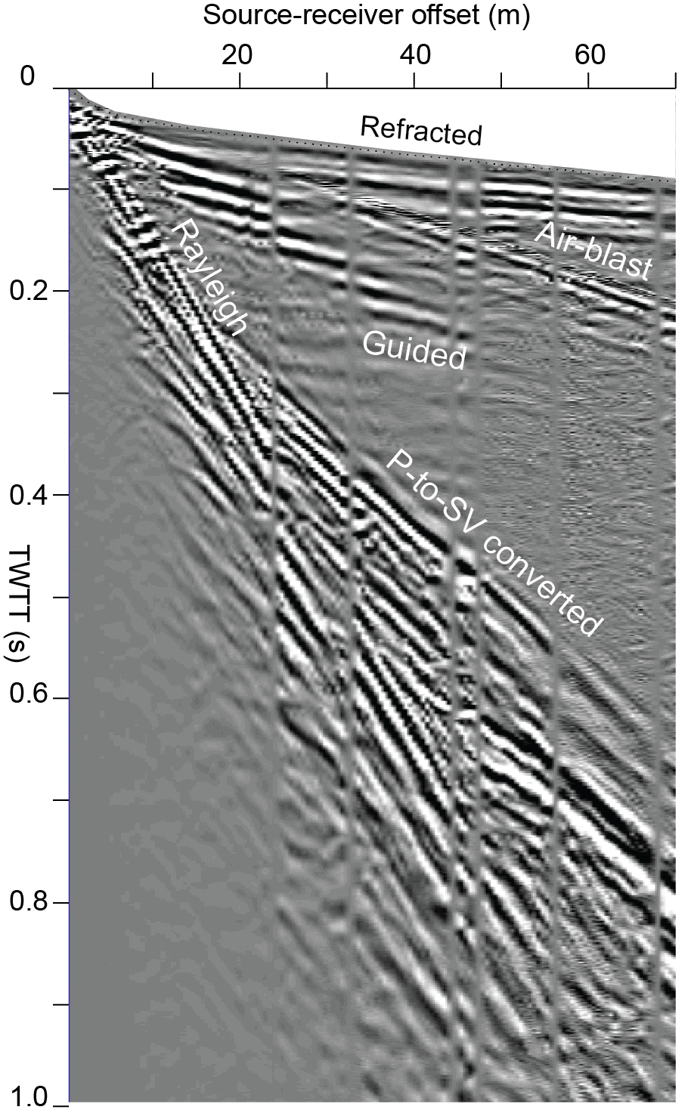
Southern P- Shot-gather
Seismic Data

Slide 4
At critical angle of incidence,
angle of refraction = 90 degrees=angle of reflection
P`
critical
angle
V1,rho1
P`P’
V2,rho2

Slide 5
Pre- and Post-critical Rays
x
z
V1
Critical distance
V2> V1
V2
Direct wave
Pre-critical reflections
Head wave
Post-critical reflections

Slide 6
One-layer Refracted Head Wave
Xc =? Tc=?
x
Critical distance=Xc
z
r1
r1
r3
V1
r2
V2> V1
V2

Slide 7
One-layer Refracted Head Wave
Xc =? Tc=?
x
Critical distance=Xc
z
z0
r1
r1
r3
V1
r2
V2> V1
V2
(9)

Slide 8
One-layer Refracted Head Wave
Xc =? Tc=?
Xc +
x
Critical distance=Xc
z
z0
r1
r1
r3
V1
r2
V2> V1
V2
(10)

Slide 9
For an incident S wave
S\
S\S/
S\S\

Slide 10
Example: Three Possible Critical Angles

