Slide 1
Reflection Coefficients
For a downward travelling P wave, for the most general case:
Where the first term on the RHS is the P-wave displacement component and the second term is the shear-wave displacement component

Slide 2
Reflection Coefficients
and where both shear stress,
and as well as normal stress is continuous across the boundary:

Slide 3
Reflection Coefficients
When all these conditions are met and for the special case of normal incident conditions, we have that Zoeppritz’s equations are:
On occasions these equations will not add up to what you might expect…!

Slide 4
Reflection Coefficients

Slide 5
Reflection Coefficients

Slide 6
Reflection Coefficients

Slide 7
Reflection Coefficients

Slide 8
Reflection Coefficients

Slide 9
Reflection Coefficients
What happens when we have a complete reflection with a 180 degree phase shift, as we might have when a ray in water travels upward toward a free surface and reflects completely at the interface?

Slide 10
Reflection Coefficients
What happens when we have a complete reflection with a 180 degree phase shift, as we might have when a ray in water travels upward toward a free surface and reflects completely at the interface?
We know that in this case:

Slide 11
Reflection Coefficients
What happens when we have a complete reflection with a 180 degree phase shift, as we might have when a ray in water travels upward toward a free surface and reflects completely at the interface?
We know that in this case:
But,
What must:

Slide 12
Reflection Coefficients
What happens when we have a complete reflection with a 180 degree phase shift, as we might have when a ray in water travels upward toward a free surface and reflects completely at the interface?
We know that in this case:
But,
So,

Slide 13
Reflection Coefficients
Briefly, how to consider displacements at interfaces using potentials, when mode conversion occurs:
layer 1
Z-
X+
layer 2
Z+
In layer 1, just above the boundary, at the point of incidence:

Slide 14
Reflection Coefficients
Briefly, how to consider displacements at interfaces using potentials, when mode conversion occurs:
layer 1
Z-
X+
layer 2
Z+
In layer 2, just below the boundary, at the point of incidence:

Slide 15
Reflection Coefficients
So, if we consider that (1) stresses as well as (2) displacements are the same at the point of incidence whether we are in the top or bottom layer the following must hold true so that (3) Snell’s Law holds true:

Slide 16
Reflection Coefficients
We get the general case of all the different types of reflection and transmission (refraction or not) coefficients at all angles of incidence :

Slide 17
Reflection Coefficients
Variation of Amplitude with angle (“AVA”) for the fluid-over-fluid case (NO SHEAR WAVES)
(Liner, 2004; Eq. 3.29, p.68; ~Ikelle and Amundsen, 2005, p. 94)

Slide 18
Reflection Coefficients
What occurs at and beyond the critical angle?

Slide 19
Reflection Coefficients
FLUID-FLUID case
What occurs at the critical angle?
(Liner, 2004; Eq. 3.29, p.68; ~Ikelle and Amundsen, 2005, p.94)

Slide 20
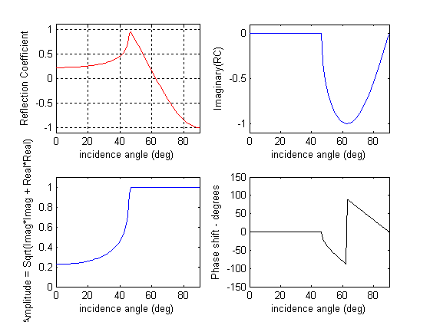
Reflection Coefficients
Reflection Coefficients at all angles: pre- and post-critical
Case:
Rho: 2.2 /1.8
V: 1800/2500
Matlab Code

Slide 21
NOTES: #1
Reflection Coefficients
At the critical angle, the real portion of the RC goes to 1. But, beyond it drops. This does not mean that the energy is dropping. Remember that the RC is complex and has two terms. For an estimation of energy you would need to look at the square of the amplitude. To calculate the amplitude we include both the imaginary and real portions of the RC.

Slide 22
NOTES: #2
Reflection Coefficients
For the critical ray, amplitude is maximum (=1) at critical angle.
Post-critical angles also have a maximum amplitude because all the energy is coming back as a reflected wave and no energy is getting into the lower layer

Slide 23
NOTES: #3
Reflection Coefficients
Post-critical angle rays will experience a phase shift, that is the shape of the signal will change.

Slide 24
Energy Coefficients
We saw that for reflection coefficients :
For the energy coefficients at
normal incidence :

Slide 25
Energy Coefficients
We saw that for reflection coefficients :
For the energy coefficients at
normal incidence :
The sum of the energy is expected to be conserved across the boundary

Slide 26
Amplitude versus Offset (AVO)
Zoeppritz’s equations can be simplified if we assume that the following ratios are much smaller than 1:
For example, the change in velocities across a boundary is very small when compared to the average velocities across the boundary; in other words when velocity variations occur in small increments across boundaries… This is the ASSUMPTION

Slide 27
Amplitude versus Offset (AVO)
If the changes across boundaries are relatively small, then we can make a lot of approximations to simplify the reflection and transmission coefficients:
( Equation, 3.242, Ikelle and Amundsen)

Slide 28
AVO cases for P-P
In addition, we can rearrange and further simplify this equation as follows:
$$Rpp=Rpp\left(normal incidenc;=0\right)+\left[4.5 delta\left(Poisson^{′}s ratio\right)−Rpp\left(0\right)\right]\sin\left(theta\right)sin⁡(theta)$$
( Equation, 3.255, Ikelle and Amundsen)

Slide 29
AVO cases for P-P
With the much simplified calculation for reflection coefficients, we can characterize reservoirs according to the Rpp at normal incidence ( intercept) and contrast in Poisson’s ratio across their boundaries (~gradient or slope):
CLASS 1 (Z1<Z2)
CLASS 1 (Z1<Z2)
slope
CLASS 1 (Z1<Z2)
intercept

Slide 30
AVO cases for P-P-CLASS 2
Class 2 shows very little contrast between layer properties
slope
CLASS 2
Z1~Z2
intercept

Slide 31
AVO cases for P-P-CLASS 3
Class 3 shows the characteristic bright spot that is often interpreted to mean shale over gas sand (Z1<Z2). The reflection coefficient becomes more negative with offset
slope
CLASS 3
Z1<Z2
intercept

Slide 32
AVO cases for P-P-CLASS 4
Class 4 is like class 3 in that there is a strong negative reflection BUT the Reflection coefficient decreases with angle (GOM)
CLASS 4
Z1<Z2
slope
CLASS 4
Z1<Z2
intercept

