Slide 1
SeismEAUXgraph
Recordings of LSU football games
2008 season

Slide 2
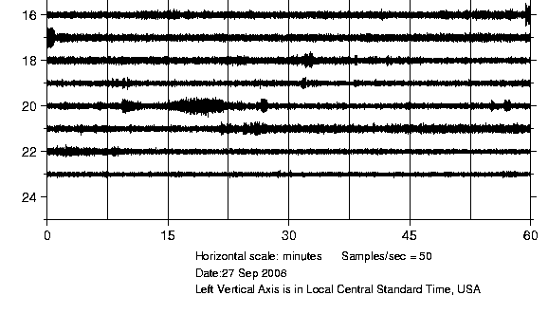
LSU-MSU
(34-24)
Attendance: 92,710
September 27, 2008
Start 6.30 p.m.
band
train

Slide 3
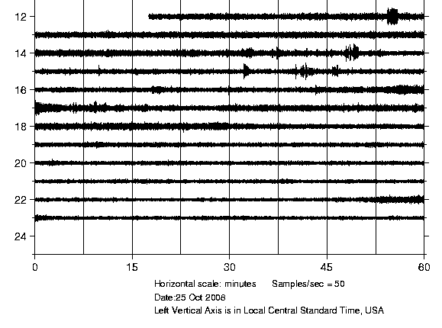
LSU-Georgia
(Loss 38-52)
Oct. 25, 2008
Start at 2.30 p.m.
band
train

Slide 4
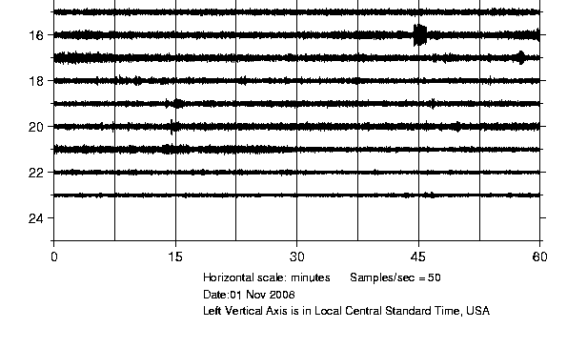
LSU-Tulane
(35-10)
November 1 2008
Start at 7.00 p.m.
train
band

Slide 5
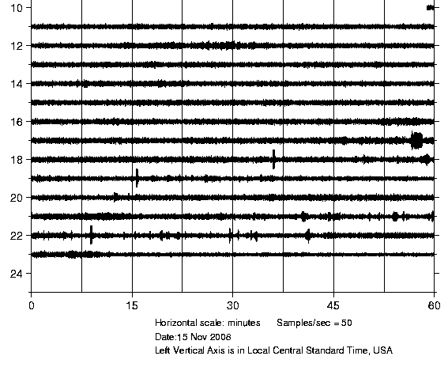
LSU Troy
(40-31)
November 15, 2008
Start 7.00 p.m.
band

