Slide 1

Chapter 8:
Stratigraphic Patterns
This presentation contains illustrations from Allen and Allen (2005)

Slide 2
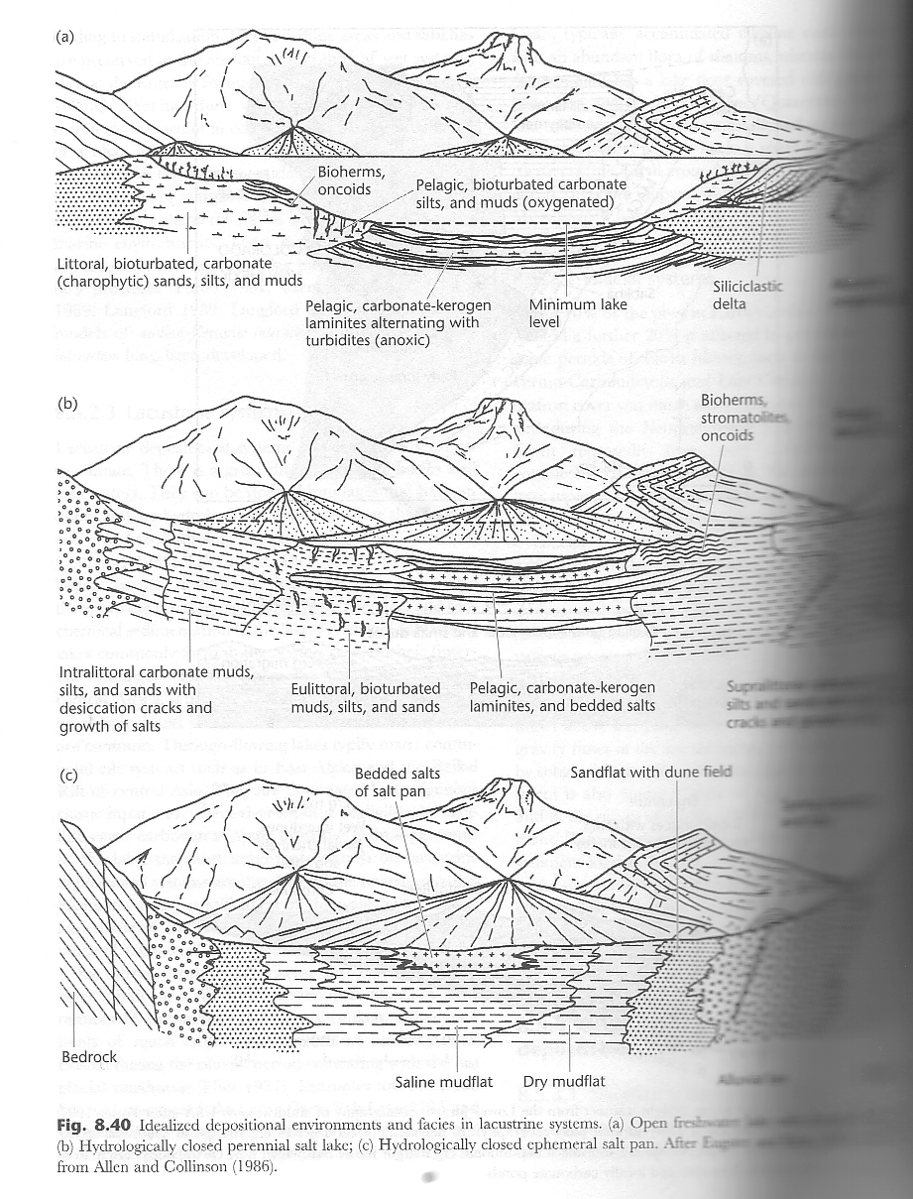
Deltas and Desert lakes

Slide 3
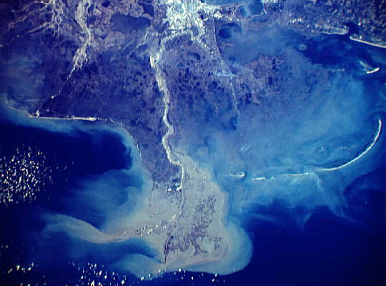
Mississippi Delta
http://earth.rice.edu/mtpe/bio/biosphere/hot/humanimpacts/delta.html

Slide 4
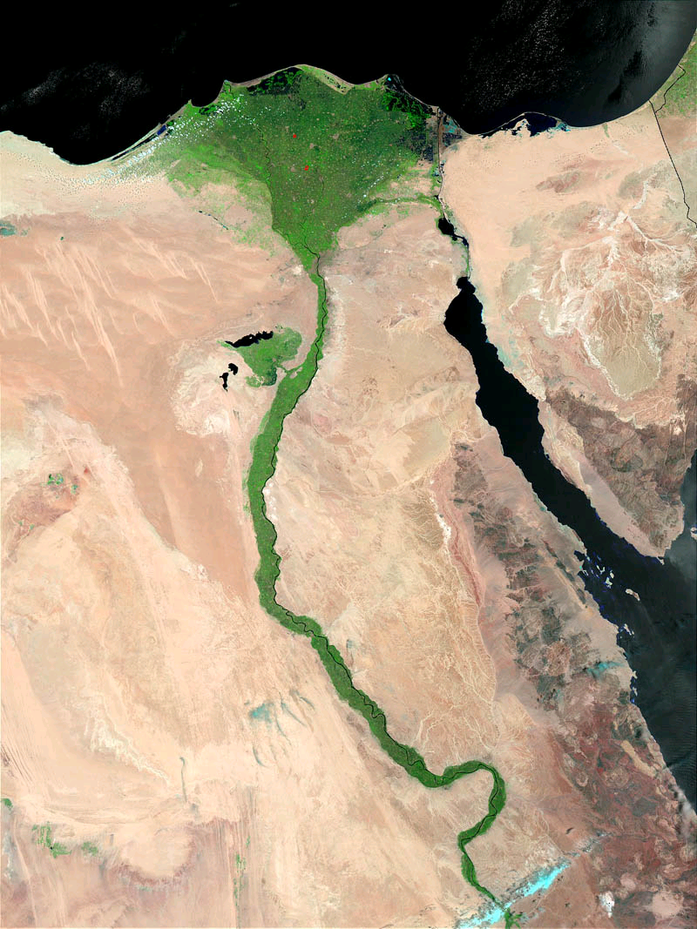
Nile Delta
http://www.artsci.wustl.edu/~anthro/courses/306/Nile%20Delta.jpg

Slide 5
Sequences
Prograding delta slope: upward thickening and coarsening decrease gamma
Meandering stream: upward fining-increase gamma
Turbidite: upward fining- increase in gamma
Desert Lake: fine- low gamma

Slide 6
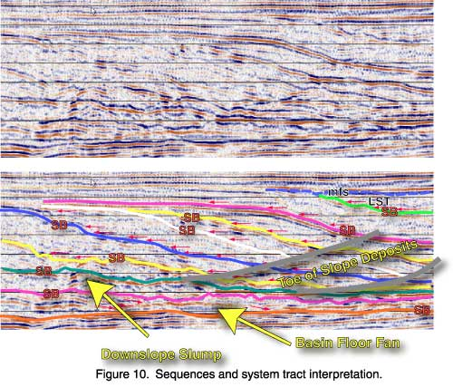
Delta cross-section
http://strata.geol.sc.edu/exerices/seismic/10MelangeOfDownSlopeFans&Slumps.jpg

Slide 7

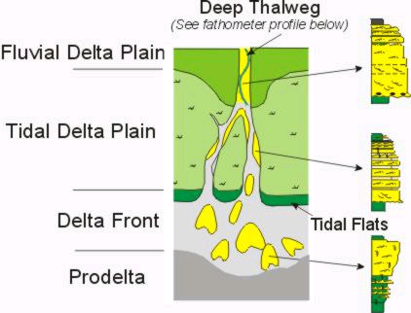
Mahakam Delta, Indonesia
http://fosi.iagi.or.id/mahakam/mah-facies-des.htm

Slide 8
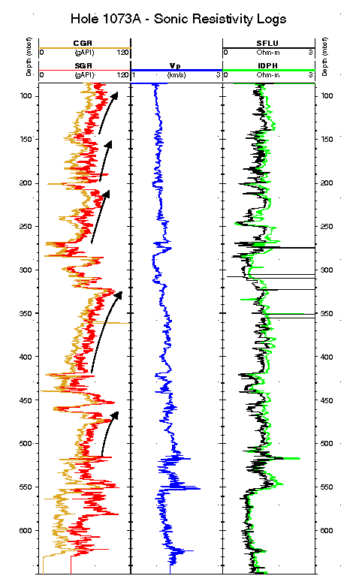
Natural Gamma Ray: increases and the amount of K-U-Th –bearing minerals decreases
http://www.ldeo.columbia.edu/BRG/ODP/ODP/LEG_SUMM/174A/fig7.html

Slide 9
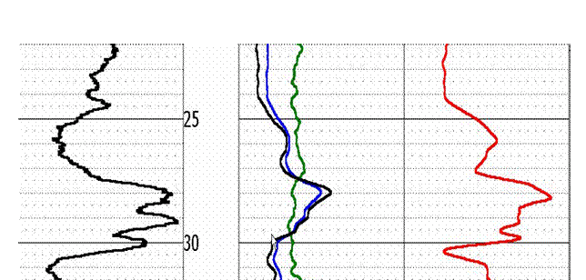
Resistivity: Decreases with the presence of free ions and ion-rich interstitial fluids
“A resistive, feldspar sand between 27.5 and 30 meters.
High gamma counts are due to the presence of small amounts of radioactive K
in the feldspar grains of the sand. This signature is common in these arkosic sands, and they are often referred to as ‘hot sands’ “
http://www.dot.ca.gov/hq/esc/geotech/gg/resistivity_log.htm

Slide 10
Gamma Ray-Resistivity Bell plots
sandier
More clay
“sand”
“clay”

Slide 11
Gamma Ray-Resistivity Bell plots
More clay
sandier
“clay”
“sand”

Slide 12
Gamma Ray-Resistivity Bell plots

Slide 13
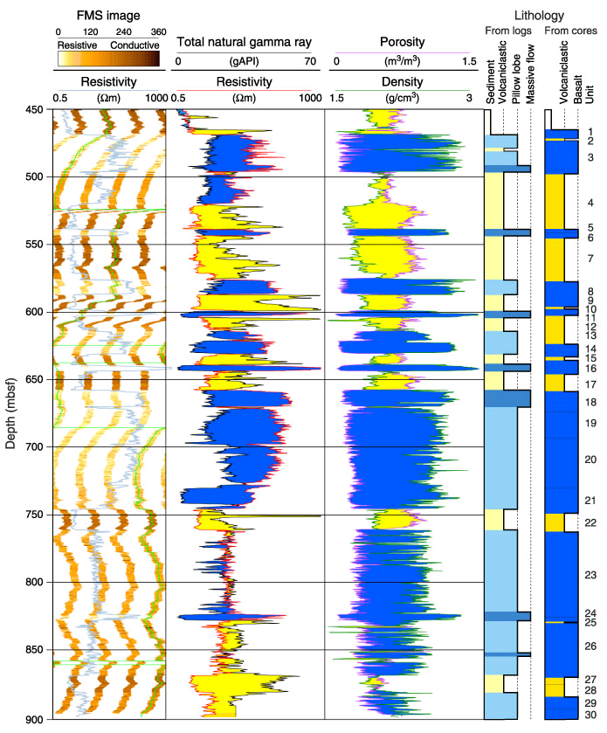
Gamma Ray-Resistivity Bell plots
http://www-odp.tamu.edu/publications/197_IR/chap_01/images/01_f16.jpg (Hawaiian-Emperor Seamount Trend)

Slide 14
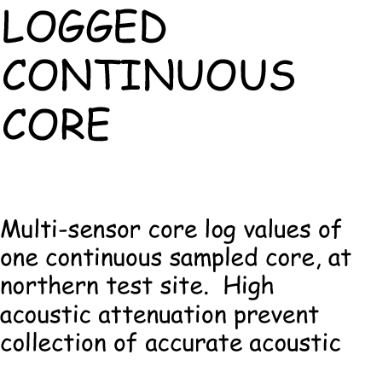
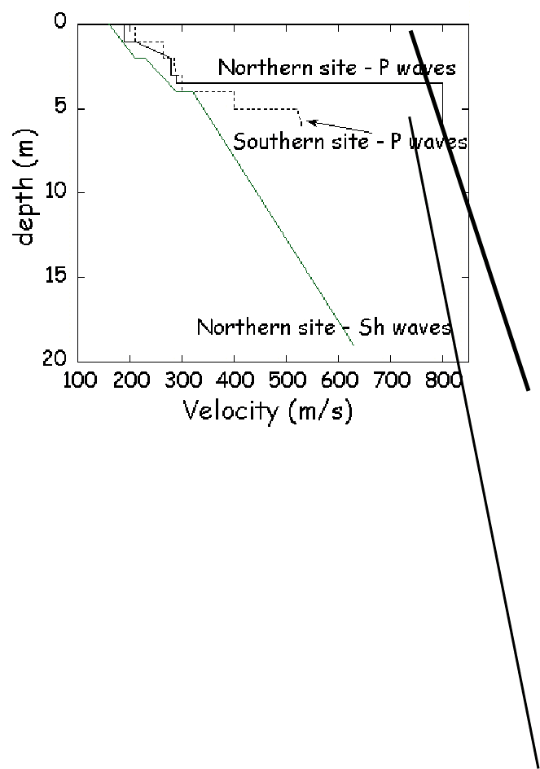
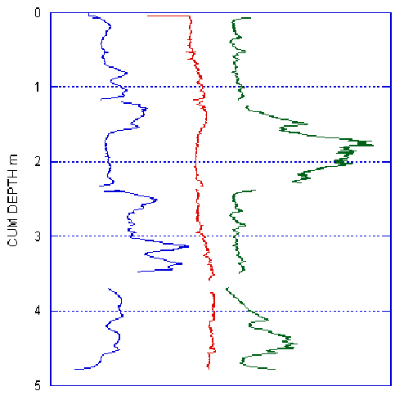

Atchafalaya Basin-Crevasse Splay

Slide 15
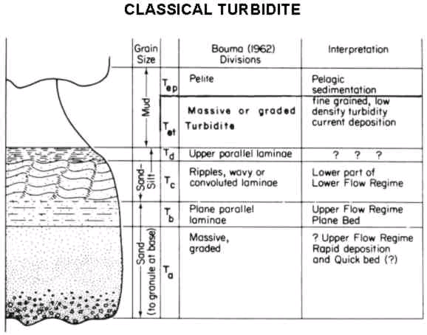
Turbidites
resistivity
gamma

Slide 16
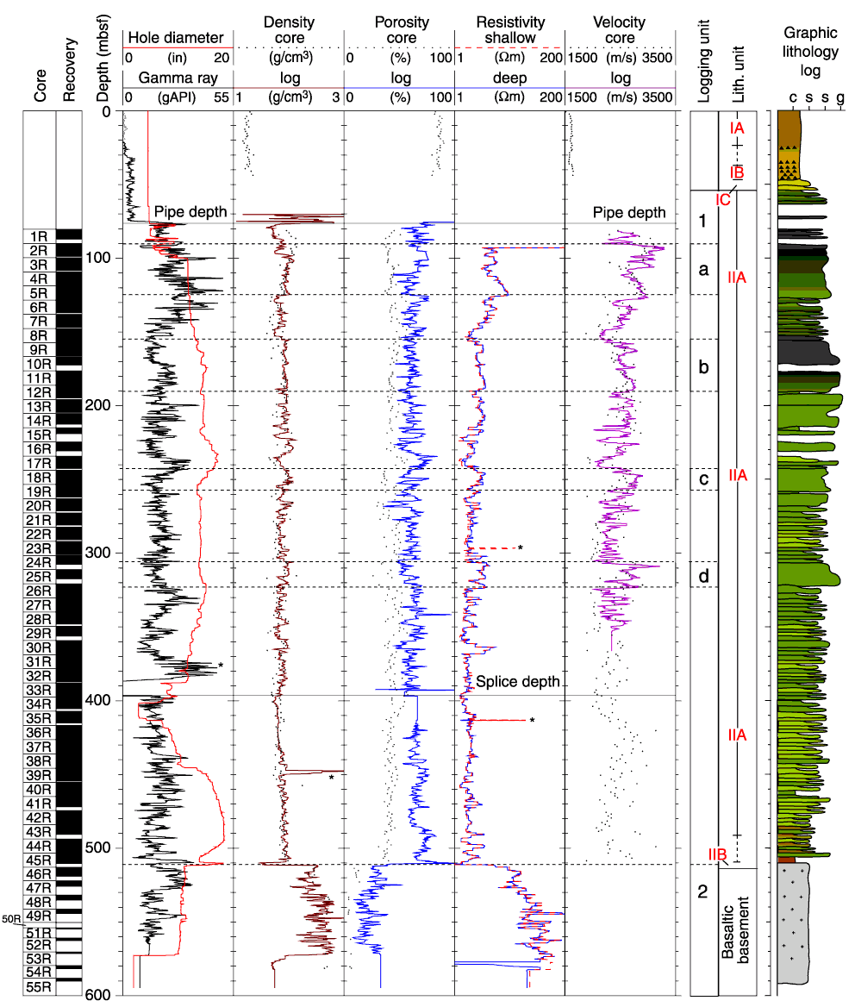
Turbidites- ODP 195 Mariana West Phillipine Sea
http://www-odp.tamu.edu/publications/195_IR/chap_01/images/01_f22.gif

Slide 17
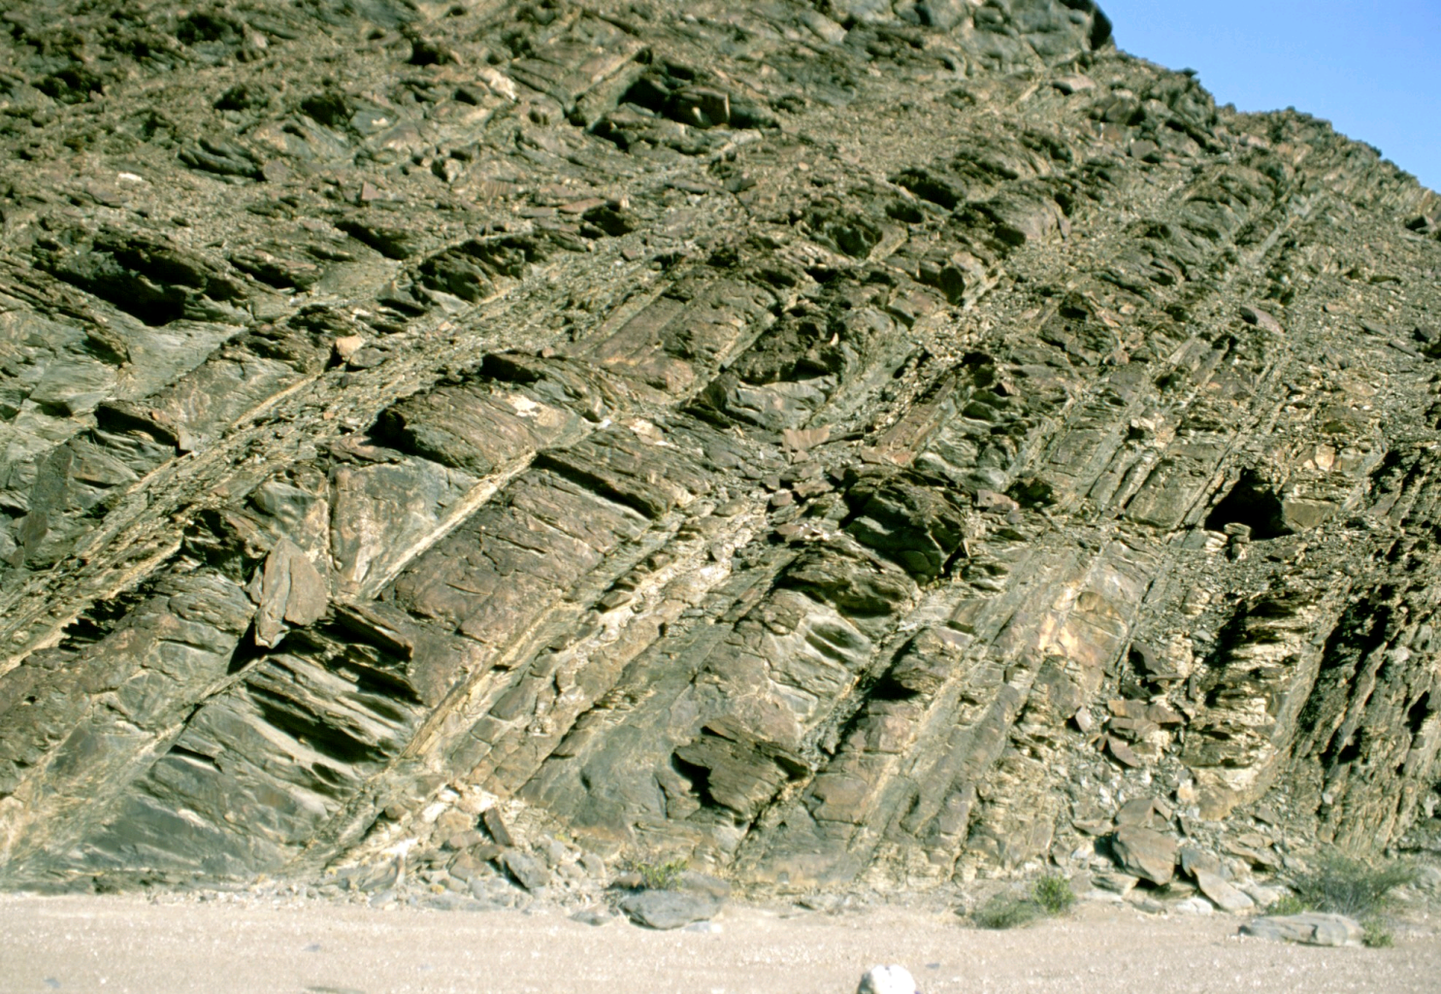
Turbidite
Movie:
http://learningobjects.wesleyan.edu/turbiditycurrents/
http://cg.ensmp.fr/Chenaux/home_turmy.html

Slide 18
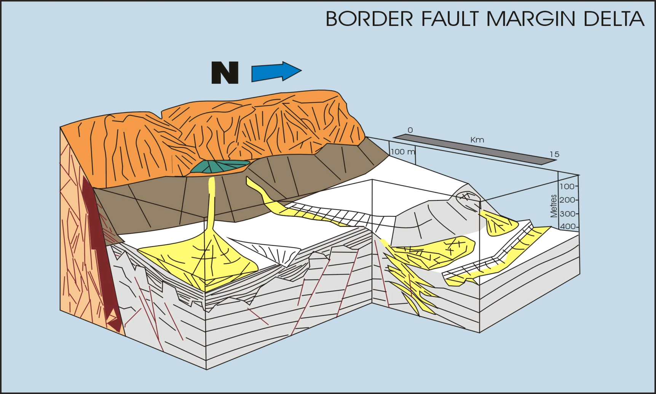
Submarine Fan Environment
http://www.geo.uib.no/Forskning/Euro-Ideal/borderfaultmargin.jpg

