Slide 1

Chapter 4:
Basins due to flexure
This presentation contains illustrations from Allen and Allen (2005)

Slide 2
Basins due to flexure
Flexure at ocean trenches and foreland basins
Flexure Theory
  Continuous plate and Broken plate under a distributed load
Controls on rigidity
  Oceanic lithosphere
  Continental lithosphere
Flexural Buckling
  Theory
  In nature and in experiments
Dynamics of Orogenic Wedges
  Critical taper Theory
  Analog models
  Numerical Models
Modeling Foreland Basin
  Moving tectonic load
  Erosion and deposition of bivergent margins

Slide 3
Flexure at ocean trenches
Ocean-continent and Ocean-ocean collision

Slide 4
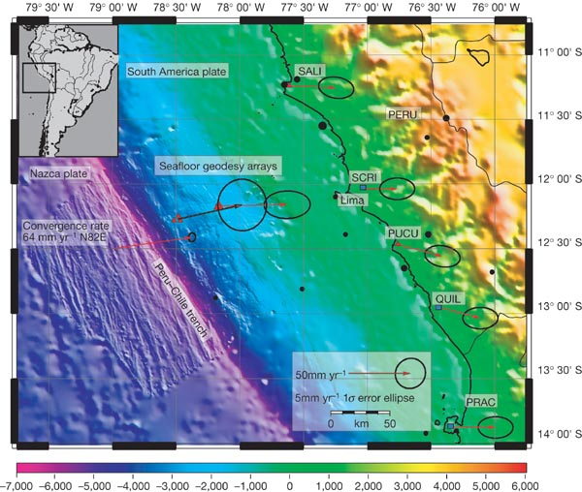
Ocean-Continent across Chile Trench
From the following article:
Measuring the onset of locking in the Peru−Chile trench with GPS and acoustic measurements
Katie Gagnon, C. David Chadwell and Edmundo Norabuena
Nature 434, 205-208 (10 March 2005)
doi: 10.1038/nature03412

Slide 5
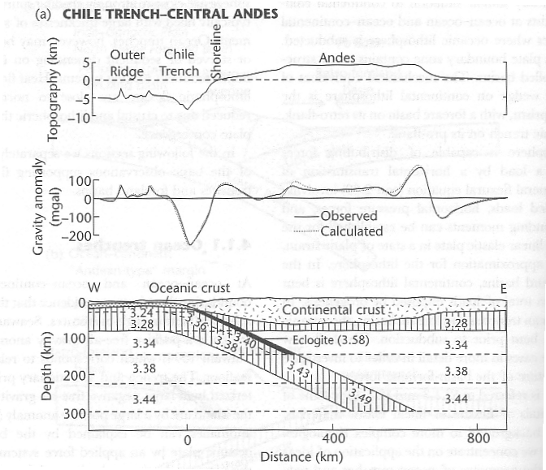
Ocean-Continent across Chile Trench
Key topographic features
  Outer ridge (forebulge)
  Trench
  Mountain range/volcanic chain

Slide 6
Ocean-Continent across Chile Trench
Local isostatic prediction

Slide 7
Ocean-Continent across Chile Trench

Slide 8
Ocean-Continent across Chile Trench
Trench should be shallower => held down
Gravity model supports this interpretation

Slide 9
Deformation in the overriding plate
Broad
Zone of deformation
700 km
(3) Shortening near craton
Shortening in accretionary prism
sometimes extension

Slide 10
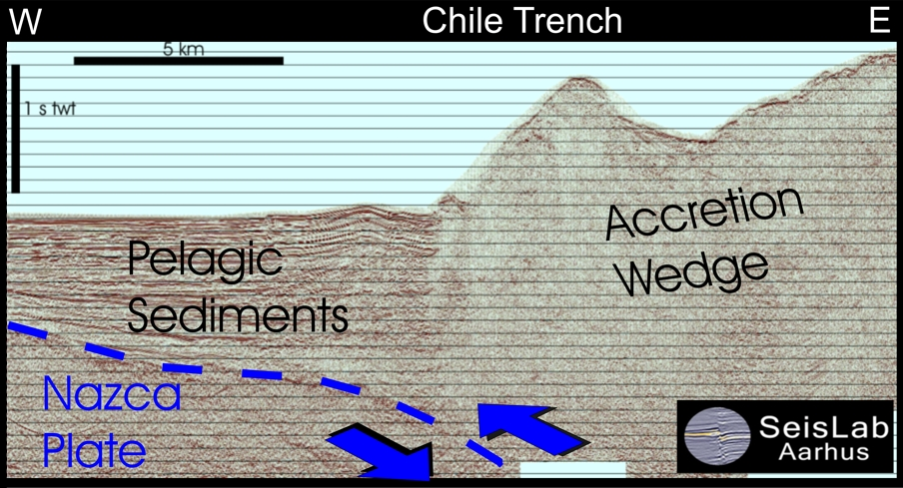
Front of deformation zone in trench
(www.geo.au.dk/.../Projects/juan/pic/jp_fig5.jpg)

Slide 11
Causes of earthquakes in the downgoing slab
(Isacks, 1969; Isacks and Molnar, 1971)
extending
bending
shortening

Slide 12
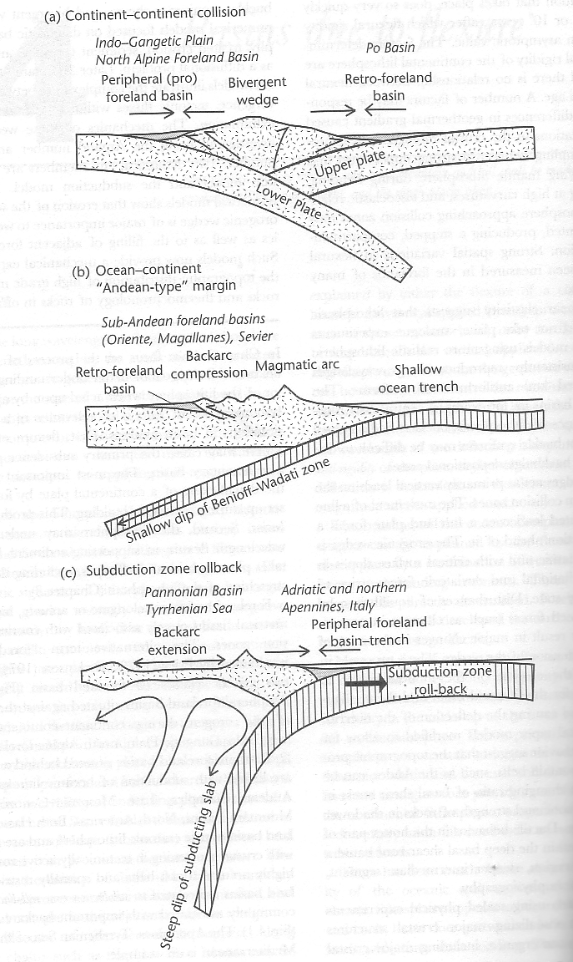
Basins associated with collisional margins
Retro-arc foreland basin
Peripheral foreland basin

Slide 13
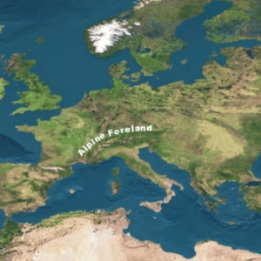
Alpine Po Basin(Italy) -Northern Alpine Foreland of Bavaria
http://images.google.com/imgres?imgurl=http://www.paleoweb.net/algae/algae/ecology/ramp/img-europe.jpg&imgrefurl=http://www.paleoweb.net/algae/algae/ecology/ramp/ramp2.htm&h=300&w=300&sz=72&hl=en&start=3&tbnid=s6DXcRiWbZwS2M:&tbnh=116&tbnw=116&prev=/images%3Fq%3DaLPINE%2BFORELAND%26svnum%3D10%26hl%3Den%26lr%3D%26sa%3DG

Slide 14
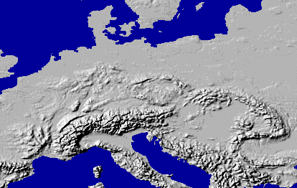
http://www.peakware.com/encyclopedia/ranges/maps/images/europe_alps.gif
Alps
Po Basin

Slide 15
Development of bivergence
Kinematic marker
Continental lithosphere
Oceanic lithosphere

Slide 16
Development of bivergence
Mechanical decoupling

Slide 17
Development of bivergence

Slide 18
Development of bivergence

Slide 19
Development of bivergence

Slide 20
Development of bivergence

Slide 21
Basins associated with collisional margins
Retro-arc foreland basin
Peripheral foreland basin/trench/foredeep

Slide 22
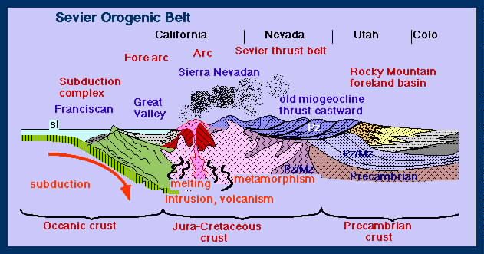
Sevier Orogenic foreland
http://jan.ucc.nau.edu/~rcb7/Sevier.jpg

Slide 23
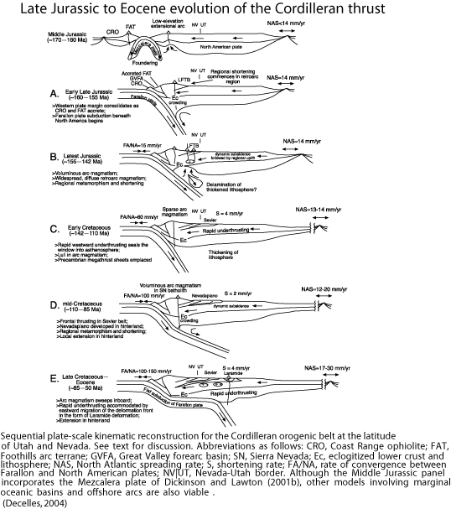
http://www.colorado.edu/GeolSci/Resources/WUSTectonics/SevierLaramide/WestUS_Tectonics/Pics%20for%20presentation/DeCelles_2004Fig19.jpg

Slide 24
Subduction Zone Rollback
Basins associated with collisional margins
Back-arc extensiona
Peripheral foreland basin/trench/foredeep

Slide 25
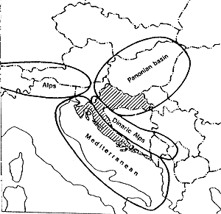
Pannonian Basin and Dinarides
C.M.
Adriatic
http://www.ingeba.euskalnet.net/lurralde/lurranet/lur17/17klemen/17klem01.gif

Slide 26
Basins due to flexure
Flexure at ocean trenches and foreland basins
Flexure Theory
Line load
  Continuous plate and Broken plate under a distributed load
Causes of rigidity
  Oceanic lithosphere
  Continental lithosphere
Flexural Buckling
  Theory
  In nature and in experiments
Dynamics of Orogenic Wedges
  Critical taper Theory
  Analog models
  Numerical Models
Modeling Foreland Basin
  Moving tectonic load
  Erosion and deposition of bivergent margins

Slide 27
Broken Plate and Distributed Load
Continuous (elastic) Plate vs. broken (elastic) plate
Deflection is continuous across the break, but there is no internal shear strength at within the plate (elastic) at the break

Slide 28
A “line” load
A theoretical counterpart very useful for first-order studies
Continuous plate
Broken plate
Time just before t=0

Slide 29
A “line” load
The geometry of the calculation will not match the details of good data
Continuous plate
Broken plate
Time just after t=0

Slide 30
Broken Plate and Distributed Load
Continuous (elastic) Plate vs. broken (elastic) plate
Time just before t=0

Slide 31
Broken Plate and Distributed Load
Continuous (elastic) Plate vs. broken (elastic) plate
An instant later …

Slide 32
Broken Plate and Distributed Load
Continuous (elastic) Plate vs. broken (elastic) plate
forebulge
Weaker plate
Narrower, deeper basin
An instant later …

Slide 33
Broken Plate and Distributed Load
Broken (elastic) plate
Trench is 2km deep
100 km between trench and forebulge ( a few hundred meters)
10 km
An instant later …

Slide 34
Broken Plate and Distributed Load
Broken (elastic) plate
100 km between trench and forebulge ( a few hundred meters)
Trench is 2km deep

Slide 35
Basins due to flexure
Flexure at ocean trenches and foreland basins
Flexure Theory
Line load
  Continuous plate and Broken plate under a distributed load
Controls of rigidity
  Oceanic lithosphere
  Continental lithosphere
Flexural Buckling
  Theory
  In nature and in experiments
Dynamics of Orogenic Wedges
  Critical taper Theory
  Analog models
  Numerical Models
Modeling Foreland Basin
  Moving tectonic load
  Erosion and deposition of bivergent margins

Slide 36
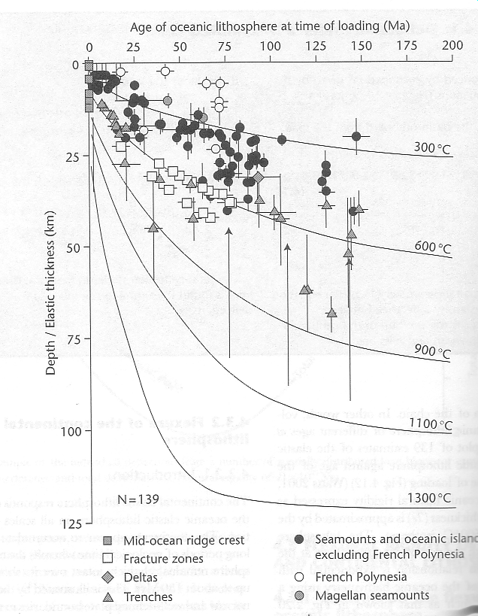
Controls on Rigidity-Oceanic Lithosphere

Slide 37
Controls on Rigitidy- Oceanic Lithosphere
Depth to the 450 degree isotherm

Slide 38
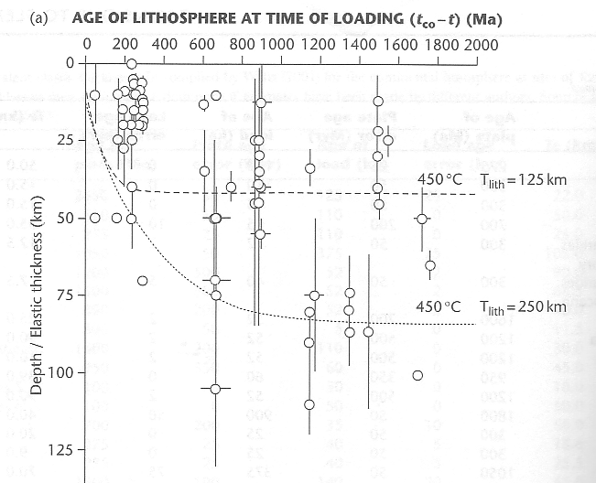
Controls on Rigitidy- Continental Lithosphere

Slide 39
Controls on Rigitidy- Continental Lithosphere
Temperature
Fluid pressure
Rate of deformation
Amount of deformation (curvature)

Slide 40
Controls on Rigidity- Continental Lithosphere
Temperature (As Temp increases, Teff decreases…)
Fluid pressure (….Teff decreases…)
Rate of deformation (…Teff increases….)
Amount of deformation (curvature) (…Teff decreases…)

Slide 41
Controls on Rigidity
Differential stress
compression
extension

Slide 42
Controls on Rigidity
Differential stress
Mechanical Decoupling
10^-7 curvature

Slide 43
Basins due to flexure
Flexure at ocean trenches and foreland basins
Flexure Theory
Line load
  Continuous plate and Broken plate under a distributed load
Controls of rigidity
  Oceanic lithosphere
  Continental lithosphere
Flexural Buckling
  Theory
  In nature and in experiments
Dynamics of Orogenic Wedges
  Critical taper Theory
  Analog models
  Numerical Models
Modeling Foreland Basin
  Moving tectonic load
  Erosion and deposition of bivergent margins

Slide 44
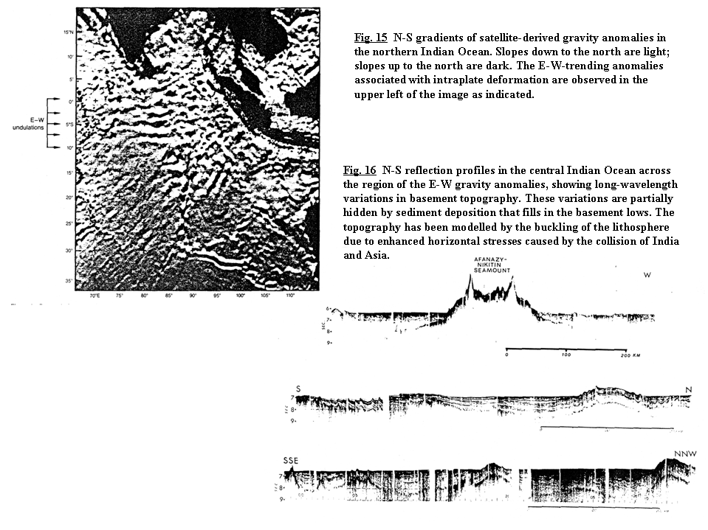
Lithospheric Buckling
Long-wavelength Buckling is more accepted for oceanic lithosphere: Indian Ocean
http://myweb.dal.ca/klouden/ocean5110/Lectures/lect7/lect7.html

Slide 45
Basins due to flexure
Flexure at ocean trenches and foreland basins
Flexure Theory
Line load
  Continuous plate and Broken plate under a distributed load
Controls of rigidity
  Oceanic lithosphere
  Continental lithosphere
Flexural Buckling
  Theory
  In nature and in experiments
Dynamics of Orogenic Wedges
  Critical taper Theory
  Analog models
  Numerical Models
Modeling Foreland Basin
  Moving tectonic load
  Erosion and deposition of bivergent margins

Slide 46
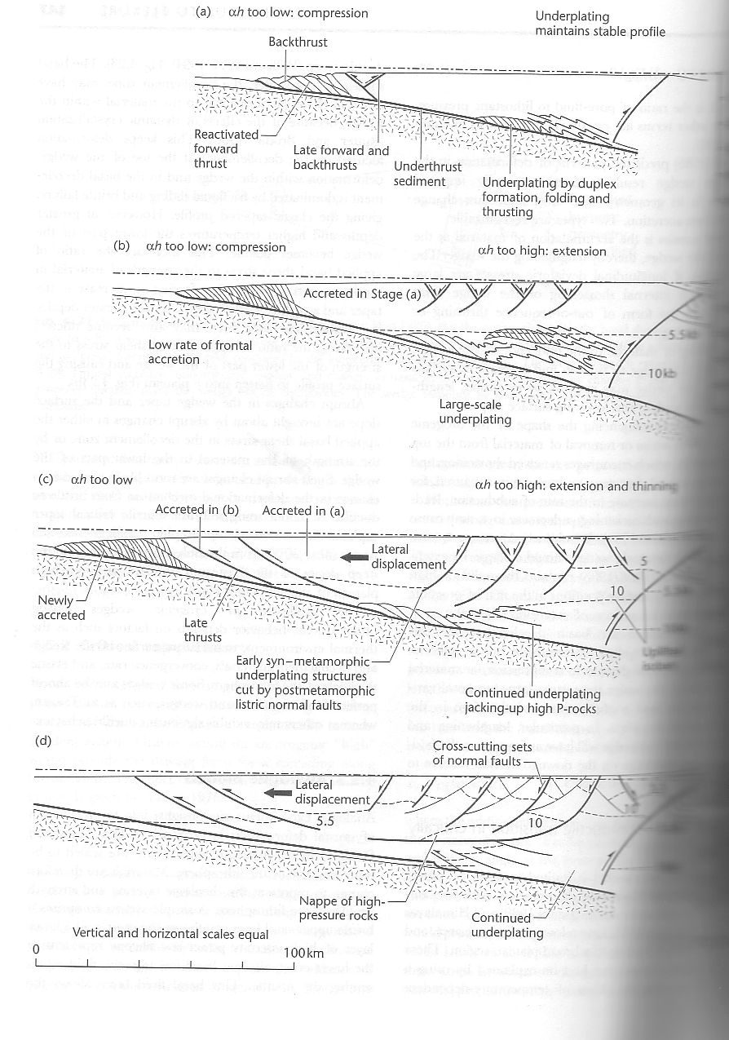
Critical Taper Theory
Movies
http://www.geology.um.maine.edu/geodynamics/analogwebsite/Projects2005/Barker_2005/Html/Results.html

Slide 47
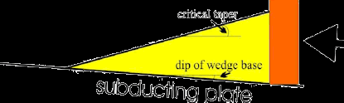
Critical wedge in shortening

Slide 48
Creitical Wedge in extension
http://terra.rice.edu/department/faculty/morganj/Movies/movie3a.html

Slide 49
Critical Wedge over salt
NO SALT
SALT

Slide 50
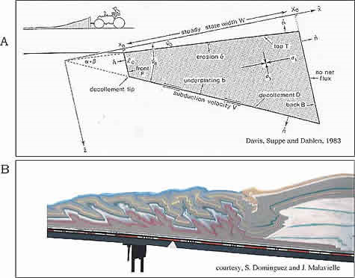
Critical Taper Theory
Taper angle
backstop
Coulomb wedge
Basal friction

Slide 51
Basins due to flexure
Flexure at ocean trenches and foreland basins
Flexure Theory
Line load
  Continuous plate and Broken plate under a distributed load
Controls of rigidity
  Oceanic lithosphere
  Continental lithosphere
Flexural Buckling
  Theory
  In nature and in experiments
Dynamics of Orogenic Wedges
  Critical taper Theory
  Analog models
  Numerical Models
Modeling Foreland Basin
  Moving tectonic load
  Erosion and deposition of bivergent margins

Slide 52
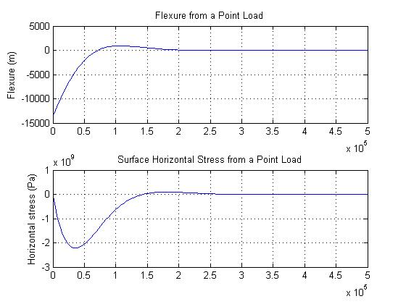
Simple flexure models (Teff=20km)
Get Matlab code HERE

Slide 53
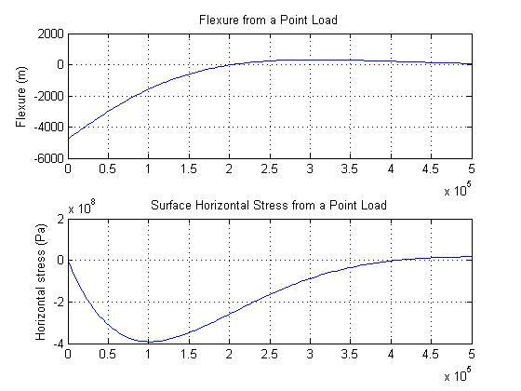
Simple flexure models (Teff=80km)
Get Matlab code HERE

Slide 54
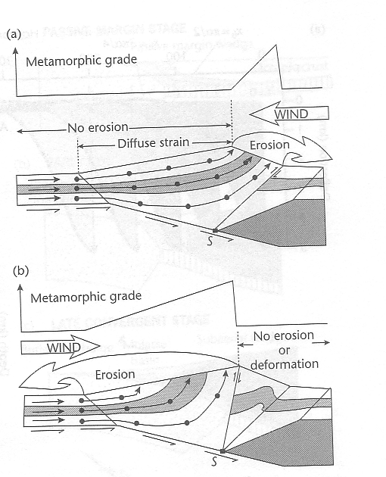
Bivergent margins-erosion

